Slide 1
CMSC 829C: Algorithms, AI, and Hardware
for Biological Data
Lecture 6: AI in Genomics
Fall 2026
September 17, 2026
Can Firtina | canfirtina@gmail.com | cs.umd.edu/~firtina
Assistant Professor of Computer Science at University of Maryland (UMD)

Slide 2
Agenda
DeepVariant: Identify variants from read evidence
DNA language models: Learn representations
AlphaGenome: Predict molecular activity and variant effects
Notes:
DeepVariant: Nature Biotechnology paper (2018): https://www.nature.com/articles/nbt.4235
DNABERT-2: official repository: https://github.com/MAGICS-LAB/DNABERT_2
AlphaGenome: Nature paper: https://www.nature.com/articles/s41586-025-10014-0

Slide 3
AI in Genomics
DeepVariant: Identify variants from read evidence
DNA language models: Learn reusable sequence representations
AlphaGenome: Predict molecular activity and variant effects

Slide 4
Which Differences Are Real?
Diploid region: two chromosome copies
Mapped reads provide noisy observations of both copies
Genotype: the two sequence alternatives (alleles) at a site
Notes:
A variant is a sequence difference from the reference. An allele is one sequence alternative at a site, and a diploid genotype specifies the pair carried by the two chromosome copies. At toy position 105, the reference has C; the 12 read observations include six C, five A, and one G. Differences can arise from sample variation, sequencing errors, or mapping errors. This germline, biallelic example compares C/C, C/A, and A/A. The nine-base window is a synthetic teaching example, and the read counts alone do not establish its genotype.
Sources
Variant Call Format (VCF) 4.5 specification: genotype and confidence fields: https://samtools.github.io/hts-specs/VCFv4.5.pdf
Genome Analysis Toolkit (GATK) 4.7.0.0: genotype likelihood calculation: https://github.com/broadinstitute/gatk/blob/0cde69eed30339f5978cbb1ac6e5cf3662f9e1f8/src/main/java/org/broadinstitute/hellbender/tools/walkers/genotyper/GenotypeLikelihoodCalculator.java#L14-L21

Slide 5
Prepare the Read Evidence
Sort alignments so nearby reads can be processed together
Flag likely copies of one fragment to limit repeated evidence
Base quality score recalibration (BQSR) adjusts error estimates
Notes:
This preparation precedes HaplotypeCaller. Sorting orders alignments by genomic position; an index enables efficient region lookup. Duplicate marking uses fragment and alignment information to flag likely repeated measurements of one original deoxyribonucleic acid (DNA) fragment. Identical displayed strings alone do not establish duplication. HaplotypeCaller excludes duplicate-flagged reads by default. Base quality score recalibration (BQSR) adjusts estimated base error probabilities without changing DNA letters. It needs suitable data and known-variant resources, and may be unsuitable for small panels. The toy illustrates its purpose but does not fit or apply a recalibration model.
Sources
Genome Analysis Toolkit (GATK): Base Quality Score Recalibration: https://gatk.broadinstitute.org/hc/en-us/articles/360035890531-Base-Quality-Score-Recalibration-BQSR
GATK 4.7.0.0: HaplotypeCaller read filters: https://github.com/broadinstitute/gatk/blob/0cde69eed30339f5978cbb1ac6e5cf3662f9e1f8/src/main/java/org/broadinstitute/hellbender/tools/walkers/haplotypecaller/HaplotypeCallerEngine.java#L463-L475

Slide 6
HaplotypeCaller Proposes Local Sequences
Genome Analysis Toolkit (GATK): focus on regions with variation
Assemble candidate haplotypes: possible local DNA sequences
Align candidates to the reference to locate possible variants
Notes:
HaplotypeCaller focuses local assembly on regions whose reads suggest variation. A haplotype is a possible deoxyribonucleic acid (DNA) sequence across such a region. Reads and the reference contribute paths through a graph; candidate paths are then aligned to the reference to identify possible variant sites. Here the strings share ACGT and CGTA, with C, A, or G between them. The displayed support filter retains C and A. This compact graph and threshold are teaching simplifications. Real HaplotypeCaller performs read threading, graph processing, and candidate-path selection before likelihood scoring.
Sources
Genome Analysis Toolkit (GATK) 4.7.0.0: active-region processing and local assembly: https://github.com/broadinstitute/gatk/blob/0cde69eed30339f5978cbb1ac6e5cf3662f9e1f8/src/main/java/org/broadinstitute/hellbender/tools/walkers/haplotypecaller/HaplotypeCallerEngine.java#L734-L782
GATK 4.7.0.0: candidate haplotypes and reference alignment: https://github.com/broadinstitute/gatk/blob/0cde69eed30339f5978cbb1ac6e5cf3662f9e1f8/src/main/java/org/broadinstitute/hellbender/tools/walkers/haplotypecaller/readthreading/ReadThreadingAssembler.java#L324-L358

Slide 7
Score Reads against Each Haplotype
Likelihood: how likely a read is under a candidate haplotype
Pair hidden Markov model (PairHMM): sum over possible alignments
Repeat for every read and haplotype to form a likelihood matrix
Notes:
A pair hidden Markov model (PairHMM) evaluates P(read | haplotype): the probability of the observed read if that candidate sequence generated it. Each path describes an alignment with possible substitutions, insertions, and deletions. The forward calculation adds contributions from all permitted paths, including alternative endpoints. Repeating the calculation for every read and candidate fills the likelihood matrix. Larger log10 values indicate stronger support. These are read likelihoods, not probabilities that a haplotype is correct. The displayed numbers use synthetic reads and fixed quality inputs to illustrate the calculation.
Sources
Genome Analysis Toolkit (GATK) 4.7.0.0: PairHMM forward recurrence and emissions: https://github.com/broadinstitute/gatk/blob/0cde69eed30339f5978cbb1ac6e5cf3662f9e1f8/src/main/java/org/broadinstitute/hellbender/utils/pairhmm/LoglessPairHMM.java#L30-L93

Slide 8
From Read Evidence to a Genotype
Keep each read's best haplotype likelihood for each allele
Combine read likelihoods for C/C, C/A, and A/A
Phred-scaled genotype likelihoods (PL): the best genotype has PL 0
Notes:
At one site, several haplotypes can carry the same allele. Genome Analysis Toolkit (GATK) keeps each read's largest likelihood within that group. For C/A, the toy model averages the C and A probabilities for each read, then multiplies across reads. Its Phred-scaled genotype likelihoods (PL) are 141, 0, and 175 for C/C, C/A, and A/A. PL is a standard Variant Call Format (VCF) field. It represents likelihood relative to the best genotype on the Phred scale: the best has PL 0, and larger values mean lower relative likelihood. These values are not posterior probabilities. This core calculation omits genotype priors, caller filtering, and confidence annotations. Per-sample Genomic Variant Call Format (gVCF) generation and later cohort joint genotyping are separate stages.
For one read and a diploid genotype ref/alt, P(read | ref/alt) = [P(read | ref) + P(read | alt)] / 2. This model gives each chromosome copy equal weight. Divide by 2 because there are two chromosome copies, regardless of the number of reads or candidate alleles. Multiply these per-read values across reads. For ref/ref, the average reduces to P(read | ref). When using the displayed log10 likelihoods, convert to probabilities before averaging, then take log10 and add across reads.
REF and ALT identify actual allele sequences. For a single-base substitution, possible alternatives are A, C, G and T excluding the reference base; the caller need not retain every possibility. Alternative alleles can also represent insertions or deletions. The caller determines which alternatives to report. ALT is an ordered list: 0 denotes REF; 1, 2 and 3 denote the first, second and third entries in ALT. The numbering follows the written list. VCF does not prescribe a universal alphabetical or likelihood-based order for that list.
For REF=C and ALT=A,G,T, 0/1 means C/A, 0/2 means C/G, 0/3 means C/T, and 1/2 means A/G. If the output instead has REF=C and ALT=G, 0/1 means C/G. Always interpret genotype numbers together with that record's REF and ALT fields. Four retained alleles give ten unordered diploid genotypes; each genotype still contains only two copies. Adding G or T does not add a third or fourth term to the C/A mixture.
Sources
GATK 4.7.0.0: maximum likelihood within each allele group: https://github.com/broadinstitute/gatk/blob/0cde69eed30339f5978cbb1ac6e5cf3662f9e1f8/src/main/java/org/broadinstitute/hellbender/utils/genotyper/AlleleLikelihoods.java#L782-L805
GATK 4.7.0.0: genotype likelihood calculation: https://github.com/broadinstitute/gatk/blob/0cde69eed30339f5978cbb1ac6e5cf3662f9e1f8/src/main/java/org/broadinstitute/hellbender/tools/walkers/genotyper/GenotypeLikelihoodCalculator.java#L14-L21
VCF 4.5 specification: genotype and confidence fields: https://samtools.github.io/hts-specs/VCFv4.5.pdf

Slide 9
Reproducibility Issues [Bioinformatics '16]
On genomic repeats and reproducibility
Can Firtina, Can Alkan
Bioinformatics, August 2016.
[Code] [Link]

Slide 10
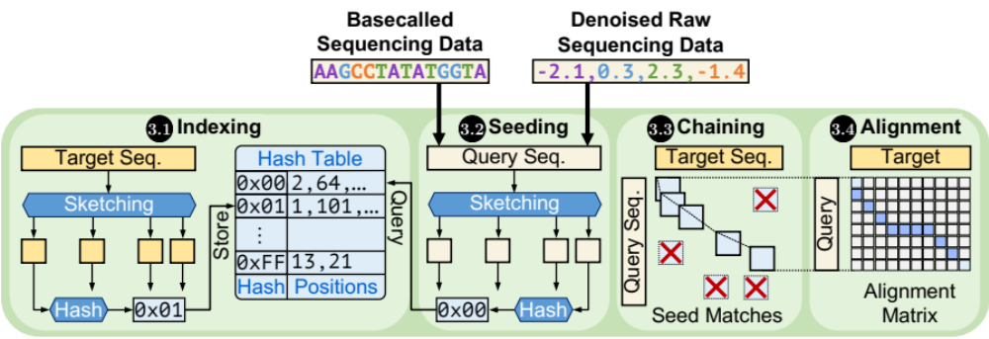
Recall: Read Mapping
Reads are matched to positions in a reference genome
What if several locations are equally good?

Slide 11
Ambiguous Mapping
Which location should be reported for this read?
Burrows–Wheeler Aligner with maximal exact matches (BWA-MEM)
Pseudorandom tie-breaking depends on the read's input position

Slide 12
Could the Variant Calls Change?
Would the same reads always produce the same variant calls?
Changed placements can change the information a caller uses
Observation: Different variant calling results after shuffling the same reads
Notes:
A changed mapping can alter the evidence available at a site and, in turn, a variant decision. The figure illustrates this possibility; its call lists are not outputs from a production caller. Mapping-quality filters matter: many ambiguous reads are excluded, so changing one primary location does not necessarily change a call. The 2016 study nevertheless observed discordant final call sets after read shuffling in its tested pipelines. Reproducibility and correctness are separate: a consistently chosen location can still be wrong.
Sources
Firtina and Alkan (2016): On genomic repeats and reproducibility: https://doi.org/10.1093/bioinformatics/btw139

Slide 13
Same Alignments, Same Final Calls?
How about the exact same Binary Alignment/Map (BAM) file?
2016: variant quality score recalibration (VQSR) changed filtering
  Different variant calling even when using the same BAM input
Notes:
Variant quality score recalibration (VQSR) learns a filtering model from known resources and variant annotations, measurements that summarize a call's evidence. The 2016 study observed different final call sets from the same alignments, then different filtering results when it reran VQSR on one fixed raw variant file
Firtina and Alkan (2016): On genomic repeats and reproducibility: https://doi.org/10.1093/bioinformatics/btw139
GATK 4.7.0.0: conditional training-data subsampling: https://github.com/broadinstitute/gatk/blob/0cde69eed30339f5978cbb1ac6e5cf3662f9e1f8/src/main/java/org/broadinstitute/hellbender/tools/walkers/vqsr/VariantDataManager.java#L229-L246
GATK 4.7.0.0: fixed default pseudorandom seed: https://github.com/broadinstitute/gatk/blob/0cde69eed30339f5978cbb1ac6e5cf3662f9e1f8/src/main/java/org/broadinstitute/hellbender/utils/Utils.java#L49-L61

Slide 14
Reproducibility Issues [Bioinformatics '16]
On genomic repeats and reproducibility
Can Firtina, Can Alkan
Bioinformatics, August 2016.
[Code] [Link]

Slide 15
DeepVariant Learns to Interpret Read Evidence
DeepVariant (Poplin et al., 2018): learn from read evidence
DeepVariant 1.10 uses a convolutional neural network (CNN)
Genotype probabilities processed into variant records
Notes:
DeepVariant learns how patterns in aligned reads correspond to genotypes. It first proposes candidate alleles, converts the surrounding evidence into a numerical array, applies a trained model, and processes the predictions into variant records. Follow the same fictional C-to-A locus through these stages. The walkthrough uses the large convolutional neural network (CNN) path in DeepVariant 1.10 for Illumina data. Its whole-genome sequencing (WGS) configuration can accept confident predictions from a smaller model first. DeepVariant's input guidance recommends skipping base quality score recalibration (BQSR), unlike the earlier Genome Analysis Toolkit (GATK) preparation example.
Sources
Poplin et al. (2018): DeepVariant paper: https://www.nature.com/articles/nbt.4235
DeepVariant 1.10: official pipeline and input requirements: https://github.com/google/deepvariant/blob/d6b15e21323d9d15b347083f1d256ad62998c4cf/docs/deepvariant-details.md
DeepVariant 1.10: released Illumina WGS model input specification: https://storage.googleapis.com/deepvariant/models/DeepVariant/1.10.0/savedmodels/deepvariant.wgs.savedmodel/model.example_info.json
DeepVariant 1.10: accepting or forwarding small-model predictions: https://github.com/google/deepvariant/blob/d6b15e21323d9d15b347083f1d256ad62998c4cf/deepvariant/small_model/inference.py#L155-L194

Slide 16
Propose Candidate Variants
Count usable read observations at each reference position
Single-nucleotide polymorphism (SNP) cutoffs: ≥2 reads and ≥12% support
Passing alleles become candidates for genotype evaluation
Notes:
At the highlighted position, the twelve usable observations contain six C bases, five A bases, and one G base. C matches the reference. With the selected DeepVariant 1.10 single-nucleotide polymorphism (SNP) cutoffs, an alternate allele needs at least two observations and a fraction of at least 0.12. A passes with 5/12 support, while G fails with 1/12. These configurable cutoffs propose alleles for further evaluation; they do not establish a genotype. Insertions and deletions require allele counting from alignment operations and sequences, beyond a single base column.
Sources
DeepVariant 1.10: candidate count and fraction defaults: https://github.com/google/deepvariant/blob/d6b15e21323d9d15b347083f1d256ad62998c4cf/deepvariant/make_examples_options.py#L312-L344
DeepVariant 1.10: candidate allele requirements: https://github.com/google/deepvariant/blob/d6b15e21323d9d15b347083f1d256ad62998c4cf/deepvariant/variant_calling.cc#L241-L261

Slide 17
Encode the Evidence as Seven Features
Each read position encoded by seven numerical features
Rows aligned by genomic position, with five reference rows
Illumina CNN input: 100 rows × 221 positions × 7 channels
Notes:
The input tensor is a three-dimensional array indexed by row, genomic position, and feature channel. Each read-position cell records base identity, base quality, mapping quality, strand, alternate-allele support, reference disagreement, and insert size. Insert size here means paired-end fragment length. The highlighted cell shows how one A observation supplies seven numerical values. Five reference rows provide sequence context above the aligned reads, and unused rows are zero-padded. The visible 17 × 9 × 7 crop illustrates the encoding within the selected 100 × 221 × 7 Illumina input.
Sources
DeepVariant 1.10: released Illumina whole-genome sequencing (WGS) model input specification: https://storage.googleapis.com/deepvariant/models/DeepVariant/1.10.0/savedmodels/deepvariant.wgs.savedmodel/model.example_info.json
DeepVariant 1.10: reference rows and encoding options: https://github.com/google/deepvariant/blob/d6b15e21323d9d15b347083f1d256ad62998c4cf/deepvariant/pileup_image.py#L36-L72
DeepVariant 1.10: row selection, ordering, and padding: https://github.com/google/deepvariant/blob/d6b15e21323d9d15b347083f1d256ad62998c4cf/deepvariant/pileup_image_native.cc#L309-L420
DeepVariant 1.10: numerical feature encoders: https://github.com/google/deepvariant/tree/d6b15e21323d9d15b347083f1d256ad62998c4cf/deepvariant/channels
DeepVariant 1.10: insert-size channel encodes fragment length: https://github.com/google/deepvariant/blob/d6b15e21323d9d15b347083f1d256ad62998c4cf/deepvariant/channels/insert_size_channel.cc#L70-L88

Slide 18
From Encoded Evidence to Genotype Probabilities
Inception-v3 filters combine nearby values across channels
Parallel branches merged, then summarized by average pooling
Three probabilities for zero, one or two alternate copies
Notes:
A convolution applies learned filters to small neighborhoods of the encoded array and produces feature maps. Inception blocks process neighborhoods through parallel branches and concatenate their outputs as additional channels. Global average pooling then replaces each final feature map with its mean. The learned classification head produces three scores, and softmax converts them into probabilities that sum to one. For this diploid, biallelic candidate the classes are C/C, C/A, and A/A. The displayed probabilities are illustrative, not model predictions computed from these reads.
Sources
DeepVariant 1.10: Inception-v3 and global average pooling: https://github.com/google/deepvariant/blob/d6b15e21323d9d15b347083f1d256ad62998c4cf/deepvariant/keras_modeling.py#L246-L292
DeepVariant 1.10: three-class softmax head: https://github.com/google/deepvariant/blob/d6b15e21323d9d15b347083f1d256ad62998c4cf/deepvariant/keras_modeling.py#L46-L65
Keras 2.13.1: Inception-v3 convolution, pooling, and parallel branches: https://github.com/keras-team/keras/blob/v2.13.1/keras/applications/inception_v3.py#L156-L185
Poplin et al. (2018): DeepVariant paper: https://www.nature.com/articles/nbt.4235

Slide 19
Learn from Benchmark Genotypes
Training examples paired with benchmark genotype labels
Prediction errors guide repeated updates to network weights
Inference applies fixed weights to new samples
Notes:
Benchmark datasets such as Genome in a Bottle (GIAB) provide variant genotypes and confident regions. A truth Variant Call Format (VCF) file records benchmark alleles and genotypes, while a confident-region Browser Extensible Data (BED) file marks where comparisons are reliable. Absence from the truth VCF is reference evidence only within those regions. During training, predictions are compared with labels and gradients update network weights. Inference uses the resulting fixed weights. Accuracy is evaluated on held-out samples or regions to test generalization. The C/A label shown here is illustrative and is not a measured benchmark genotype.
Sources
Poplin et al. (2018): DeepVariant paper: https://www.nature.com/articles/nbt.4235
DeepVariant 1.10: official pipeline and input requirements: https://github.com/google/deepvariant/blob/d6b15e21323d9d15b347083f1d256ad62998c4cf/docs/deepvariant-details.md

Slide 20
Turn Predictions into a Variant Record
For this candidate, the largest probability selects C/A
Postprocessing combines predictions and assigns confidence
Variant Call Format (VCF) records: position, alleles, genotype, confidence
Notes:
For the illustrative distribution, C/A has the highest probability. In Variant Call Format (VCF), the genotype (GT) field 0/1 denotes one reference allele and one alternate allele; the slash does not specify phase or parental origin. DeepVariant's postprocessing selects genotypes from the probability distribution, assigns confidence and filter fields, combines predictions when needed, and produces sorted records. Genotype quality (GQ) measures confidence in the selected genotype, whereas the site quality field (QUAL) measures confidence that the site is nonreference. The reference allele (REF) and alternate allele (ALT) fields name the sequences represented by 0 and 1 here. Multiallelic sites require additional handling. The displayed record is a compact illustration for the fictional locus, not an executed caller result.
Sources
DeepVariant 1.10: selecting a genotype from predictions: https://github.com/google/deepvariant/blob/d6b15e21323d9d15b347083f1d256ad62998c4cf/deepvariant/postprocess_variants.py#L380-L453
DeepVariant 1.10: GQ and QUAL calculation: https://github.com/google/deepvariant/blob/d6b15e21323d9d15b347083f1d256ad62998c4cf/deepvariant/postprocess_variants.py#L611-L646
VCF 4.5 specification: genotype and confidence fields: https://samtools.github.io/hts-specs/VCFv4.5.pdf

Slide 21
Measure Correct Calls and Missed Variants
Compare calls with benchmark variants in confident regions
Separate correct calls, missed variants and false calls
Recall measures recovery, precision measures correctness
Notes:
Evaluation compares calls against trusted variants inside confident benchmark regions. A true positive (TP) is a correctly matched call, a false negative (FN) is a benchmark variant missed by the caller, and a false positive (FP) is an unsupported call. This illustrative six-site example contains three correct calls, two missed variants, and one false call. Recall is 3/(3+2) = 60%, while precision is 3/(3+1) = 75%. These toy rates do not represent DeepVariant performance. Coverage, sequencing platform, sample, and benchmark regions affect real comparisons.
Sources
Poplin et al. (2018): DeepVariant paper: https://www.nature.com/articles/nbt.4235

Slide 22
A Historical Result from the 2018 Paper
Genome in a Bottle (GIAB) v3.2.2 benchmark, sample HG002
SNP false calls + misses: 5,281 for GATK raw, 1,104 for DeepVariant
Insertion/deletion (indel) errors: 4,562 for GATK raw, 3,548 for DeepVariant
Notes:
Table 1 benchmarks the human benchmark sample HG002 (also identified as NA24385) against Genome in a Bottle (GIAB) v3.2.2. HG002 and NA24385 are sample identifiers, not acronyms. This selected comparison uses DeepVariant v0.4.1-b4e8d37d and Genome Analysis Toolkit (GATK) 3.8-0-ge9d806836. GATK raw means unfiltered HaplotypeCaller output. Here, errors are false positives plus false negatives; the bars sum them separately for single-nucleotide polymorphisms (SNPs) and insertions/deletions (indels). This DeepVariant release has fewer total errors in both categories, with the larger difference for SNPs. These are historical results for this dataset and these software versions. They do not measure the DeepVariant 1.10 model discussed earlier.
Sources
Poplin et al. (2018): DeepVariant paper: https://www.nature.com/articles/nbt.4235

Slide 23
What Changes with a Learned Classifier?
HaplotypeCaller uses likelihoods, DeepVariant learns a classifier
DeepVariant 1.10: confident early calls for whole-genome sequencing (WGS)
Variant calling finds DNA changes, functional models assess effects
Notes:
HaplotypeCaller constructs local haplotypes and scores reads with an explicit read-generation model before genotyping. DeepVariant's main convolutional neural network (CNN) path classifies encoded evidence for proposed alleles. Both pipelines include preparation, candidate construction, and output processing. The selected DeepVariant 1.10 whole-genome sequencing (WGS) configuration accepts confident small-model predictions early; remaining candidates continue to the large CNN. Both routes feed postprocessing. A variant record identifies a deoxyribonucleic acid (DNA) change and its genotype. Predicting how that change affects gene regulation, splicing, or protein function is a separate modeling task.
Sources
Genome Analysis Toolkit (GATK) 4.7.0.0: candidate haplotypes and reference alignment: https://github.com/broadinstitute/gatk/blob/0cde69eed30339f5978cbb1ac6e5cf3662f9e1f8/src/main/java/org/broadinstitute/hellbender/tools/walkers/haplotypecaller/readthreading/ReadThreadingAssembler.java#L324-L358
GATK 4.7.0.0: pair hidden Markov model (PairHMM) forward recurrence and emissions: https://github.com/broadinstitute/gatk/blob/0cde69eed30339f5978cbb1ac6e5cf3662f9e1f8/src/main/java/org/broadinstitute/hellbender/utils/pairhmm/LoglessPairHMM.java#L30-L93
DeepVariant 1.10: accepting or forwarding small-model predictions: https://github.com/google/deepvariant/blob/d6b15e21323d9d15b347083f1d256ad62998c4cf/deepvariant/small_model/inference.py#L155-L194
DeepVariant 1.10: released Illumina WGS model input specification: https://storage.googleapis.com/deepvariant/models/DeepVariant/1.10.0/savedmodels/deepvariant.wgs.savedmodel/model.example_info.json
DeepVariant 1.10: official pipeline and input requirements: https://github.com/google/deepvariant/blob/d6b15e21323d9d15b347083f1d256ad62998c4cf/docs/deepvariant-details.md

Slide 24
AI in Genomics
DeepVariant: Identify variants from read evidence
DNA language models: Learn reusable sequence representations
AlphaGenome: Predict molecular activity and variant effects

Slide 25
Learning DNA Representations
DNA language models learn reusable representations of sequence
These numerical features can support many prediction tasks
Notes:
DeepVariant learns a specific labeled task. A deoxyribonucleic acid (DNA) language model first learns numerical features from DNA sequences themselves. Those features can provide a starting point for different prediction tasks. In the figure, the encoder returns a matrix of features, and the branches show possible applications of that representation. Each prediction task still needs a suitable head and labeled examples. DNABERT-2 is the worked example for the following steps, rather than a definition of all DNA models. The feature values and task outputs are illustrative. The model name refers to Bidirectional Encoder Representations from Transformers (BERT), adapted to DNA.
Sources
Original DNABERT paper, 2021: https://doi.org/10.1093/bioinformatics/btab083
DNABERT-2 paper, version 2: https://arxiv.org/abs/2306.15006v2
Official DNABERT-2 embedding examples: https://github.com/MAGICS-LAB/DNABERT_2/blob/f25bed9ee20db966dff39e5c1571249d04e36404/README.md#L100-L112

Slide 26
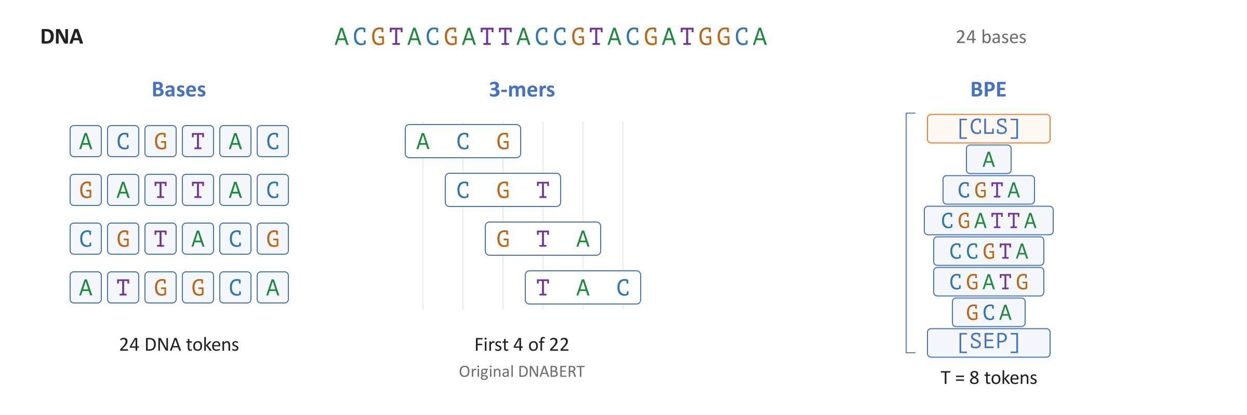
How DNA Becomes Tokens
Tokenization divides DNA into pieces and assigns integer identifiers (IDs)
Bases, k-mers, or byte-pair encoding (BPE) provide the tokens
DNABERT-2 uses variable-length BPE tokens
Notes:
A token is one input unit, and its integer identifier (ID) is a lookup key. The figure compares individual bases, overlapping three-base strings, and DNABERT-2's byte-pair encoding (BPE). BPE builds a vocabulary by repeatedly merging frequent adjacent pieces in training deoxyribonucleic acid (DNA). That vocabulary then determines variable-length, nonoverlapping pieces for new sequences. The right column shows the official tokenizer's split, with a classification token ([CLS]) and a separator token ([SEP]) marking the classification position and sequence end in this example. Neither an ID's numerical magnitude nor a BPE boundary has an assigned biological meaning.
Sources
Original DNABERT paper, 2021: https://doi.org/10.1093/bioinformatics/btab083
DNABERT-2 paper, version 2: https://arxiv.org/abs/2306.15006v2
Official DNABERT-2 tokenizer, pinned revision: https://huggingface.co/zhihan1996/DNABERT-2-117M/blob/7bce263b15377fc15361f52cfab88f8b586abda0/tokenizer.json

Slide 27
From Tokens to Vectors
A learned embedding table maps each token ID to a vector
DNABERT-2 uses 768 numbers per token, including special tokens
These input vectors do not yet incorporate the surrounding sequence
Notes:
Each token identifier (ID) selects one row of a learned embedding table. That row is a vector, an ordered list of numerical features. DNABERT-2 has 4,096 table rows and 768 features per row. The eight tokens in the example therefore produce an 8 by 768 matrix. The width 768 is a model design choice, independent of the four-letter alphabet of deoxyribonucleic acid (DNA). Repeated copies of a token select the same table row before contextual processing. The figure isolates this lookup from other local embedding operations, and its displayed vector values are illustrative.
Sources
DNABERT-2 configuration, pinned revision: https://huggingface.co/zhihan1996/DNABERT-2-117M/blob/7bce263b15377fc15361f52cfab88f8b586abda0/config.json
Official DNABERT-2 model code, pinned revision: https://huggingface.co/zhihan1996/DNABERT-2-117M/blob/7bce263b15377fc15361f52cfab88f8b586abda0/bert_layers.py
Official DNABERT-2 tokenizer, pinned revision: https://huggingface.co/zhihan1996/DNABERT-2-117M/blob/7bce263b15377fc15361f52cfab88f8b586abda0/tokenizer.json

Slide 28
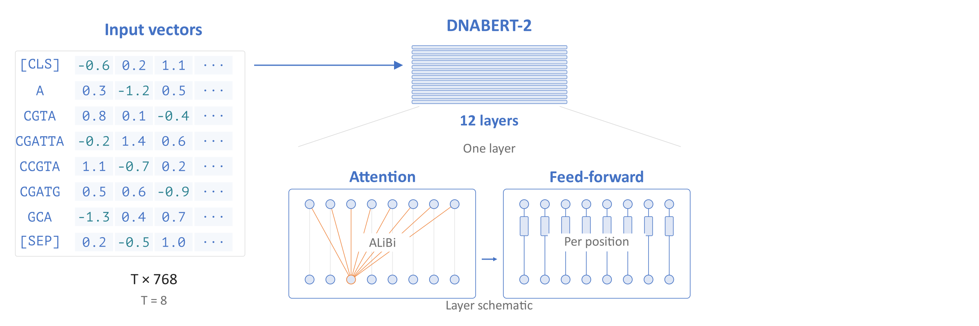
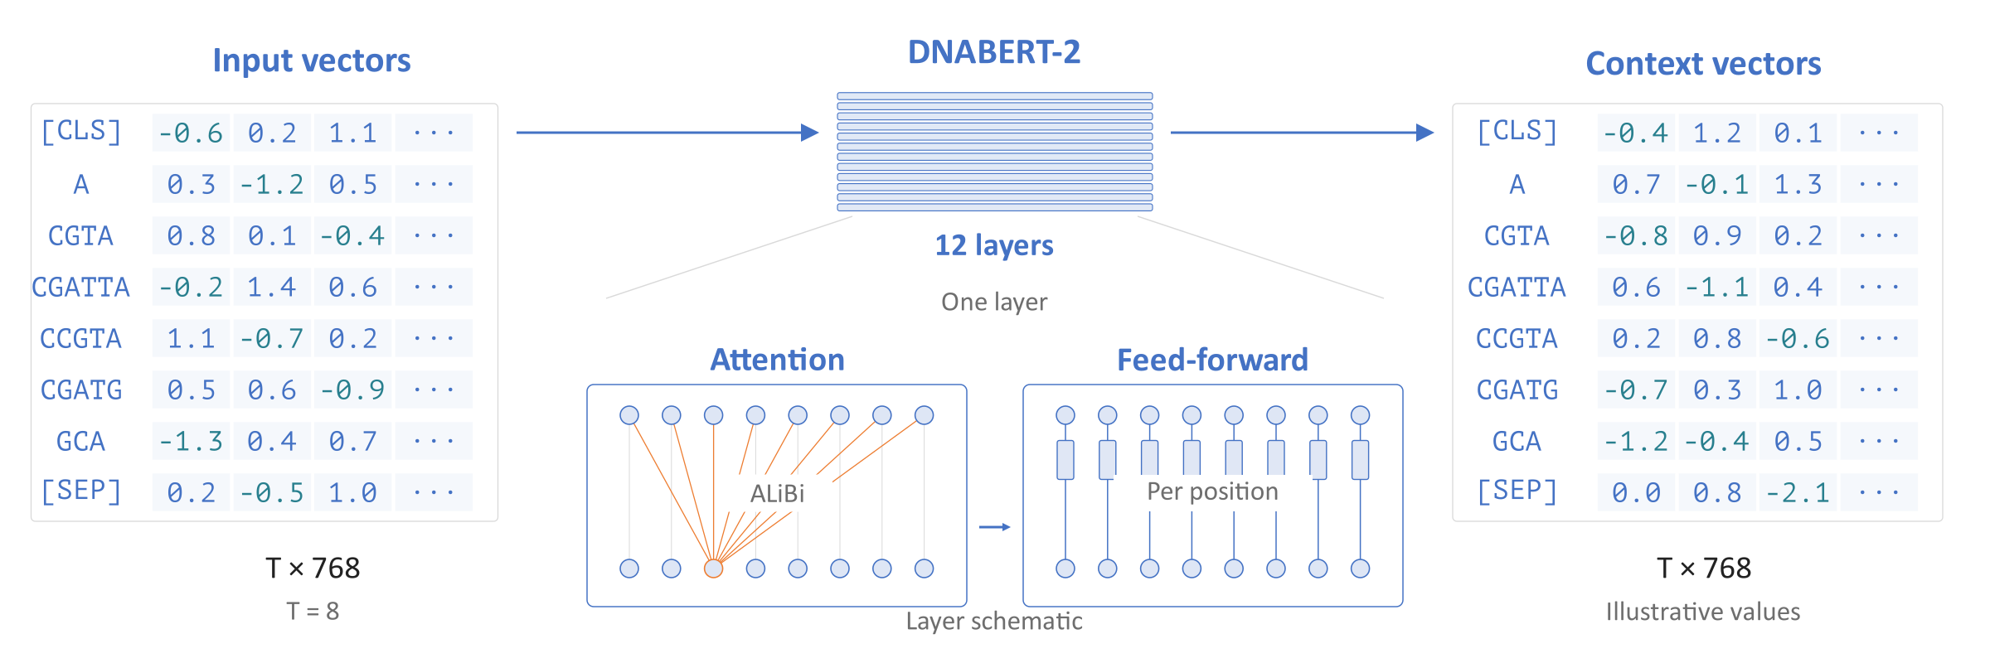
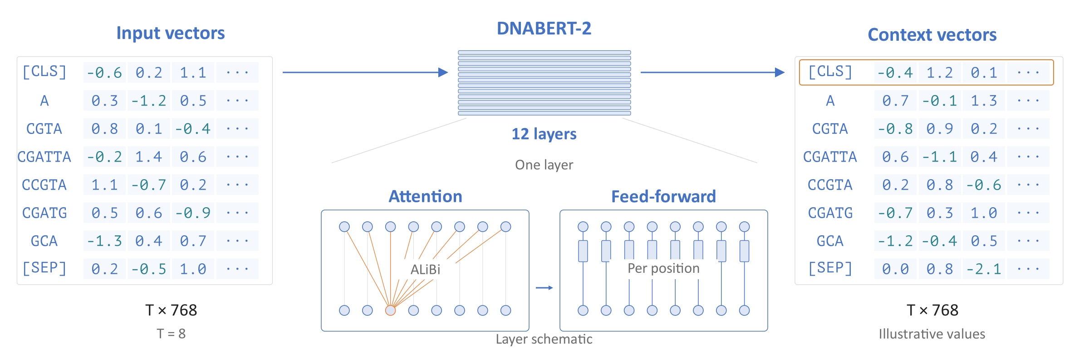
The Transformer Encoder
Self-attention combines information from different token positions
Each layer also transforms the features at every position
The encoder returns one contextual vector per token
Notes:
Self-attention compares token representations and uses the resulting weights to combine information across positions. A feed-forward network then transforms the features at each position. DNABERT-2 repeats these operations through 12 Transformer layers. It supplies positional information through Attention with Linear Biases (ALiBi), a bias based on separation between token positions. The output remains an 8 by 768 matrix, but each row can now depend on surrounding deoxyribonucleic acid (DNA). These are contextual vectors. Their coordinates are learned features, rather than named biological properties or probabilities of a particular class.
Sources
DNABERT-2 paper, version 2: https://arxiv.org/abs/2306.15006v2
DNABERT-2 configuration, pinned revision: https://huggingface.co/zhihan1996/DNABERT-2-117M/blob/7bce263b15377fc15361f52cfab88f8b586abda0/config.json
Official DNABERT-2 model code, pinned revision: https://huggingface.co/zhihan1996/DNABERT-2-117M/blob/7bce263b15377fc15361f52cfab88f8b586abda0/bert_layers.py

Slide 29
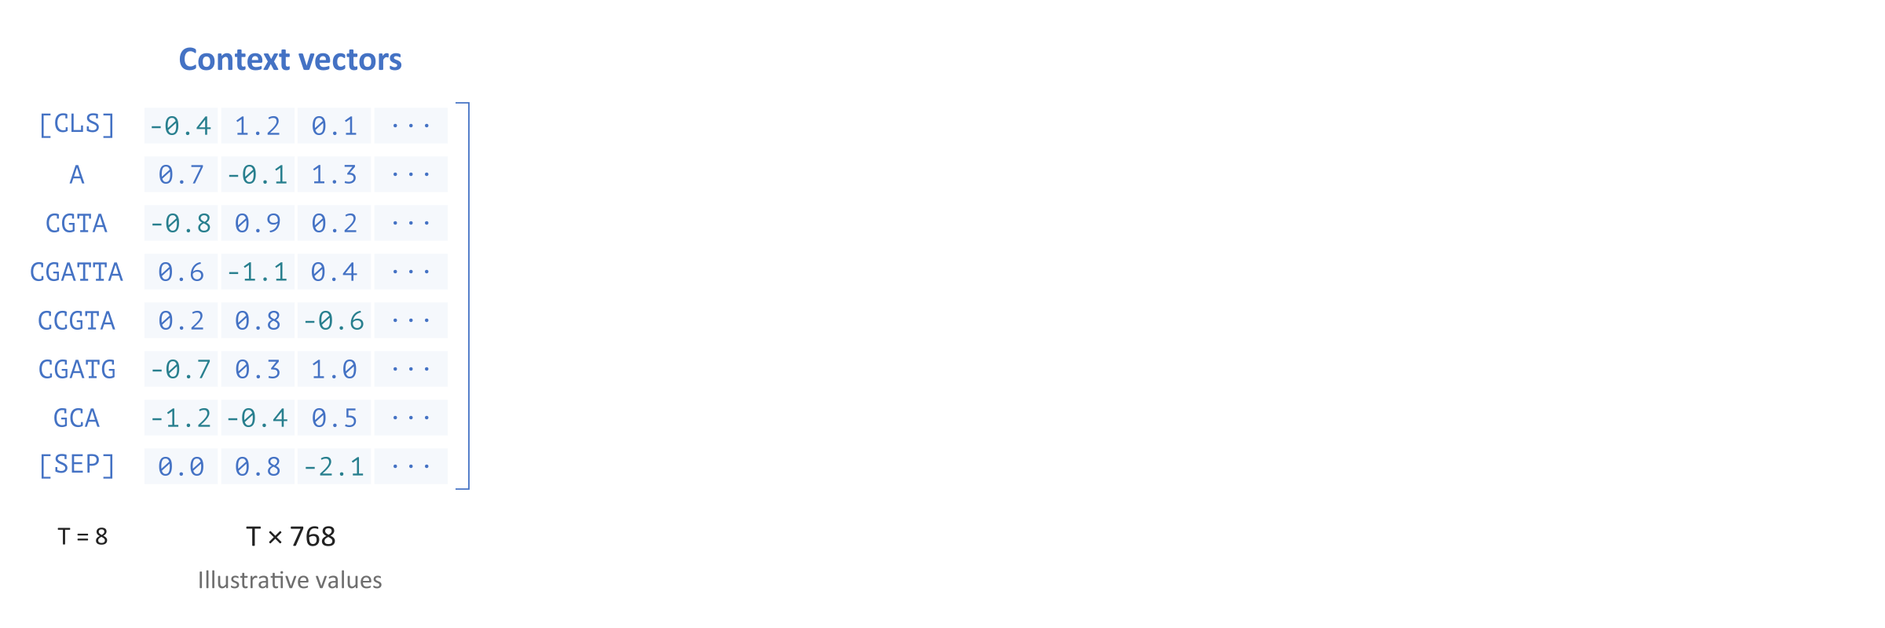
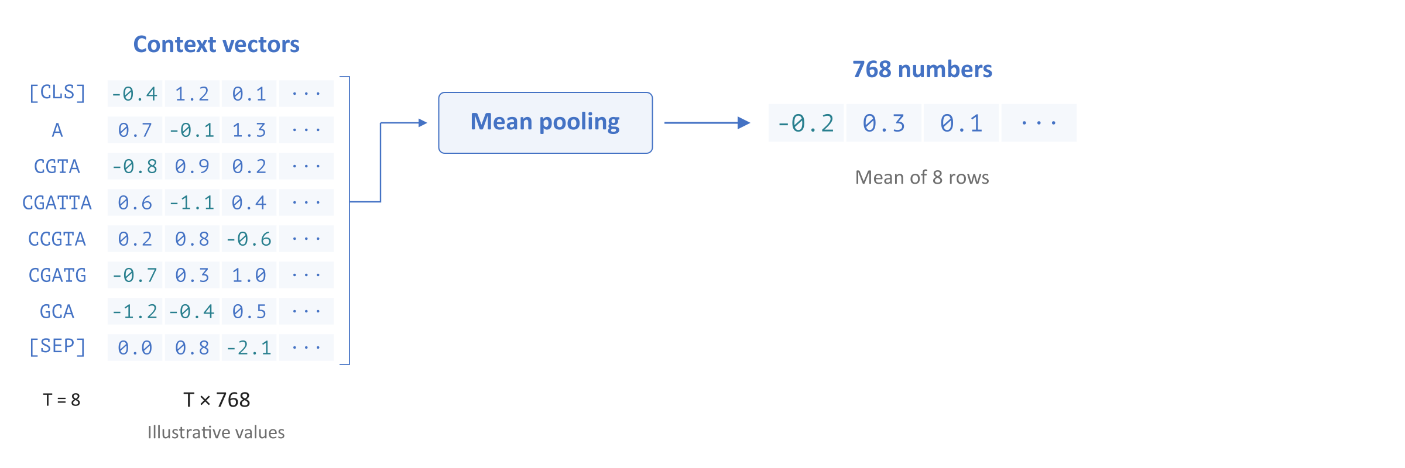
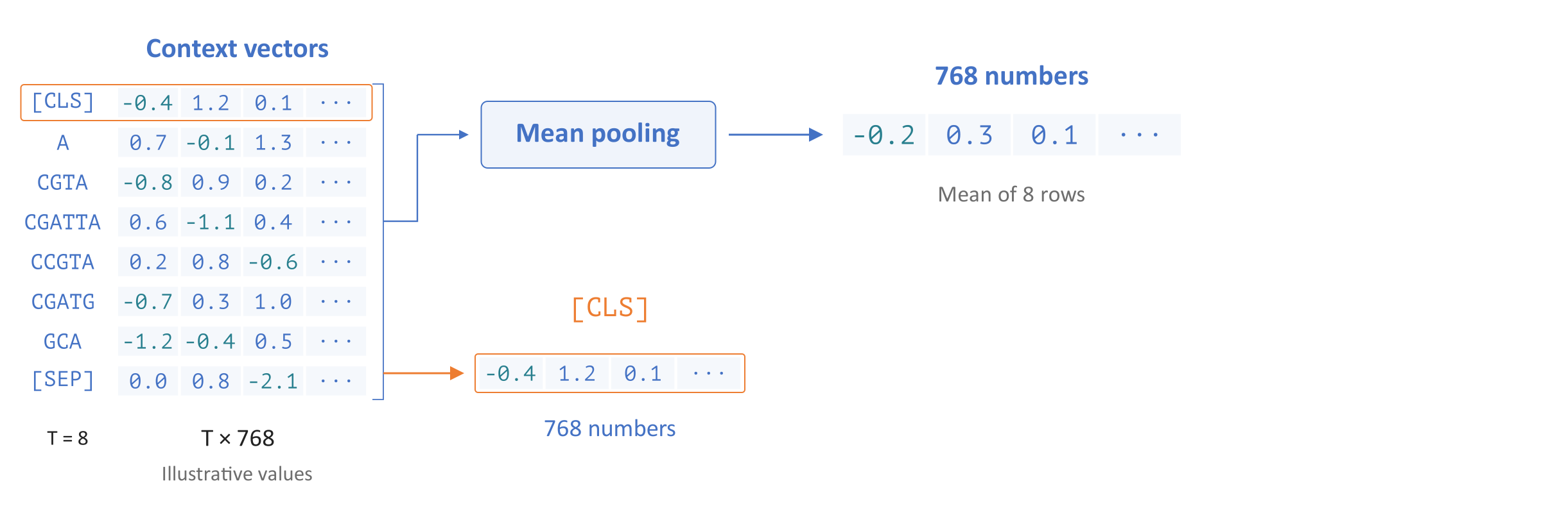
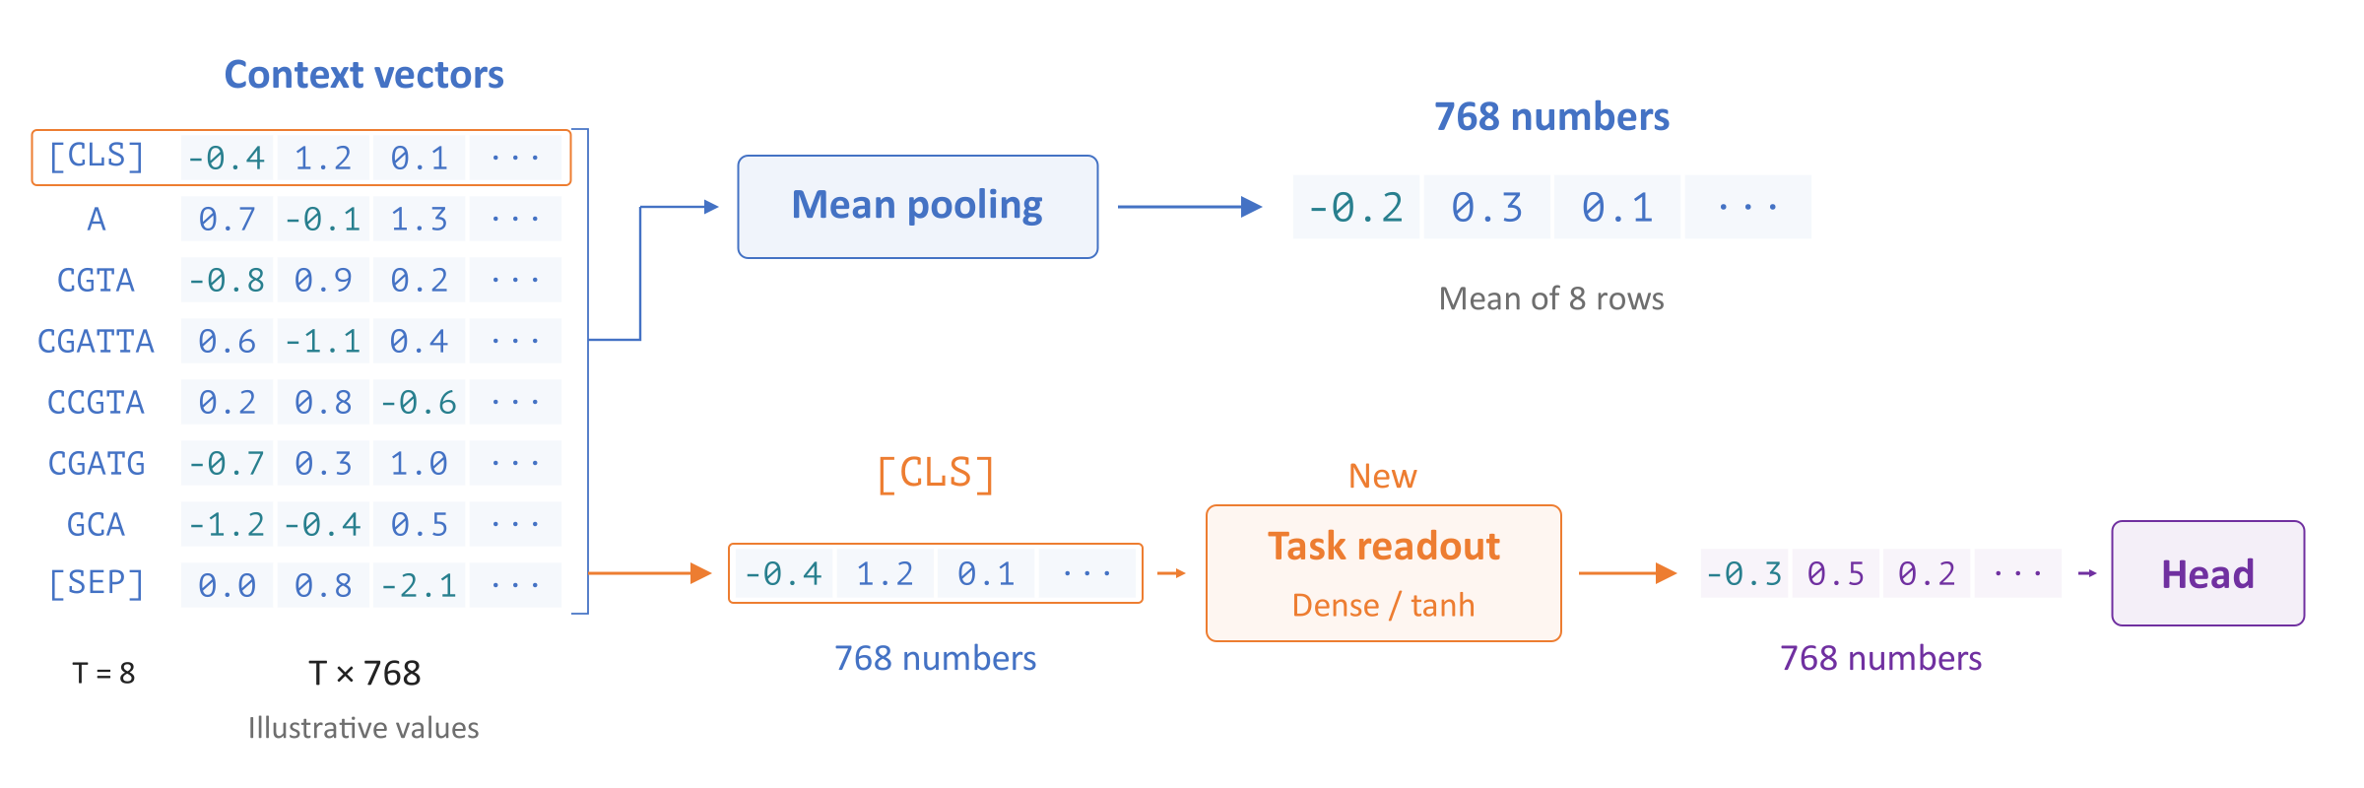
A Vector for a Sequence
Summarize token vectors to represent the whole sequence
Mean pooling averages each feature across the token positions
DNABERT-2 uses the classification token ([CLS]) for its readout
Notes:
Mean pooling averages each column of the contextual matrix, turning eight 768-component rows into one 768-component sequence vector. The official unpadded example includes the special tokens. Padding must be excluded when averaging a padded batch. Pooling summarizes the sequence and does not preserve a separate output for every position. DNABERT-2's classifier instead selects the contextual row for the classification token ([CLS]) and applies a learned dense layer, which mixes its features, followed by the nonlinear hyperbolic tangent (tanh) function. This readout is learned during task adaptation before the class head converts features into prediction scores.
Sources
Official DNABERT-2 embedding examples: https://github.com/MAGICS-LAB/DNABERT_2/blob/f25bed9ee20db966dff39e5c1571249d04e36404/README.md#L100-L112
Official DNABERT-2 model code, pinned revision: https://huggingface.co/zhihan1996/DNABERT-2-117M/blob/7bce263b15377fc15361f52cfab88f8b586abda0/bert_layers.py

Slide 30
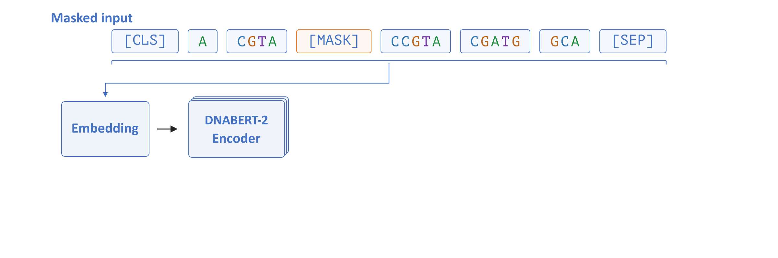
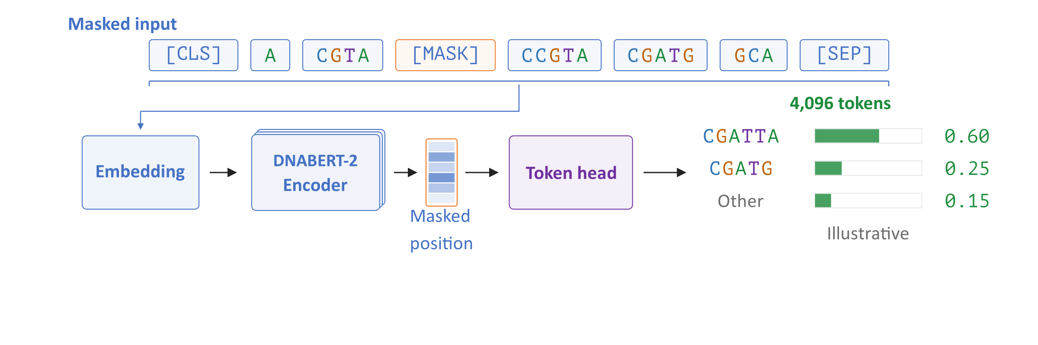
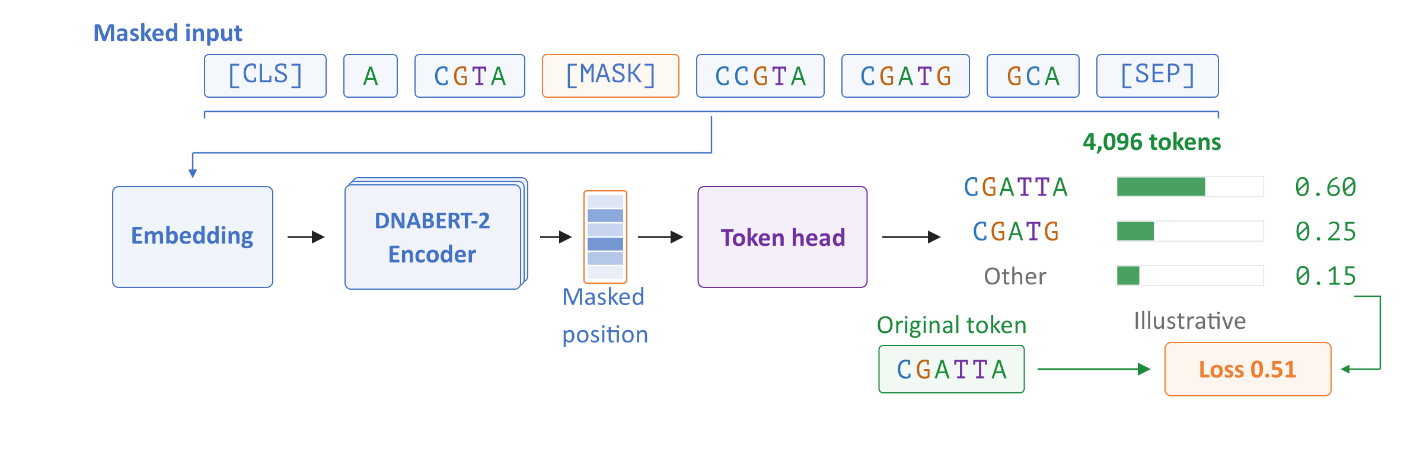
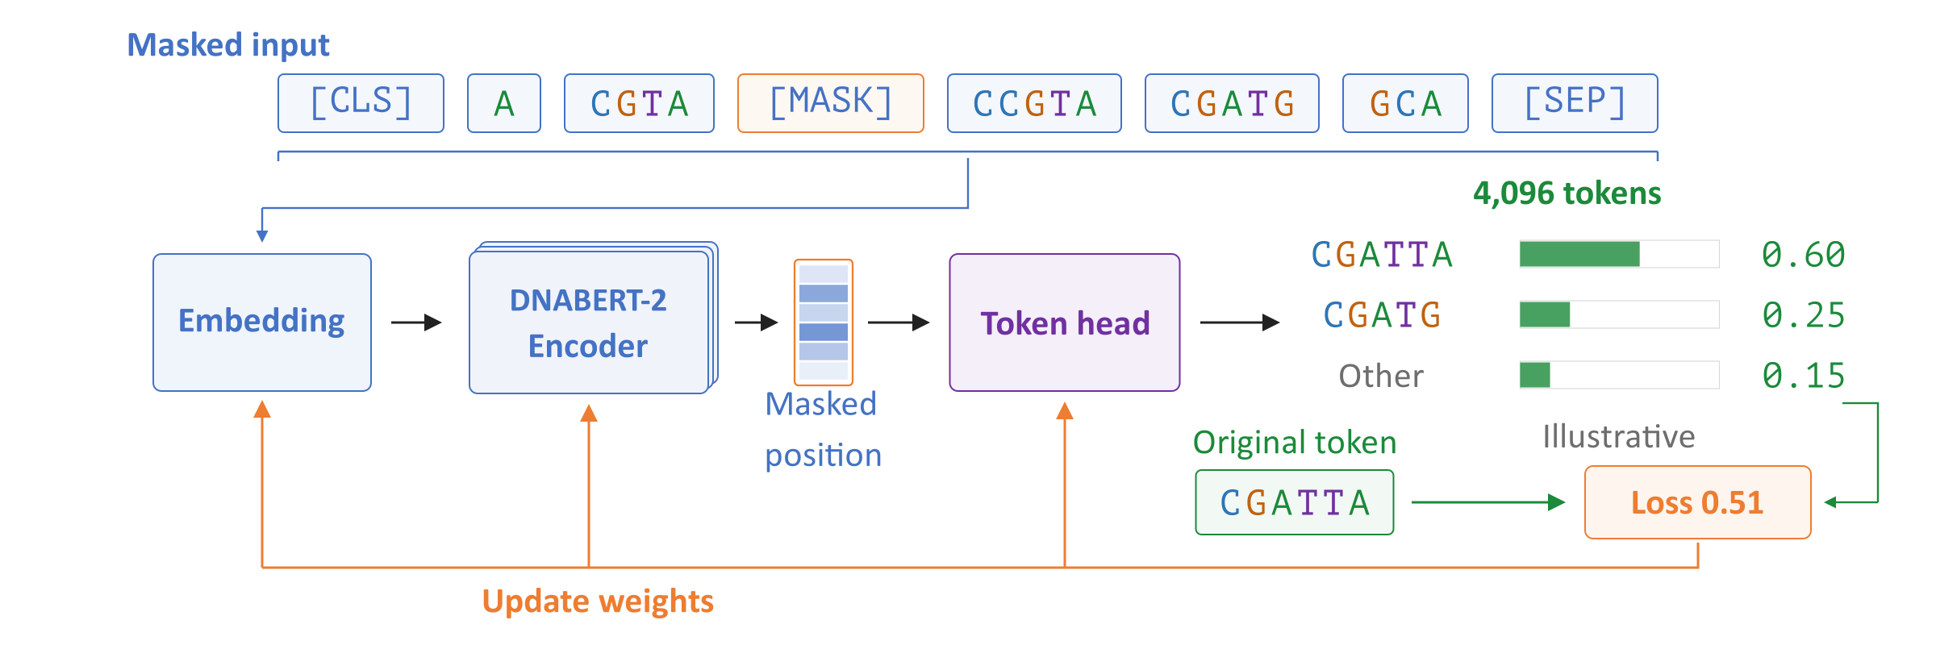
Pretraining on DNA
Pretraining predicts masked tokens using surrounding DNA
The target comes from the original sequence, without task labels
Prediction errors update the embedding table, encoder, and output head
Notes:
Pretraining creates a prediction target from the original sequence. Here, CGATTA is saved as the target and replaced by the special masking token [MASK] in the input. The encoder computes the masked position's contextual vector, and the token head converts that vector into scores over the vocabulary. The loss penalizes low probability for the original token. Training uses that loss to update the embedding table, encoder, and token head. Enhancer or binding-site labels are unnecessary for this objective. The probabilities and loss shown in the figure are illustrative.
Sources
DNABERT-2 paper, version 2: https://arxiv.org/abs/2306.15006v2
Official DNABERT-2 model code, pinned revision: https://huggingface.co/zhihan1996/DNABERT-2-117M/blob/7bce263b15377fc15361f52cfab88f8b586abda0/bert_layers.py

Slide 31
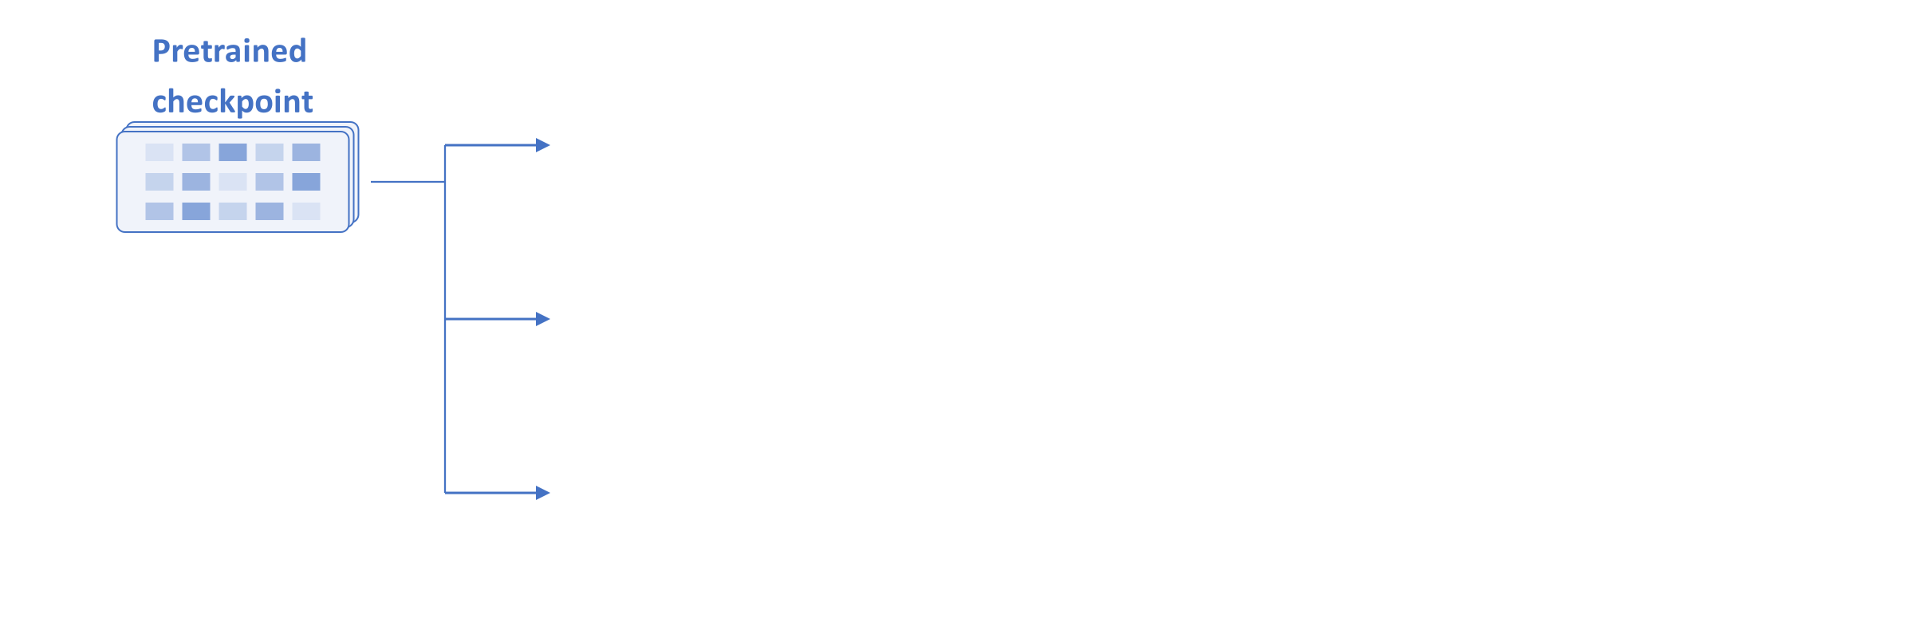
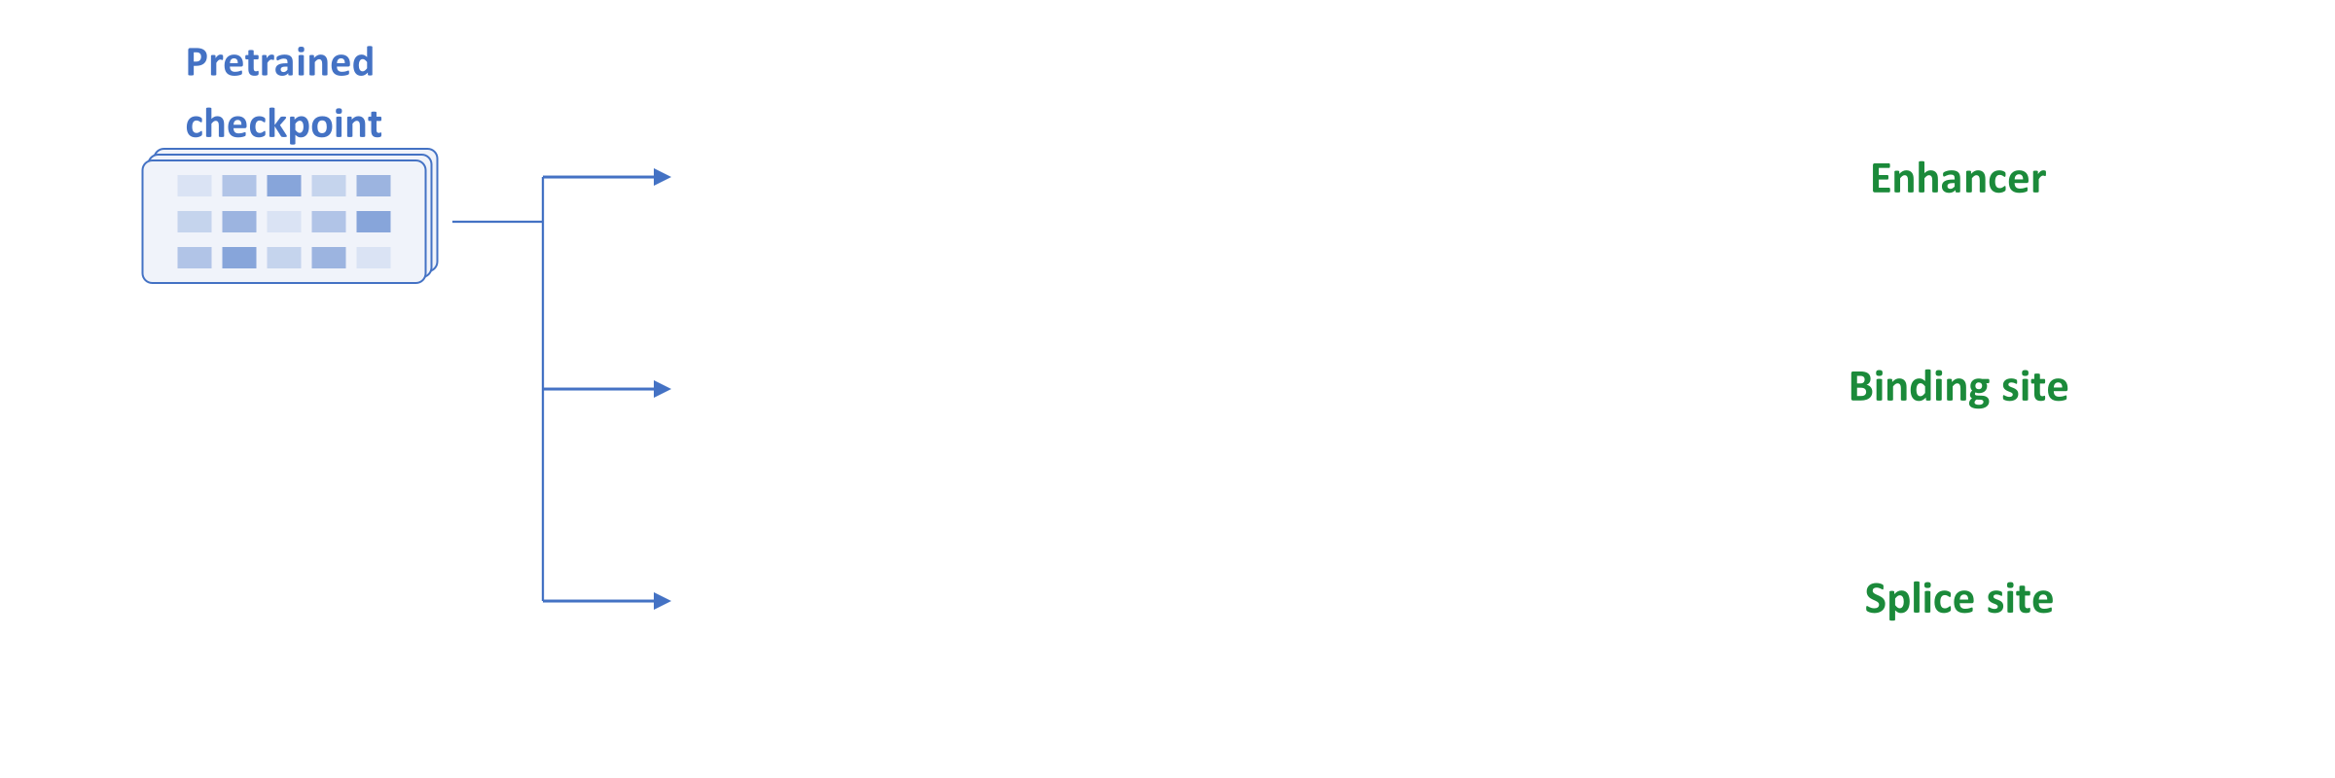
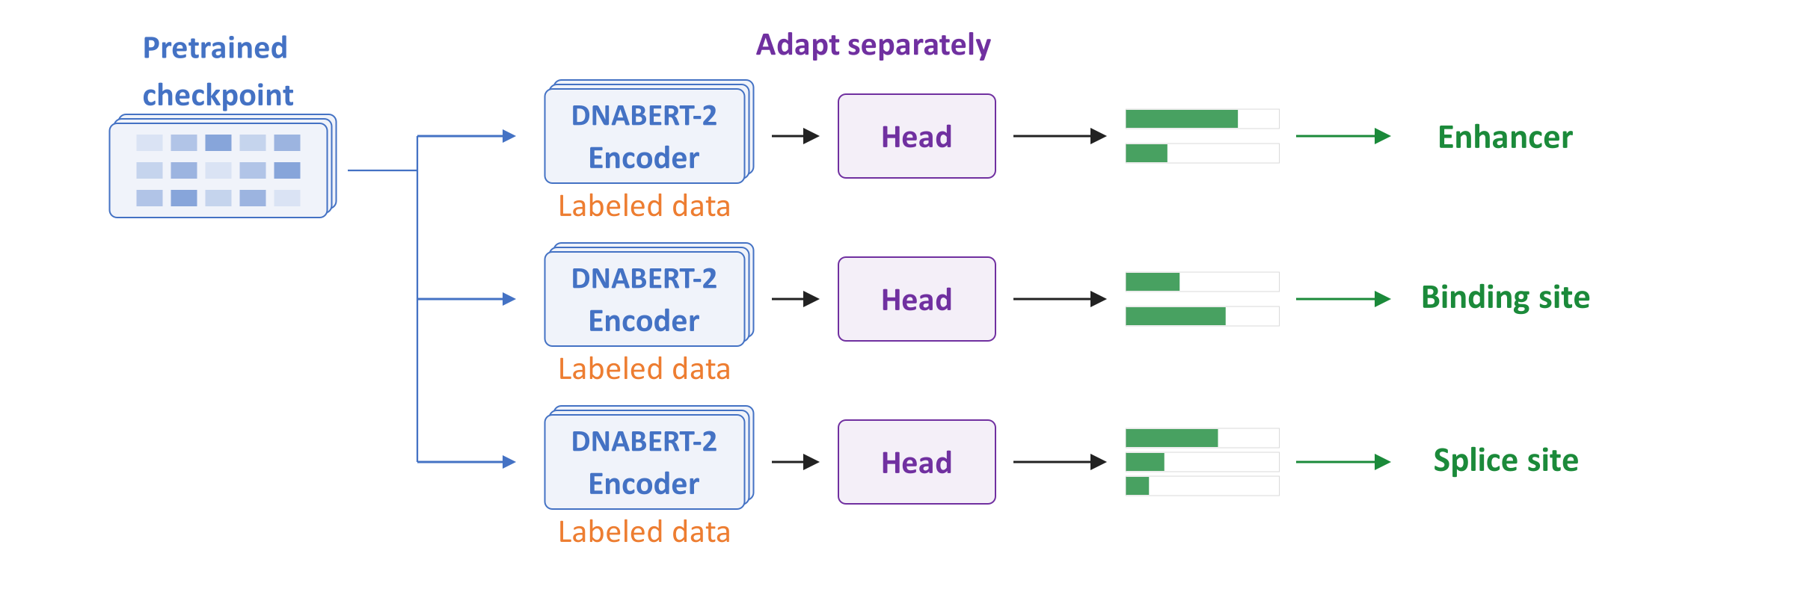
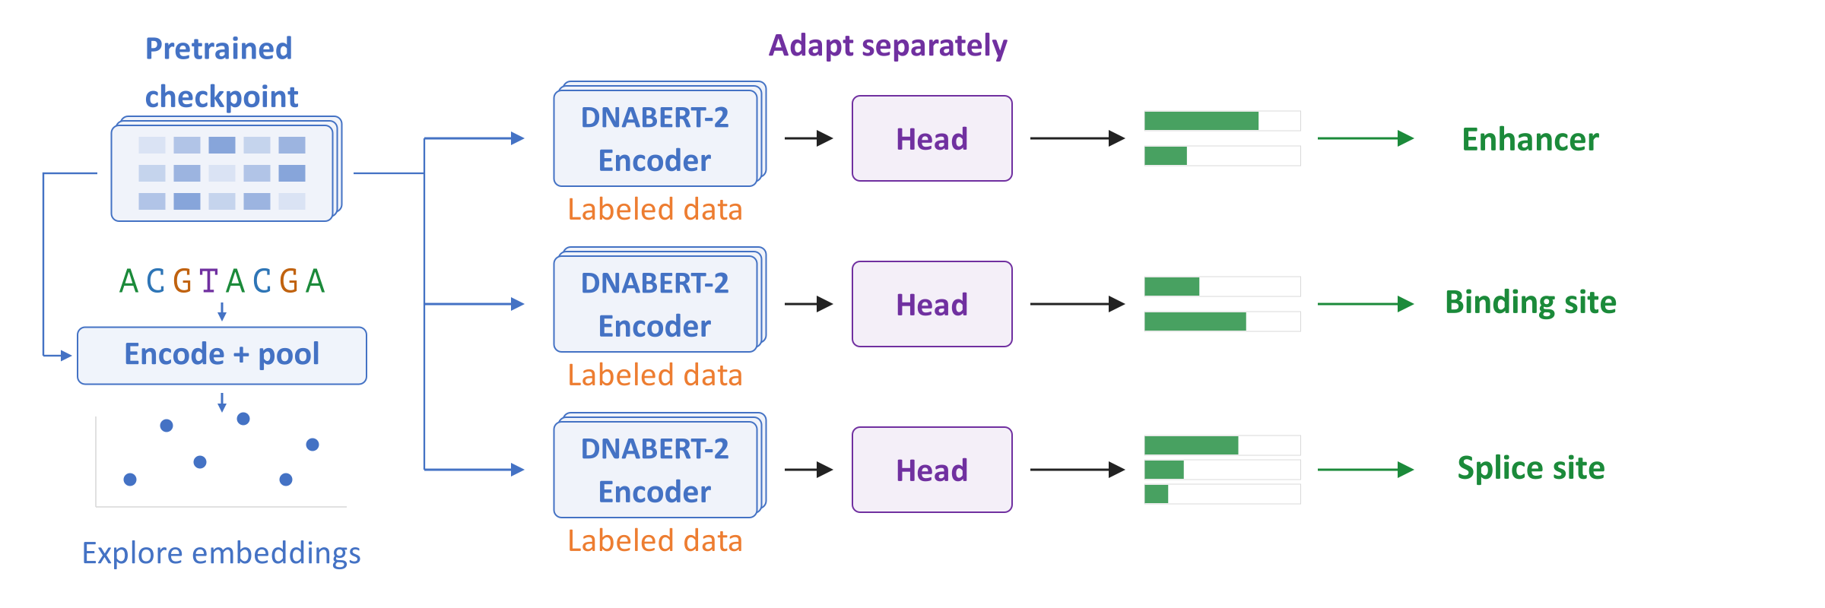
One Model, Many Tasks
Reuse learned features to explore sequences or train prediction models
Examples include enhancer, binding-site, and splice-site prediction
Each prediction task needs an appropriate head and labeled examples
Notes:
A pretrained checkpoint contains saved model parameters that can be reused for separate applications. The left branch explores similarities between pooled sequence vectors. The other branches train task-specific prediction heads using labeled examples. An enhancer is a deoxyribonucleic acid (DNA) region that can increase transcription, the production of ribonucleic acid (RNA). A transcription-factor binding site is a region associated with binding by a particular regulatory protein. A splice site marks a boundary used when introns are removed from RNA. Each application needs suitable labels, and embedding similarity alone does not establish shared biological function.
Sources
Original DNABERT paper, 2021: https://doi.org/10.1093/bioinformatics/btab083
DNABERT-2 paper, version 2: https://arxiv.org/abs/2306.15006v2
Official DNABERT-2 embedding examples: https://github.com/MAGICS-LAB/DNABERT_2/blob/f25bed9ee20db966dff39e5c1571249d04e36404/README.md#L100-L112
Revised Nucleotide Transformer task definitions: https://huggingface.co/datasets/InstaDeepAI/nucleotide_transformer_downstream_tasks_revised/blob/851f9946252e90c665cdb3cc3eedb78f1f26197c/README.md

Slide 32
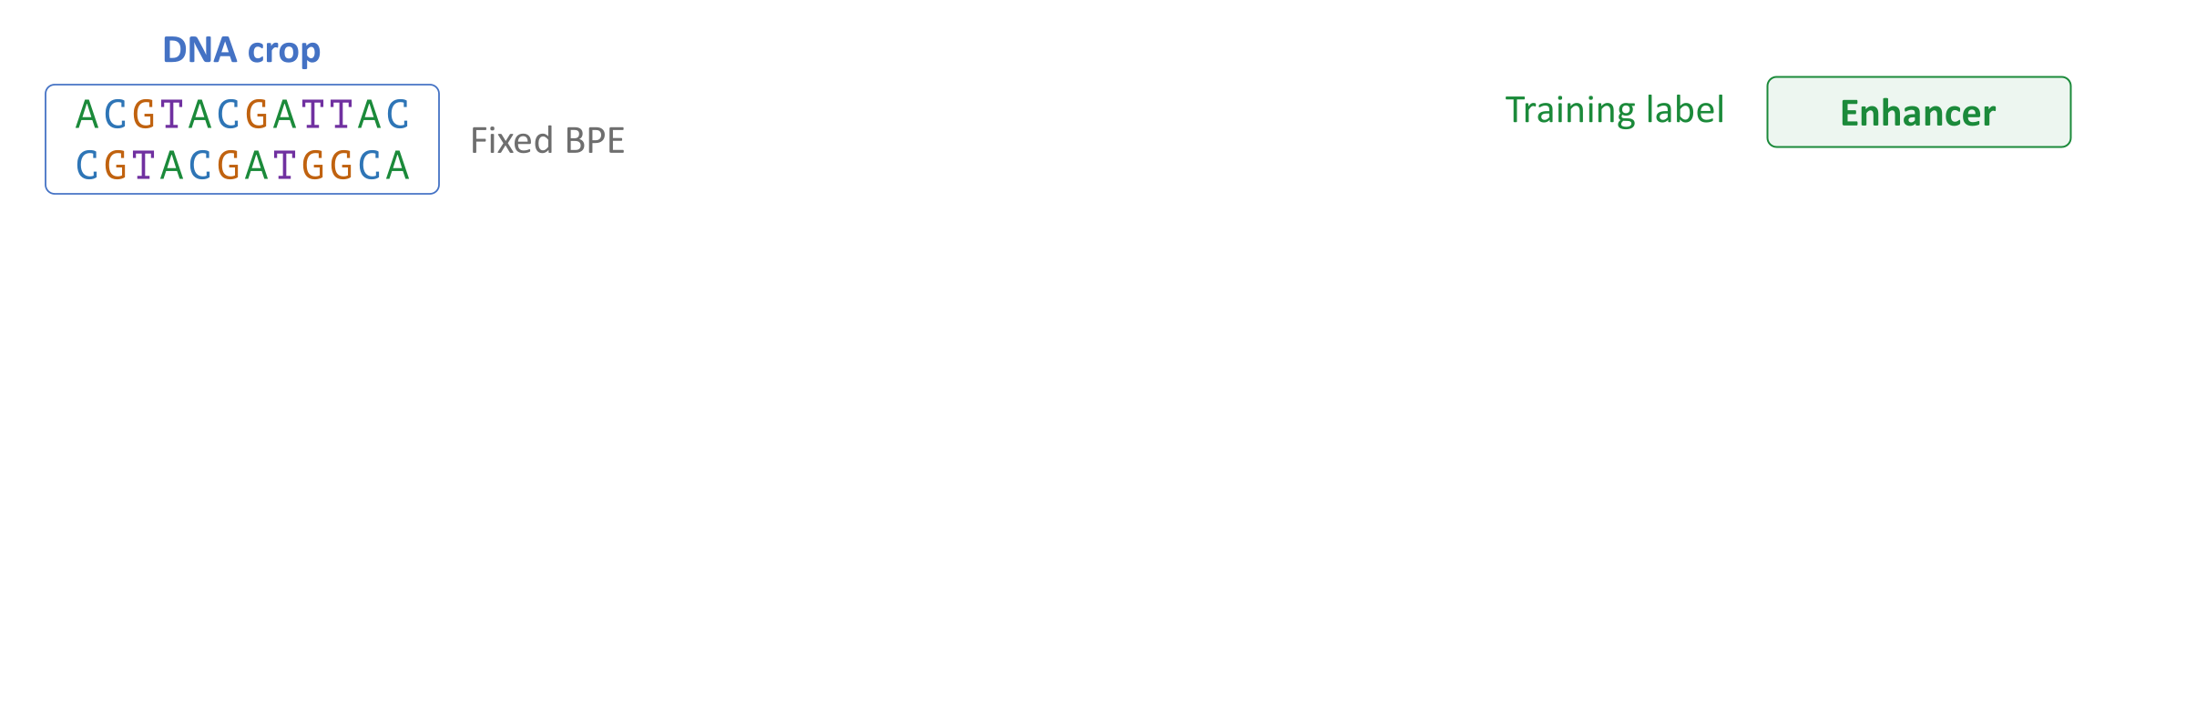
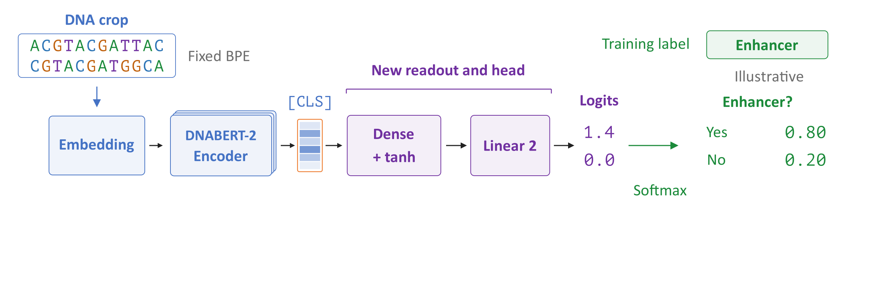
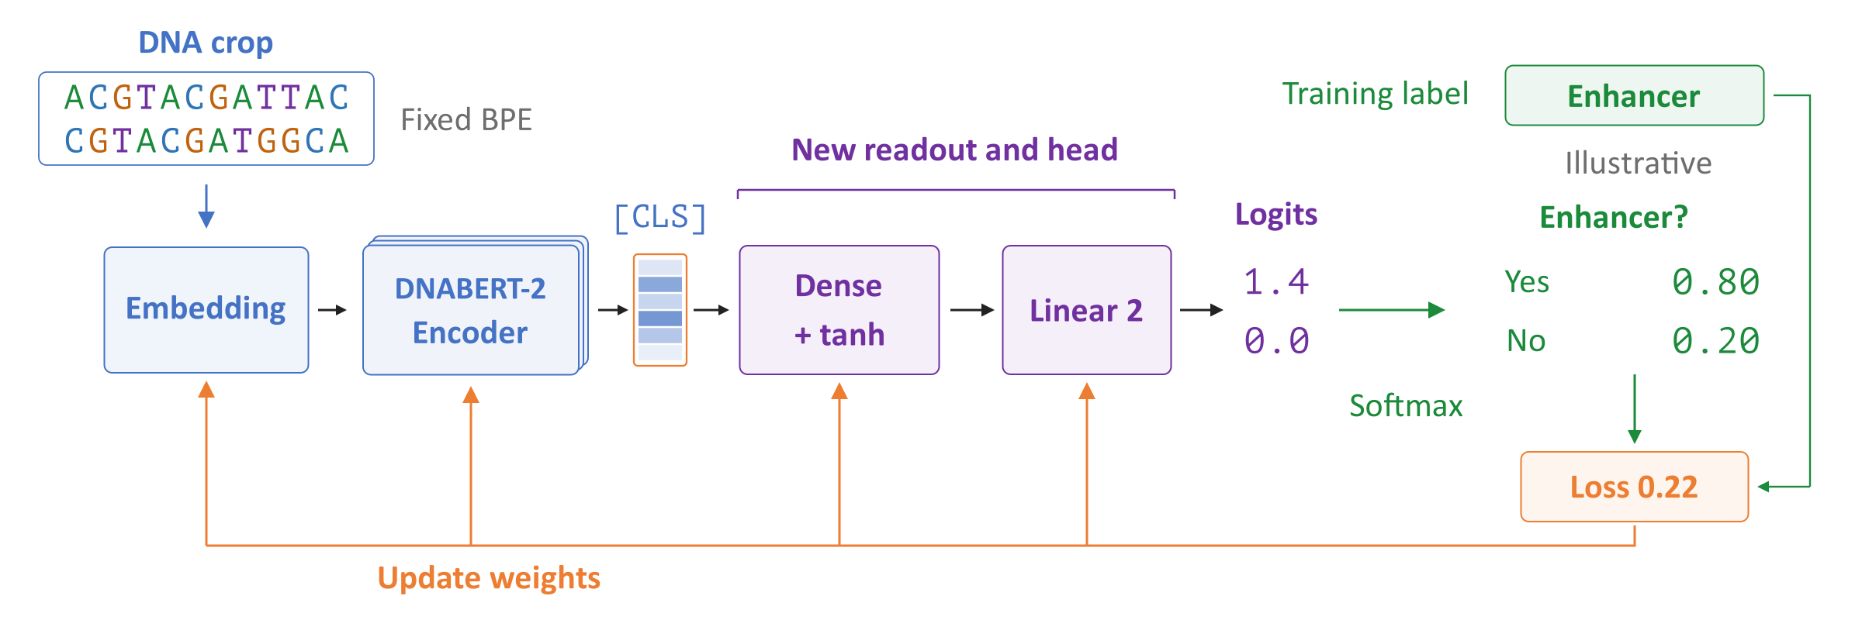
Full Fine-Tuning
Example: classify labeled DNA regions as enhancer or non-enhancer
Add a two-class head and compare predictions with the labels
Full fine-tuning updates the pretrained model and the new head
Notes:
Full fine-tuning starts with pretrained parameters and adds a sequence readout and task head. Here, the head produces two logits, unnormalized scores that softmax converts into enhancer and non-enhancer probabilities. Classification loss compares those probabilities with the training label. The orange arrows update the embeddings, encoder, readout, and head while the byte-pair encoding (BPE) tokenizer remains fixed. The revised Nucleotide Transformer benchmark uses annotation-based labels on 400-base regions. A negative label means no enhancer annotation in that benchmark. The short sequence, scores, and loss here are illustrative rather than a measured DNABERT-2 result.
Sources
Official DNABERT-2 fine-tuning code: https://github.com/MAGICS-LAB/DNABERT_2/blob/f25bed9ee20db966dff39e5c1571249d04e36404/finetune/train.py
Official DNABERT-2 model code, pinned revision: https://huggingface.co/zhihan1996/DNABERT-2-117M/blob/7bce263b15377fc15361f52cfab88f8b586abda0/bert_layers.py
Revised Nucleotide Transformer task definitions: https://huggingface.co/datasets/InstaDeepAI/nucleotide_transformer_downstream_tasks_revised/blob/851f9946252e90c665cdb3cc3eedb78f1f26197c/README.md

Slide 33
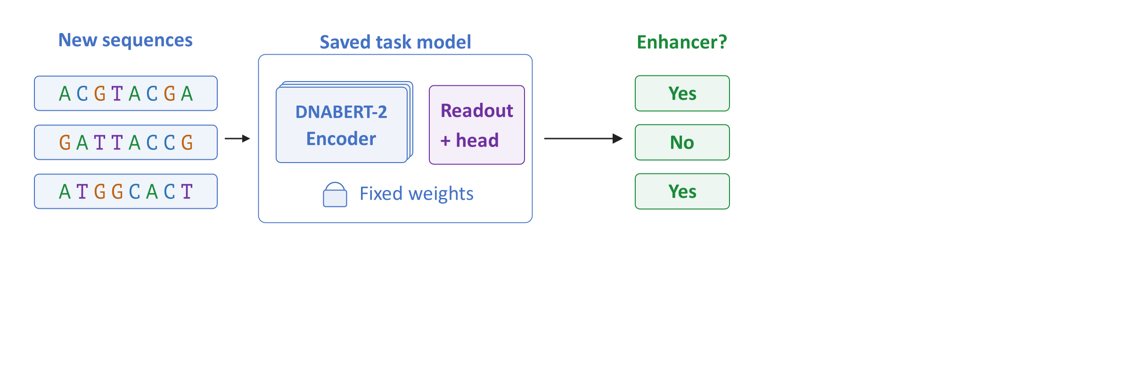
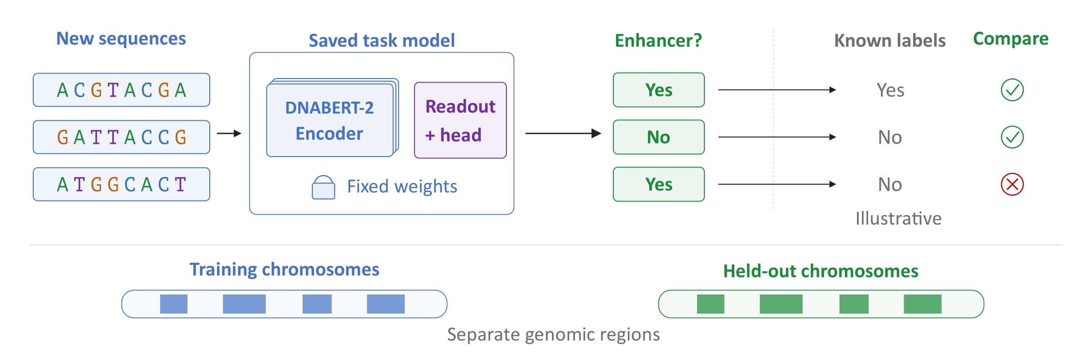
Prediction and Evaluation
For a new sequence, run the fine-tuned model without updating it
Evaluate on held-out sequences with independent labels
Related or overlapping sequences can make evaluation too optimistic
Notes:
Inference runs the saved task model with fixed parameters. Evaluation then compares its predictions with labels held out from supervised training. Validation data guide model choices before final testing. The chromosome split illustrates one way to prevent nearby or overlapping genomic regions from appearing in both training and test sets. Such separation tests transfer to different regions, but does not guarantee absence of related sequences elsewhere. A region excluded from fine-tuning may also have appeared during pretraining. Those two forms of exposure must be distinguished when interpreting a result.
Sources
Official DNABERT-2 fine-tuning code: https://github.com/MAGICS-LAB/DNABERT_2/blob/f25bed9ee20db966dff39e5c1571249d04e36404/finetune/train.py
Revised Nucleotide Transformer task definitions: https://huggingface.co/datasets/InstaDeepAI/nucleotide_transformer_downstream_tasks_revised/blob/851f9946252e90c665cdb3cc3eedb78f1f26197c/README.md
Nucleotide Transformer study, Nature Methods: https://www.nature.com/articles/s41592-024-02523-z

Slide 34
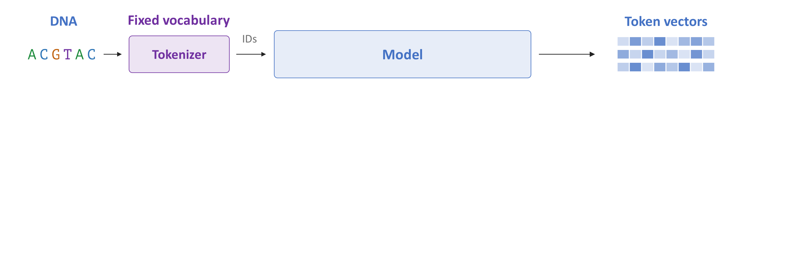
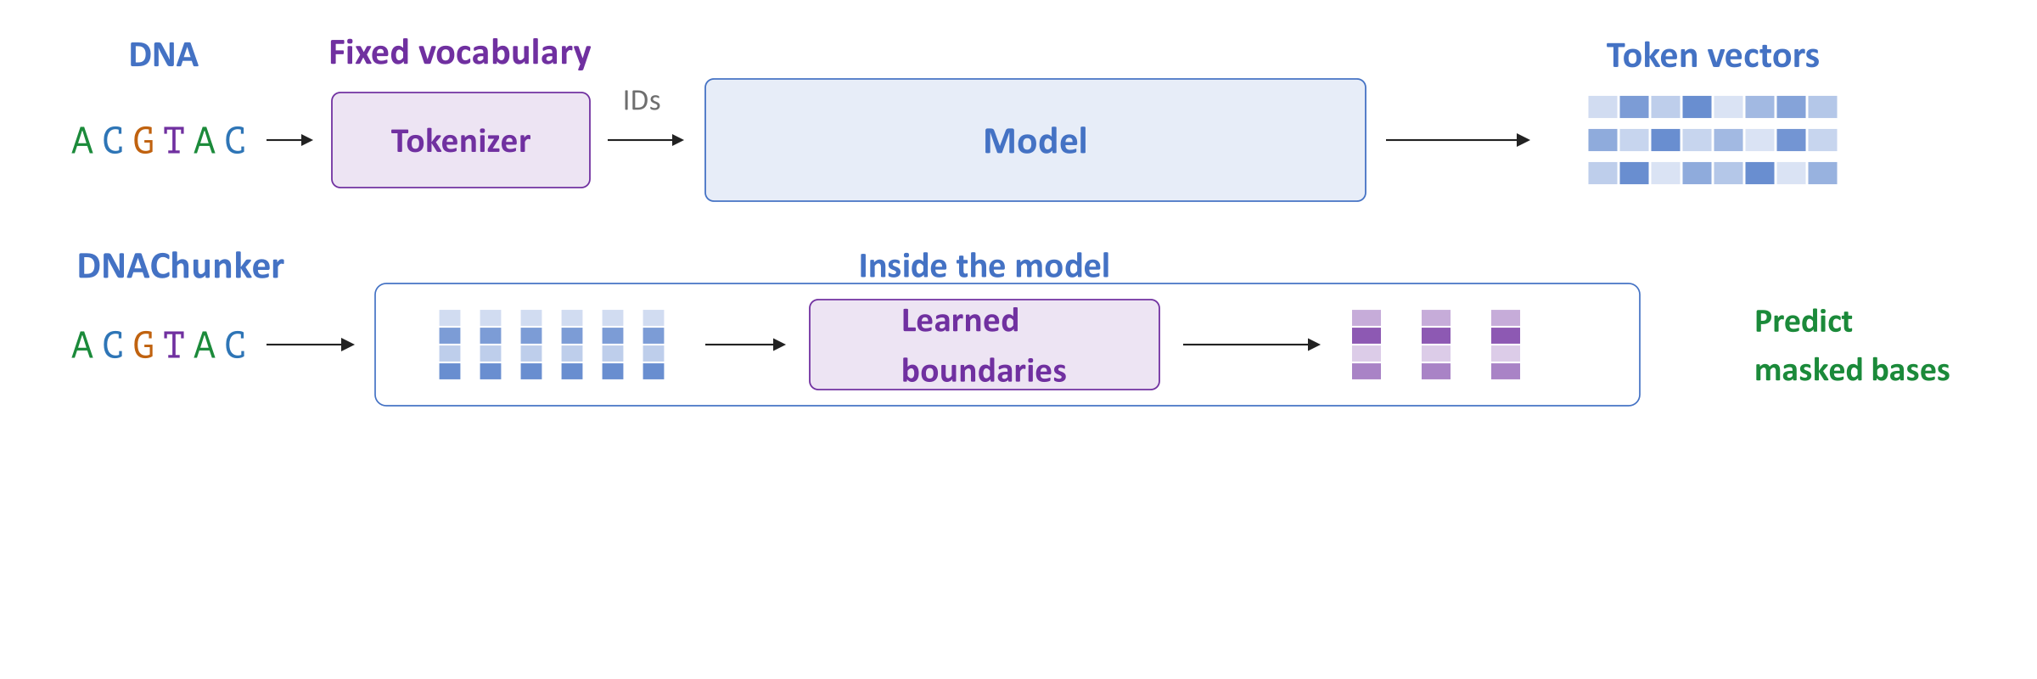
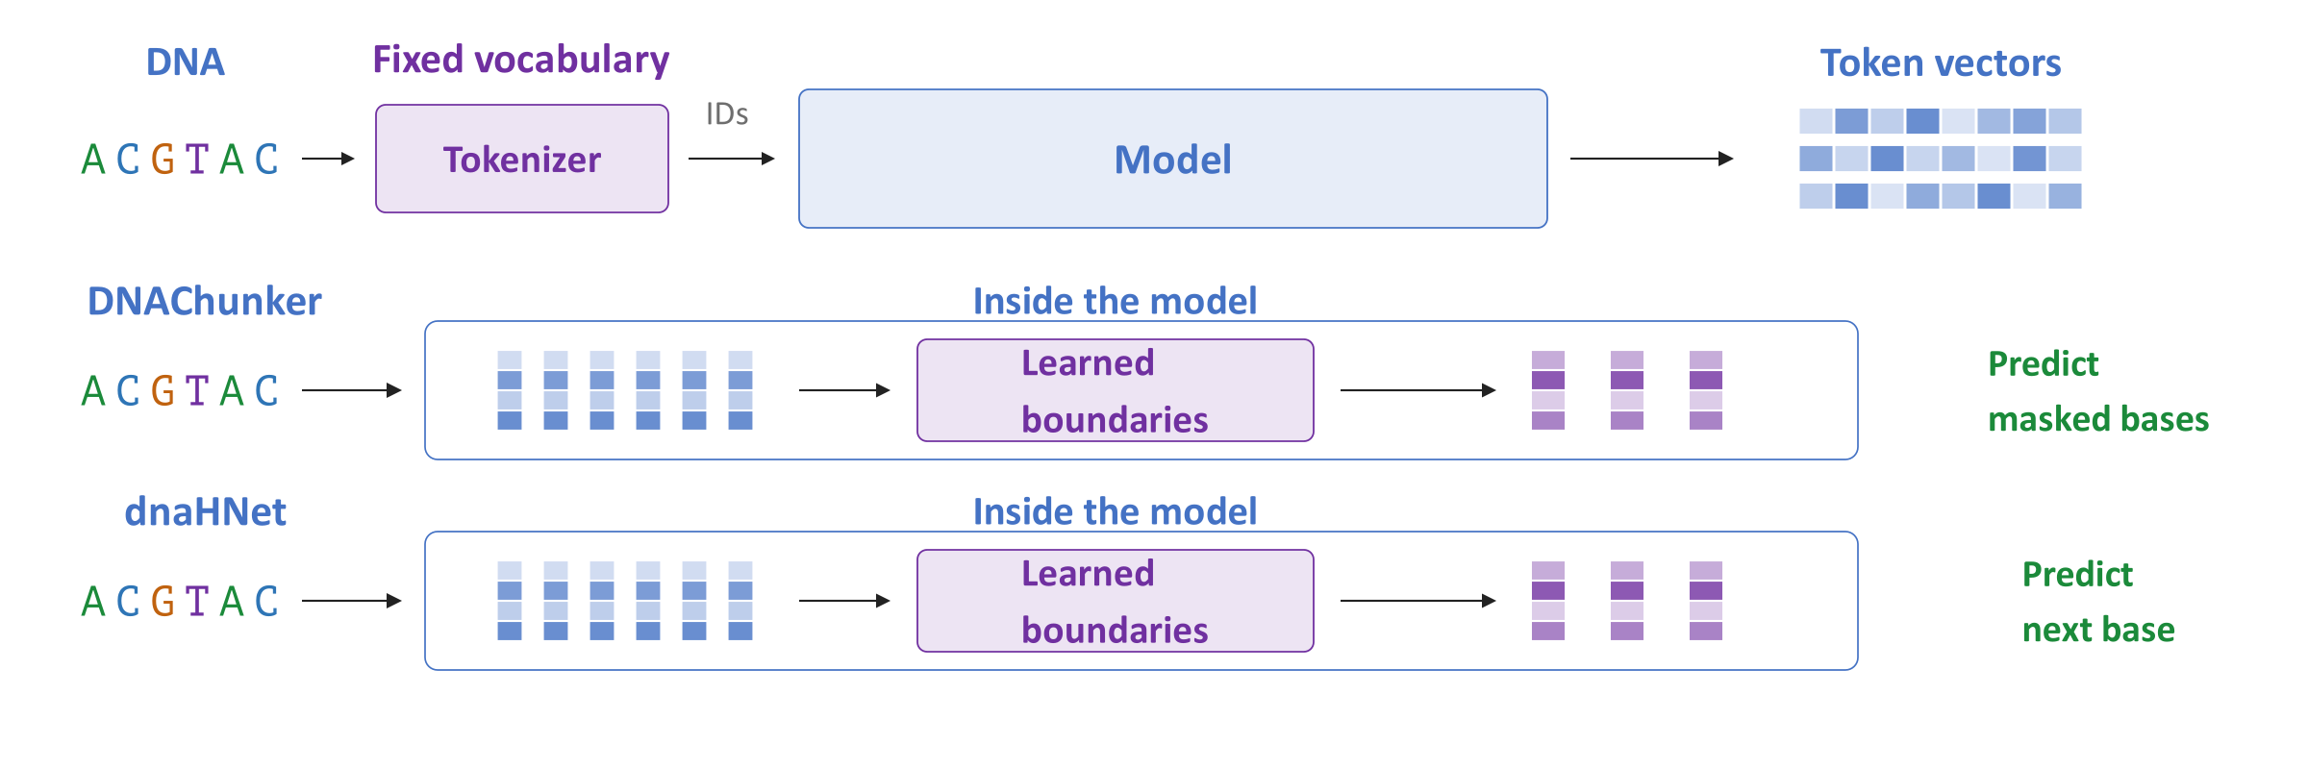
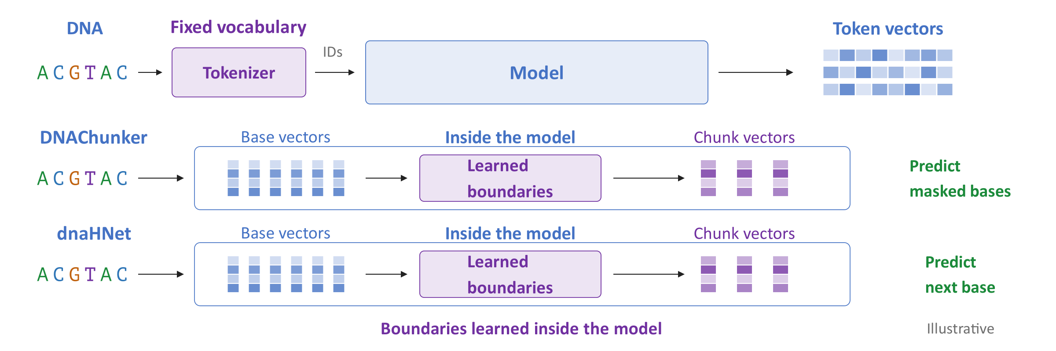
Why Tokenization Matters
The choice of DNA tokens changes what the model sees
DNAChunker learns boundaries during masked-sequence pretraining
dnaHNet learns hierarchical boundaries in an autoregressive model
Notes:
Tokenization changes the units and prediction problem seen by the model. Overlapping k-mers can reveal masked bases through neighboring tokens, while fixed nonoverlapping groups can change after a window shift. Byte-pair encoding (BPE) learns its vocabulary before model training. DNAChunker instead learns internal boundaries using both flanks and restores nucleotide-level outputs to predict masked bases. dnaHNet learns hierarchical chunks for causal next-base prediction, which uses preceding bases at each prediction. Both systems jointly learn segmentation and sequence modeling. Their chunking components belong inside their architectures and cannot simply replace DNABERT-2's tokenizer.
Sources
DNABERT-2 paper, version 2: https://arxiv.org/abs/2306.15006v2
DNAChunker paper, version 4: https://arxiv.org/abs/2601.03019v4
dnaHNet paper, version 3: https://arxiv.org/abs/2602.10603v3

Slide 35
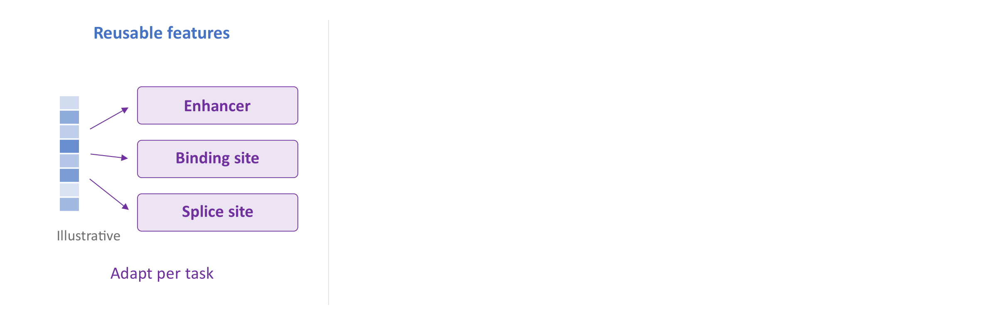
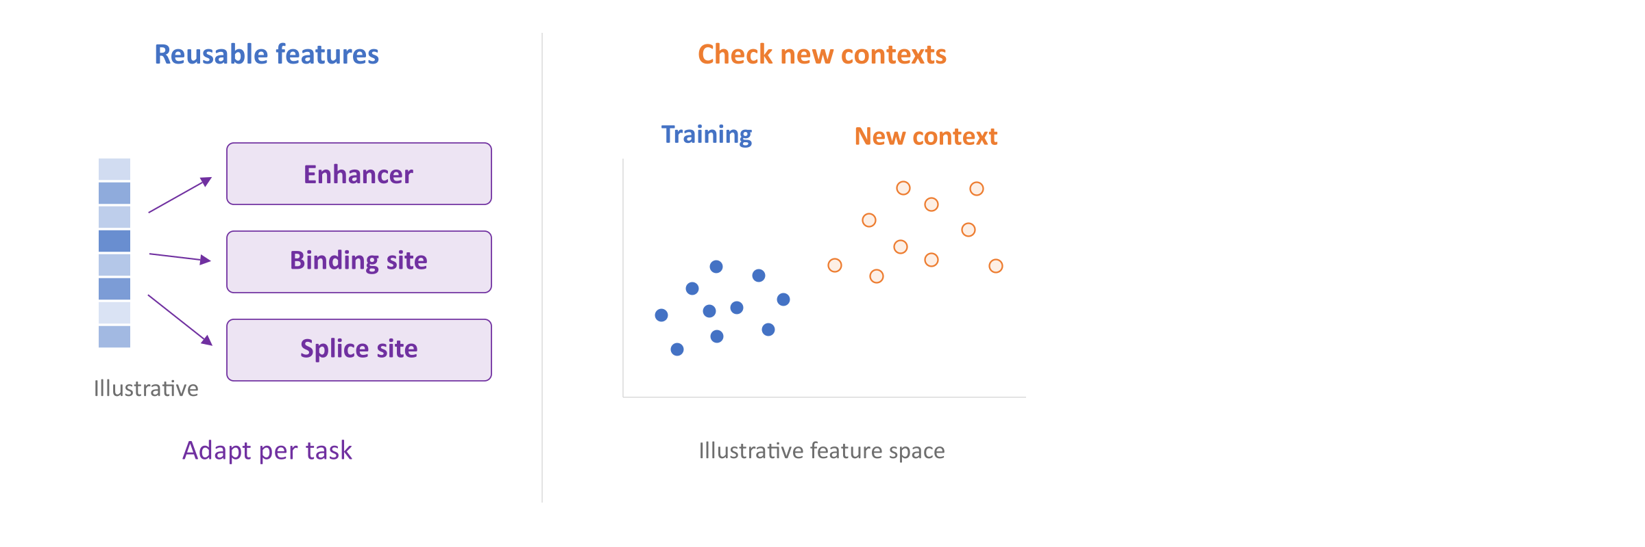
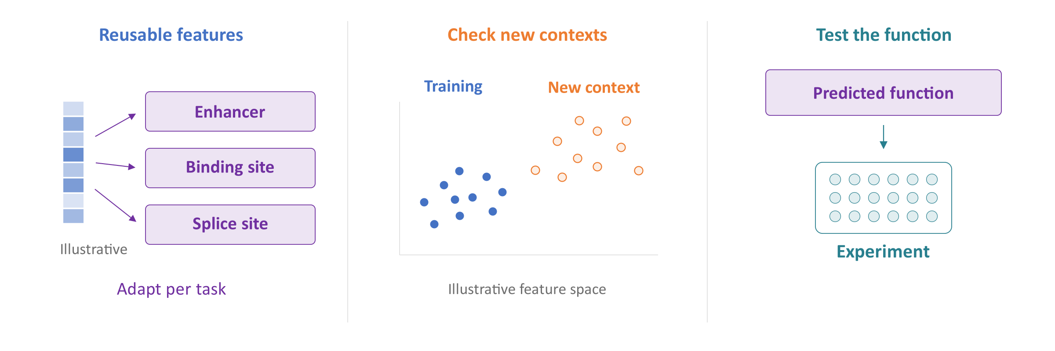
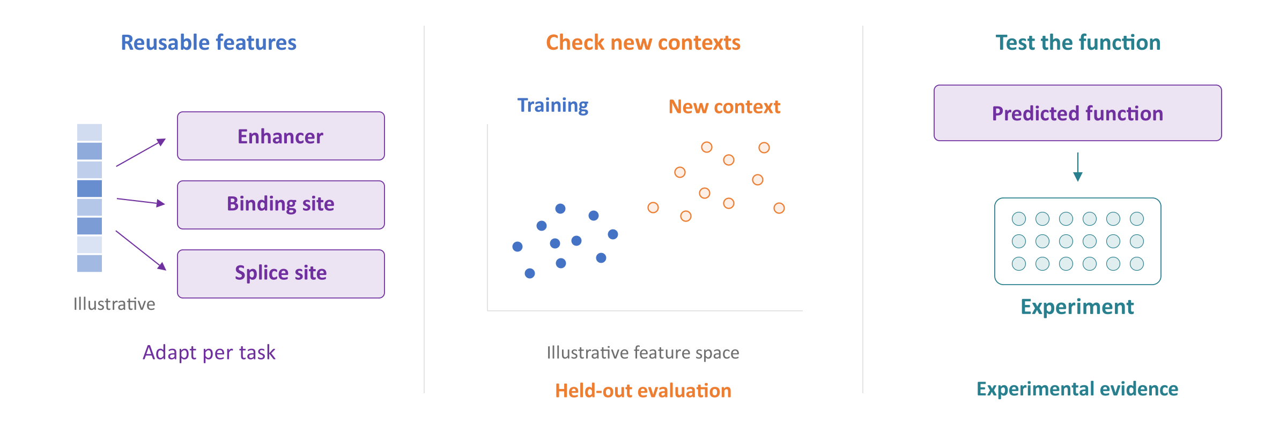
Benefits and Limitations
Pretraining can provide useful starting features for several tasks
Performance depends on training data, task, and biological context
A useful embedding is not automatically a biological explanation
Notes:
Pretraining can supply useful features, but its benefit depends on the task and available data. The middle panel illustrates a change between training examples and a new biological setting. Performance needs testing in that setting, including the relevant species and experimental labels. The right panel separates a predicted function from experimental evidence for that function. An embedding, attention weight, or learned boundary can suggest a hypothesis without establishing a causal role. Deoxyribonucleic acid (DNA) language models therefore require both careful predictive evaluation and appropriate biological validation.
Sources
DNABERT-2 paper, version 2: https://arxiv.org/abs/2306.15006v2
Nucleotide Transformer study, Nature Methods: https://www.nature.com/articles/s41592-024-02523-z
DNAChunker paper, version 4: https://arxiv.org/abs/2601.03019v4
dnaHNet paper, version 3: https://arxiv.org/abs/2602.10603v3

Slide 36
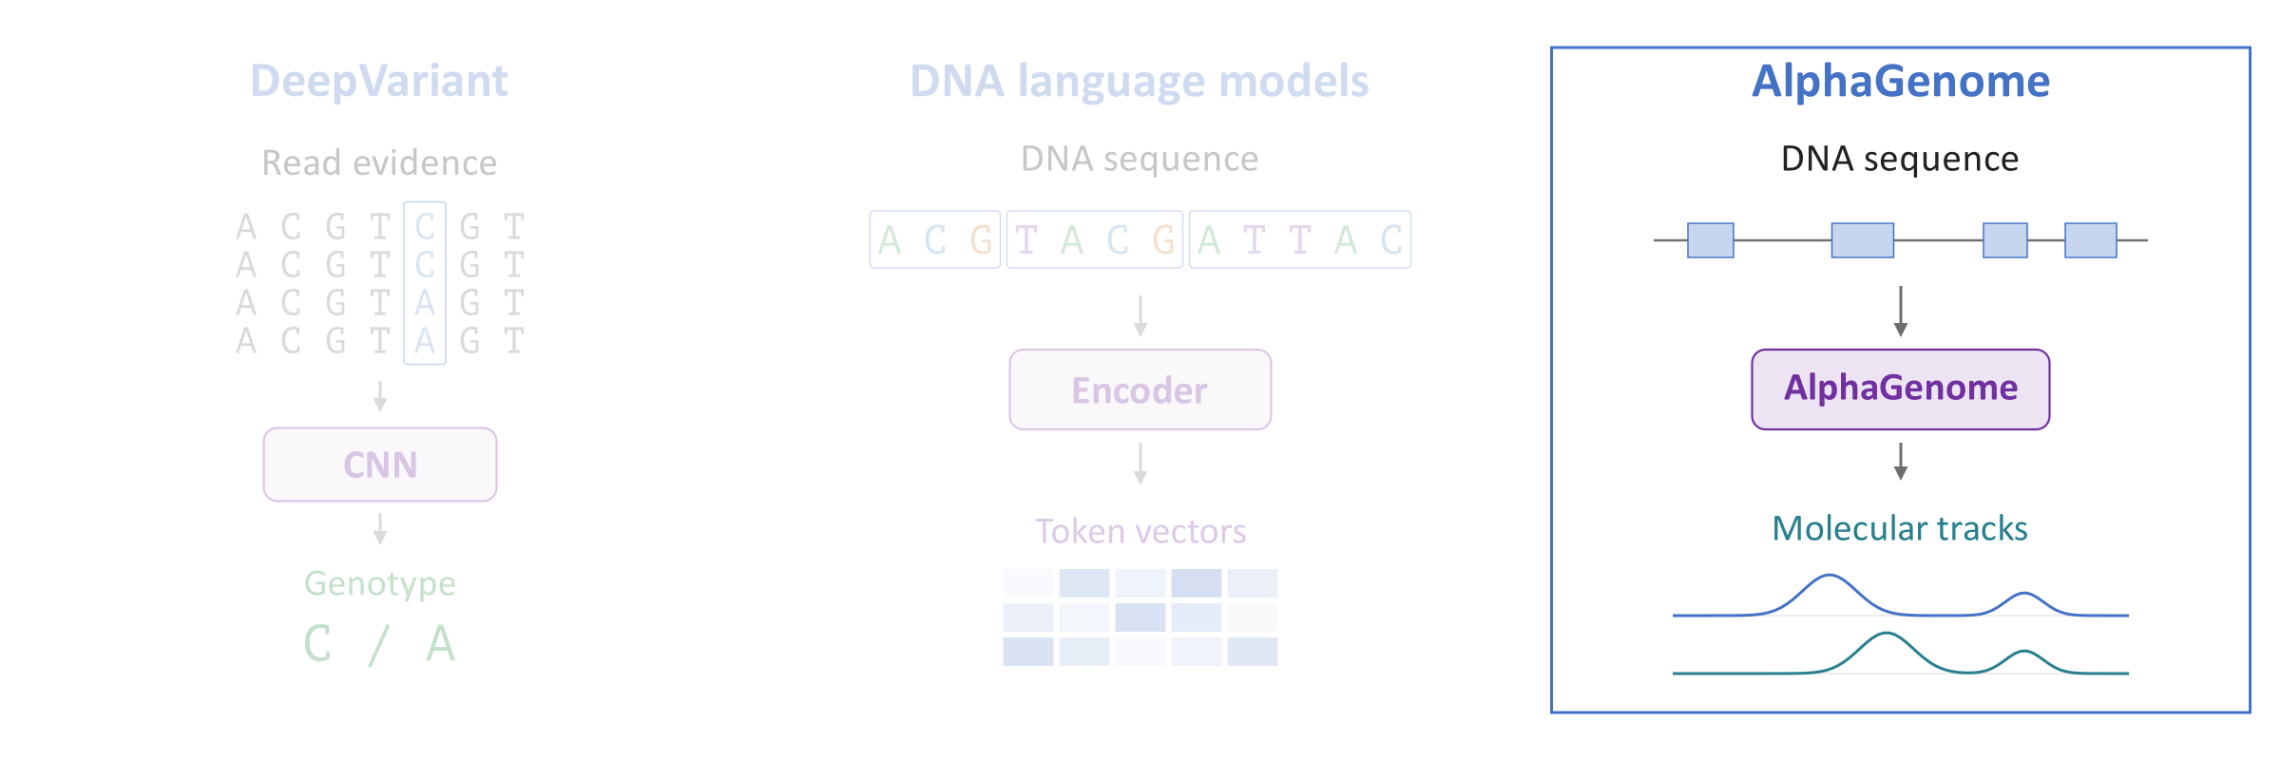
AI in Genomics
DeepVariant: Identify variants from read evidence
DNA language models: Learn reusable sequence representations
AlphaGenome: Predict molecular activity and variant effects
Notes:
AlphaGenome addresses a different training objective: predicting molecular measurements from a long deoxyribonucleic acid (DNA) sequence. Its shared sequence model feeds several output heads, producing predictions for different assays and biological contexts. We then change the sequence while keeping the model fixed and compare the predictions. This estimates how a variant may change molecular activity. It does not by itself establish a disease effect. The landmarks in this outline are explanatory annotations, not additional sequence-model inputs.
Sources
AlphaGenome: Nature paper: https://www.nature.com/articles/s41586-025-10014-0

Slide 37
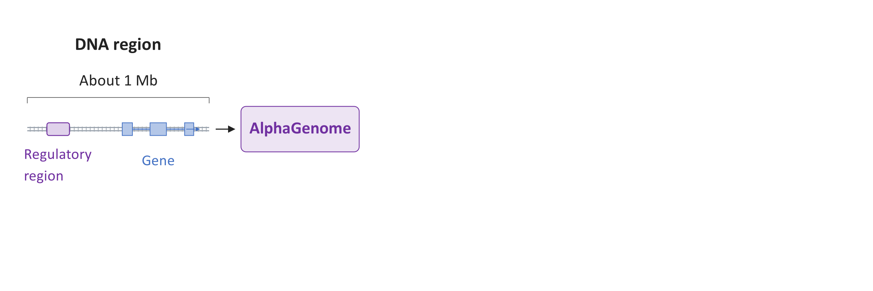
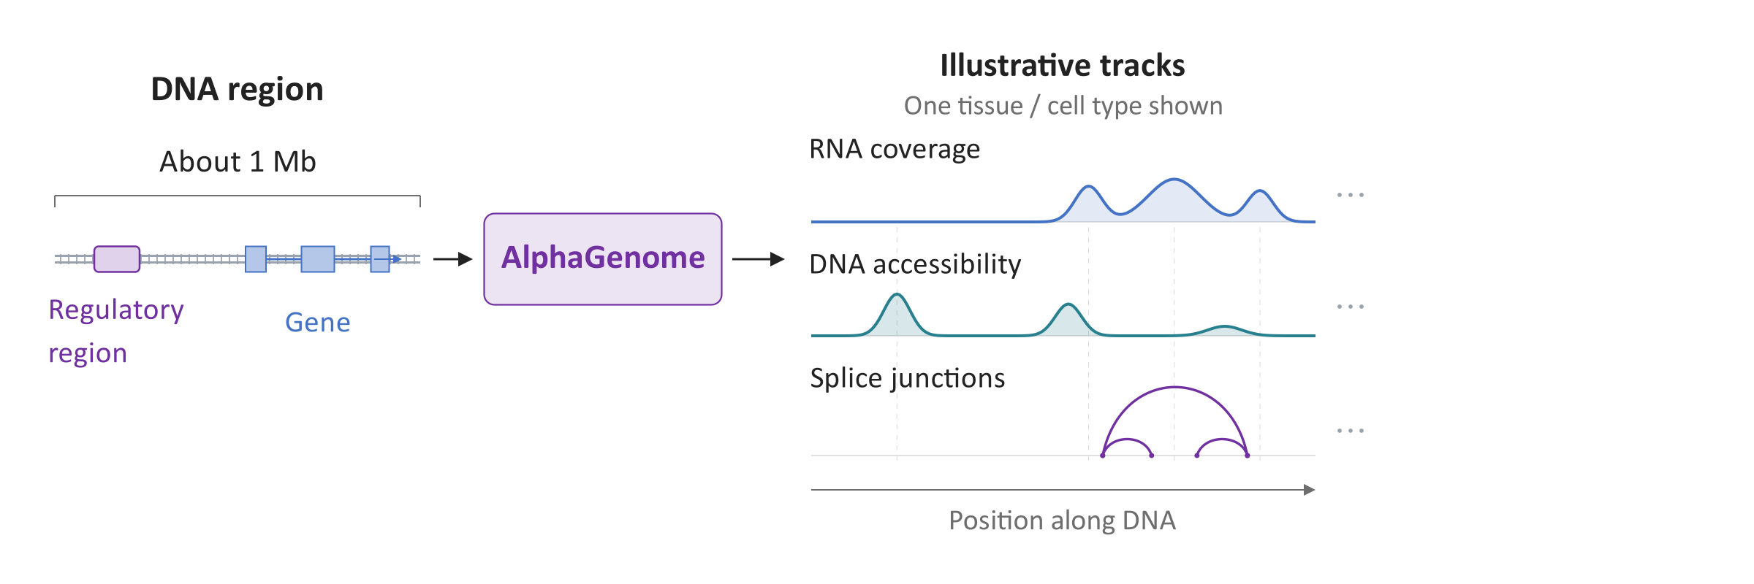
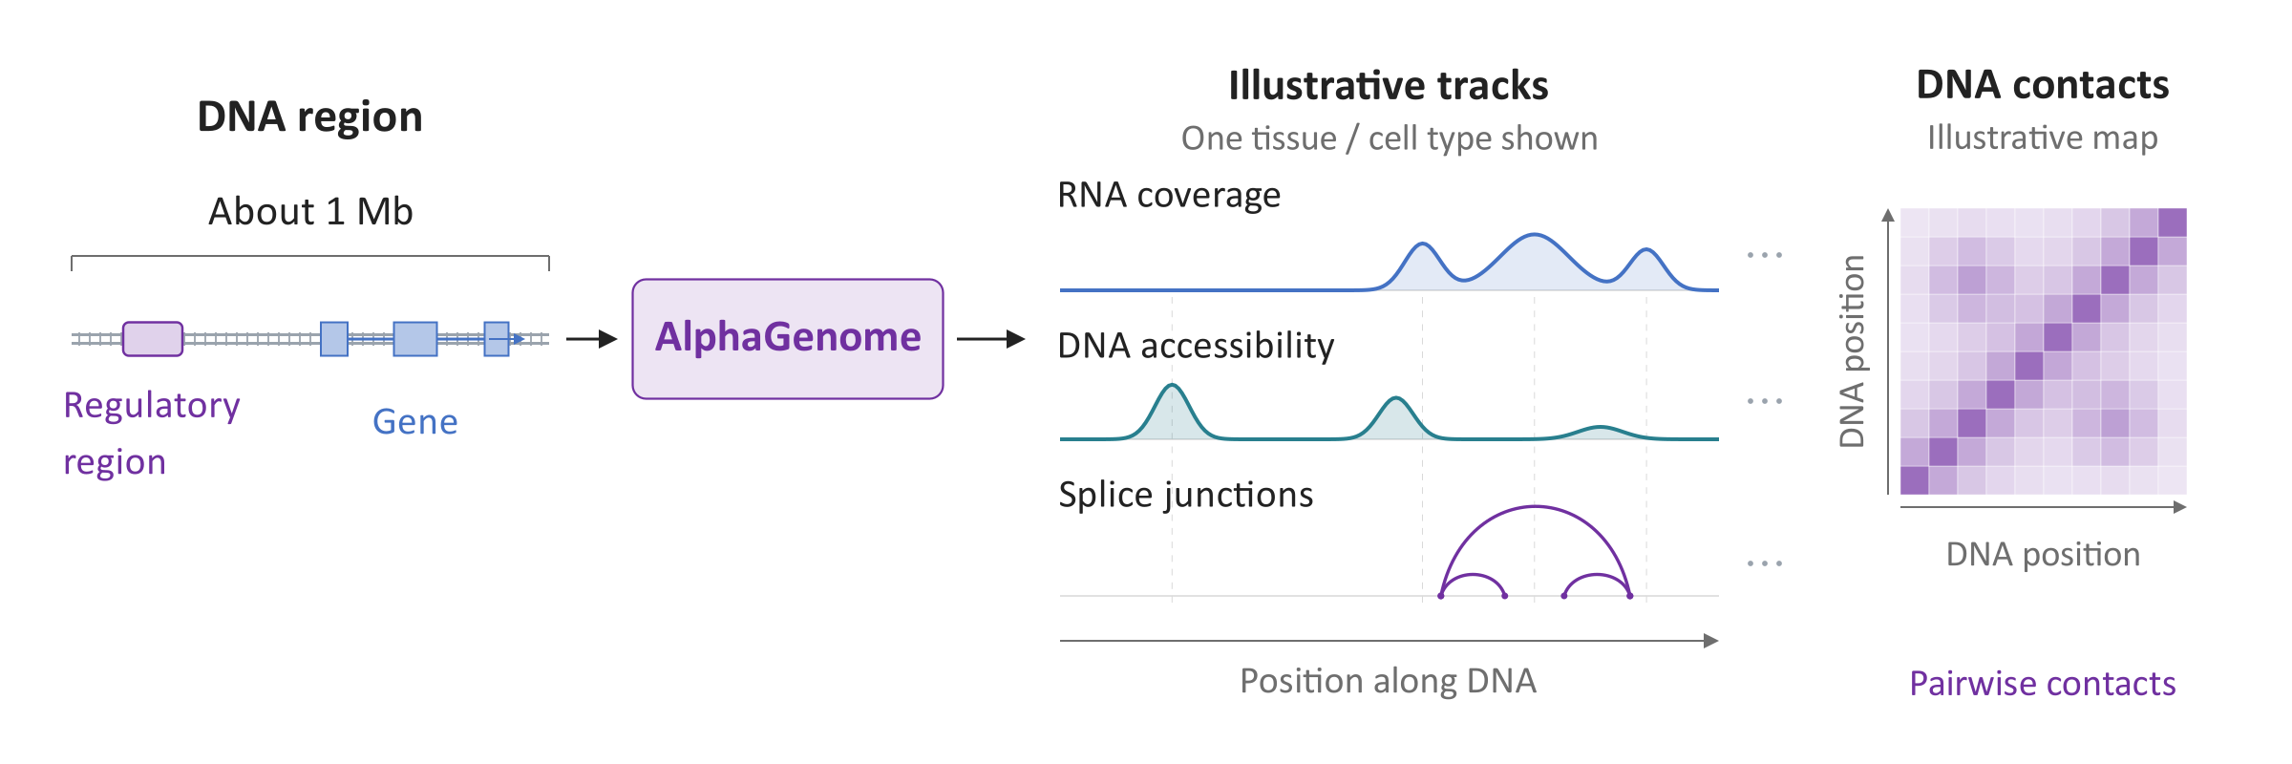
AlphaGenome: Sequence to Function
Predict molecular measurements from about one million DNA bases
Genome tracks describe activity along DNA in a tissue or cell type
Outputs include expression, splicing, accessibility, and DNA contacts
Notes:
AlphaGenome predicts molecular measurements from roughly one million deoxyribonucleic acid (DNA) bases. A genome track places experimental measurements along the genome for a particular tissue or cell type. Ribonucleic acid (RNA) coverage estimates where sequenced RNA fragments accumulate, while accessibility estimates how exposed the DNA is. Splice-junction arcs connect RNA segments after the intervening sequence is removed. Alternative arcs can represent different transcripts. A contact map predicts spatial contacts between pairs of DNA regions, with genomic position on both axes. These drawings are illustrative. Gene and regulatory annotations help explain the DNA, while the neural network receives sequence and species identity. Output resolution depends on the measurement type.
Sources

Slide 38
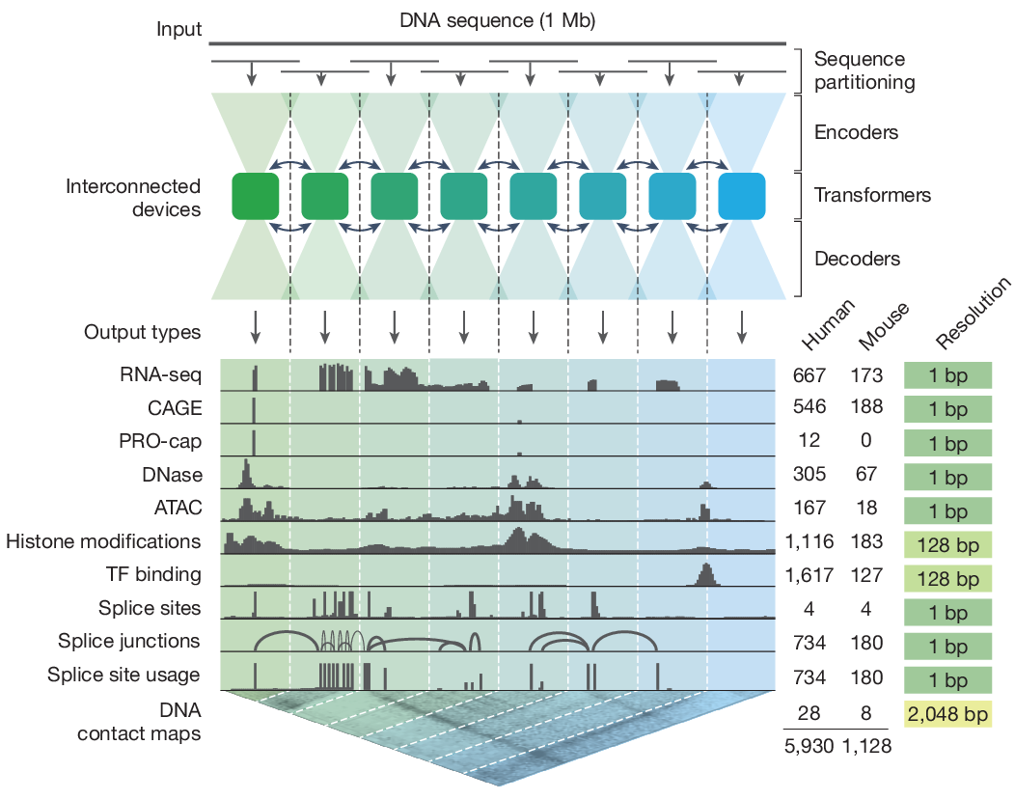
AlphaGenome: Sequence to Function
Predict molecular measurements from about one million DNA bases
Genome tracks describe activity along DNA in a tissue or cell type
Outputs include expression, splicing, accessibility, and DNA contacts
https://www.nature.com/articles/s41586-025-10014-0
Notes:
AlphaGenome paper, model description and Figures 1–2 (Nature, 2026): https://www.nature.com/articles/s41586-025-10014-0

Slide 39
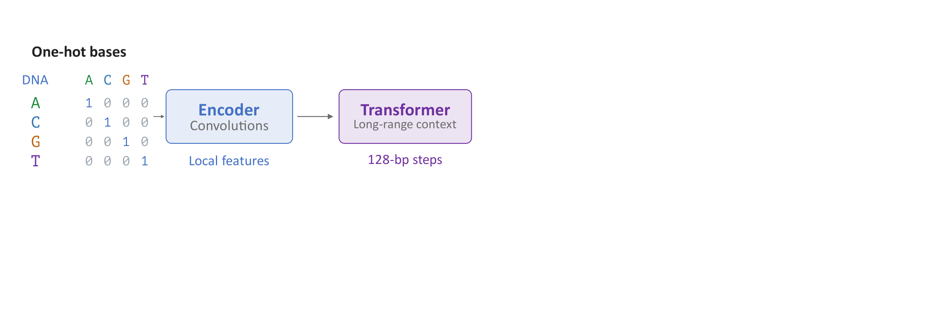
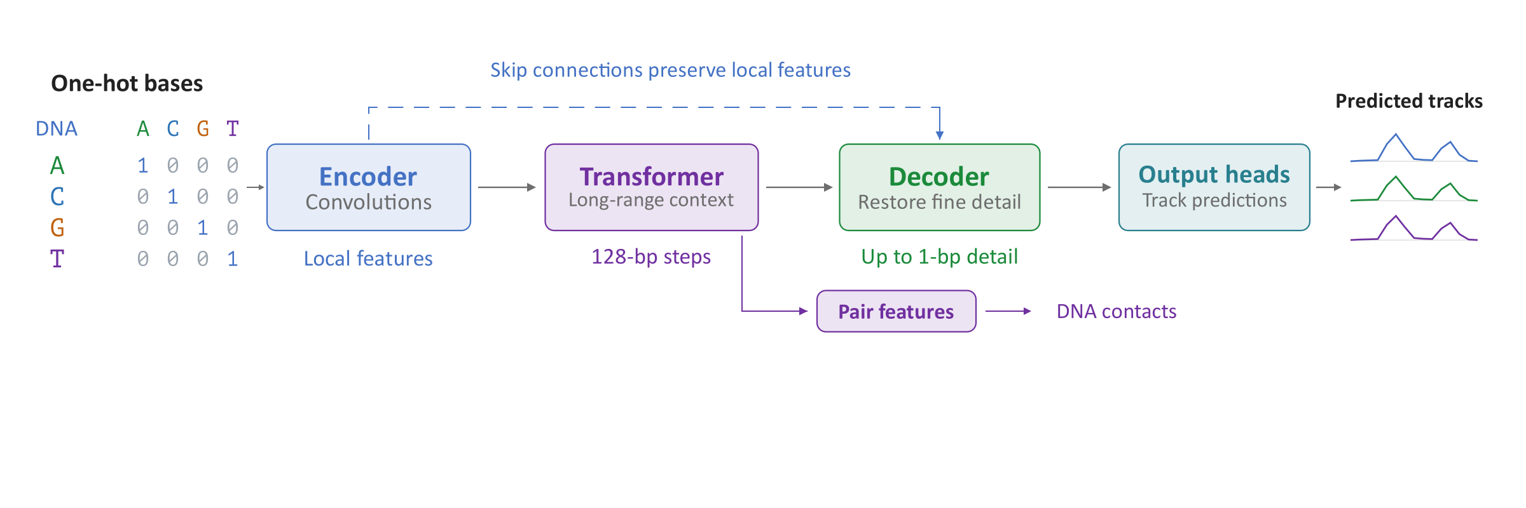
How AlphaGenome Works
A base-by-base encoding feeds convolutional and transformer layers
The decoder combines local detail with long-range context for prediction
Training fits human and mouse experimental tracks
Notes:
Each deoxyribonucleic acid (DNA) base becomes a four-number one-hot vector marking A, C, G, or T. Convolutions detect local sequence patterns and downsample to one position per 128 bases. Transformers exchange information across those positions. The decoder upsamples these representations, combining long-range context with saved encoder features through skip connections. Output heads convert the features into predicted measurements. Some outputs use single-base detail, others use coarser representations, and contact maps use paired regions. Training compares predicted and measured human and mouse tracks and updates parameters. The variant-effect model also uses distillation, learning to reproduce teacher-model predictions.
Sources
AlphaGenome paper, model description and Figures 1–2 (Nature, 2026): https://www.nature.com/articles/s41586-025-10014-0
Official AlphaGenome model architecture, pinned revision: https://github.com/google-deepmind/alphagenome_research/blob/0db53bd4352c66d1e00a049a81da373a066e6670/src/alphagenome_research/model/model.py

Slide 40
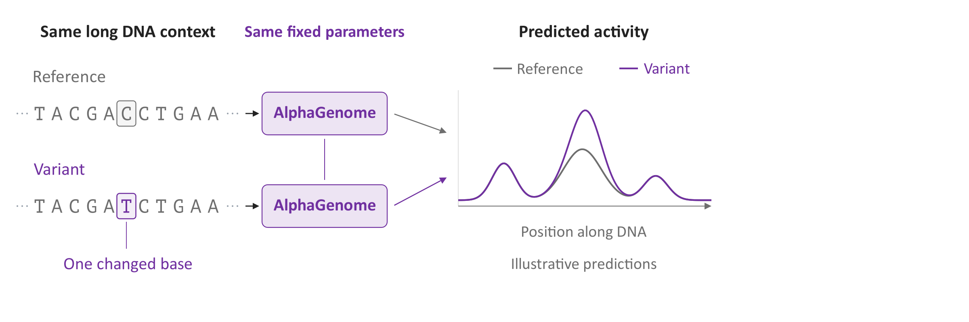
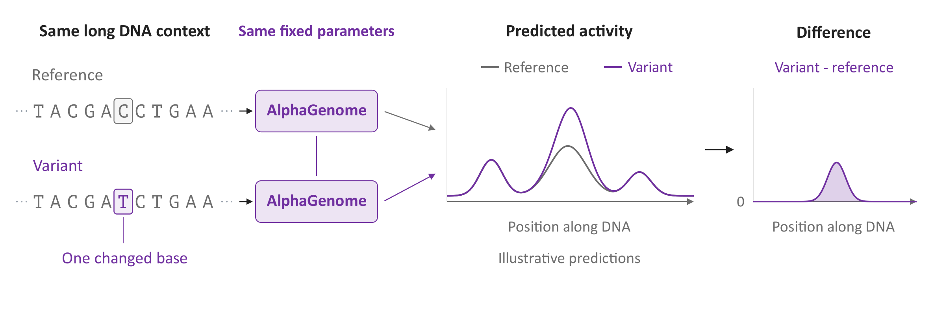
Predicting a Variant’s Effects
Change the sequence and keep the trained model fixed
Predict the same molecular tracks for reference and variant
Compare the predictions to estimate the molecular effect
Notes:
The two boxes represent the same trained model, with fixed parameters and no further training. Their reference (REF) and alternative (ALT) inputs share surrounding deoxyribonucleic acid (DNA), with only one C changed to T. The overlaid curves are illustrative predictions drawn on the same vertical scale. The last panel subtracts REF from ALT to estimate a molecular effect. Actual scoring can summarize a gene or region, rather than subtracting every plotted position. Insertions and deletions also require coordinate alignment. A molecular effect motivates follow-up, but it does not establish that a variant causes disease.
Sources
Official AlphaGenome variant-scoring guide: https://www.alphagenomedocs.com/variant_scoring.html
Official REF/ALT inference and track filtering, pinned revision: https://github.com/google-deepmind/alphagenome_research/blob/0db53bd4352c66d1e00a049a81da373a066e6670/src/alphagenome_research/model/dna_model.py
AlphaGenome paper, Discussion limitations: https://www.nature.com/articles/s41586-025-10014-0

Slide 41
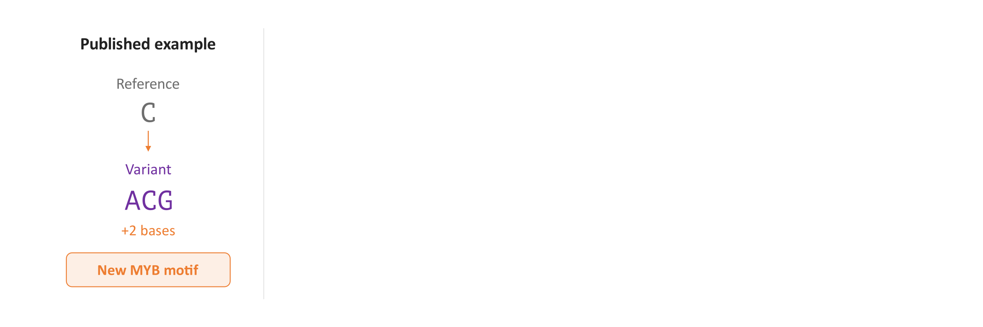
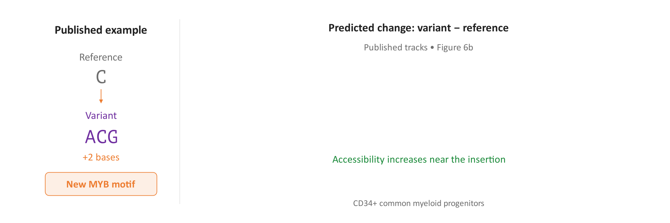
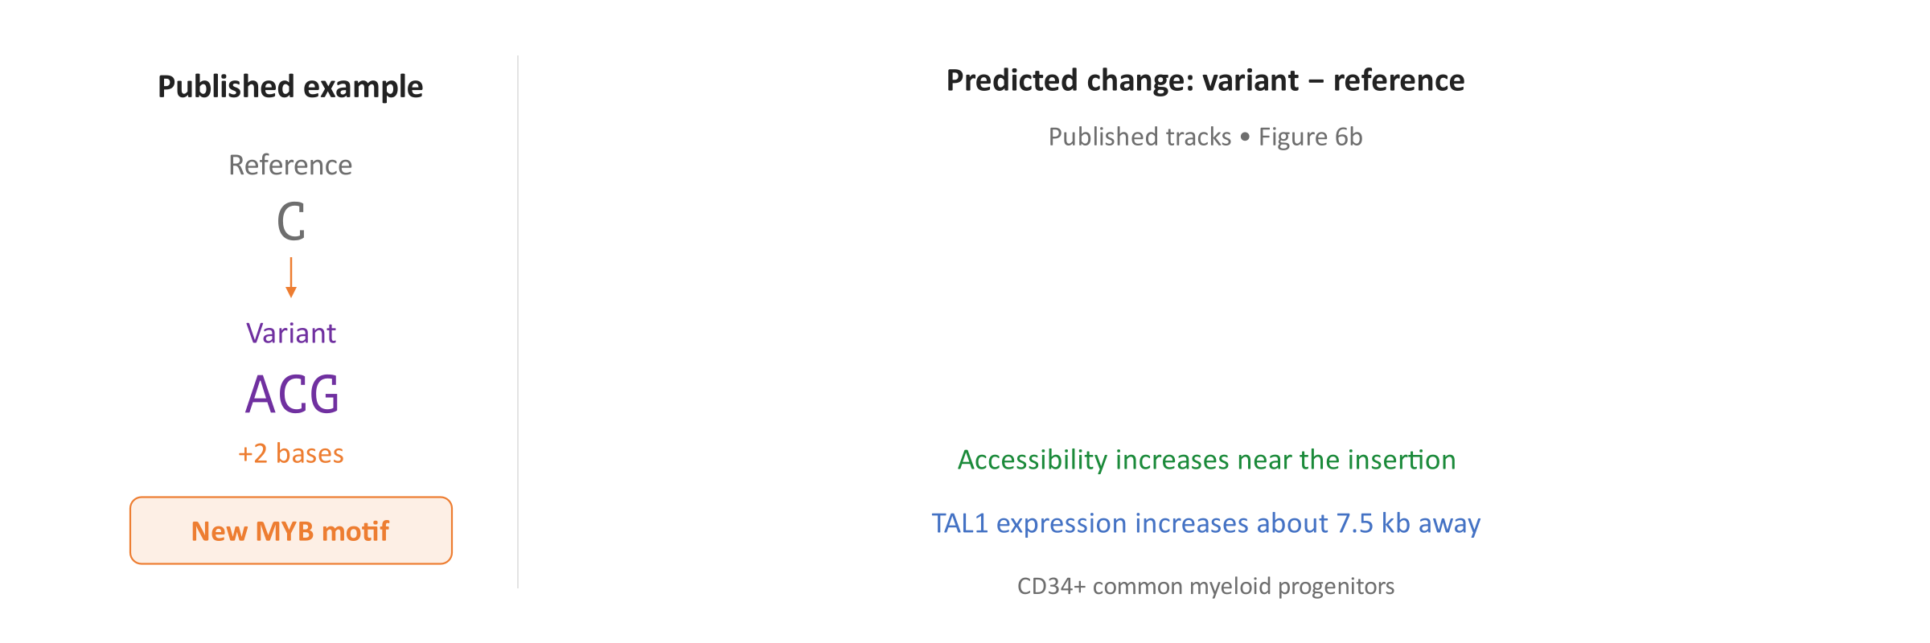
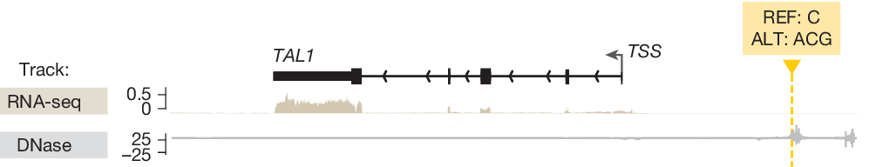
An Insertion near TAL1
A two-base insertion near TAL1 creates a binding motif for the MYB protein
The model predicts increased accessibility near the insertion
It also predicts increased TAL1 expression about 7,500 bases away
Notes:
The insertion chr1:47239296 C>ACG adds two bases near TAL1, a gene implicated in T-cell acute lymphoblastic leukemia. In the surrounding deoxyribonucleic acid (DNA), those bases create a binding motif, a sequence recognized by the MYB regulatory protein. The published Figure 6b plots predicted alternative-minus-reference differences (ALT minus REF). Increased deoxyribonuclease (DNase) assay signal indicates greater accessibility near the insertion. Increased signal from ribonucleic acid (RNA) sequencing, abbreviated RNA-seq, indicates greater TAL1 expression about 7,500 bases away. The displayed tracks refer to immature blood cells called common myeloid progenitors that express the CD34 surface marker (CD34+), the closest available context. Earlier experiments established the regulatory mechanism, and AlphaGenome reproduces some of its molecular consequences. TAL1 and MYB are established gene symbols; MYB also names the regulatory protein encoded by that gene.
Sources
AlphaGenome paper, Figure 6b/e and TAL1 case study: https://www.nature.com/articles/s41586-025-10014-0
Mansour et al. (Science, 2014), original abstract and Figure 4 caption: https://pubmed.ncbi.nlm.nih.gov/25394790/

Slide 42
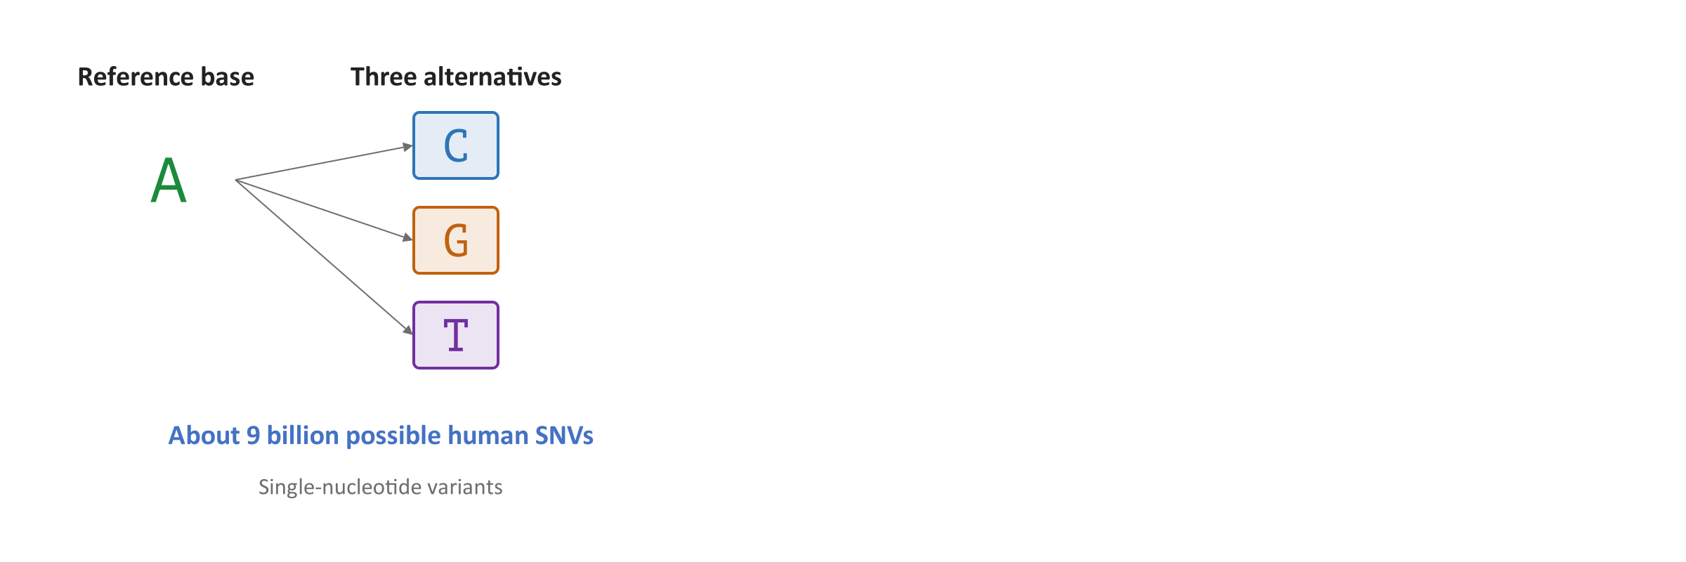
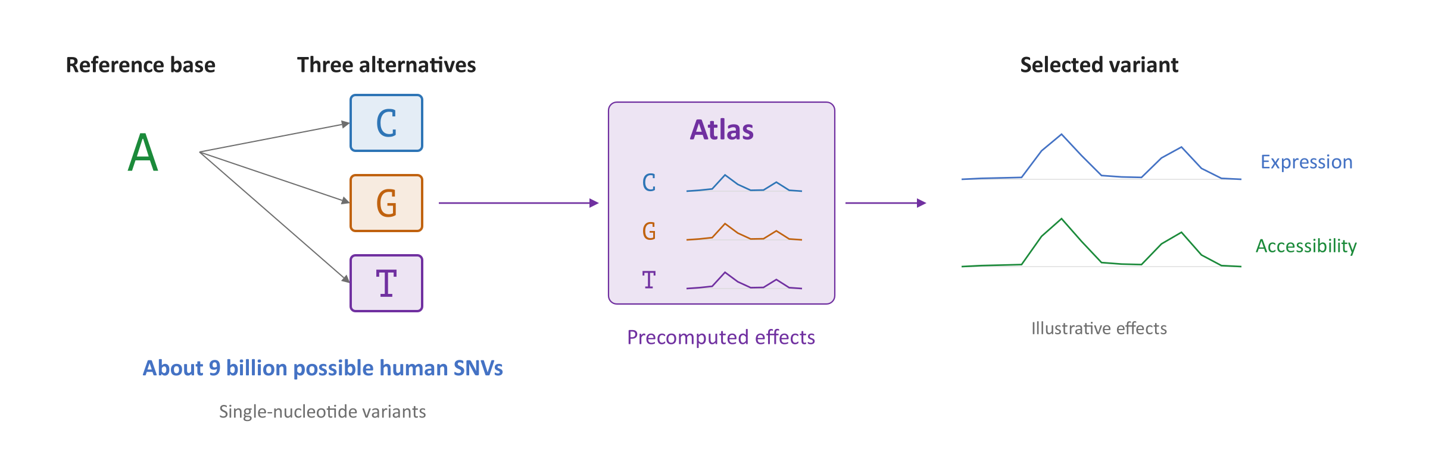
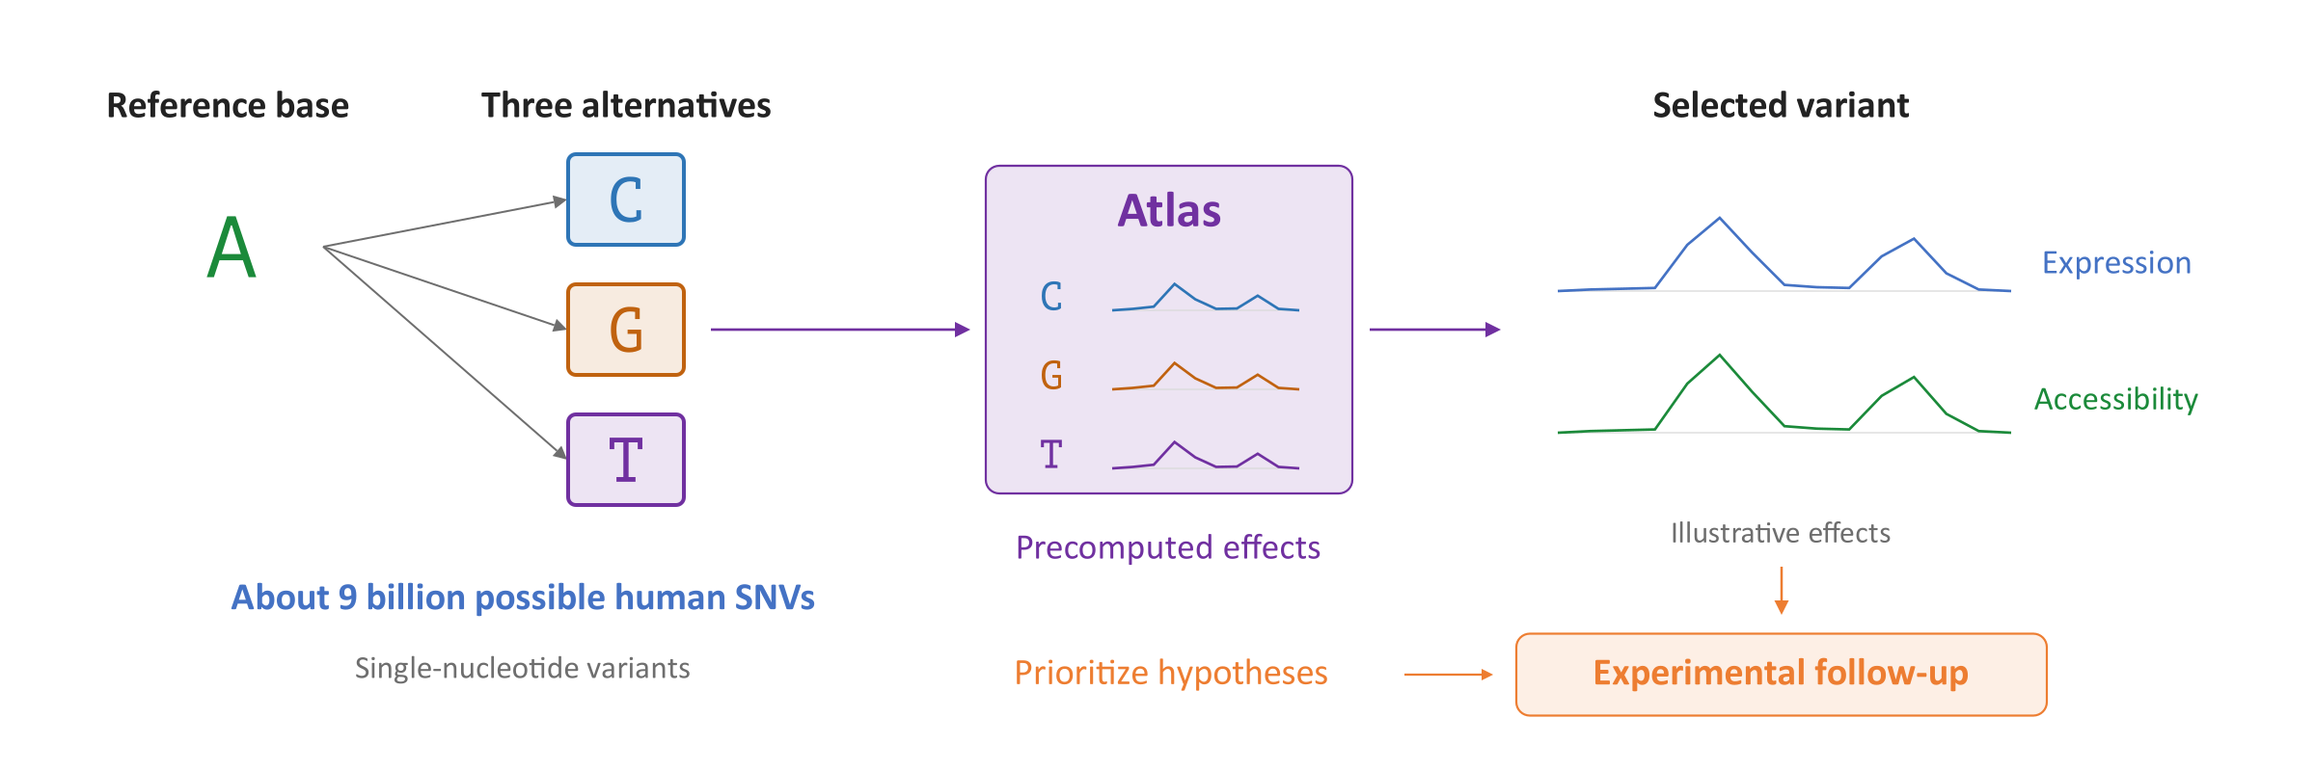
Using AlphaGenome Predictions
Atlas stores about 9 billion human single-nucleotide variant (SNV) predictions
Look up a variant to inspect predicted effects and prioritize follow-up
Cell-type coverage and distant regulatory effects remain limitations
Notes:
A single-nucleotide variant (SNV) replaces one base. Each reference base has three alternatives, explaining the roughly nine billion possible human SNVs in AlphaGenome Atlas, released on 8 September 2026. Atlas stores summarized molecular-effect scores. The curves here illustrate effects rather than stored full tracks. Its separate AlphaGenome Variant Impact (AVI) score helps rank variants and is not a disease probability. The Atlas study also scored over 100 million observed insertions and deletions. Predictions need experimental follow-up because tissue-specific effects and distant regulation, particularly beyond 100,000 bases, remain difficult.
Sources
Official AlphaGenome Atlas announcement, 8 September 2026: https://deepmind.google/blog/alphagenome-atlas-a-predictive-map-of-every-possible-dna-letter-change-in-the-human-genome/
AlphaGenome Atlas paper, pages 2–3 and scoring methods: https://storage.googleapis.com/deepmind-media/DeepMind.com/Blog/alphagenome-atlas-a-predictive-map-of-every-possible-dna-letter-change-in-the-human-genome/alphagenome-atlas.pdf
Official AlphaGenome documentation, model inference and Atlas scores: https://www.alphagenomedocs.com/
AlphaGenome paper, Discussion limitations: https://www.nature.com/articles/s41586-025-10014-0

Slide 43
Questions?

Slide 44
Next Week
Hardware Accelerators for Genomics

Slide 45
CMSC 829C: Algorithms, AI, and Hardware
for Biological Data
Lecture 6: AI in Genomics
Fall 2026
September 17, 2026
Can Firtina | canfirtina@gmail.com | cs.umd.edu/~firtina
Assistant Professor of Computer Science at University of Maryland (UMD)

Slide 46
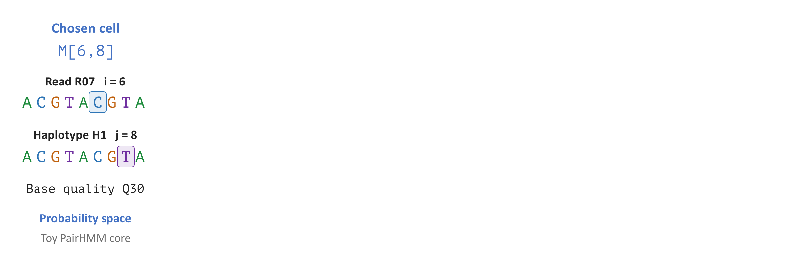
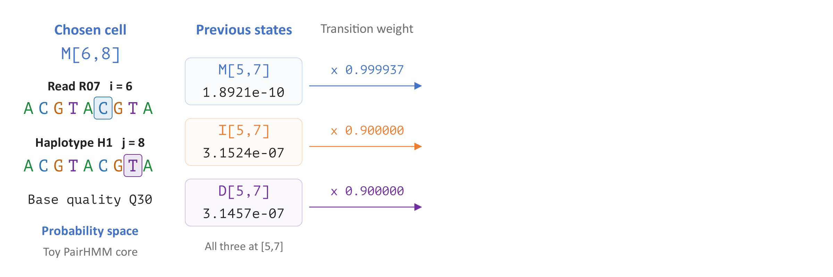
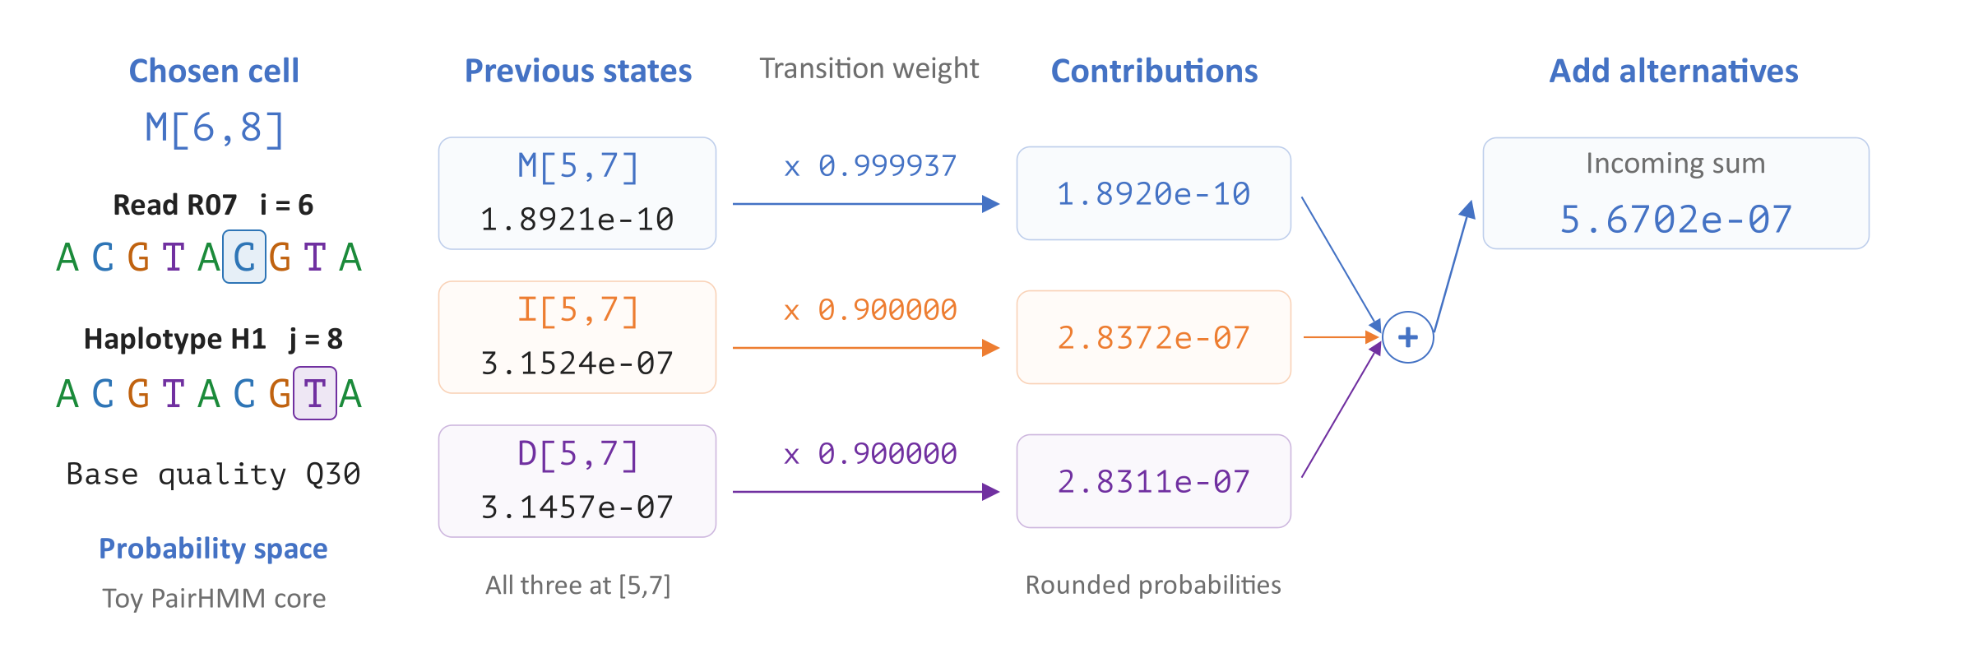
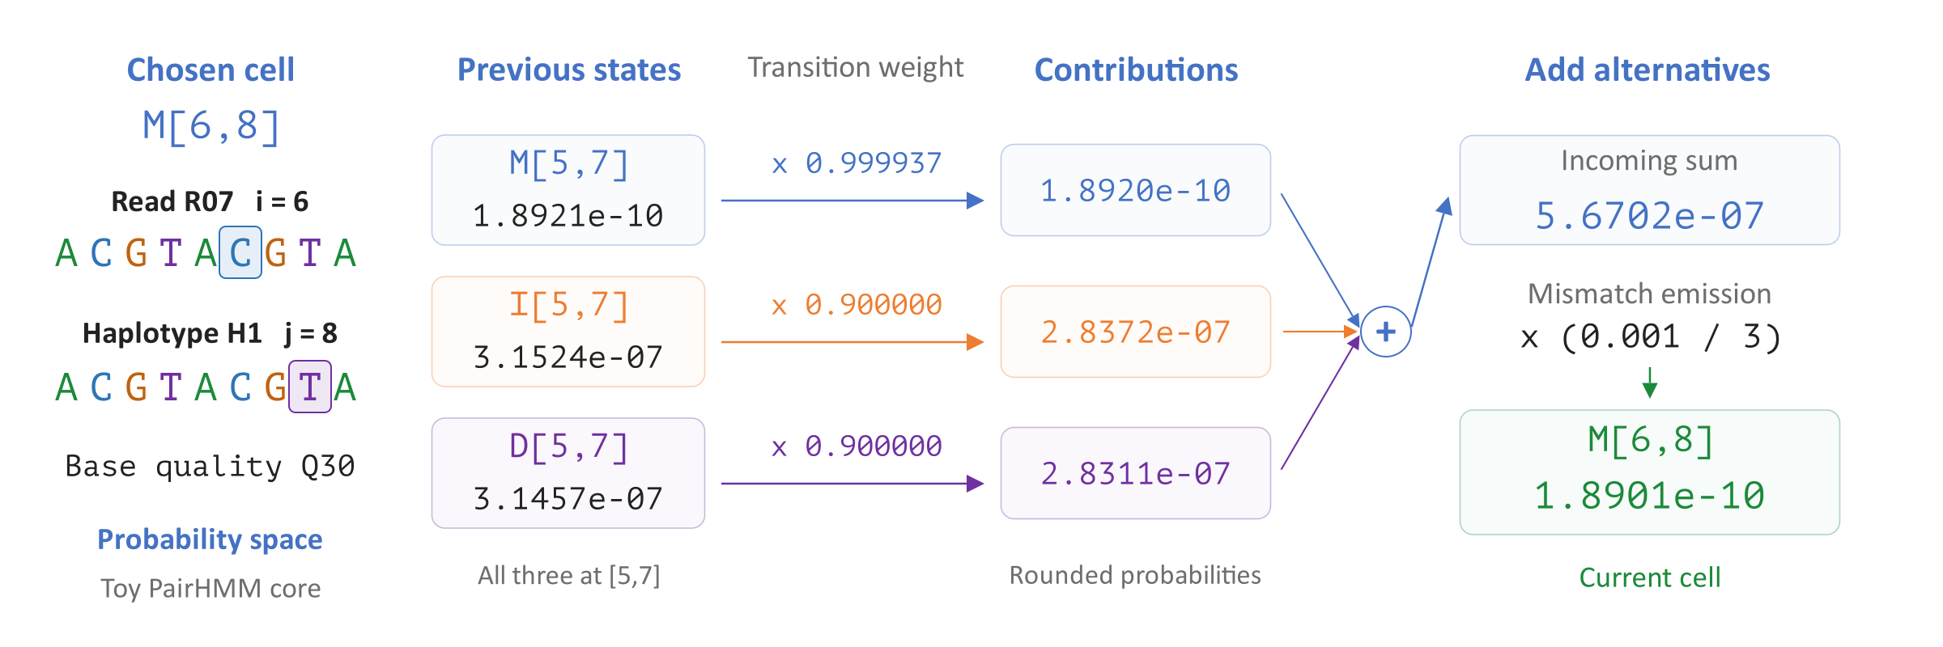
Fill One PairHMM Cell
Each dynamic programming (DP) cell sums probabilities of incoming paths
Weight predecessor states and add their contributions
Apply the base emission probability to obtain the current cell
Notes:
This pair hidden Markov model (PairHMM) uses dynamic programming (DP) to sum alignment-path probabilities. The match/mismatch state (M) consumes one read base and one haplotype base, whether they match or differ. This example expands M[6,8] for read R07 and candidate haplotype H1; these are example identifiers. Its three predecessors at [5,7] store probability mass from earlier paths. Multiplying by their transition probabilities and adding gives 5.6702e-7. At this cell, the read C aligns to haplotype T. A Phred base quality of 30 (Q30) corresponds to a base error probability of 0.001, so the mismatch emission is 0.001/3 and the resulting M value is 1.8901e-10. These computed toy values are displayed in probability space and rounded.
Sources
Genome Analysis Toolkit (GATK) 4.7.0.0: PairHMM forward recurrence and emissions: https://github.com/broadinstitute/gatk/blob/0cde69eed30339f5978cbb1ac6e5cf3662f9e1f8/src/main/java/org/broadinstitute/hellbender/utils/pairhmm/LoglessPairHMM.java#L30-L93

Slide 47




Learning from DNA
Identify promoters, DNA regions that help start transcription
Learn reusable features from genomic sequences
Adapt the model to a task using labeled examples
Notes:
The DeepVariant example used labeled data for a specific prediction task. A DNA language model first learns patterns from genome sequences and can then be trained for a task with labeled examples. The main example is Nucleotide Transformer v2, using the 50M multispecies checkpoint. The eventual task is promoter classification. A promoter is a DNA region involved in initiating transcription. All sequences, feature colors, and probabilities in the worked illustration are synthetic teaching examples.
Sources
Nucleotide Transformer, Nature Methods (2025)
Revised NT downstream tasks

Slide 48




From DNA to Model Inputs
Group DNA into nonoverlapping six-base tokens
Prepend <CLS>, a special token for classification
Convert token IDs into learned embedding vectors
Notes:
A token is one unit processed by the model. NT-v2 groups DNA into nonoverlapping six-base tokens and prepends <CLS>. The running synthetic crop is ACGTACGATTACCGTACGATGGCA, split as ACGTAC, GATTAC, CGTACG, and ATGGCA. It illustrates 24 bases of a 300-base task input and has no experimentally established promoter label. Each symbolic token ID selects a row from a learned embedding table. An embedding is a vector of numbers. The displayed vector colors are illustrative.
Sources
Official NT tokenizer
NT-v2-50M model implementation

Slide 49




The Transformer Encoder
Repeated Transformer layers build sequence context
Self-attention combines information across positions
Feed-forward layers transform each position's vector
Notes:
NT-v2 is a Transformer encoder with bidirectional self-attention. Each attention operation combines information from token positions, and a feed-forward network transforms the resulting vectors. Repeated layers produce contextual embeddings, whose values depend on the input sequence. These vectors are features rather than probabilities. The selected NT-v2-50M checkpoint has 12 layers, 512-dimensional hidden vectors, and 16 attention heads. Rotary position embeddings supply position information inside attention. The diagram abstracts normalization and residual connections.
Sources
NT-v2-50M configuration
NT-v2-50M model implementation

Slide 50




Pretraining on DNA
The original DNA supplies the training targets
Predict hidden tokens from the surrounding sequence
Prediction error guides updates to model weights
Notes:
Pretraining uses the original DNA as its own source of targets. In the illustrative crop, GATTAC is hidden and retained as the correct answer. A masked-token prediction head converts the contextual vector at that position into scores over the token vocabulary. Softmax gives a token probability distribution. The loss measures prediction error, and training updates the embedding, encoder, and prediction-head weights. Repeating this process over genomic sequences learns reusable features without promoter labels. The displayed probabilities are illustrative.
Sources
Nucleotide Transformer, Methods: Training
NT-v2-50M masked language model implementation

Slide 51




Reusing a Pretrained Model
A checkpoint stores the learned model weights
Load those weights to process a new DNA sequence
Compute contextual embeddings separately for each input
Notes:
A pretrained checkpoint contains the learned weights of the embedding table, Transformer encoder, and masked-token prediction head. Loading the checkpoint reuses those learned parameters. Contextual embeddings are computed when a particular sequence passes through the model, so a new input produces new representations. The selected checkpoint is InstaDeepAI/nucleotide-transformer-v2-50m-multi-species. A task such as promoter classification requires an appropriate output head and labeled training examples.
Sources
NT-v2-50M checkpoint
NT-v2-50M model implementation

Slide 52




Promoter Classification
Use the final contextual <CLS> vector
A new classification head produces two class scores
Softmax converts the scores into class probabilities
Notes:
The revised promoter task asks whether a 300-base human DNA sequence contains an annotated promoter. Replace the masked-token head with a new classification head. The selected implementation reads the final contextual <CLS> vector, applies a dense layer with tanh activation, and produces two logits through another dense layer. Logits are class scores, and softmax converts them into probabilities for non-promoter and promoter. The four-token crop illustrates this data flow. Its class labels and probabilities are illustrative.
Sources
NT-v2-50M sequence classification implementation
Revised promoter benchmark

Slide 53




Full Fine-Tuning
Train with sequences labeled promoter or non-promoter
Compare each prediction with its label to compute loss
Update the pretrained model and the new head together
Notes:
Full fine-tuning trains the task model on labeled sequences. Cross-entropy compares the two class scores with the correct label. The resulting training signal updates all active parameters, including the pretrained embedding table and Transformer encoder together with the new classification head. This teaching example adapts the official regular fine-tuning workflow, originally demonstrated with NT-500M-human-ref, to NT-v2-50M and the revised promoter dataset. No performance result is claimed for this adaptation.
Sources
Official regular NT fine-tuning notebook
NT-v2-50M classifier and loss implementation
Revised promoter benchmark

Slide 54




Prediction and Evaluation
Evaluate on sequences excluded from fine-tuning
Inference uses trained weights without updating them
Compare predictions with held-out labels
Notes:
Inference means making predictions with the trained model. A DNA sequence passes through tokenization, the embedding table, the encoder, and the classifier without changing the weights. Test labels are used to evaluate predictions. The published revised benchmark reserves chromosomes 20 and 21 for downstream testing. Held out here refers to supervised task training and does not establish that a sequence was absent from pretraining. The illustrated predictions are synthetic examples rather than a measured evaluation.
Sources
Nucleotide Transformer, Methods: Dataset splits
Revised NT downstream tasks
NT-v2-50M sequence classification implementation

Slide 55




Predicting the Next Base
NT-v2 predicts masked tokens using both sides
Evo 2 predicts the next base from the preceding sequence
Append a predicted base and repeat to generate DNA
Notes:
Masked language modeling and next-base prediction use different training targets. NT-v2 can use tokens on both sides of a masked position. Evo 2 is trained autoregressively at single-nucleotide resolution, predicting the next base from the available prefix. Repeated next-base predictions support sequence generation. Its StripedHyena 2 architecture combines convolutional sequence operators with attention. The distribution over A, C, G, and T and the appended base are illustrative. A sequence probability is not a probability that the sequence has a particular biological function.
Sources
Evo 2, Nature (2026)
Official Evo 2 repository
Nucleotide Transformer, Methods: Models

