Slide 1
CMSC 829C: Algorithms, AI, and Hardware
for Biological Data
Lecture 5: Genome Assembly
Fall 2026
September 15, 2026
Can Firtina | canfirtina@gmail.com | cs.umd.edu/~firtina
Assistant Professor of Computer Science at UMD

Slide 2
Agenda
From overlapping reads to contigs
  Overlap graphs, cleaning, consensus and scaffolding
Assembly with de Bruijn graphs
Modern assembly and how to evaluate it

Slide 3
Genome Assembly
Reconstruct genomic sequence from overlapping reads
A contig is one continuous assembled sequence
Reads
Contig
Notes:
Assembly reconstructs sequence from overlapping reads without a reference. A contig is one continuous assembled sequence, and a chromosome may end up as several. Colors mark shared sequence, not bases.

Slide 4
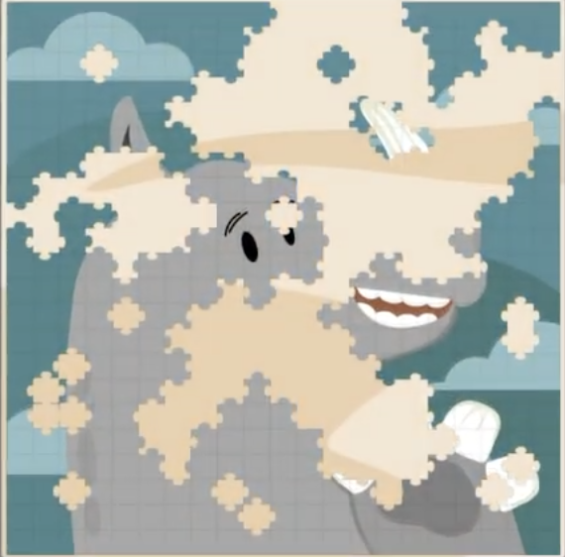
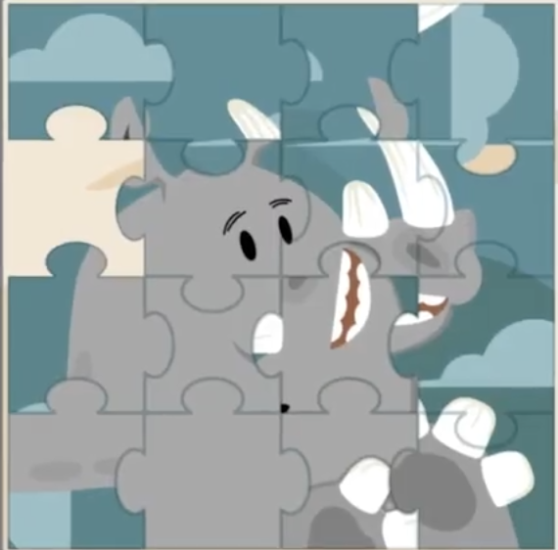
Read Length, Accuracy and Coverage
Small puzzle pieces
Short reads
Large puzzle pieces
Long reads
Either way, every position must be read, ideally several times
Accurate local sequence
Repeats can exceed read length
Longer reads can span repeats
Accuracy depends on the technology
Notes:
Long reads span repeats. Accuracy depends on chemistry and basecalling; HiFi and recent ONT reads are accurate. Either way every position must be read, ideally several times.

Slide 5
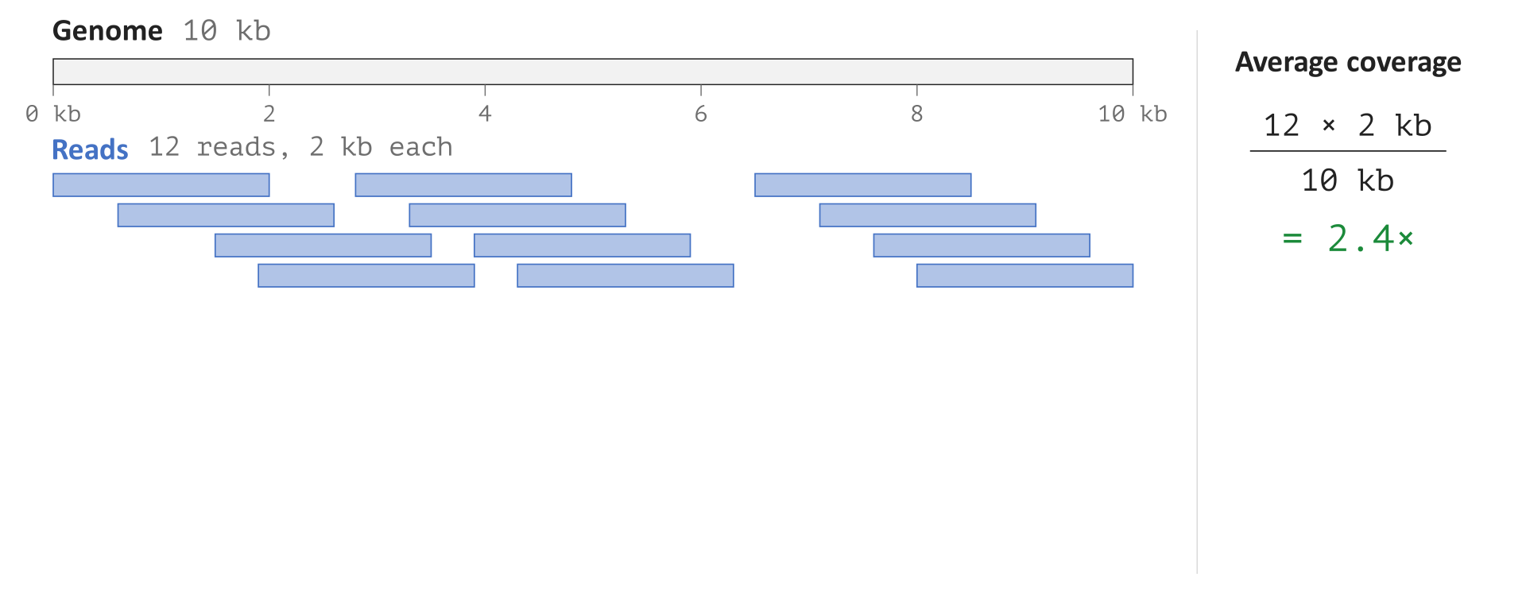
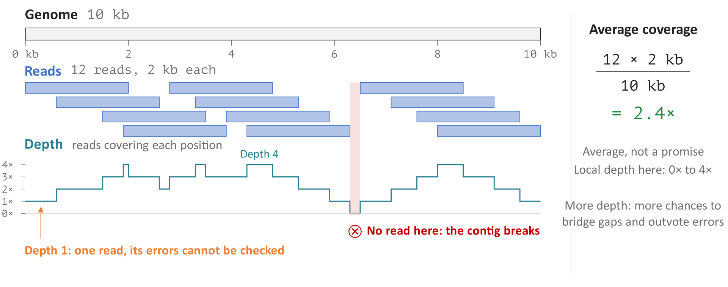
Coverage: How Many Reads Cover a Position
Average coverage is total read bases divided by genome length
Local depth varies: gaps break contigs, single reads go unchecked
Notes:
Toy numbers: 12 reads of 2 kb on a 10 kb genome give 2.4x on average, yet one position is uncovered and one stretch has a single read. Depth is not repeat copy number.

Slide 6
From Reads to an Assembly
DNA Molecules
Sequencing
Reads
Overlap
Layout
Consensus
Notes:
Schematic overlap, layout and consensus. The assembler does not know the true order; the rotation stands for reverse complementation; contained copies leave the layout but still support consensus.

Slide 7
Overlap, Layout and Consensus
Input
Reads
FASTQ: read sequences and base qualities
Find overlaps
PAF: read pairs, strand, aligned coordinates
Graph and layout
GFA: nodes, arcs, unitig paths
Output
Consensus contigs
FASTA: contig sequences
Optional
Polish / scaffold
Analysis
Notes:
A conceptual pipeline, not every assembler's order. Read correction may precede the graph, consensus and polishing can merge, and scaffolding uses other evidence.

Slide 8
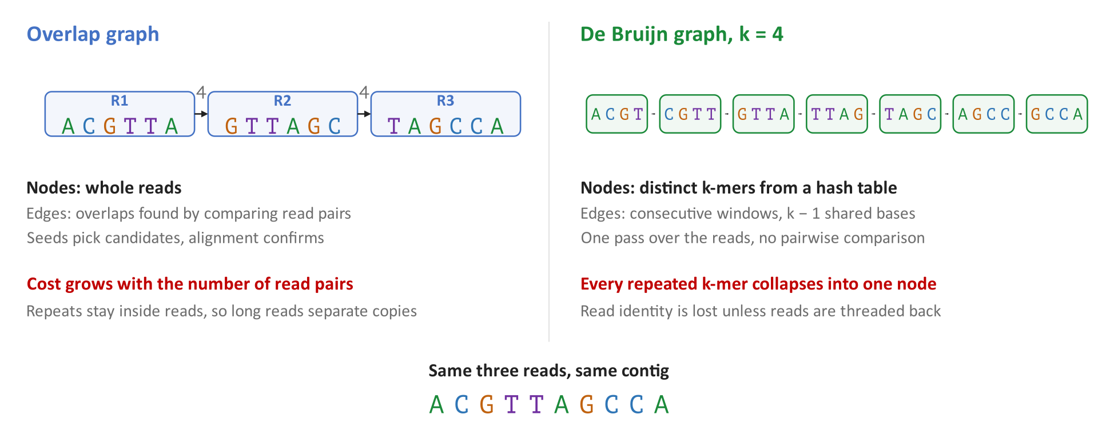
Two Ways to Build an Assembly Graph
Overlap graphs: connect whole reads through overlaps
De Bruijn graphs: connect k-mers (DNA words of length k)
Notes:
Begin with whole-read overlap graphs, highlighted on the left. The right panel previews assembly from DNA words of length k. Both diagrams use the same three toy reads and spell the same sequence. The following slides work through the overlap approach.

Slide 9
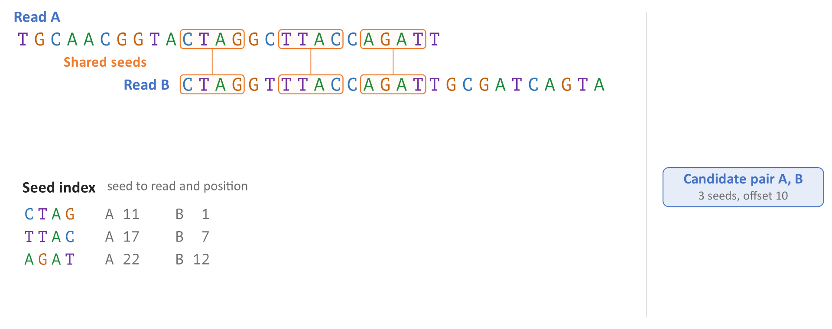
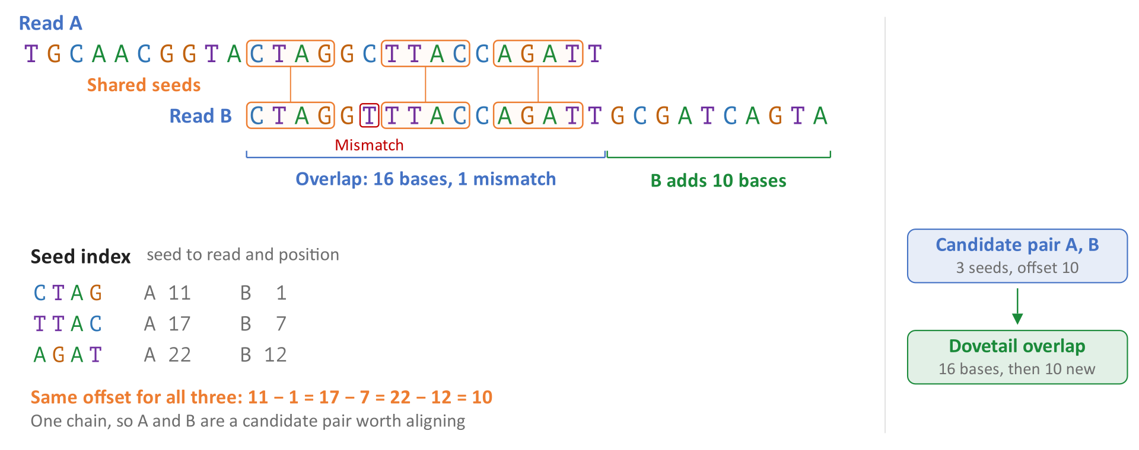
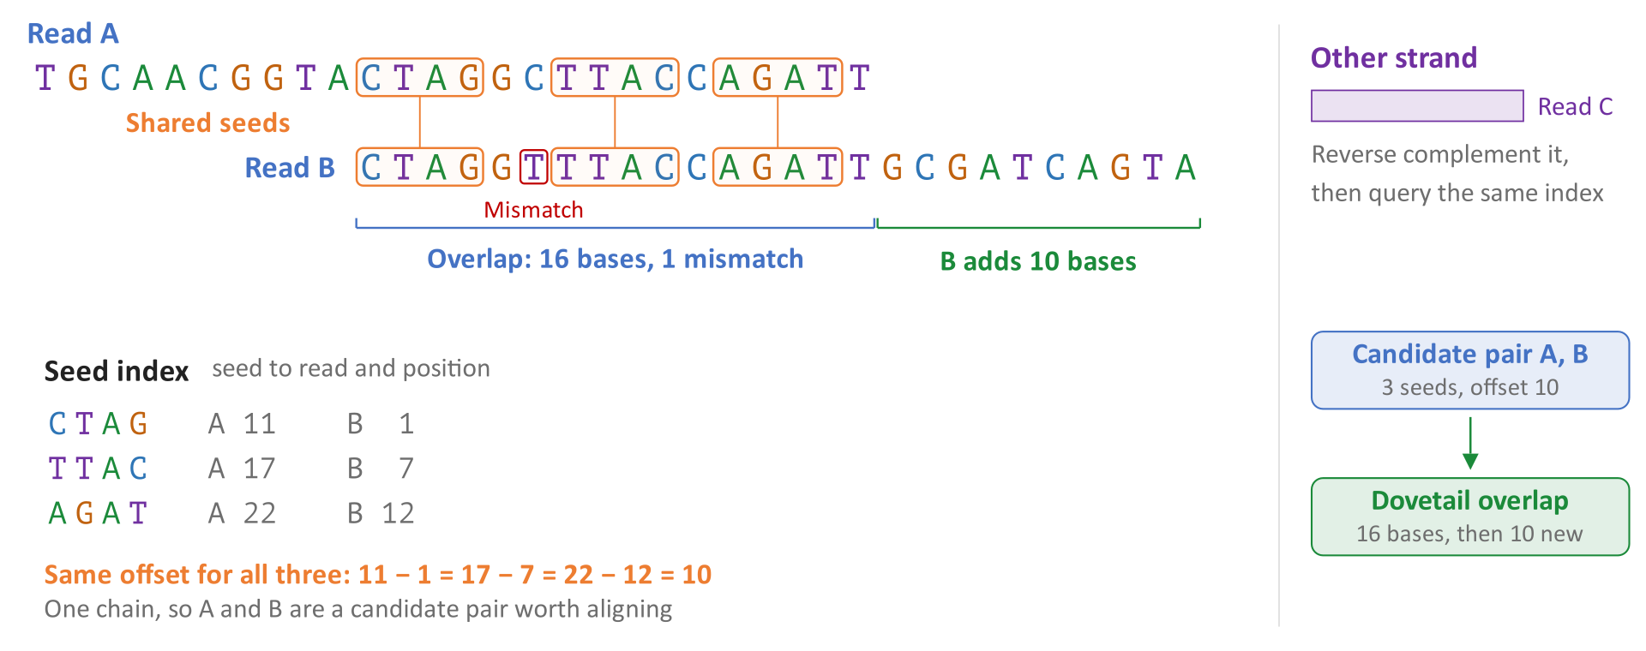
Finding Overlapping Reads
Find candidate read pairs using shared seeds
Chain matching seeds and estimate the overlap
Account for the reverse-complement orientation
Notes:
Seed, chain, align, now read against read. Toy: three shared 4-mers at one offset give a 16-base overlap with one mismatch. Minimap2 in ava mode writes such candidates as PAF for miniasm.

Slide 10
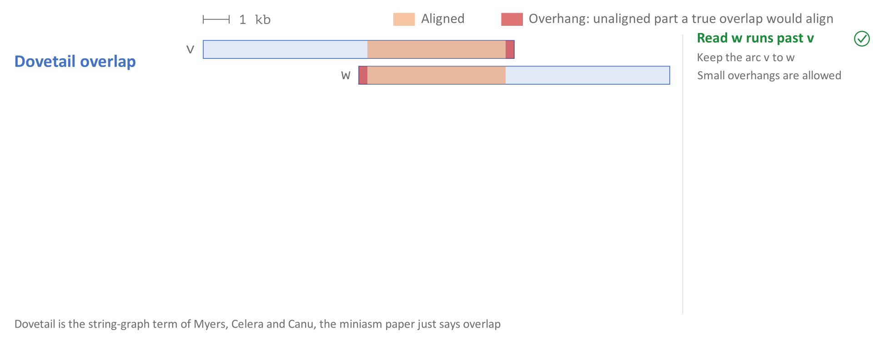
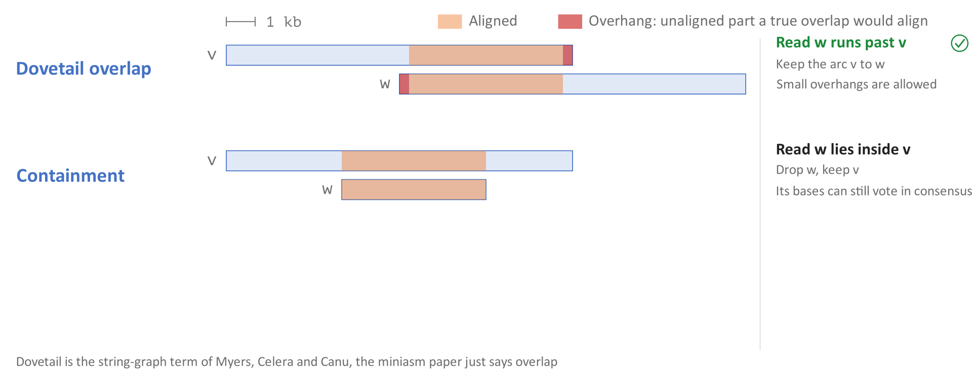
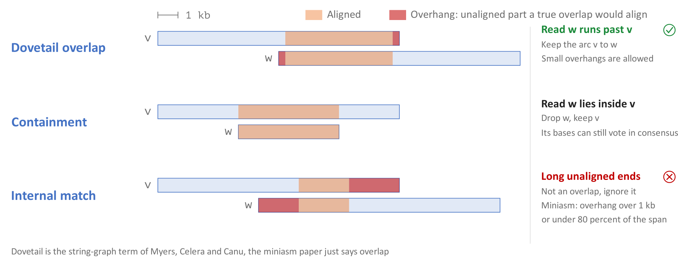
Which Matches Extend a Read?
Compare the aligned region with what lies beyond it on each read
Only informative (dovetail) overlaps become arcs of the graph
Notes:
Overhang: sequence beyond the aligned region that a true overlap would also align. Miniasm calls a mapping internal when an overhang exceeds 1 kb or the aligned span is under 80 percent (-h, -I). Dovetail is Myers' term; miniasm says overlap.

Slide 11
Reads as an Overlap Graph
Nodes represent oriented reads
Edges represent informative overlaps
4
R1
A
C
G
T
T
A
R1
R2
R2
G
T
T
A
G
C
4
2
R3
T
A
G
C
C
A
R3
Minimum overlap: 2 bases
Notes:
Exact toy with minimum overlap 2: R1 to R2 and R2 to R3 overlap by 4, R1 to R3 by 2. Labels are overlap lengths; real graphs also hold reverse complements.

Slide 12
Removing a Transitive Overlap
Both routes add the same sequence after R1
Before
After
R1
+GC
R2
+CA
R3
R1
+GC
R2
+CA
R3
A
C
G
T
T
A
G
T
T
A
G
C
T
A
G
C
C
A
A
C
G
T
T
A
G
T
T
A
G
C
T
A
G
C
C
A
+GCCA
Direct
GCCA
Contig
Via R2
GC + CA = GCCA
A
C
G
T
T
A
G
C
C
A
The reduced graph is Myers' string graph: each arc spells only the bases it adds
Notes:
The direct arc adds GCCA, the route via R2 adds GC then CA: the same extension, so the arc is redundant. Myers calls the reduced, containment-free graph a string graph; miniasm uses a 1 kb fuzz.

Slide 13
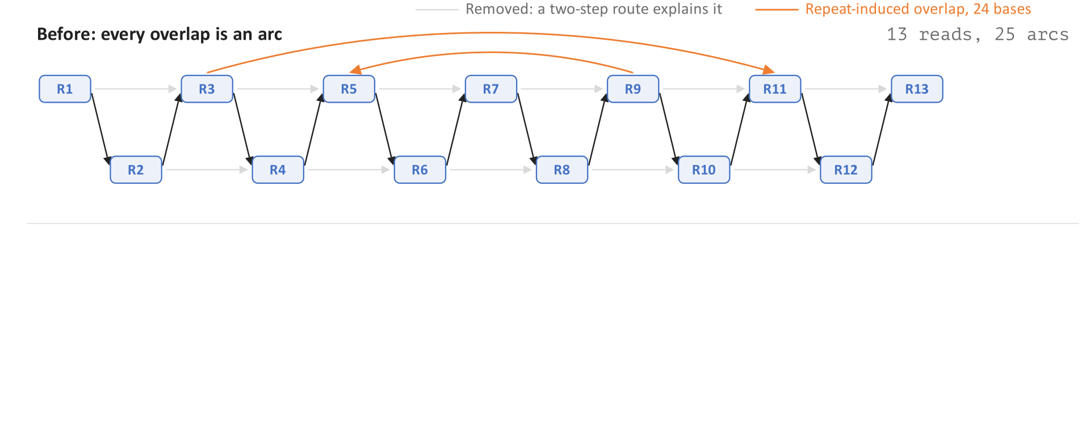
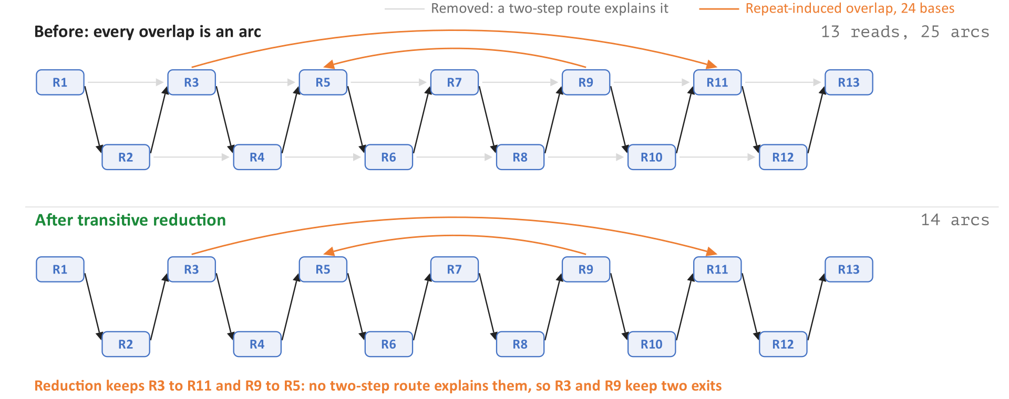
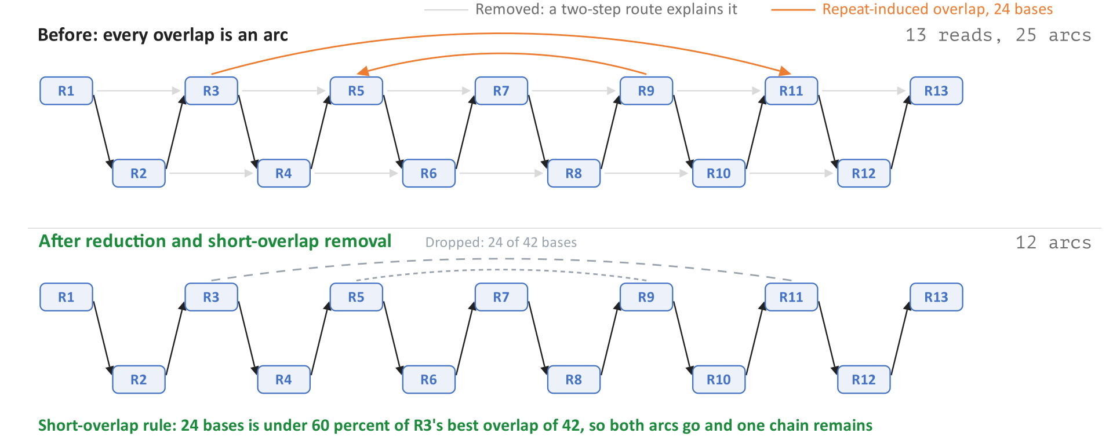
Graph Simplification
Remove redundant edges while preserving sequence relationships
Repeat-induced overlaps survive: no two-step route explains them
Miniasm then drops arcs much shorter than a read's best overlap
Notes:
Simulated 13 reads with two identical repeat copies. Reduction removes only arcs explained by a two-step route, so the two repeat-induced arcs stay; miniasm's short-overlap rule then drops them (24 of 42 bases).

Slide 14
Short Dead Ends in the Graph
A tip is a short branch that stops early
Trimming suspicious tips is a heuristic
Short dead end
Miniasm cuts a dead end made of fewer than 4 reads (-e 4)
A short end can also be real sequence
Notes:
A tip is a dead end; miniasm removes dead-end paths of fewer than 4 reads. Short ends can also be real sequence, so trimming is a heuristic.

Slide 15
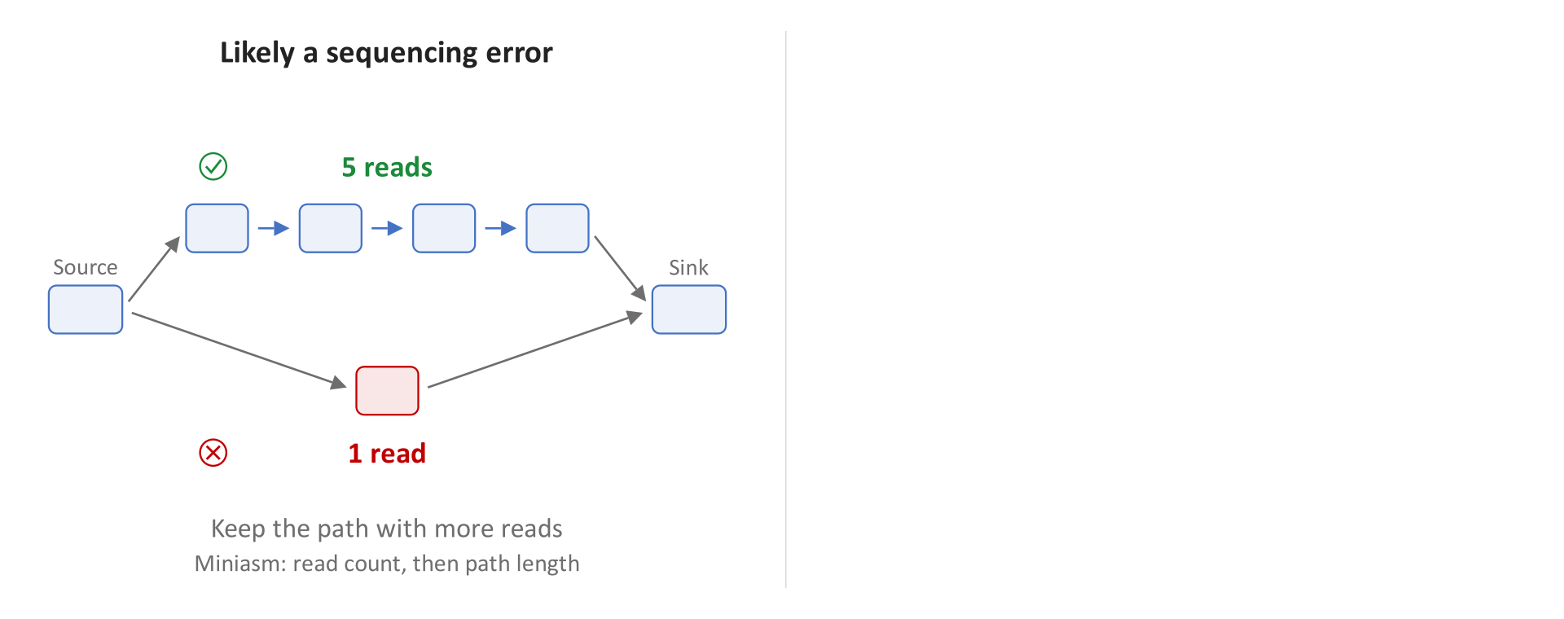
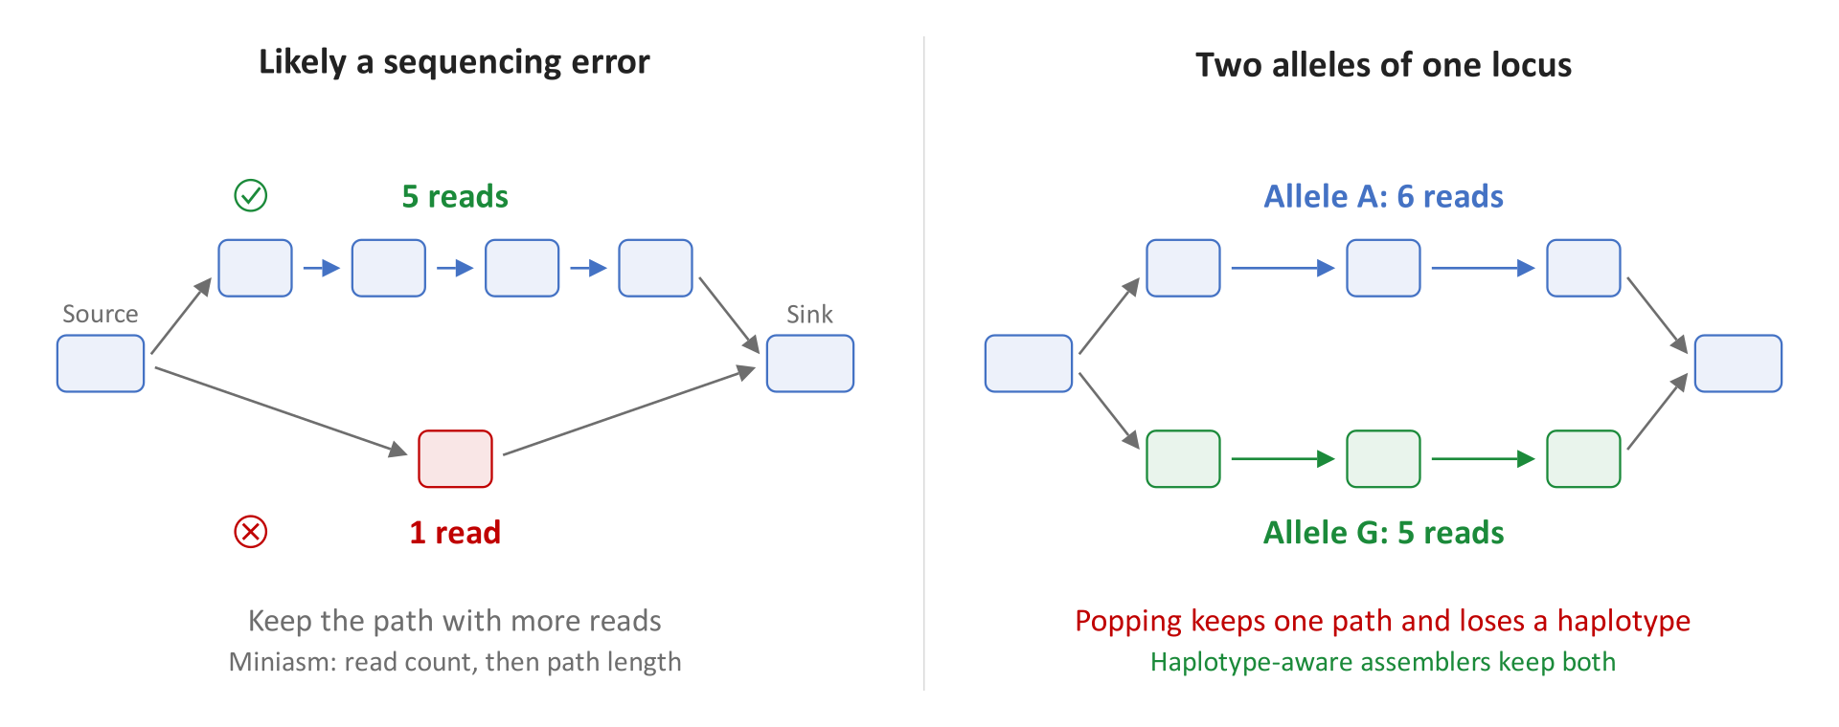
Bubbles: Errors or Real Variants
Alternative paths can share a source and a sink
Sequencing errors and real alleles look alike, yet need different treatment
Notes:
Miniasm keeps the bubble path with more reads, ties broken by length, so it also pops a 6-versus-5 allele bubble and loses a haplotype. Haplotype-aware assemblers keep both.

Slide 16
From Nonbranching Paths to Unitigs
Continue while each internal step has one way in and one way out
Compact the maximal unambiguous path
R4
R1
R2
R3
Branch
Unitig
R5
Notes:
Merge while the first read has one exit and the next one entrance; stop at R3. Unambiguous in the graph does not mean biologically correct; circular unitigs exist.

Slide 17
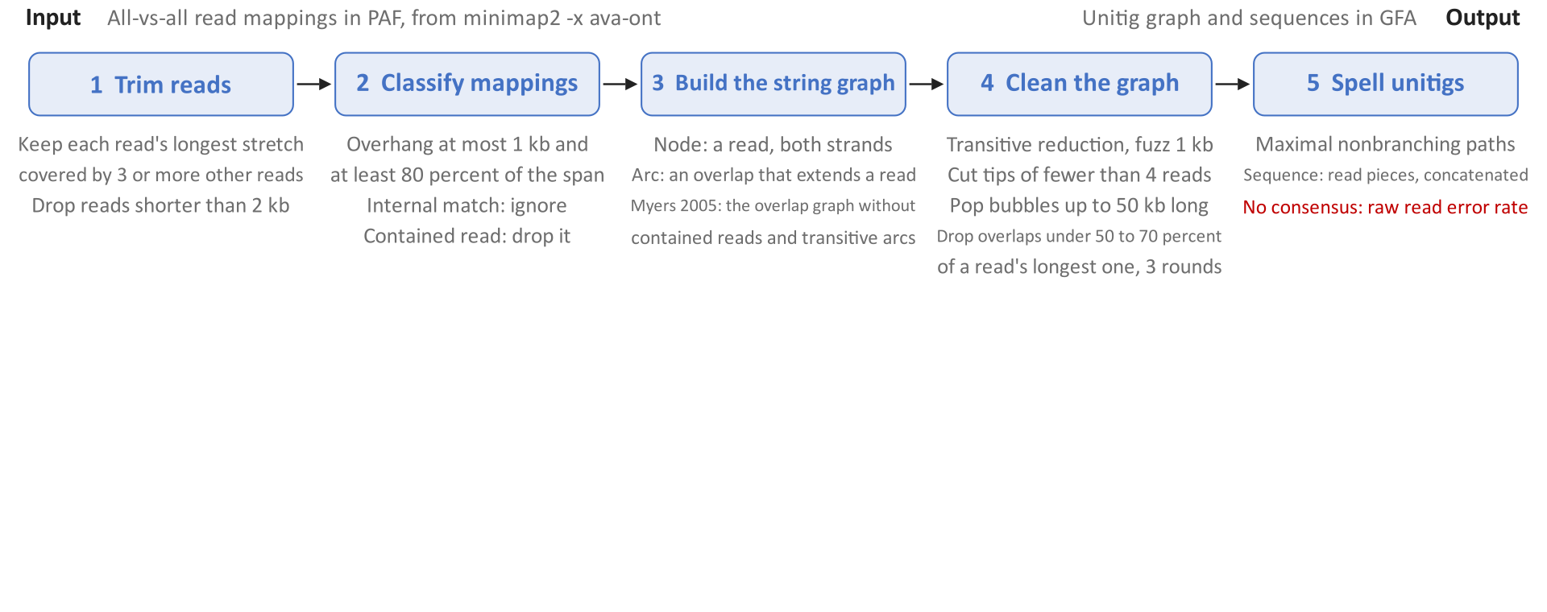
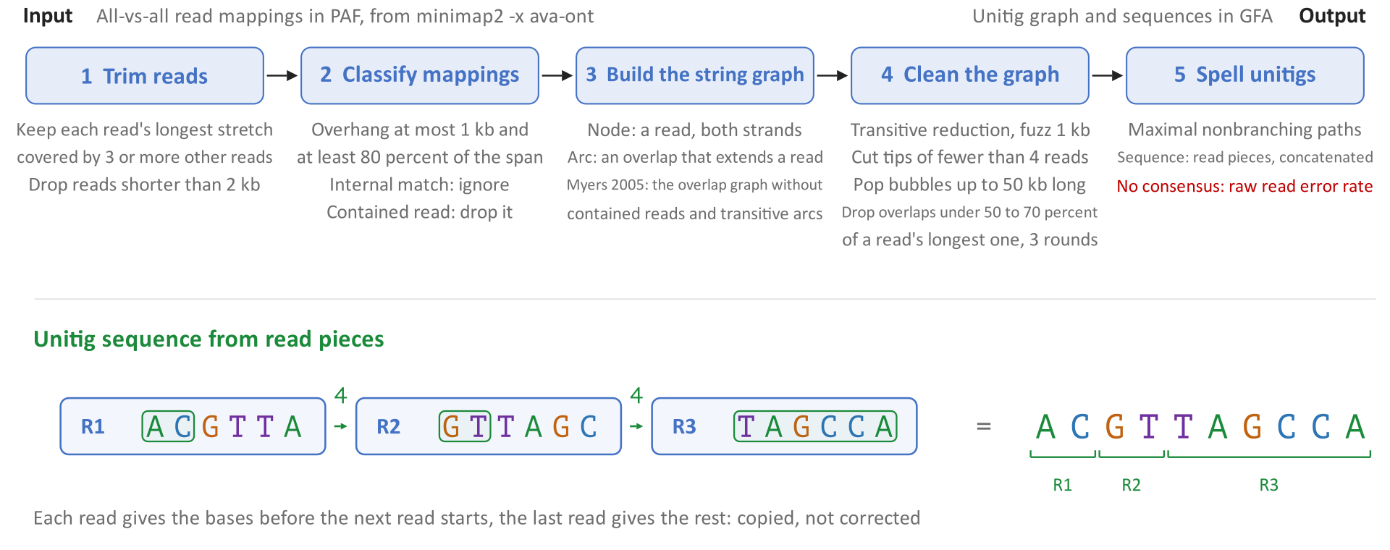
Miniasm: From Mappings to Unitigs
Every step is a filter or a graph rule with a threshold
No base is corrected: a consensus tool must follow
Notes:
Defaults: coverage 3 (-c), minimum span 2 kb (-s), overhang 1 kb and 80 percent, fuzz 1 kb, tips under 4 reads, bubbles to 50 kb, drop ratios 0.5 to 0.7 then 0.8. No consensus: unitig bases keep the read error rate.

Slide 18
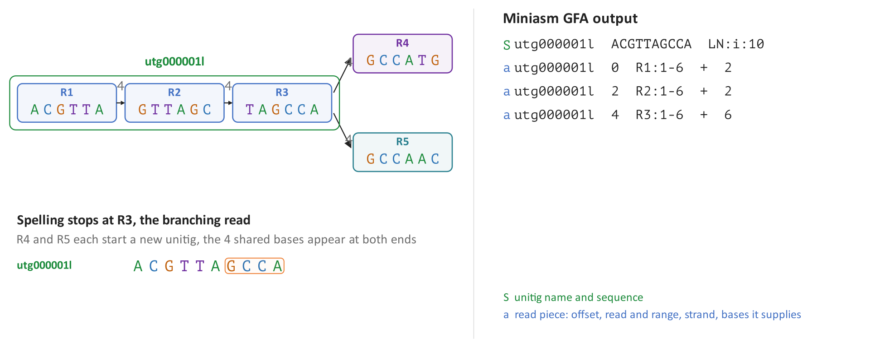
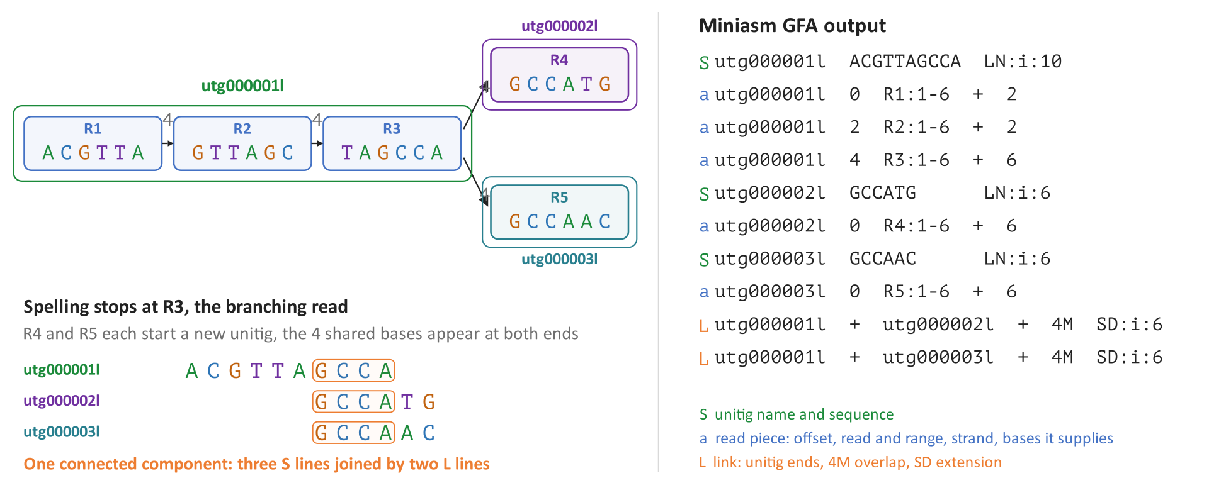
Unitigs and Links in a GFA File
One S line per unitig, a lines give the read pieces behind it
L lines keep the branch: three unitigs, two links, one component
Notes:
Miniasm's format: S is the unitig sequence, a a read piece (offset, read range, strand, bases), L a link with overlap 4M and extension SD. Bandage draws S as nodes and L as edges; linked unitigs form one component.

Slide 19
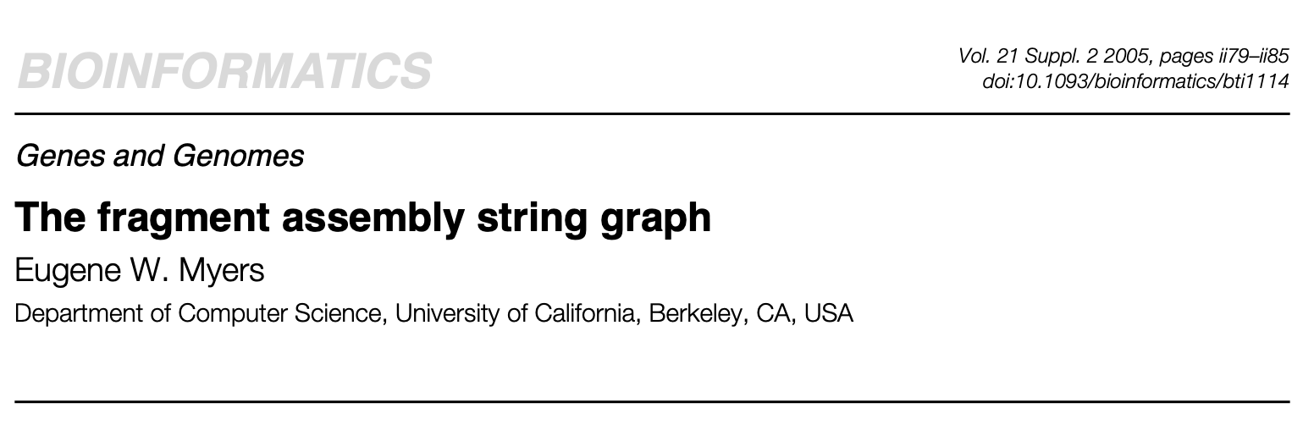
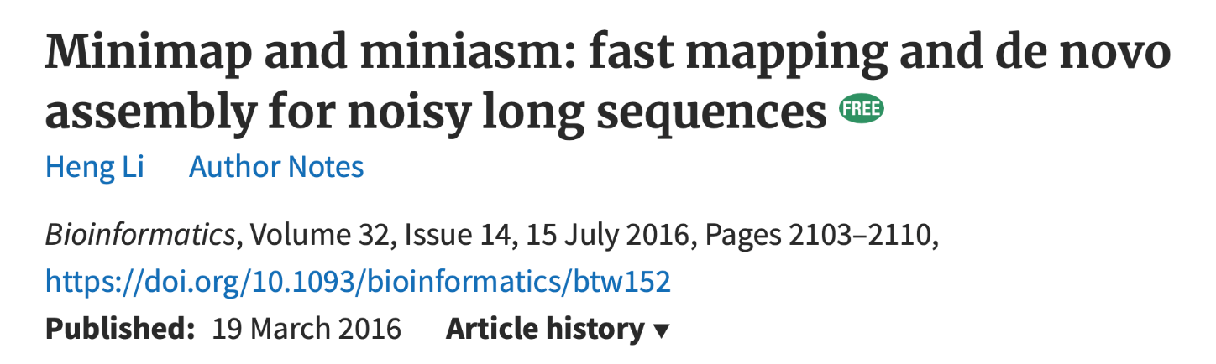
Further Reading: Assembly Graphs
Read the following paper if you are curious about
  How the transitive reduction works:
  How to collapse bubbles in overlap graphs:
Notes:
Transitive reduction: Myers E.W. (2005) The fragment assembly string graph. Bioinformatics, 21, ii79–ii85.
Bubbles: Zerbino D.R. Birney E. (2008) Velvet: algorithms for de novo short read assembly using de Bruijn graphs. Genome Res., 18, 821–829.

Slide 20
Consensus from Aligned Reads
Align the reads consistently with the layout
Combine their evidence to infer the assembled bases
A
T
T
G
A
C
C
T
A
A
C
T
T
T
A
C
C
T
T
G
A
C
C
T
A
A
T
T
T
T
A
C
C
T
C
C
T
A
A
T
T
T
T
A
G
C
T
T
T
A
G
C
T
T
T
T
A
C
C
T
T
T
A
G
A
T
T
G
A
T
A
C
C
T
T
T
A
G
A
T
T
G
A
G
G
A
C
G
A
C
G
Contig
T
A
G
T
T
T
G
A
G
G
A
C
G
A
C
G
C
C
A
G
G
A
C
A
T
T
G
A
C
C
T
A
A
T
T
T
T
A
C
C
T
T
T
A
G
A
T
T
G
A
G
G
A
C
G
A
C
G
C
C
A
G
G
A
C
Notes:
A column vote is only the intuition. Real consensus handles indels, alignment uncertainty and error profiles, and must not mix haplotypes into a mosaic.

Slide 21
Assembly Polishing
Align reads to the draft and revise unsupported bases
  By combining evidence from different read technologies
Errors
Align reads
Draft contig
Aligned reads
Correct errors
Polished contig
Notes:
Polishing improves bases with read evidence; it does not fix misjoins or fill gaps. Apollo is the instructor's technology-independent polisher.

Slide 22
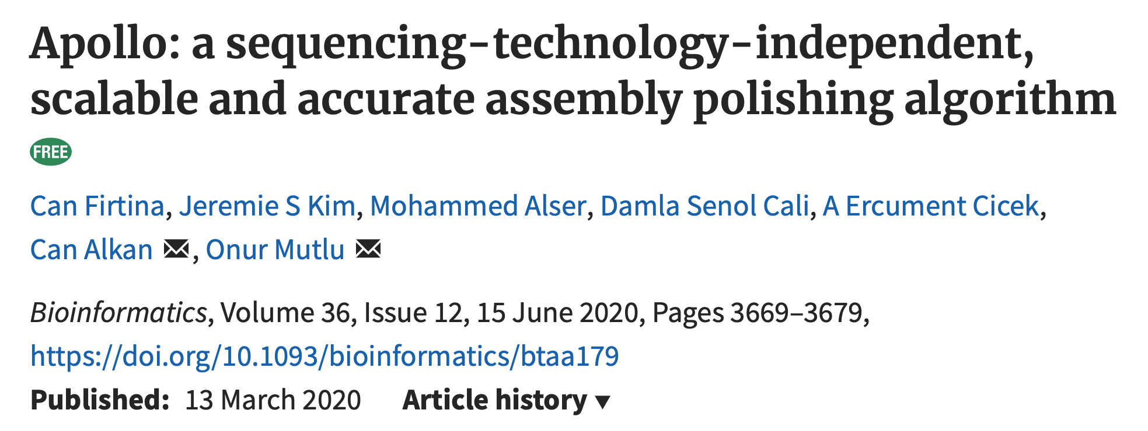
Error Correction using ML [Bioinformatics '20]
Apollo: a sequencing-technology-independent, scalable and accurate
assembly polishing algorithm
Can Firtina, Jeremie S. Kim, Mohammed Alser, Damla Senol Cali, A Ercument Cicek, Can Alkan, Onur Mutlu
Bioinformatics, June 2020.
[PDF] [Code] [Link]

Slide 23
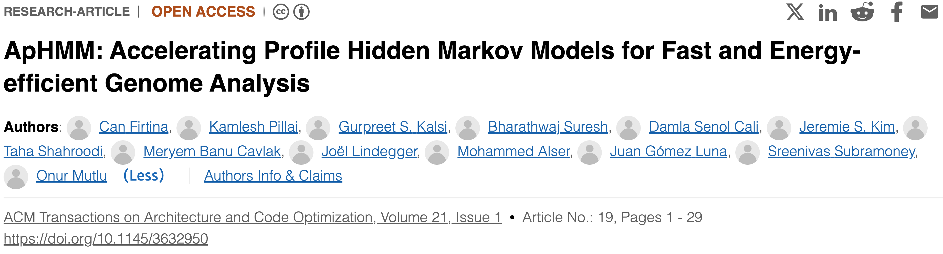
Accelerating ML & Genome Graphs [ACM TACO '24]
ApHMM: Accelerating Profile Hidden Markov Models for Fast and Energy-efficient
Genome Analysis
Can Firtina, Kamlesh Pillai, Gurpreet S. Kalsi, Bharathwaj Suresh, Damla Senol Cali, Jeremie S. Kim, Taha Shahroodi, Meryem Banu Cavlak, Joël Lindegger, Mohammed Alser, Juan Gómez Luna, Sreenivas Subramoney, Onur Mutlu
ACM Transactions on Architecture and Code Optimization (TACO), February 2024.
[PDF] [Code] [DOI]
HiPEAC 2024 Talk [Video] [Slides (pptx)] [Slides (pdf)]

Slide 24
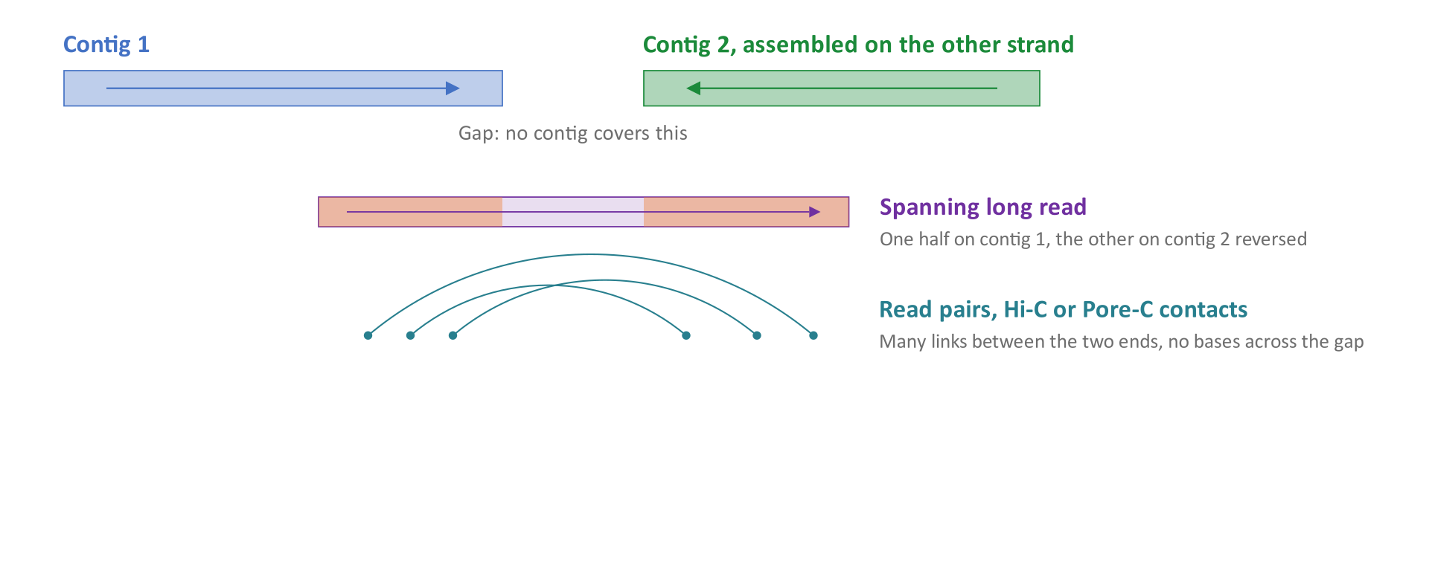
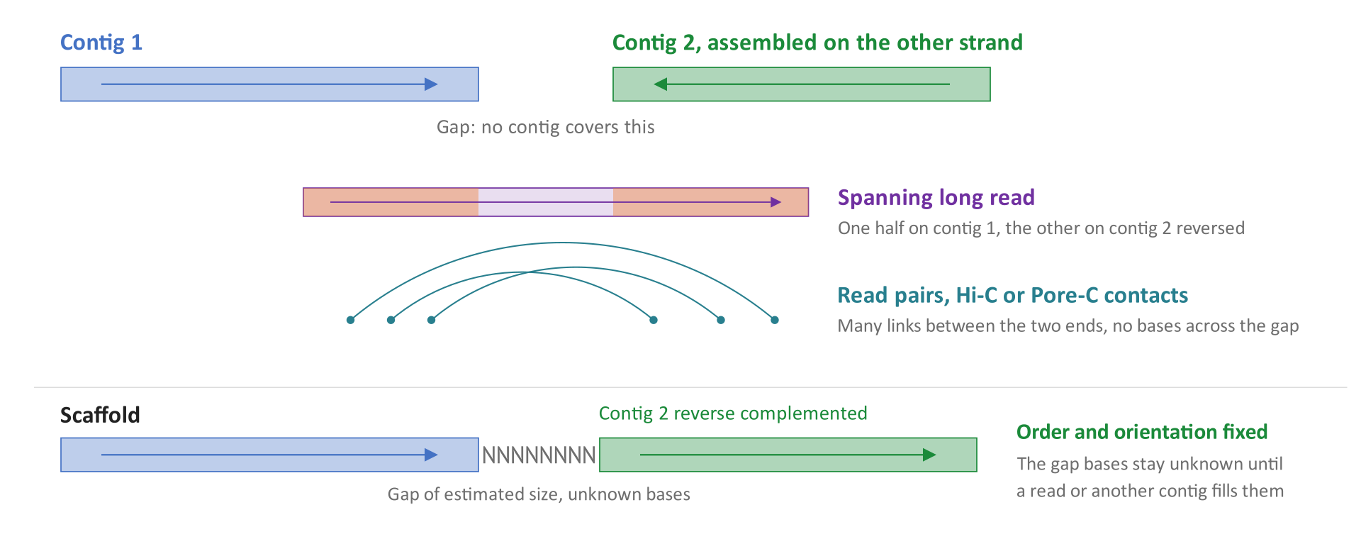
Scaffolds: Order and Orientation
Use long-range evidence to order and orient contigs
Unknown sequence between contigs remains a gap of estimated size
Notes:
Contig 2 was assembled on the other strand, so it is reverse complemented. A spanning read gives order, orientation and gap size; Hi-C links give no bases. N marks unknown sequence.

Slide 25
Contiguity: What N50 Measures
Sort contigs by length and accumulate half the total assembly
N50 alone does not establish a correct assembly
Total = 24 kb
Half = 12 kb
N50
Correct
contigs
10
8
4
2
8 kb
After
misjoin
4
2
18 kb
18
False join
Notes:
Lengths 10, 8, 4, 2 kb total 24; half is 12, reached inside the 8 kb contig, so N50 is 8 kb. A false join of the first two gives N50 18 kb while the structure gets worse.

Slide 26
Assembly Quality Has Several Dimensions
Check base accuracy, completeness, structure and phase
Different checks reveal different kinds of error
Base accuracy
A
C
C
T
A
C
A
C
G
T
A
C
QV
Completeness
Missing
1
2
3
4
Structure
A
B
X
Y
Sources
A
B
X
Y
Misjoin
Phasing
Assembly 1
Switch
Assembly 2
Notes:
Merqury uses read k-mers for base accuracy, completeness and phase; BUSCO checks conserved genes; QUAST compares with a reference. Each catches different errors; none certifies the whole assembly.

Slide 27
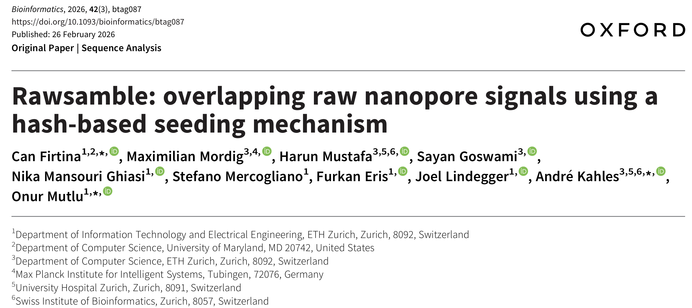
New Directions: Overlapping Raw Signals
Rawsamble: Overlapping Raw Nanopore Signals using a Hash-based Seeding Mechanism
Can Firtina, Maximilian Mordig, Harun Mustafa, Sayan Goswami, Nika Mansouri Ghiasi, Stefano Mercogliano, Furkan Eris, Joel Lindegger, Andre Kahles, and Onur Mutlu
Bioinformatics, February 2026
[online link] [pdf] [code]
ISMB 2024 Talk [video] [pptx] [pdf]
CSHL 2024 (Biological Data Science) Talk [video] [pptx] [pdf]
Social Media Thread [Twitter (X)] [LinkedIn]

Slide 28
Beyond Reference Mapping: Overlapping
Reference Genome (Converted to Signals)
Raw Nanopore Signals
Raw Nanopore Signals
TGCTGCAA
CGAAGTCA
CGTAGTGG
CCACCGGT
Reference Signals
CTGCAATC
TGATCCGA
TCAGCCGT
AGTGGACC
GGTAAGCT
TGCTGCAATCGTGATCCGAAGTCAGCCGTAGTGGACCACCGGTAAGCT
Hash-Based
Seeding and Mapping
Challenge: Reference genome is not always available
Assembly: Constructing genome from overlapping reads
✕
Existing solutions cannot find overlapping reads without basecalling

Slide 29
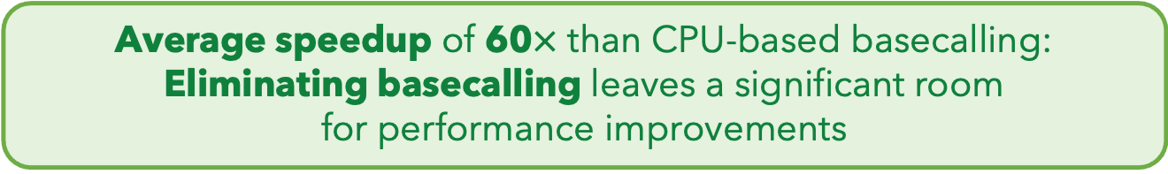





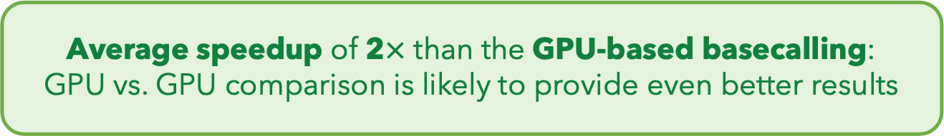
Eliminating Basecalling from the Pipeline
Rawsamble
Basecalling (CPU)
+ Overlapping
Basecalling (GPU)
+ Overlapping
$${10}^{2}$$
Elapsed Time
(Normalized to Rawsamble)
59.70$×$
$${10}^{1}$$
$${10}^{0}$$
1.99$×$
SARS-CoV-2
E. coli
Yeast
Green Algae
Human
Geo. Mean
Average speedup of 60$×$ than CPU-based basecalling: Eliminating basecalling leaves a significant room
for performance improvements
Average speedup of 2$×$ than the GPU-based basecalling:
GPU vs. GPU comparison is likely to provide even better results

Slide 30
New Directions: Overlapping Raw Signals
Rawsamble: Overlapping Raw Nanopore Signals using a Hash-based Seeding Mechanism
Can Firtina, Maximilian Mordig, Harun Mustafa, Sayan Goswami, Nika Mansouri Ghiasi, Stefano Mercogliano, Furkan Eris, Joel Lindegger, Andre Kahles, and Onur Mutlu
Bioinformatics, February 2026
[online link] [pdf] [code]
ISMB 2024 Talk [video] [pptx] [pdf]
CSHL 2024 (Biological Data Science) Talk [video] [pptx] [pdf]
Social Media Thread [Twitter (X)] [LinkedIn]

Slide 31
Two Ways to Build an Assembly Graph
Overlap graphs: connect whole reads through overlaps
De Bruijn graphs: connect k-mers (DNA words of length k)
Notes:
Return to the same comparison to introduce the second approach, highlighted on the right. The next slides construct the graph from DNA words of length k, one read at a time. Then show how shared words connect paths and how branches affect spelling.

Slide 32
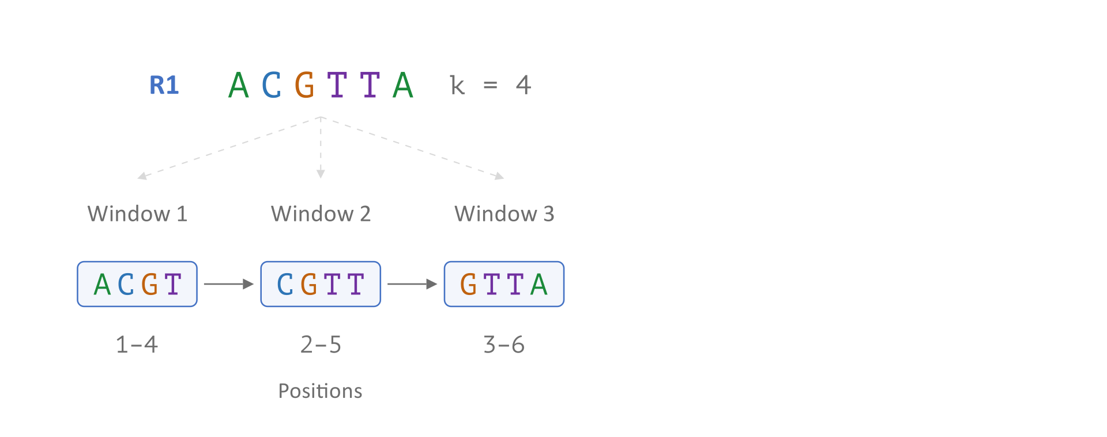
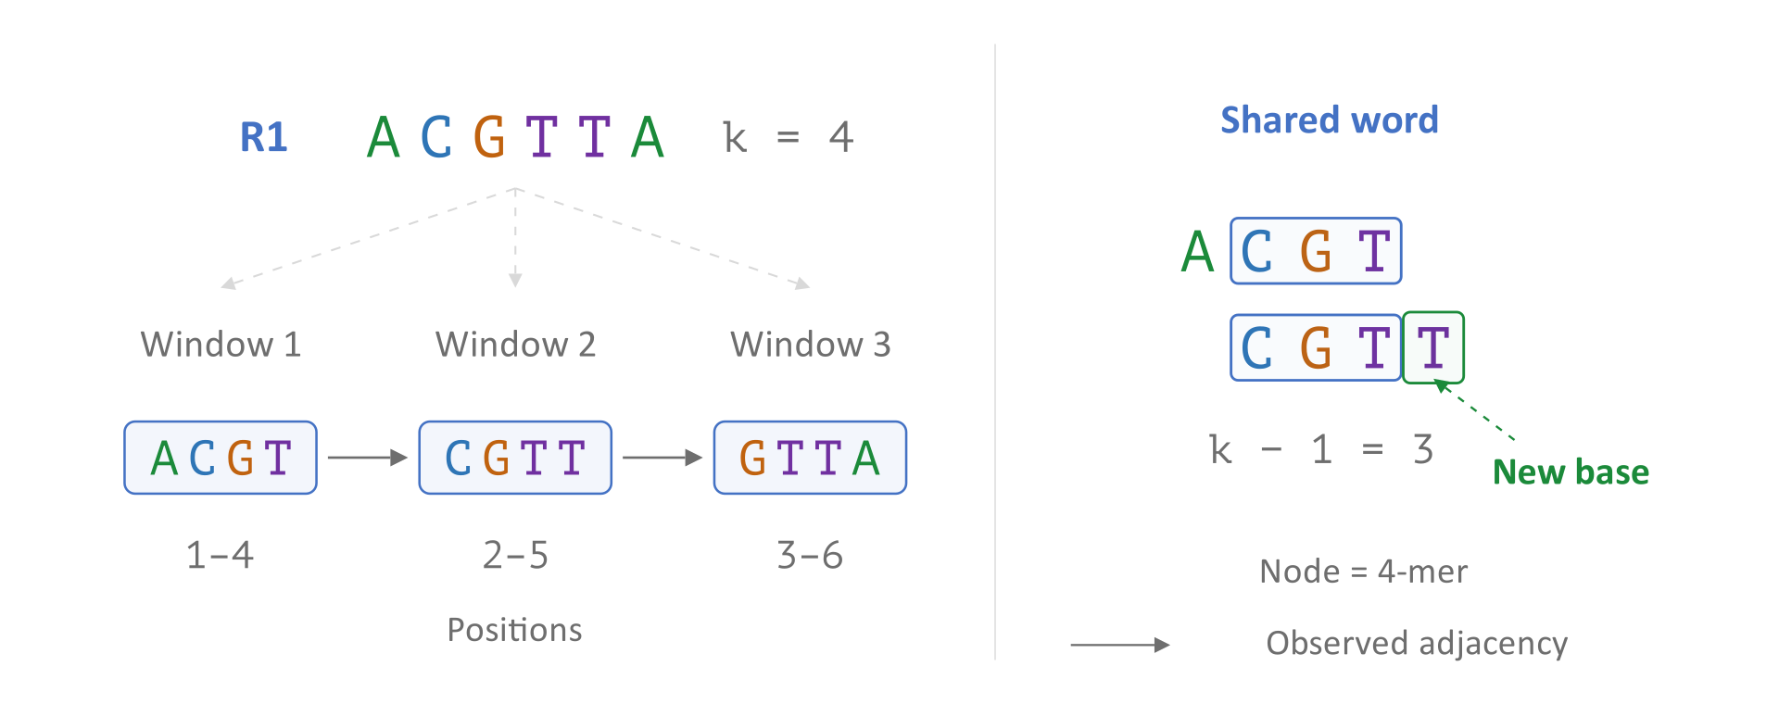
From a Read to K-mer Nodes
Create one node for each distinct k-mer
Consecutive windows share k − 1 bases
Notes:
k = 4, forward strand, exact words. Consecutive windows share three bases, so each new node adds one base. Real tools use odd k, both strands and count filtering.

Slide 33
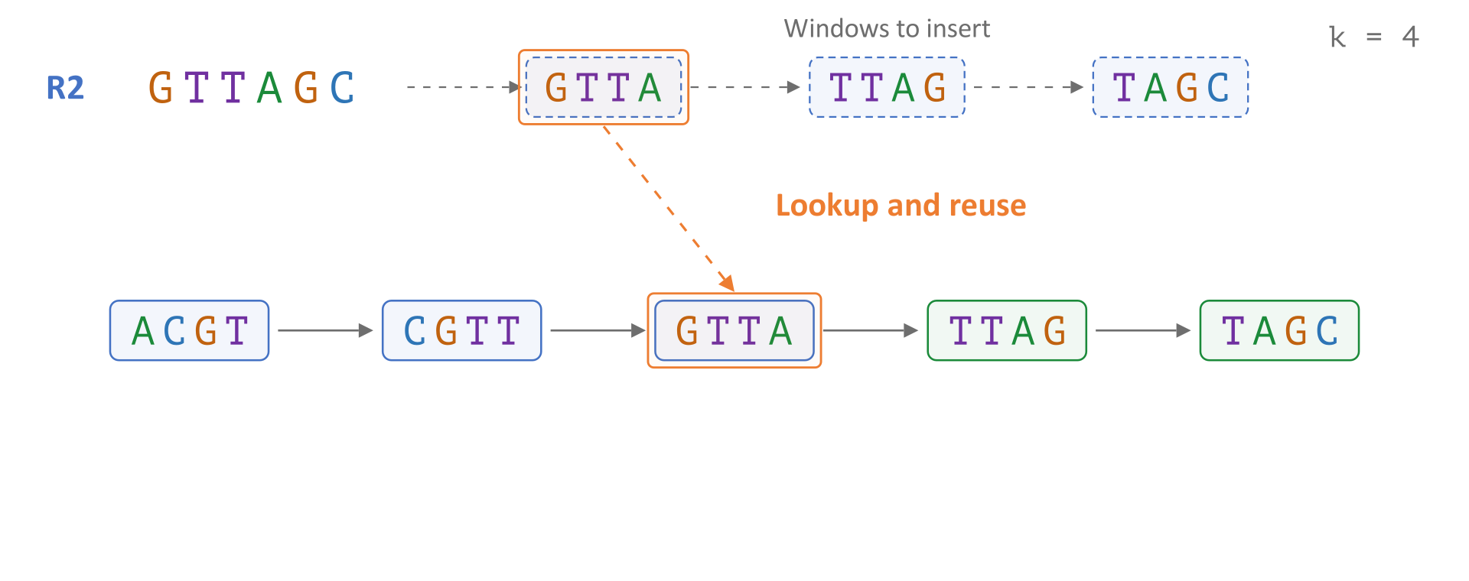
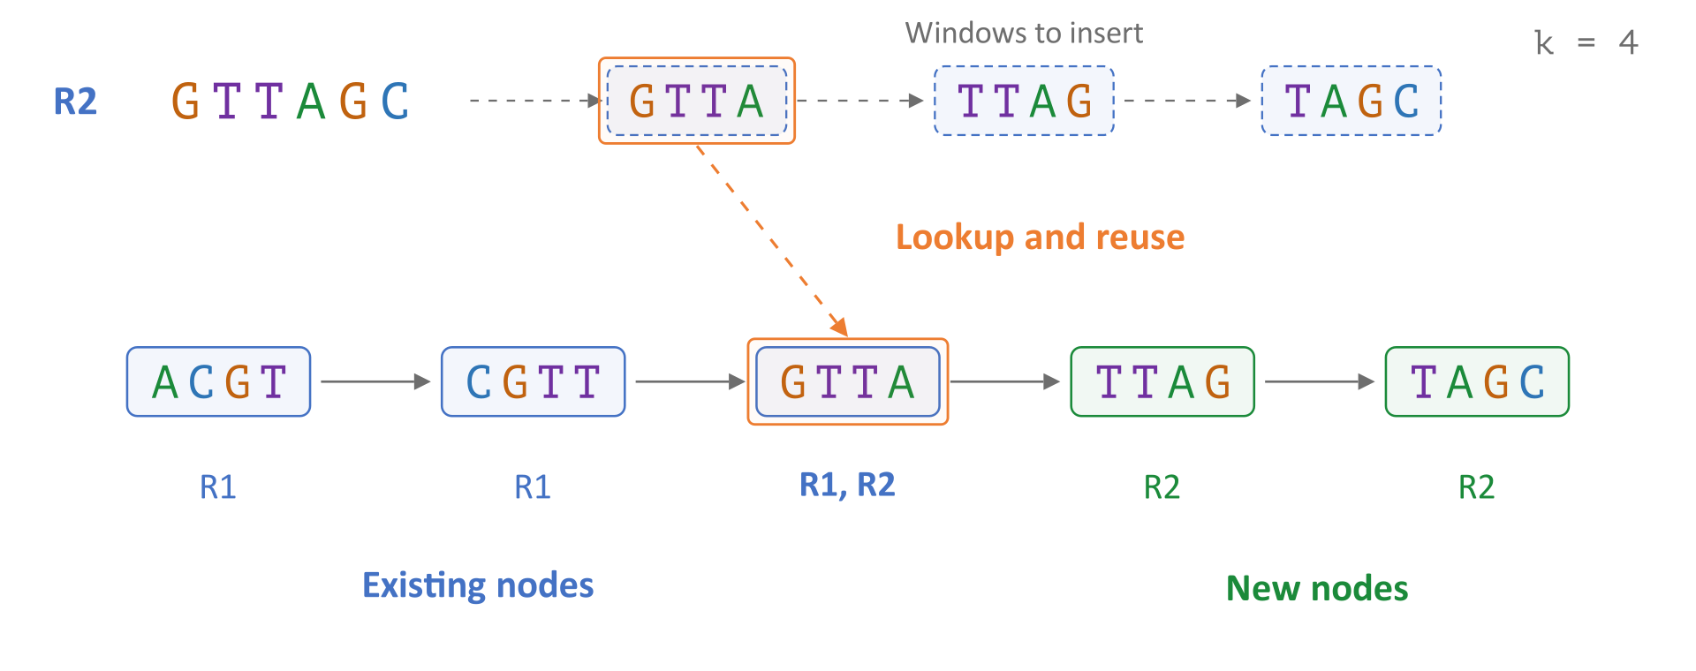
An Identical K-mer Reuses Its Node
Look up the full k-mer sequence
Reuse its node and update the observed support
Notes:
R2 starts with GTTA, already present: reuse the node and raise its count to 2. Only full-word equality reuses a node.

Slide 34
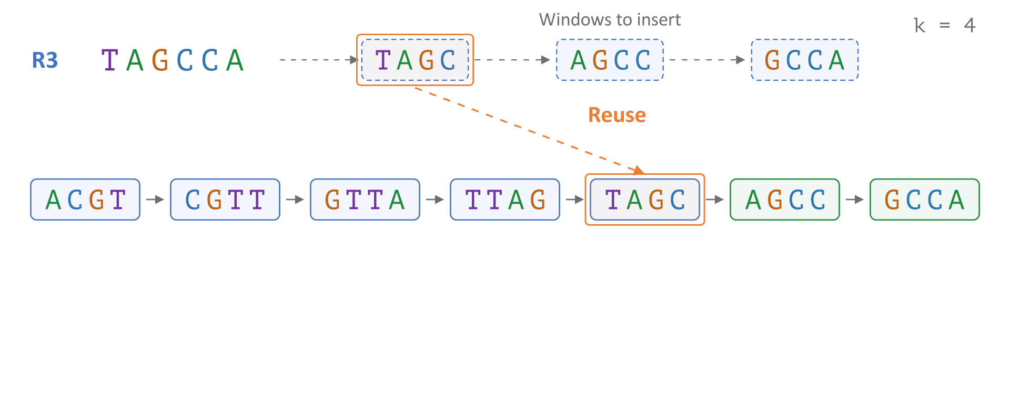
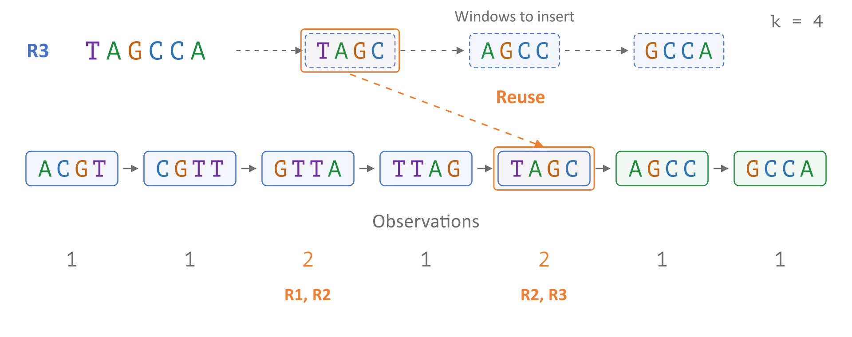
Shared Words Connect the Read Paths
The third read reuses TAGC and adds two new words
Counts come from observations in the input reads
Notes:
Nine observations, seven nodes, six edges; counts 1,1,2,1,2,1,1. A count here equals the number of supporting reads; repeats would raise counts too.

Slide 35
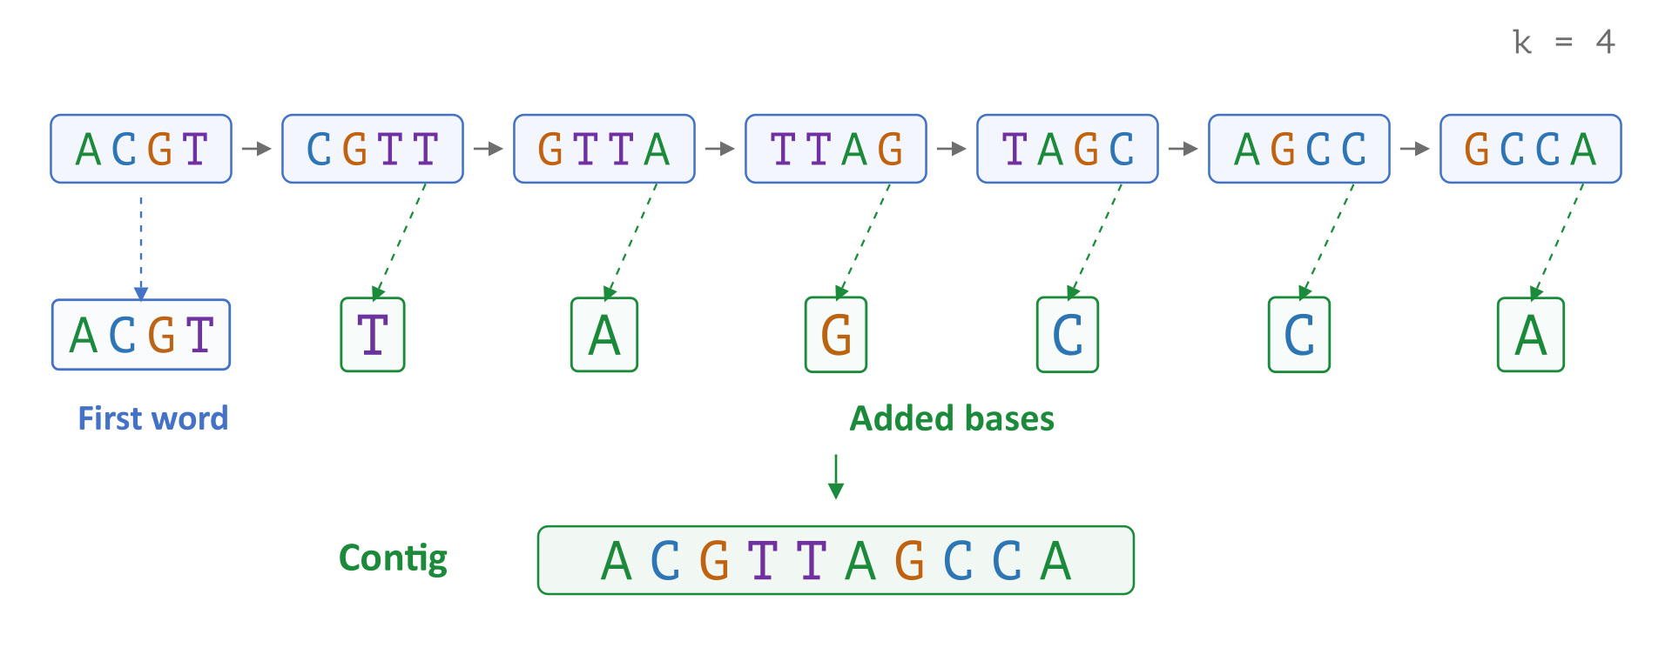
Spelling a Path
Write the first k-mer, then append one new base per step
Notes:
Write ACGT, then one new base per node: ACGTTAGCCA. Concatenating whole nodes would repeat the shared bases.

Slide 36
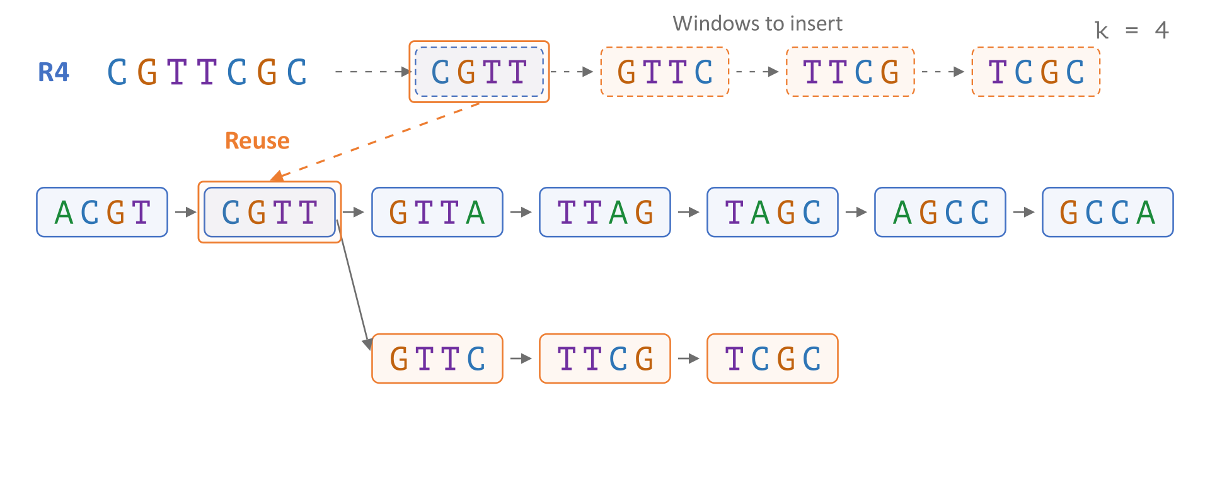
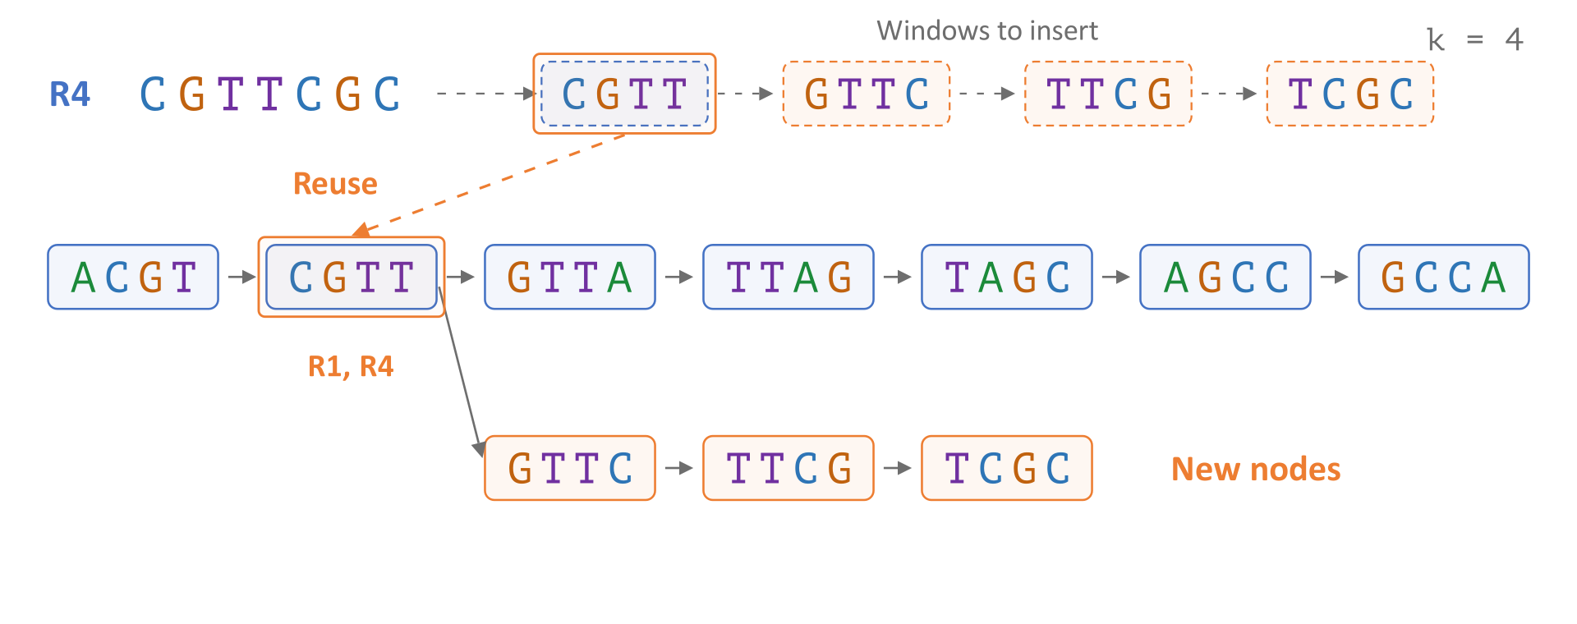
Another Read Creates a Branch
A new read supports a second continuation after CGTT
Keep both connections until there is enough evidence
Notes:
R4 reuses CGTT and adds GTTC, TTCG, TCGC, so CGTT has two exits. The graph records the alternative; it does not decide between error, variant and repeat.

Slide 37
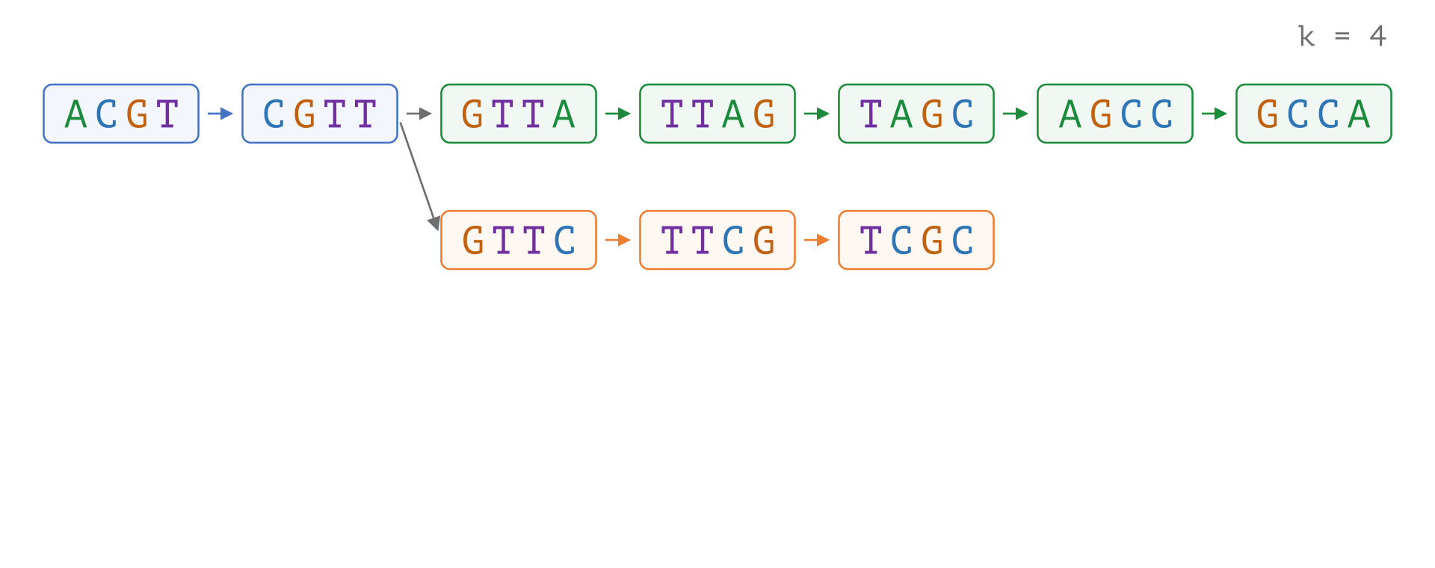
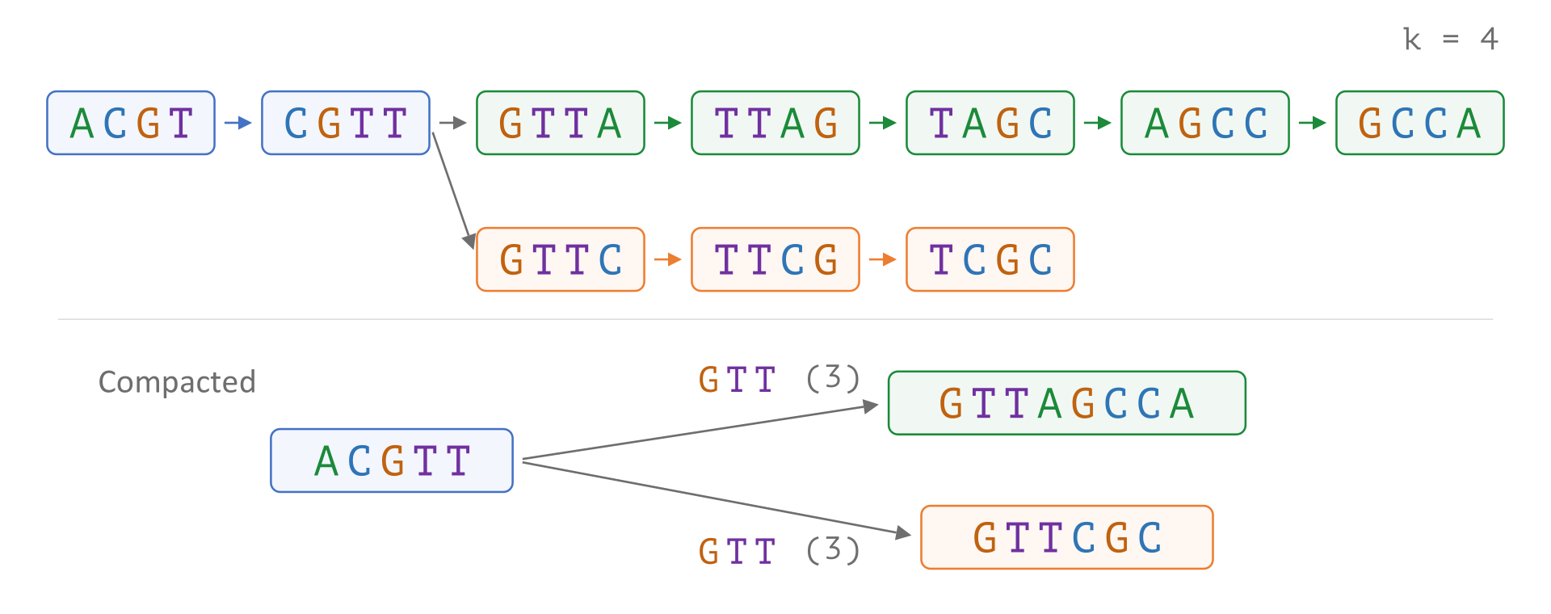
A Unitig Stops at an Unresolved Branch
Merge u and v only when u has one exit and v has one entrance
Compaction preserves the unresolved alternatives
Notes:
Three node-disjoint unitigs: ACGTT, GTTAGCCA, GTTCGC. Both compacted links overlap by GTT; compaction keeps the branch.

Slide 38
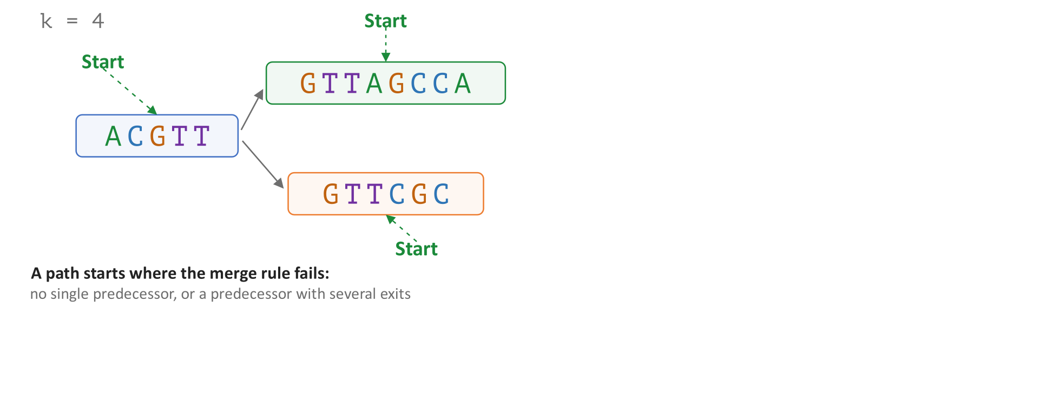
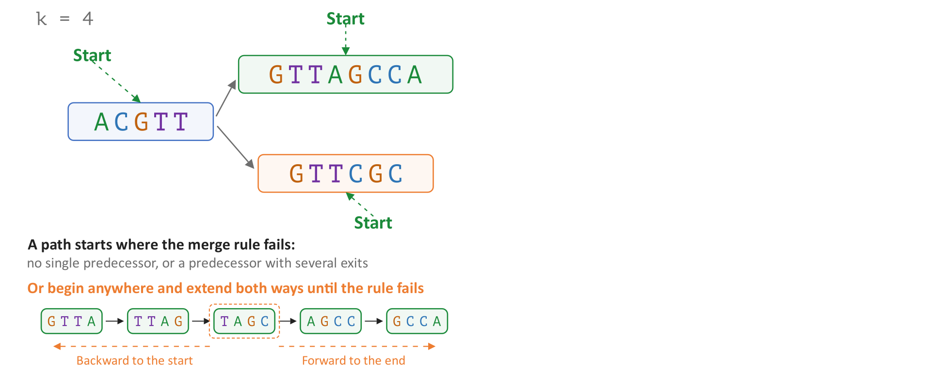
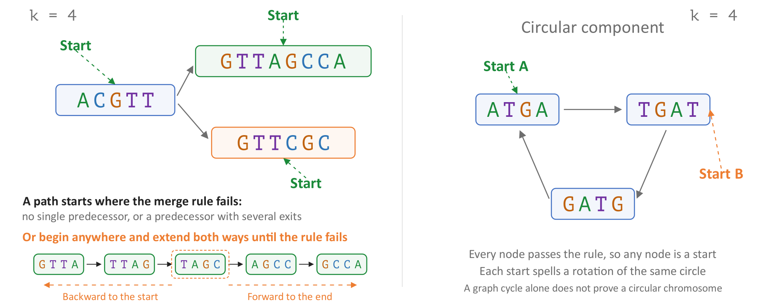
Finding Every Unitig
Find maximal unambiguous paths throughout every component
Start where the rule fails, or anywhere and then extend both ways
An isolated cycle has no start: any node gives a rotation of it
Notes:
Maximal nonbranching paths partition the nodes, so the start does not matter: miniasm begins at any unvisited node, walks forward, then backward, and marks nodes used. In a cycle every node is a valid start and gives a rotation of one circular unitig.

Slide 39
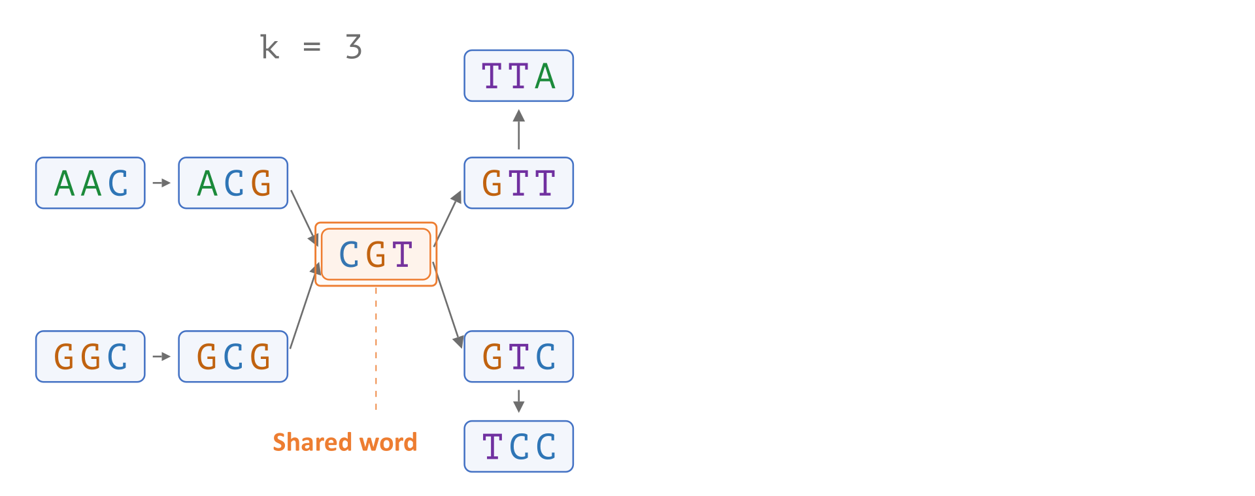
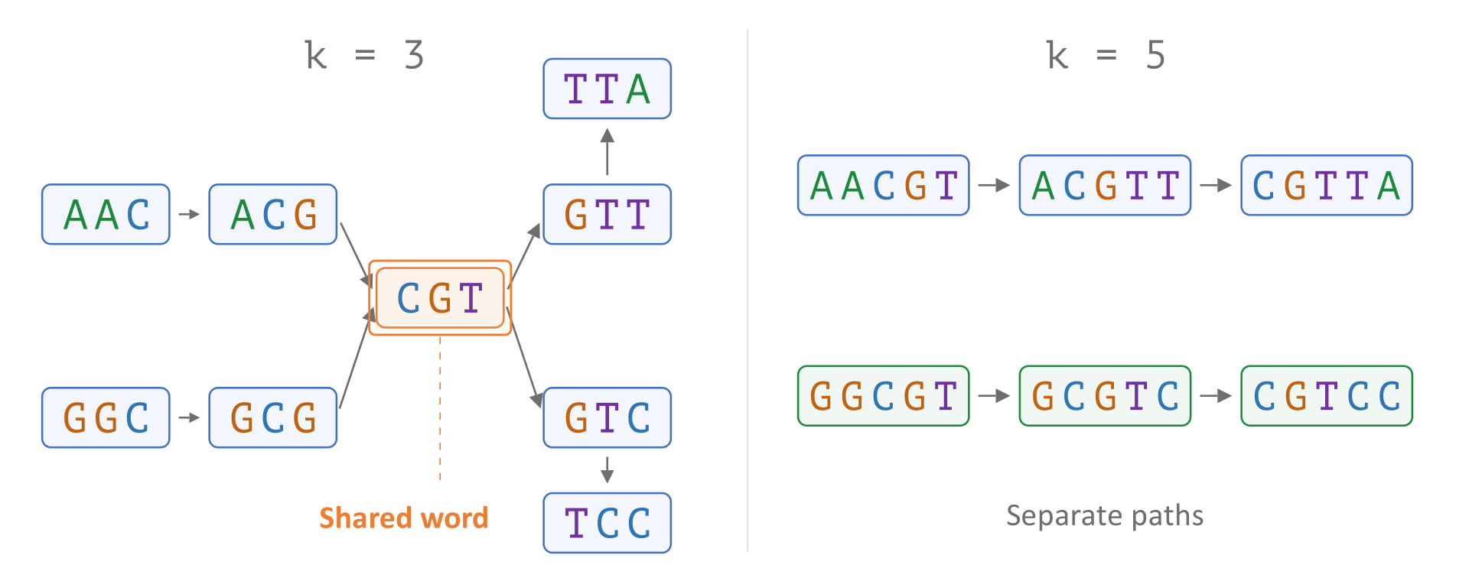
Choosing k
Smaller k can merge distinct genomic contexts
Larger k requires longer exact, supported words
Notes:
AACGTTA and GGCGTCC share CGT at k = 3 and separate at k = 5. Larger k needs longer exact words, so errors and low coverage break paths.

Slide 40
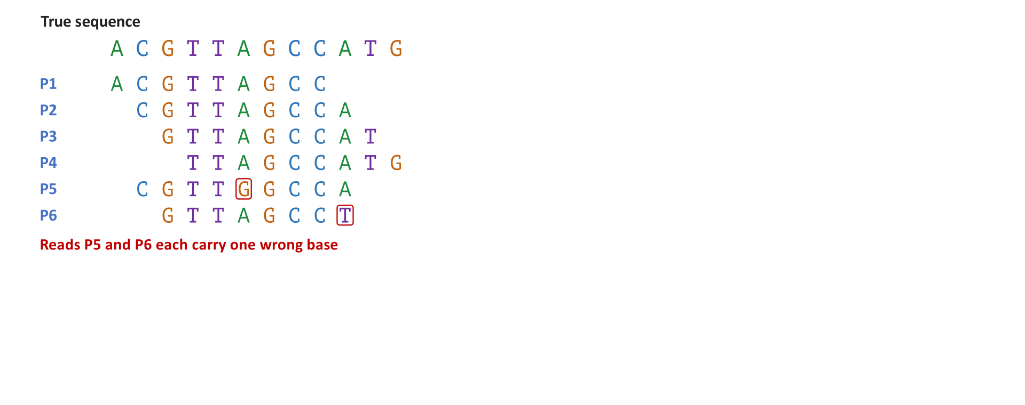
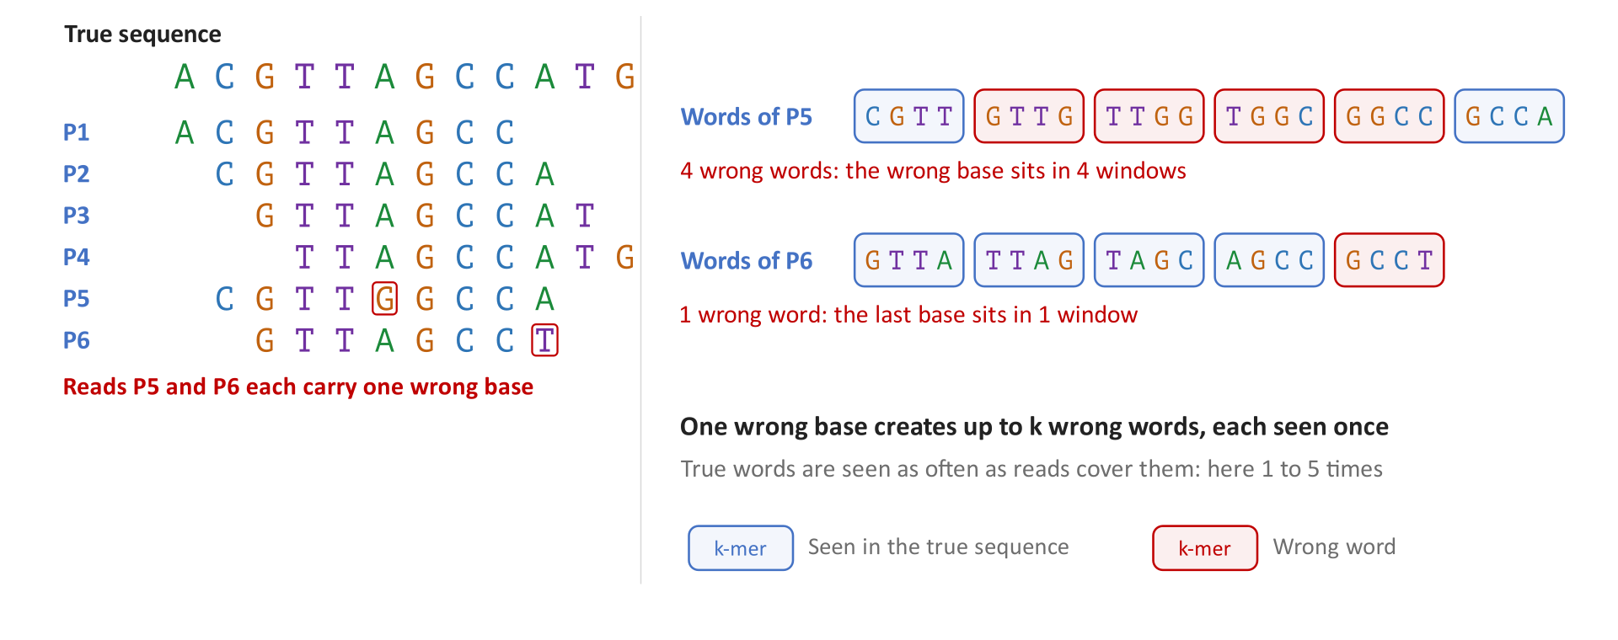
Sequencing Errors Create Rare Words
A wrong base changes every window that contains it: up to k wrong k-mers
Wrong words are seen once, true words as often as reads cover them
Notes:
Six reads of ACGTTAGCCATG; P5's wrong fifth base falls in four windows, P6's wrong last base in one. True words are seen 1 to 5 times, wrong words once.

Slide 41
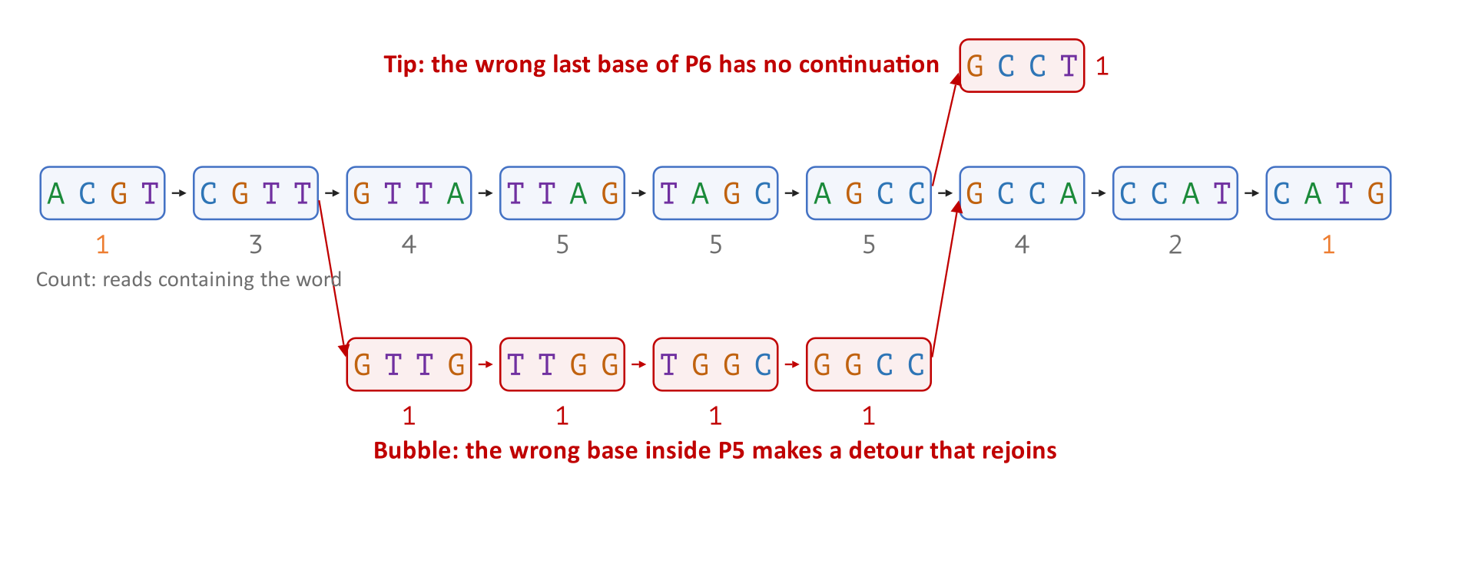
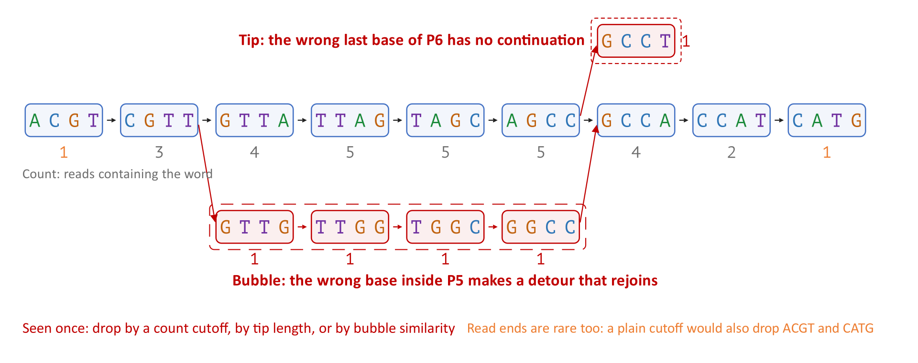
Errors in the Graph: Bubbles and Tips
An error inside a read makes a bubble, an error near a read end makes a tip
Drop rare words and short tips, then collapse near-identical bubbles
Notes:
P5's wrong words detour and rejoin at GCCA (a bubble); P6's hangs off AGCC (a tip). Velvet removes tips under 2k, low-count words by a cutoff, and similar bubble paths. End words are rare too.

Slide 42
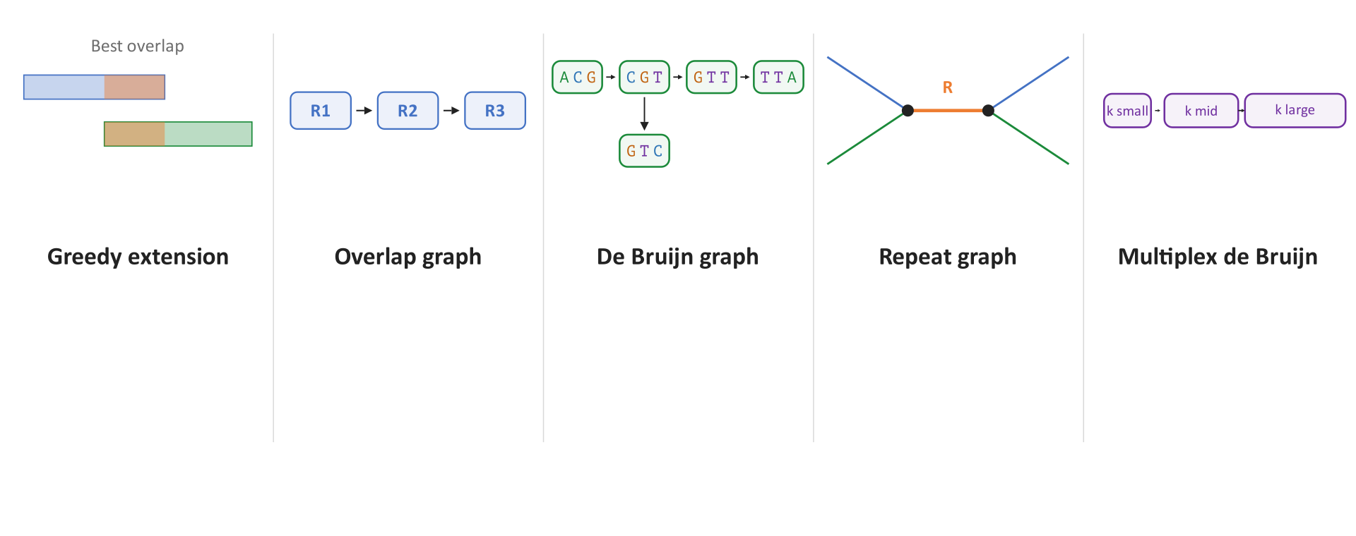

Assembler Families at a Glance
Every family builds a graph, then walks its unambiguous paths
They differ in what a node is and in how much read context survives
Notes:
Greedy: Phrap, TIGR, SSAKE. Overlap and string graph: Celera, Canu, miniasm, hifiasm. De Bruijn: Velvet, SPAdes, ABySS, MEGAHIT. Repeat graph: Flye. Multiplex de Bruijn: Verkko's MBG, LJA; metaMDBG in minimizer space.

Slide 43

Repeats Can Hide the Correct Connections
Two repeat copies allow more than one pairing
Notes:
U1 to U4 are unique flanks, R a repeat in two copies. Collapsing R loses which entrance pairs with which exit.

Slide 44

A Spanning Read Resolves a Connection
A read reaching both unique flanks identifies their pairing
Notes:
A read spanning R into unique sequence on both sides fixes one pairing; with two copies the other follows. Other repeats need copy-specific differences or long-range links.

Slide 45
Flye: A Repeat Graph
Build approximate repeat structure from long reads
Use read paths to resolve supported repeat connections
Noisy reads
Disjointigs
Repeat graph
Spanning reads
A
R
B
A
B
A
R
D
A
R
B
R
C
R
D
C
R
B
C
R
D
C
D
Arbitrary walks
Edges: Sequence
Resolved paths
Dots: Junctions
Notes:
Disjointigs are rough walks that may join wrong flanks; collapsing repeats gives a repeat graph whose edges carry sequence. Reads mapped to the graph resolve bridged repeats.

Slide 46
Hifiasm: Preserving Haplotype Paths
Keep coherent alleles together through the assembly graph
Accurate reads and phasing evidence help separate haplotypes
Variant bubbles
Local phase
A
C
Haplotype 1
Shared
A
C
Haplotype 2
G
T
G
T
A
C
Reads
G
T
Notes:
Phasing-aware correction keeps alleles that co-occur in reads, so bubbles stay and local phase links them. Since 2026 hifiasm also assembles ONT simplex reads; dual assemblies may switch phase.

Slide 47
Verkko: Combining Read Evidence
Accurate long reads construct the initial sequence graph
Ultra-long reads and phasing evidence resolve more ambiguity
Accurate long reads
Ultra-long reads
Phased paths
Haplotype 1
A
B
A
R
B
R
Repeat
Haplotype 2
C
D
Nodes: Unitig sequence
C
R
D
Haplotype
markers
Edges: Adjacency
Notes:
Accurate reads (HiFi, ONT duplex, corrected simplex) build a multiplex de Bruijn graph; ultra-long reads resolve repeats and haplotype markers separate copies. Complete chromosomes are possible, not guaranteed.

Slide 48
Genome Assembly: Key Ideas
Coverage and read length bound what any assembler can resolve
Overlaps connect reads through shared sequence
Graph cleaning removes redundancy but can also lose real sequence
Errors appear as rare tips and bubbles in every graph type
Read paths help resolve repeats and preserve haplotypes
Consensus improves bases, scaffolding connects contigs

Slide 49
Questions?

Slide 50
Next Lecture
AI/ML in genomics

Slide 51
CMSC 829C: Algorithms, AI, and Hardware
for Biological Data
Lecture 5: Genome Assembly
Fall 2026
September 15, 2026
Can Firtina | canfirtina@gmail.com | cs.umd.edu/~firtina
Assistant Professor of Computer Science at UMD

