Slide 1
CMSC 829C: Algorithms, AI, and Hardware
for Biological Data
Lecture 4: Sequence Analysis in Genomics
Fall 2026
September 10, 2026
Can Firtina | canfirtina@gmail.com | cs.umd.edu/~firtina
Assistant Professor of Computer Science at UMD

Slide 2
Agenda
Read mapping
  Indexing, seeding, chaining, alignment
Pangenome graphs: representing and searching alternatives

Slide 3
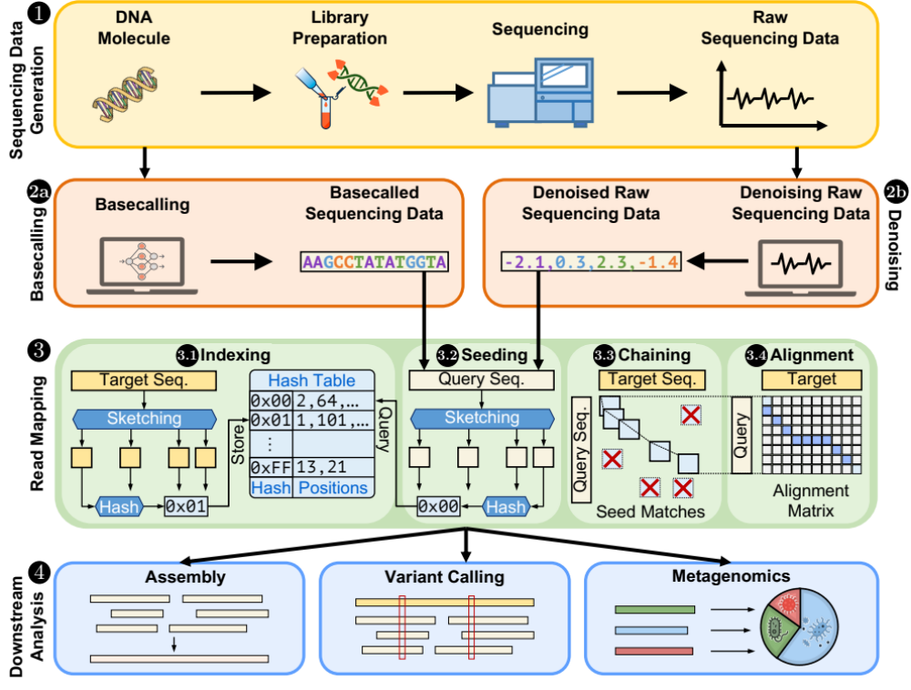
Recall: Genome Analysis Pipeline

Slide 4
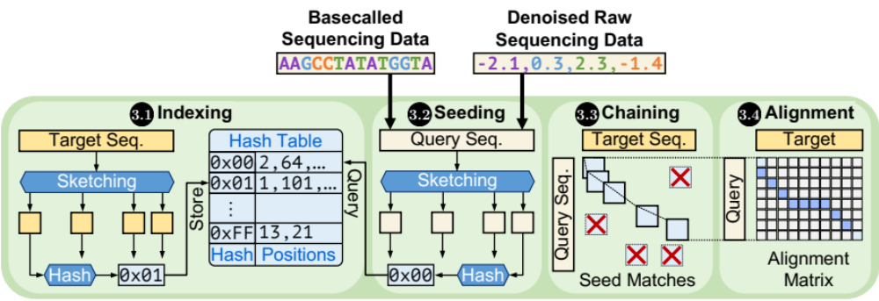
Read Mapping

Slide 5
Sequencing Data Analysis
Heuristic algorithms
Data structures
Filters
TATGG
AAGCC
TATAT
TGGTA
GCCTA
AGATA
TGCAC
CCTGG
✓
Quick, accurate, and energy-efficient analysis
Distributed
computing
✕
Imperfections in sequencing data
impact design choices
Hardware accelerators
Notes:
Since we need to analyze a large volume of sequencing data, there are many types of optimizations to make the genome analysis practical

Slide 6


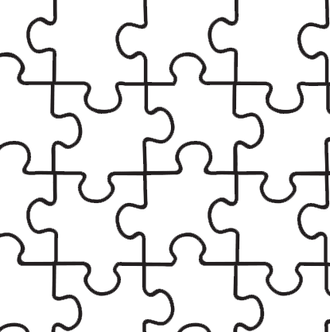


Recall: Challenges in Genomic Data Analysis
Human (reference) genome: 3.2 billion bps (haploid)
CGAAATGCC...AGATTAAACGCT...TGCCCTAA...GAATGGCGT
?
Scale: ~$1/{10}^{8}$
AAATGG
CGAAATGCC...AGATTAAATGGT...TGCCCTAA...GAATGGCGT
Entire genomic sequence of an organism
Read: ~100 – 100,000 bps
Small pieces (reads)
?
Unknown origins
Dealing with massive and noisy datasets
(TBs to PBs)
Non-identical reference genome
Large volume of data to analyze

Slide 7
Recall: Solving the Puzzle in a Naïve Way
Human (Reference) Genome: 3.2 Billion bps (haploid)
CGAAATGCC...AGATTAAACGGGCTTTCT...TGCCCTAA...GAATGGCGT
AAATGG
Pairwise Approximate String Matching
(Alignment)
$$O(n^{2})$$
For All Reads
$$O\left(n^{2}mk\right) \\ ≅O\left({10}^{20}\right)$$
Entire Genome
$$O(n^{2}m)$$
$≅$Years

Slide 8
Solving the Puzzle: The Practical Way
Goal: quickly and accurately reduce the search space
CGAAATGCC...AGATTAAATGGGCTTTCT...TGCCCTAA...GAATGGCGT
Costly alignment
is quickly avoided
in most regions
AAAT
AAAT
CTAA
AATG
AAATGG
AAATGG
Exact match
AAAT
AAATGG
Read mapping
Indexing
Seeding
Chaining
Alignment
Reference genome
Hash table
Read
0x00
2,64,…
Sketching
0x01
1,101,…
Query
Sketching
Store
…
0xFF
13,21
Hash
Positions
Hash
0x01
0x00
Hash
Hash matches
DP calculations

Slide 9
Steps in Read Mapping – Indexing and Seeding
Read mapping
Indexing
Seeding
Chaining
Alignment
Reference genome
Hash table
Read
0x00
2,64,…
Sketching
0x01
1,101,…
Query
Sketching
Store
…
0xFF
13,21
Hash
Positions
Hash
0x01
0x00
Hash
Hash matches
DP calculations

Slide 10
Hash-Based Sketching and Seed Matching
Target sequence
Query sequence
GCTATTACCTTAATGTGATGGACGA
CAGGCTATAACCCTAATGTTGC
Sketching
Sketching
GCTA
TAAT
GACG
GCTA
ATGT
Hash
Hash
Hash
Hash
Hash
0x01
0xA4
0x41
0x01
0xFE
Store
Store
Store
Query
Query
<List of positional information>
Match
0x01
0xA4
0x41
No match
Hash table (index)

Slide 11




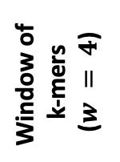
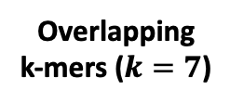
Minimizer Sketching
Sketching Goal: Selectively use some subsequences for similarity estimation
  Trade-offs: (Usually) reduced storage and computation requirements vs. sensitivity
GCTATTACCT
GCTATTA
Hash
0xA1
Find
minimum
Window of
k-mers
($w = 4$)
CTATTAC
Hash
0x02
Hash table
0x02
TATTACC
Hash
0xFC
ATTACCT
Hash
0x45
CTATTAC
Overlapping
k-mers ($k=7$)
Sampled
k-mer (minimizer)

Slide 12
Spaced Seeding
Can we tolerate certain mismatches?
GCTATTA
Pattern
GXTAXTA
Hash
0xA1
GATACTA
Pattern
GXTAXTA
Hash
0xA1
GACACTA
Pattern
GXCAXTA
Hash
0xFC
Spaced seeds

Slide 13
Strobemer Sketches
Can we tolerate insertions and deletions between selected subsequences?
GCTATTACCTTAATGTGATGGAC
Link
GCTATTAATGGA
Hash
0xA1
GCTATCCCCTTAATGGGATGGAC
Link
GCTATTAATGGA
Hash
0xA1
GCCCTCCCCTTAAAGGGAATGGA
Link
CCTCTAAATGGA
Hash
0xFC
Selected k-mers (e.g., minimizers)
Strobemers

Slide 14
Fuzzy Seeding
Can we tolerate arbitrary mismatches?
CXCCXGG
Fuzzy
0x0C
Hash table
GXTAXTA
Fuzzy
0xA1
Hash table
GXCAXTA
Fuzzy
0xA1
Hash table
Notes:
Fuzzy hashes increase the chance that similar seeds share a hash but do not guarantee this for every pair. Hash equality is not proof of sequence equality. Source: https://doi.org/10.1093/nargab/lqad004 .

Slide 15
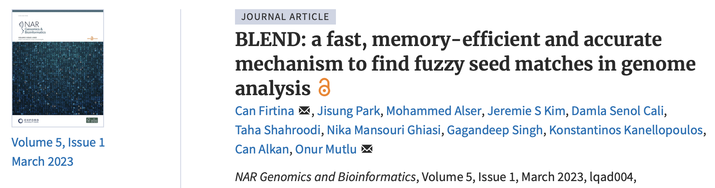
BLEND: Fuzzy Seed Matching [NARGAB '23]
BLEND: a fast, memory-efficient and accurate mechanism to find fuzzy seed matches
in genome analysis
Can Firtina, Jisung Park, Mohammed Alser, Jeremie S. Kim, Damla Senol Cali, Taha Shahroodi, Nika Mansouri Ghiasi, Gagandeep Singh, Konstantinos Kanellopoulos, Can Alkan, Onur Mutlu
NAR Genomics and Bioinformatics (NARGAB), March 2023
[PDF] [Code] [DOI]
Preprint (bioRxiv) [Link] [PDF]
RECOMB 2023 Talk [Video] [Slides (pptx)] [Slides (pdf)]
Social media thread [Twitter (X), publication] [Twitter (X), preprint]

Slide 16
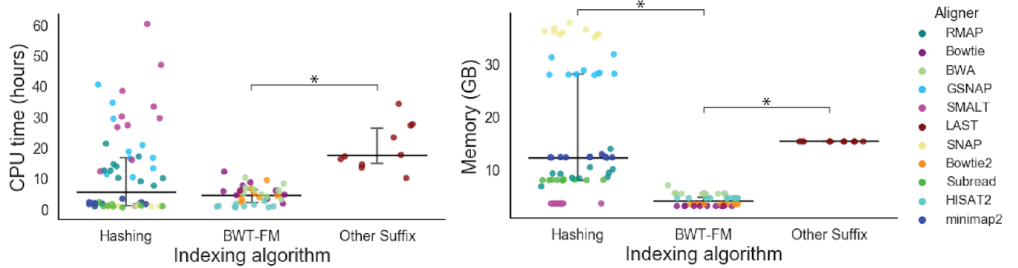
Indexing Cost: A Historical Comparison
Mapper
Alser+, "Technology dictates algorithms: Recent developments in read alignment", Genome Biology, 2021
Notes:
This is the published comparison from Alser et al. (2021), not a current ranking of mapper implementations. Data, presets, hardware, and versions influence indexing costs.

Slide 17
Steps in Read Mapping – Chaining
Read mapping
Indexing
Seeding
Chaining
Alignment
Reference genome
Hash table
Read
0x00
2,64,…
Sketching
0x01
1,101,…
Query
Sketching
Store
…
0xFF
13,21
Hash
Positions
Hash
0x01
0x00
Hash
Hash matches
DP calculations

Slide 18



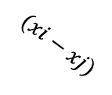








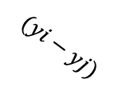
Chaining (Two Points)
$$xj$$
$$xi$$
Chaining
Reference
Reference
$$aj$$
$$ai$$
Anchor
(seed match)
$$wi$$
$$(xi−xj)$$
$$aj$$
$$yj$$
$$yi$$
Read
Read
$$aj$$
$$ai$$
$$(yi−yj)$$
$$wi$$

Slide 19
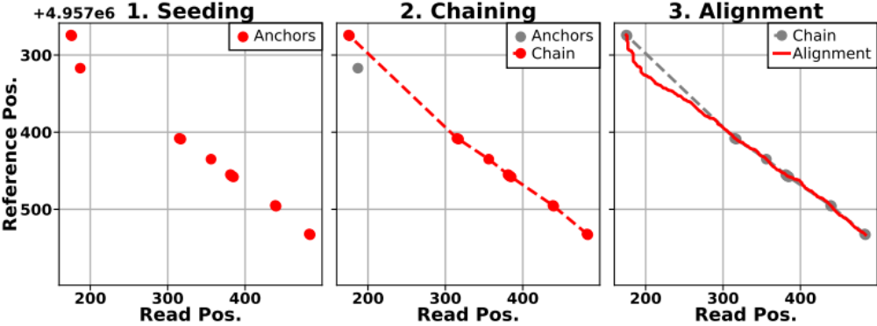
Chaining (Multiple Points)
Seed hits provide candidate anchors
Useful anchors advance in both sequences
Chaining links consistent anchors across gaps

Slide 20
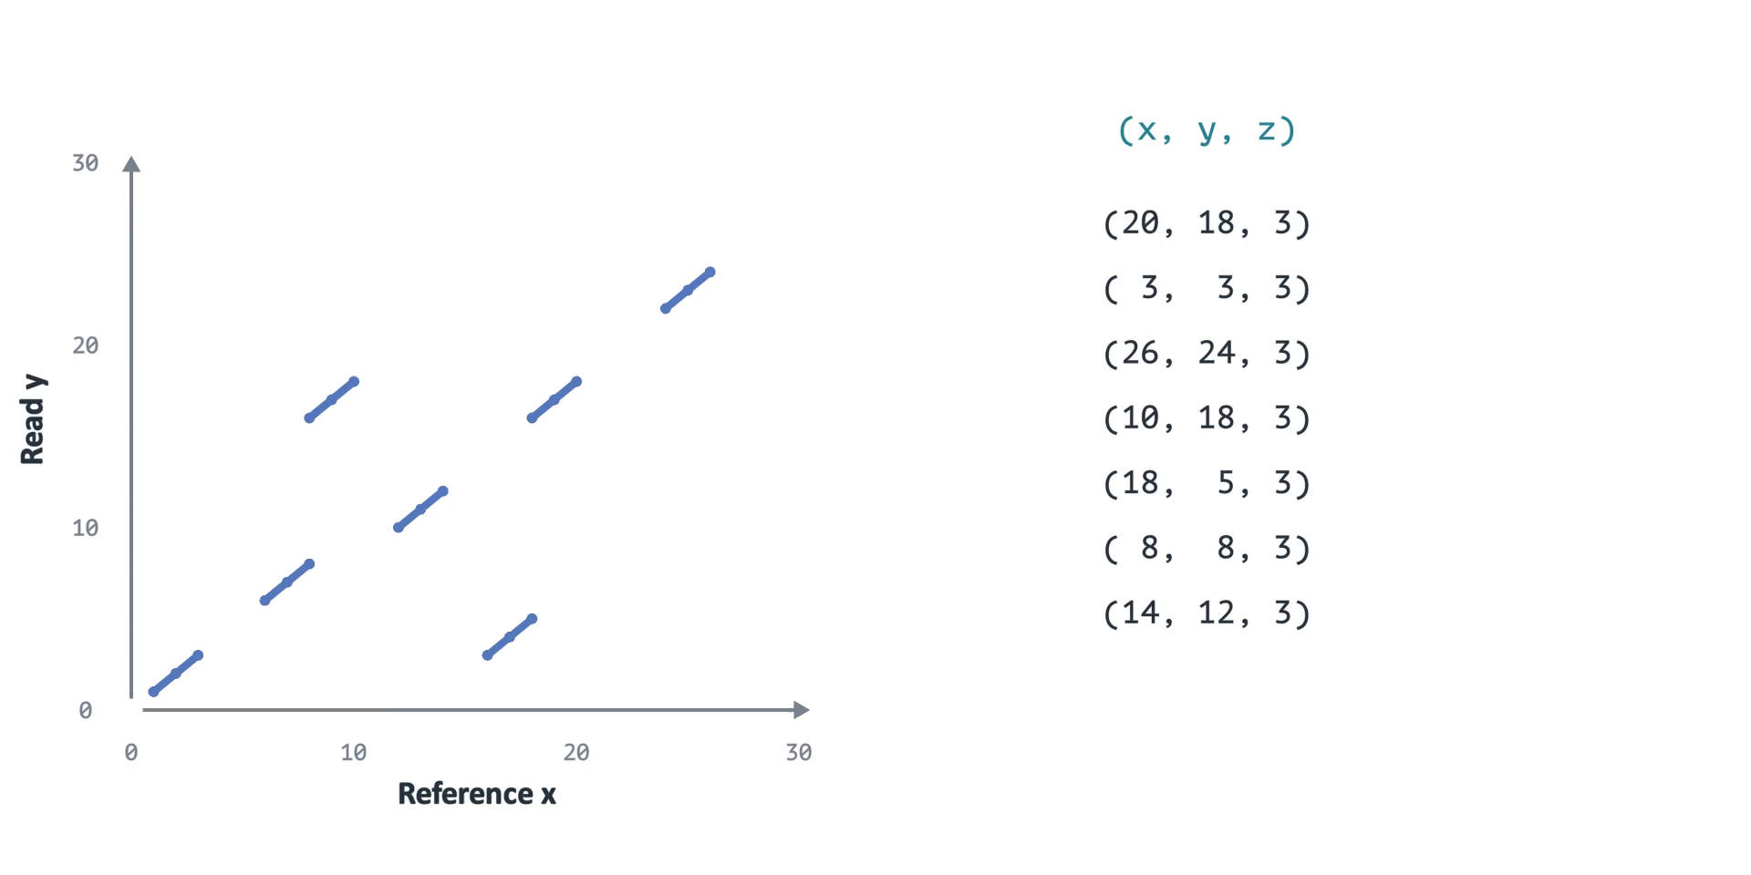
Anchors: Coordinates and DP Order
Sort anchors by reference end position (x)
Notes:
The same seven anchors are used in the next clip. x is the reference end position, y is the read end position, and z is the inclusive seed span (called w in the minimap2 paper). The illustration uses one reference and one forward orientation, with 1-based positions and span 3. Sort by increasing reference end x; only compatible predecessors advancing in both coordinates can form a chain. The sorted index i is the DP index, not a base position. f[i] stores the best chain score ending at anchor i; p[i] stores its predecessor index. These are one-dimensional arrays, not the base-level alignment matrix. Source: https://github.com/lh3/minimap2#algorithm-overview and https://doi.org/10.1093/bioinformatics/bty191 .

Slide 21
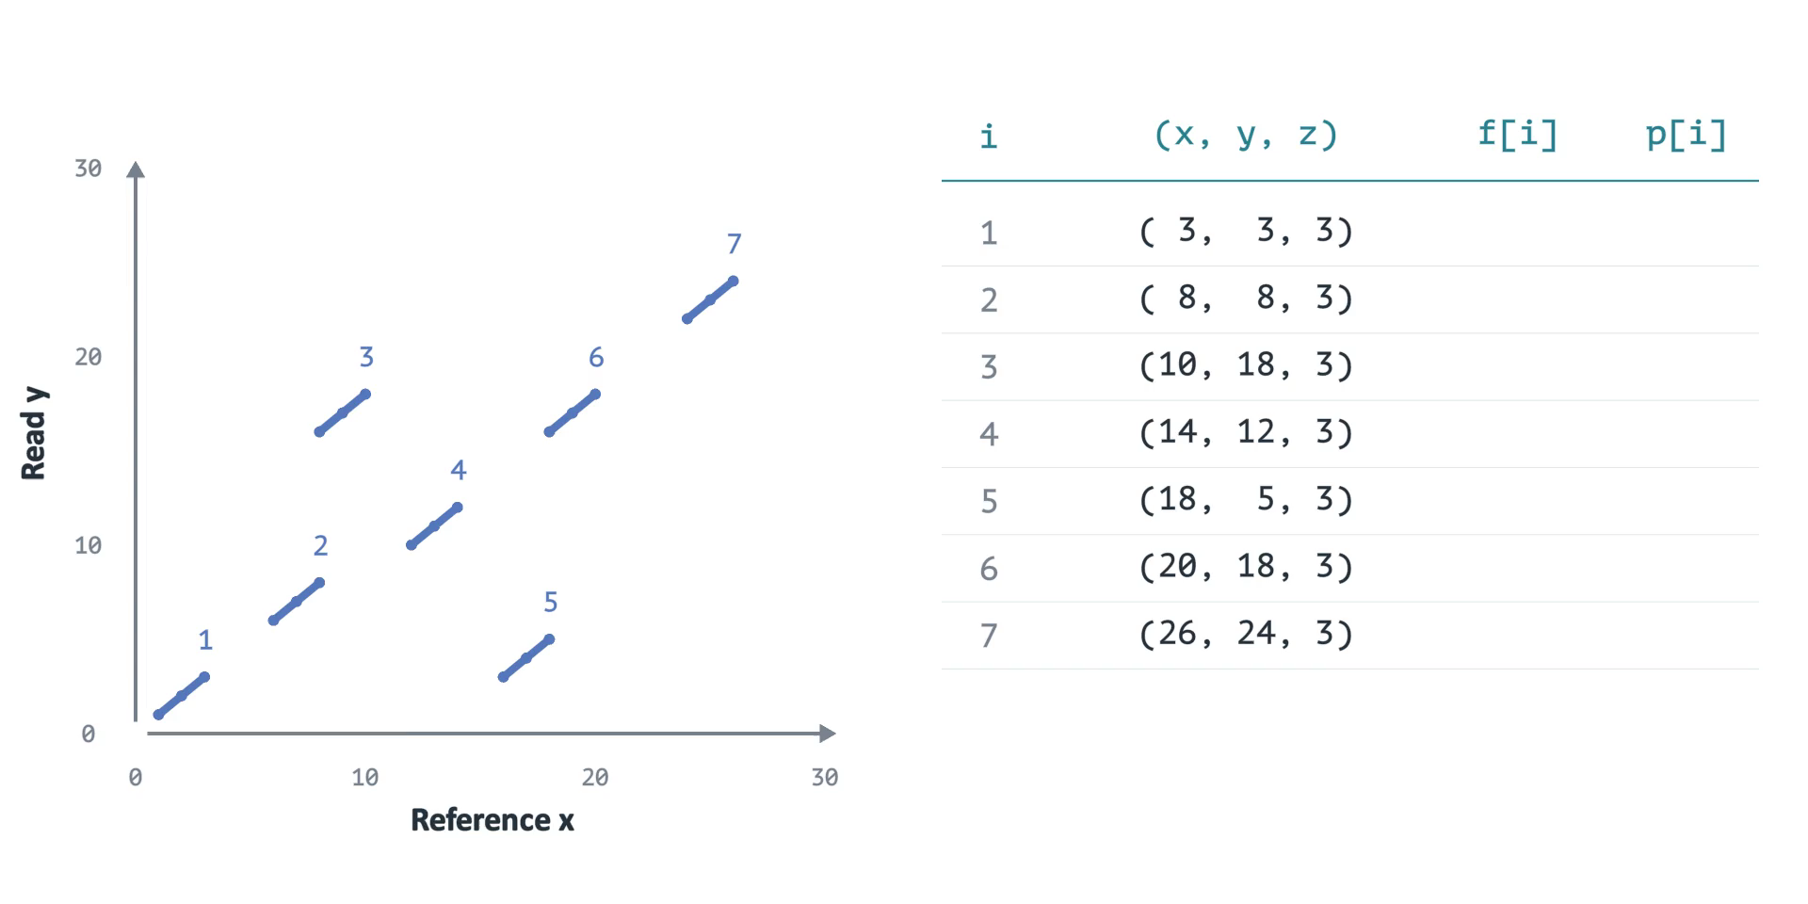
Chaining: Scoring Consistent Anchors
Example gap penalty: |Δx − Δy|
Notes:
Each segment is an anchor, a seed match with positions in the reference and read. The example uses seven non-overlapping anchors of weight 3. Extend only from anchors that advance in both coordinates. The toy score is matched length minus |Δreference − Δread|; it is deliberately simpler than minimap2's chaining score. A chain can start at any anchor. The displayed scores and chain are computed, not hand-selected. Anchor 6 extends anchor 4: 7 + 3 − 0 = 10. Backtracking from the largest score selects 1, 2, 4, 6, 7. Production mappers restrict candidate predecessors and may use heuristics. Chaining narrows the search region; base-level alignment still follows. Source: Li, Minimap2 (2018), https://doi.org/10.1093/bioinformatics/bty191 .

Slide 22
Steps in Read Mapping – Alignment
Read mapping
Indexing
Seeding
Chaining
Alignment
Reference genome
Hash table
Read
0x00
2,64,…
Sketching
0x01
1,101,…
Query
Sketching
Store
…
0xFF
13,21
Hash
Positions
Hash
0x01
0x00
Hash
Hash matches
DP calculations

Slide 23
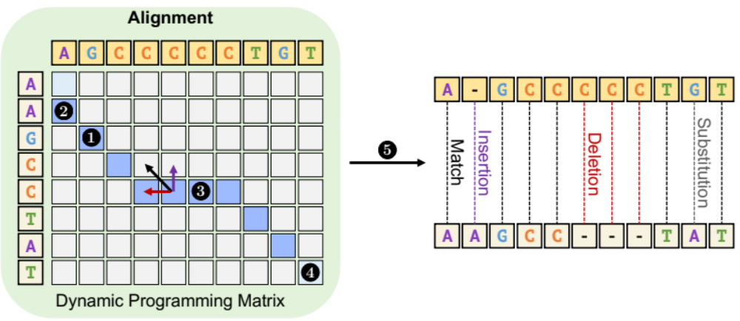
Sequence Alignment

Slide 24
Alignment Objectives
Global
Reference
A
C
G
T
A
C
Both Sequences, End to End
Query
A
C
-
T
T
C
Semi-Global
Reference
G
G
A
C
G
T
A
C
C
C
A Full Read Within a Reference
Query
-
-
A
C
G
T
A
C
-
-
Local
Reference
T
T
A
C
G
T
G
G
Matching Substrings of Both
Query
C
C
A
C
G
T
A
A
Notes:
Global alignment consumes both sequences end to end. Semi-global alignment can align the entire read within a longer reference region without penalizing the reference's outside flanks. Local alignment selects substrings of both sequences, usually with positive match rewards and negative mismatch/gap scores. Gray bases illustrate unaligned flanks, not a shared scoring calculation. The next animations use GLOBAL UNIT EDIT DISTANCE: match 0, mismatch 1, each inserted/deleted base 1. Real read mapping commonly aligns candidate regions using extension or ends-free variants. Sources: https://github.com/smarco/WFA2-lib ; https://biopython.org/docs/latest/Tutorial/chapter_pairwise.html .

Slide 25
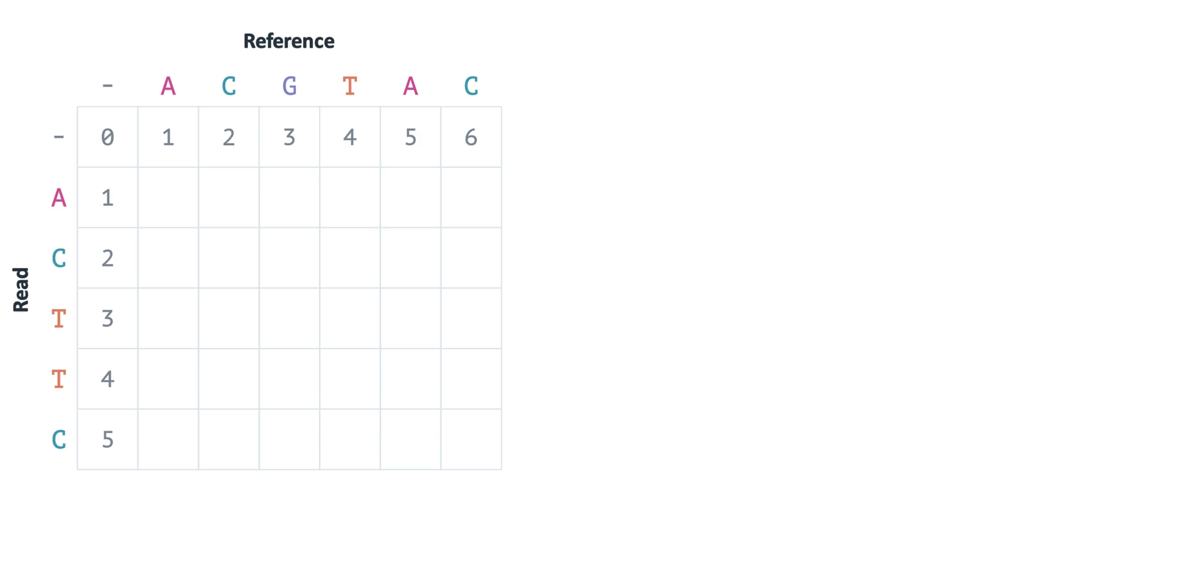
Alignment: Filling the DP Matrix
Each cell stores the best cost for two prefixes
Notes:
The top sequence is the reference ACGTAC; the left sequence is the query ACTTC. A cell D[i,j] stores the minimum edit cost for the first i query bases and first j reference bases. Row/column zero represent an empty prefix, so their costs are 0, 1, 2, ... . Diagonal compares two bases and adds 0 for a match or 1 for a mismatch. Left consumes a reference base and inserts a gap in the query; up consumes a query base and inserts a gap in the reference. Both gap moves cost 1. Each cell takes the smallest accumulated cost. The final cell is 2. This is the simple global edit-distance DP, not affine-gap alignment or local Smith–Waterman. Source: Wagner and Fischer (1974), https://doi.org/10.1145/321796.321811 .
At the final read C and the penultimate reference A, D[5,5] is 2. The candidate from above is D[4,5]+1 = 2+1 = 3, because a vertical move adds a gap in the reference. The candidate from the left is D[5,4]+1 = 2+1 = 3. The diagonal candidate is D[4,4]+1 = 1+1 = 2, because C and A mismatch. Thus the lower 2 comes from the diagonal 1, not the upper 2. Neighboring cells can have the same optimal value while using different alignment paths.

Slide 26
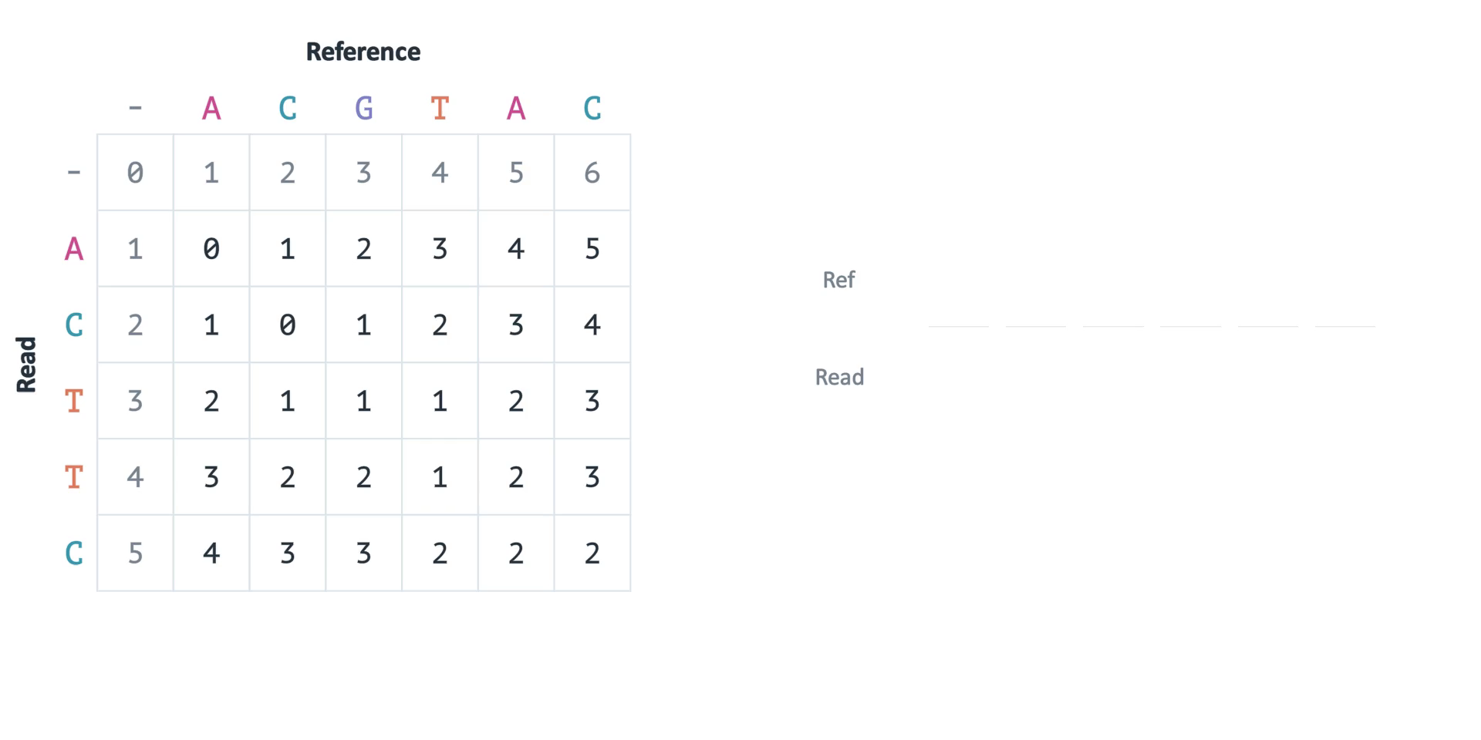
Alignment: Traceback
Follow a predecessor that explains the current cost
Notes:
Continue directly from the preceding filled matrix. The final value gives the COST, not yet the base-by-base alignment. Starting at the bottom-right cell, choose a predecessor whose cost plus its edit explains the current value. Diagonal consumes both bases; left makes a query gap; up makes a reference gap. Because we walk backward, prepend each aligned pair. The demonstrated result is reference ACGTAC versus query AC-TTC, one gap plus one mismatch, total cost 2. Other tie choices may yield another optimal alignment. The code uses a deterministic tie order and verifies that ungapping recovers both input strings. Source: https://doi.org/10.1145/321796.321811 .
At the final read C and the penultimate reference A, D[5,5] is 2. The candidate from above is D[4,5]+1 = 2+1 = 3, because a vertical move adds a gap in the reference. The candidate from the left is D[5,4]+1 = 2+1 = 3. The diagonal candidate is D[4,4]+1 = 1+1 = 2, because C and A mismatch. Thus the lower 2 comes from the diagonal 1, not the upper 2. Neighboring cells can have the same optimal value while using different alignment paths.

Slide 27
Affine Gap Costs
Gap cost = open + length × extend
Open = 4 extend = 1
One gap of length 3
Three gaps of length 1
Reference
Reference
A
C
A
A
A
A
A
A
G
T
A
C
A
A
A
A
A
A
G
T
Query
Query
A
C
A
-
-
-
A
A
G
T
A
C
-
A
-
A
-
A
G
T
4 + 3 × 1 = 7
3 × (4 + 1) = 15
Opening another gap has an extra cost
Notes:
The two examples align the SAME reference ACAAAAAAGT to the SAME query ACAAAGT. All non-gap pairs match. With unit per-base gap cost both alignments cost 3. An affine model distinguishes opening a new gap from extending an existing gap. Here g(ℓ)=o+ℓe, o=4 and e=1: one gap of length three costs 7, while three gaps of length one cost 15. Some literature instead writes o+(ℓ−1)e, so be explicit about the convention. Gotoh-style DP maintains match/insertion/deletion states. Gap-affine WFA also uses multiple states. Source: WFA2-lib distance metrics, https://github.com/smarco/WFA2-lib .

Slide 28
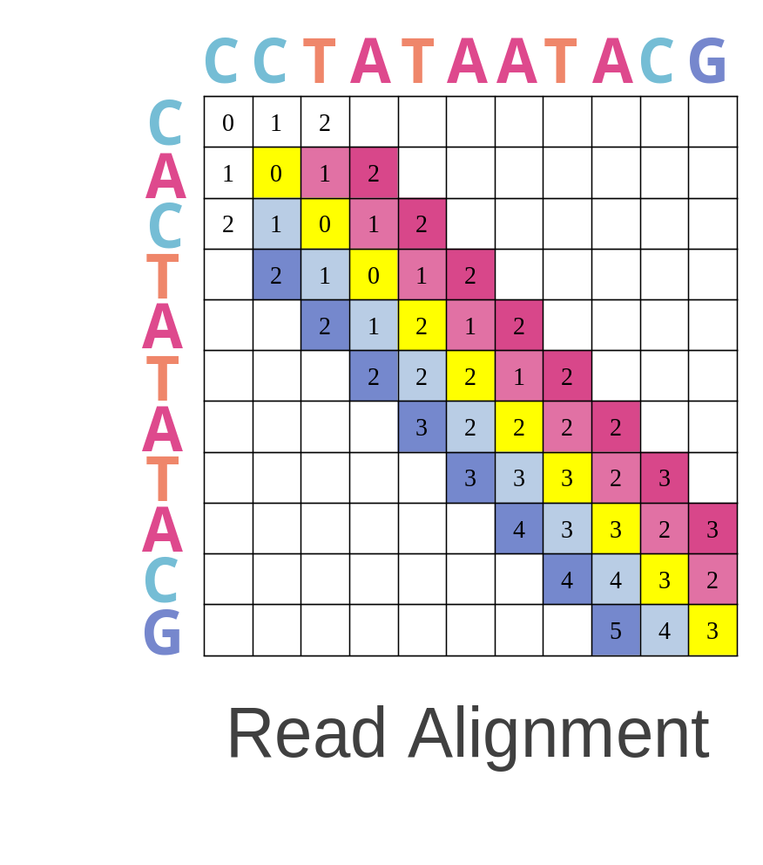
Why Is Read Alignment Slow?
Full DP evaluates O(mn) cells
etc
etc
Dependencies constrain the update order
etc
Many cells may be unnecessary for similar sequences
Notes:
1- Read alignment follows the basic dynamic-programming doctrine which runs in a quadratic time.
2- Data dependencies between the entries limits the parallelism. Each cell depends or three pre-computed cells (immediate left, upper, and upper-left cells). Thus, we can compute the vectors one after another but not in parallel. Left-to-right, or top-to-bottom, anti-diagonal.
3- We can solve a significant amount of time, If we can find a way to detect the incorrect mappings with cheap heuristics, much cheaper than computing the alignment.
Cells on the same anti-diagonal can be processed in parallel once predecessor diagonals are ready. Dependencies constrain scheduling rather than prohibit parallelism. Full DP is a baseline, not a requirement of every alignment algorithm.

Slide 29
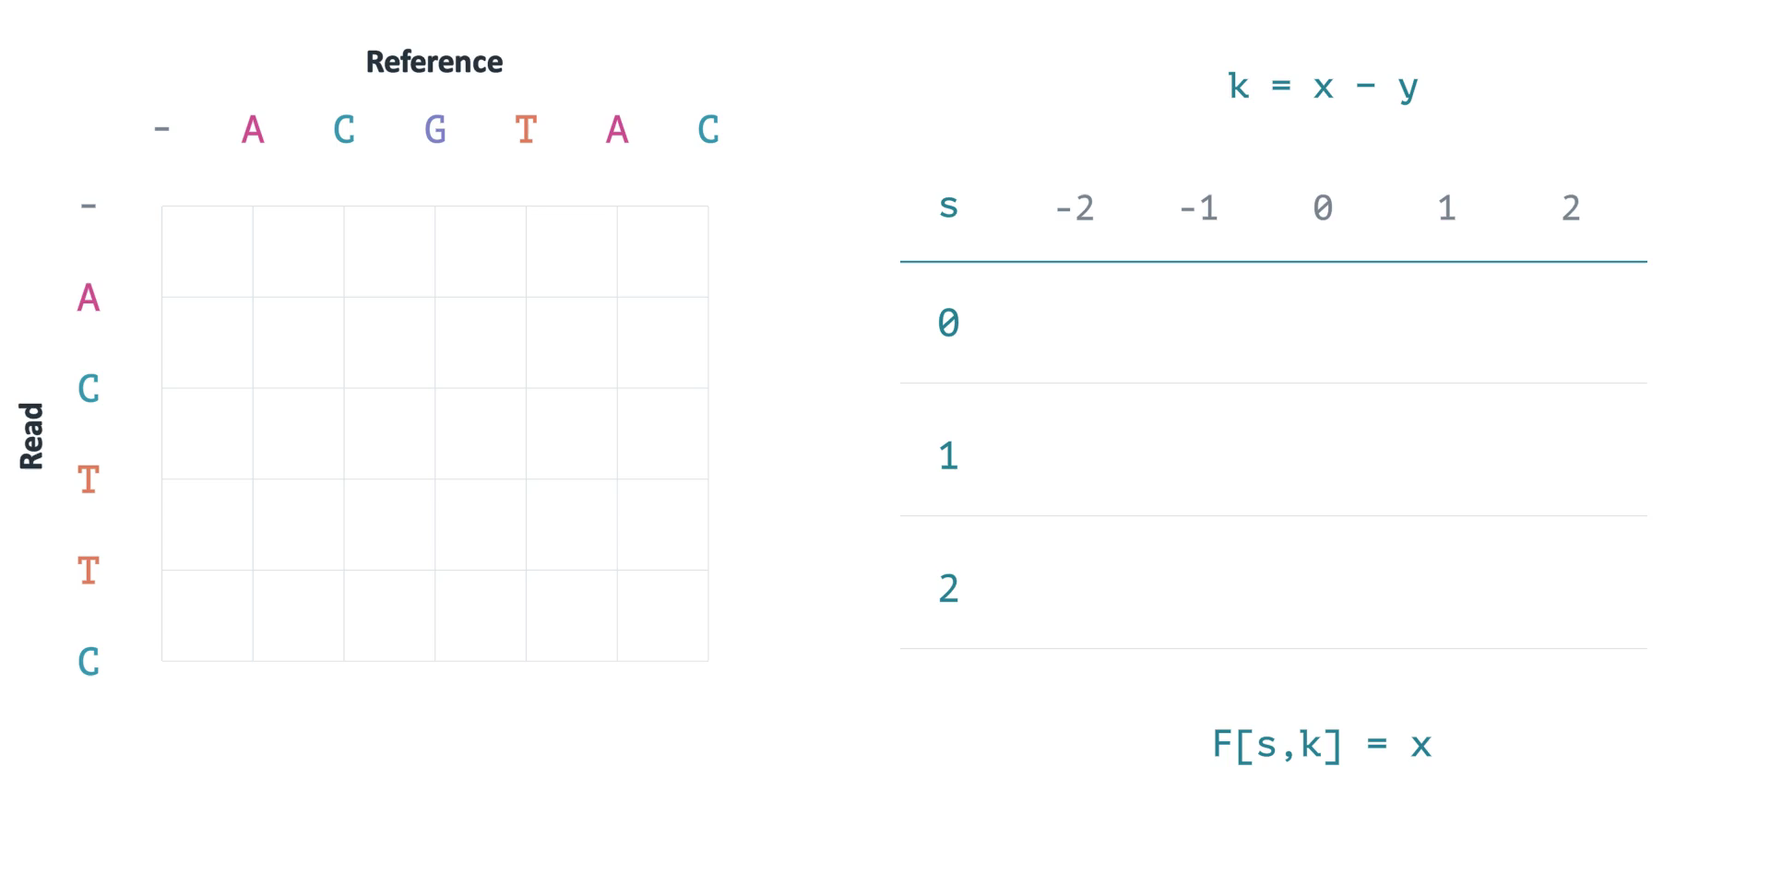
Wavefront Alignment
Unit-cost example: furthest reachable point per diagonal
Notes:
Use the SAME two sequences and SAME unit costs as the preceding DP clip. Instead of filling every prefix pair, increase the total allowed edit cost s. On each diagonal retain a furthest-reaching point. Pay for a mismatch or a one-base gap, then extend exact matches at no additional cost. The first frontier that reaches the end has optimal cost 2, matching the full DP. Diagonal k = reference position − query position. Dots are retained states, not probabilities. This is the unit-cost teaching version of the diagonal-transition idea; production gap-affine WFA uses match, insertion, and deletion wavefronts. It is not merely a diagonal traversal of the full DP table. Exactness holds here because no states are heuristically pruned. Sources: https://doi.org/10.1093/bioinformatics/btaa777 ; https://github.com/smarco/WFA2-lib .

Slide 30
WFA in Practice
Similar sequences can have a small alignment penalty
n = sequence length s = optimal alignment penalty
Time
O(ns + s²)
Fewer states when s is small
Memory
O(s²) → O(s)
BiWFA uses bidirectional divide and conquer
Guarantee
Exact
Heuristic pruning can sacrifice optimality
Worst-case quadratic cost still remains possible
Notes:
n denotes the longer sequence length; s is the optimal alignment penalty, not a similarity percentage or number of matrix diagonals. With the fixed penalty models supported by the library, the stated WFA2 bound is O(ns+s²) time and O(s²) memory. BiWFA reduces auxiliary memory to O(s) using bidirectional divide and conquer. Small s is the favorable regime; worst-case quadratic behavior is still possible. The exact algorithm preserves optimality for its stated alignment objective. Static bands or adaptive pruning can sacrifice that guarantee. The simple movie used unit costs; WFA2 also handles affine and dual-affine penalties. Sources: https://github.com/smarco/WFA2-lib ; https://doi.org/10.1093/bioinformatics/btad074 .

Slide 31
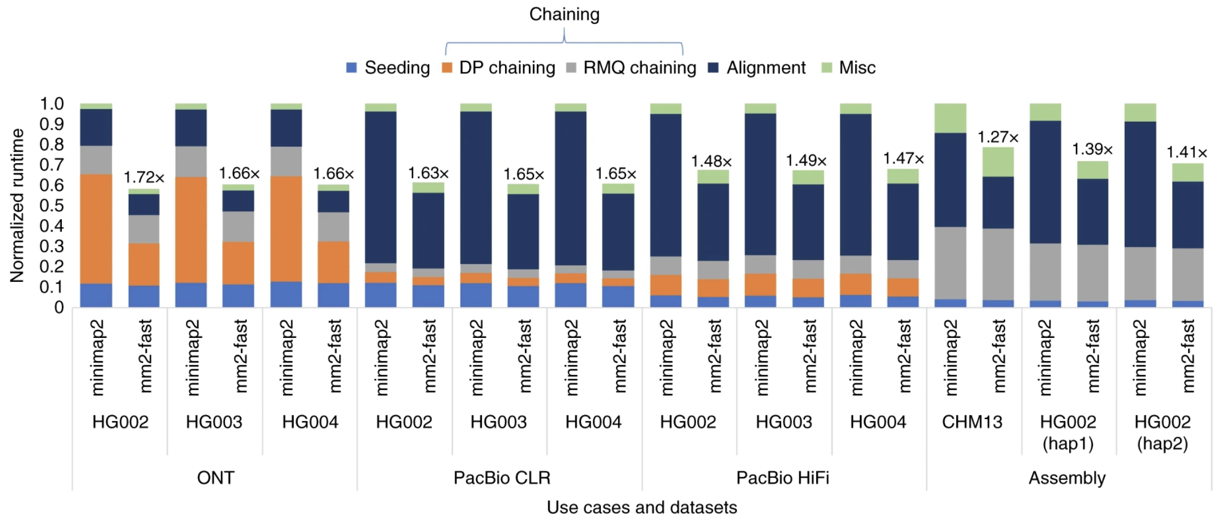
Read Mapping Execution Time
Chaining + alignment
Dominate these minimap2 benchmarks
Kalikar et al., Nature Computational Science, 2022
Notes:
The source profile is Kalikar et al. (2022). Its dominant stages depend on these datasets, presets, code versions, and hardware; it is not a universal percentage for all modern read mappers. https://www.nature.com/articles/s43588-022-00201-8 .

Slide 32
Why do we rely on a single reference genome?

Slide 33

Recall: Solving the Puzzle
Reference genome
Reads
A human reference
About 3.2 billion bases
One representation of genomic sequence
Short and long reads
Candidate locations are found
Relative to a reference

Slide 34

The Problem: Variants in the Genome
Reference genome
Reads
Variants

Slide 35
The Problem: Variants in the Genome
Reference genome
Reads
Some reads can be mapped due to sufficient context
Some reads fail to be mapped
because they are too different from the single reference
Reference bias!

Slide 36


Mapping to Multiple References
Map against multiple reference genomes
Repeating the search duplicates work
The sample may contain new combinations of variants

Slide 37
Mapping to a Graph Reference
Share sequence across reference genomes
Represent alternative alleles as graph paths
Search these alternatives within one reference structure

Slide 38
Genome Graphs
Nodes store sequence; edges connect alternatives
Paths represent different genomic sequences
A graph can reduce single-reference bias
T
Sequence #1: ACGTACGT
Sequence #2: ACGGACGT
Sequence #3: ACGTTACGT
Sequence #4: ACGACGT
ACG
ACGT
T
G
Notes:
With increasing importance and usage of genome graphs, having accurate and efficient tools for mapping genomic sequences to these genome graphs has become crucial. [CLICK]
A graph includes the variation represented by its construction inputs, not all variation in an entire population. Additional variants may still be absent. Graph topology may also permit paths that are not observed haplotypes; the following new slide explains this distinction.

Slide 39
Read Mapping to a Pangenome Graph
Shared sequence, alternative paths
Seeds
T
Matches on graph paths
ACG
ACGT
Chains
G
Compatible order and graph distances
Extension
Read
A
C
G
G
A
C
G
T
Base-level alignment in a candidate region
vg Giraffe: short reads and long-read chaining
Minigraph-Cactus and PGGB build graphs; mappers search them
Notes:
Reuse the seed-chain-extend story from linear mapping. Seeds now have positions on graph paths. For long reads, chaining must use graph connectivity and distances, not just subtract two linear coordinates. Base-level extension then aligns to candidate graph regions. The small graph illustration is schematic, not a literal trace from vg. Giraffe now supports long-read chaining as well as short-read mapping (long-read support released in vg 1.63.0; current documentation checked September 2026). Distinguish graph construction (e.g., Minigraph-Cactus and PGGB) from read mapping. Sources: https://github.com/vgteam/vg ; https://github.com/vgteam/vg/wiki/Mapping-long-reads-with-Giraffe ; https://www.nature.com/articles/s41587-023-01793-w ; https://github.com/pangenome/pggb .

Slide 40
Haplotype-Aware References
Graph topology alone can allow unobserved combinations
Observed haplotype 1
A
C
G
T
A
C
G
T
A
T
T
Observed haplotype 2
A
C
G
G
A
C
G
T
C
T
T
Another graph path
A
C
G
T
A
C
G
T
C
T
T
Notes:
A haplotype path records a sequence observed in an individual chromosome. Graph topology alone may allow combinations of variants that were never observed together. Haplotypes therefore provide additional information for indexing and mapping. Personalized pangenome references use read k-mer counts to select a smaller set of supported haplotype segments for a sample; this can reduce distracting alternatives. Do not claim the graph contains every human variant or that all graph paths are biologically observed. The diagram is illustrative; production haplotype sampling can build synthetic haplotypes from supported segments. Sources: Sirén et al., Personalized pangenome references (2024), https://doi.org/10.1038/s41592-024-02407-2 ; https://github.com/vgteam/vg/wiki/Haplotype-Sampling .

Slide 41
Sequence Analysis: Key Ideas
Seeds
Find candidate matches
Chains
Link consistent positional evidence
Alignment
Resolve base-level differences
Pangenomes
Represent alternatives across genomes
Notes:
Return to the main distinction: mapping searches for candidate locations, alignment explains the base-level differences at a candidate location. Ask students to connect each stage to the computation it avoids or performs. Seeds reduce the search space, chains combine positional evidence, and alignment resolves substitutions and gaps. WFA changes which alignment states are evaluated; graph references change the search space from a linear sequence to alternatives shared across genomes. This slide summarizes the preceding material and introduces no new performance claim.

Slide 42
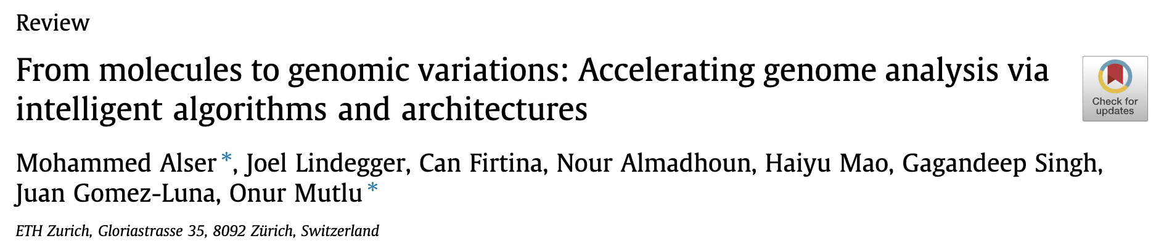
Recommended: Genome Analysis Steps [CSBJ '22]
From molecules to genomic variations: Accelerating genome analysis via
intelligent algorithms and architectures
Mohammed Alser, Joel Lindegger, Can Firtina, Nour Almadhoun, Haiyu Mao, Gagandeep Singh, Juan Gomez-Luna, Onur Mutlu
Computational and Structural Biotechnology Journal (CSBJ), August 2022.
[PDF] [Code] [DOI]

Slide 43
Genome Analysis Pipeline

Slide 44
Further Steps in Genome Analysis

Slide 45
Metagenomics
How to analyze many unknown organisms in the same environment?
Metagenomics

Slide 46
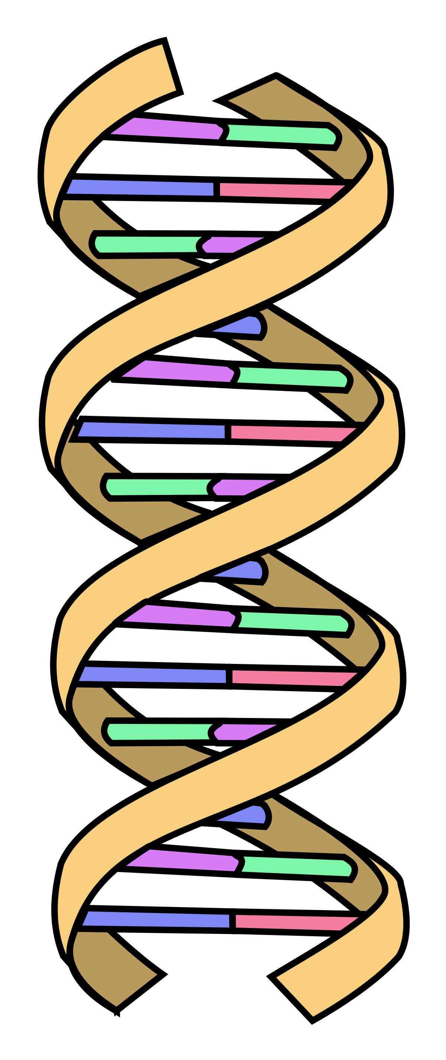
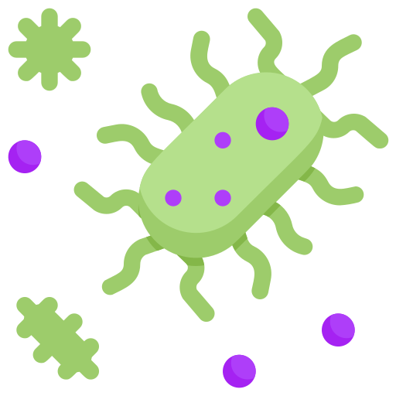





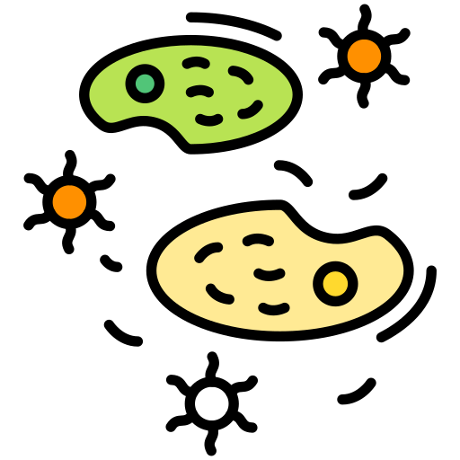

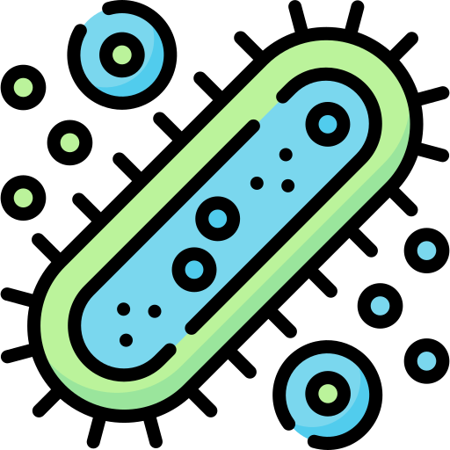
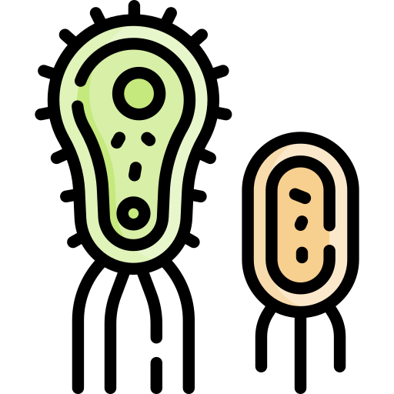

Metagenomic Analysis
GCTCA
Preparation
of input queries
Query
k-mers
CTCAT
TCATG
…
Metagenomic sample
with species that
are not known in advance
V. cholerae
Presence/absence identification
SARS-CoV-2
E. coli
Abundance
estimation
A large database
containing information
on many species
Database size depends on its content and representation

Slide 47
Questions?

Slide 48
Next Week
Finalizing paper assignments
What happens when there is no reference genome available?
  De novo assembly
AI/ML in genomics

Slide 49
CMSC 829C: Algorithms, AI, and Hardware
for Biological Data
Lecture 4: Sequence Analysis in Genomics
Fall 2026
September 10, 2026
Can Firtina | canfirtina@gmail.com | cs.umd.edu/~firtina
Assistant Professor of Computer Science at UMD

