Slide 1
CMSC 829C: Algorithms, AI, and Hardware
for Biological Data
Lecture 3: Introduction to Genomics and Sequencing
Fall 2026
September 8, 2026
Can Firtina | canfirtina@gmail.com | cs.umd.edu/~firtina
Assistant Professor of Computer Science at UMD

Slide 2
Agenda
A quick introduction to genomes and genome analysis
Sequencing technologies
  Particular focus: Nanopore sequencing and real-time analysis

Slide 3

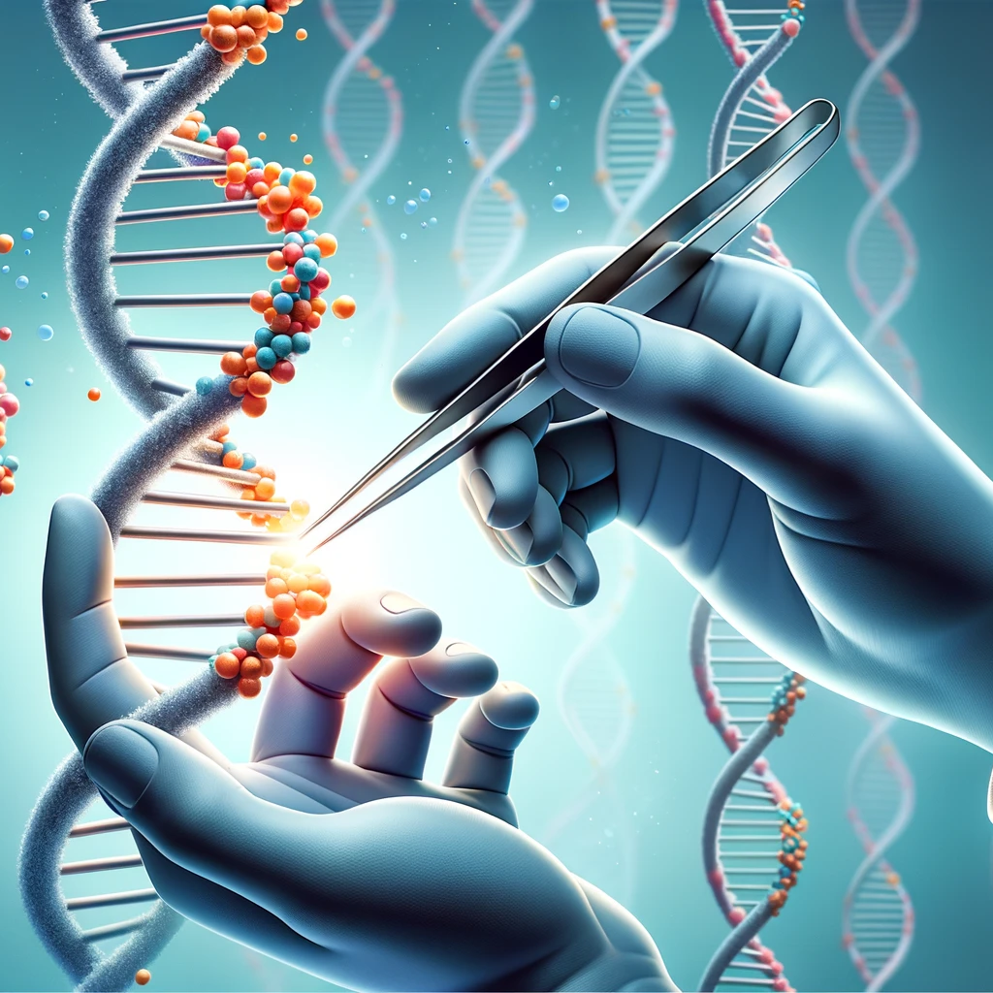


Recall: Analyzing Genomes Reveals Key Insights
Personalized Medicine
Genome Editing
Detecting pathogens
in the environment
Rapid surveillance of
disease outbreaks

Slide 4

What is a Genome?

Slide 5
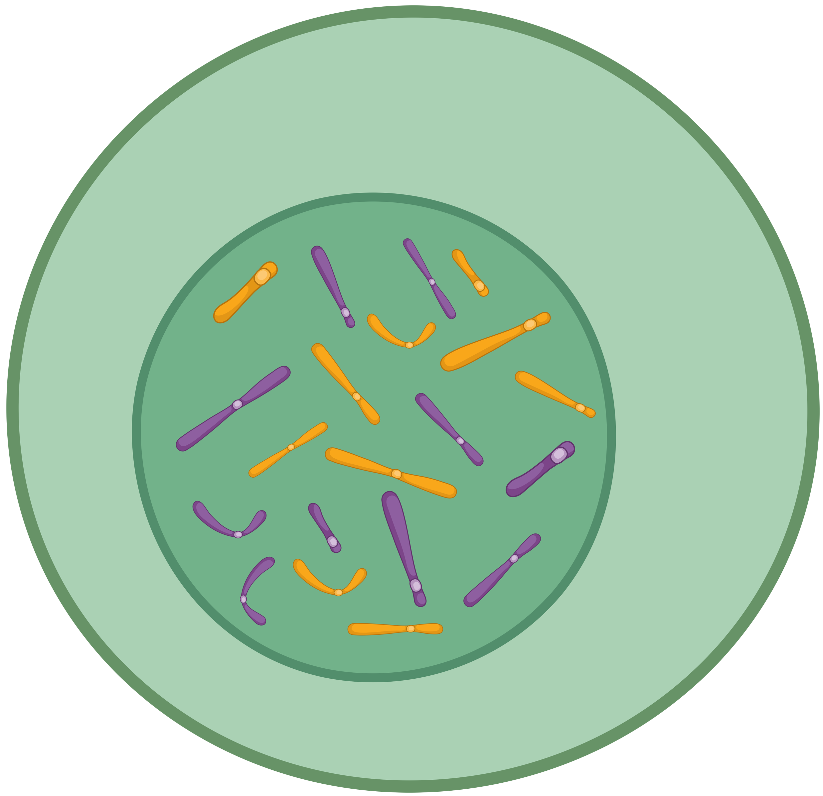
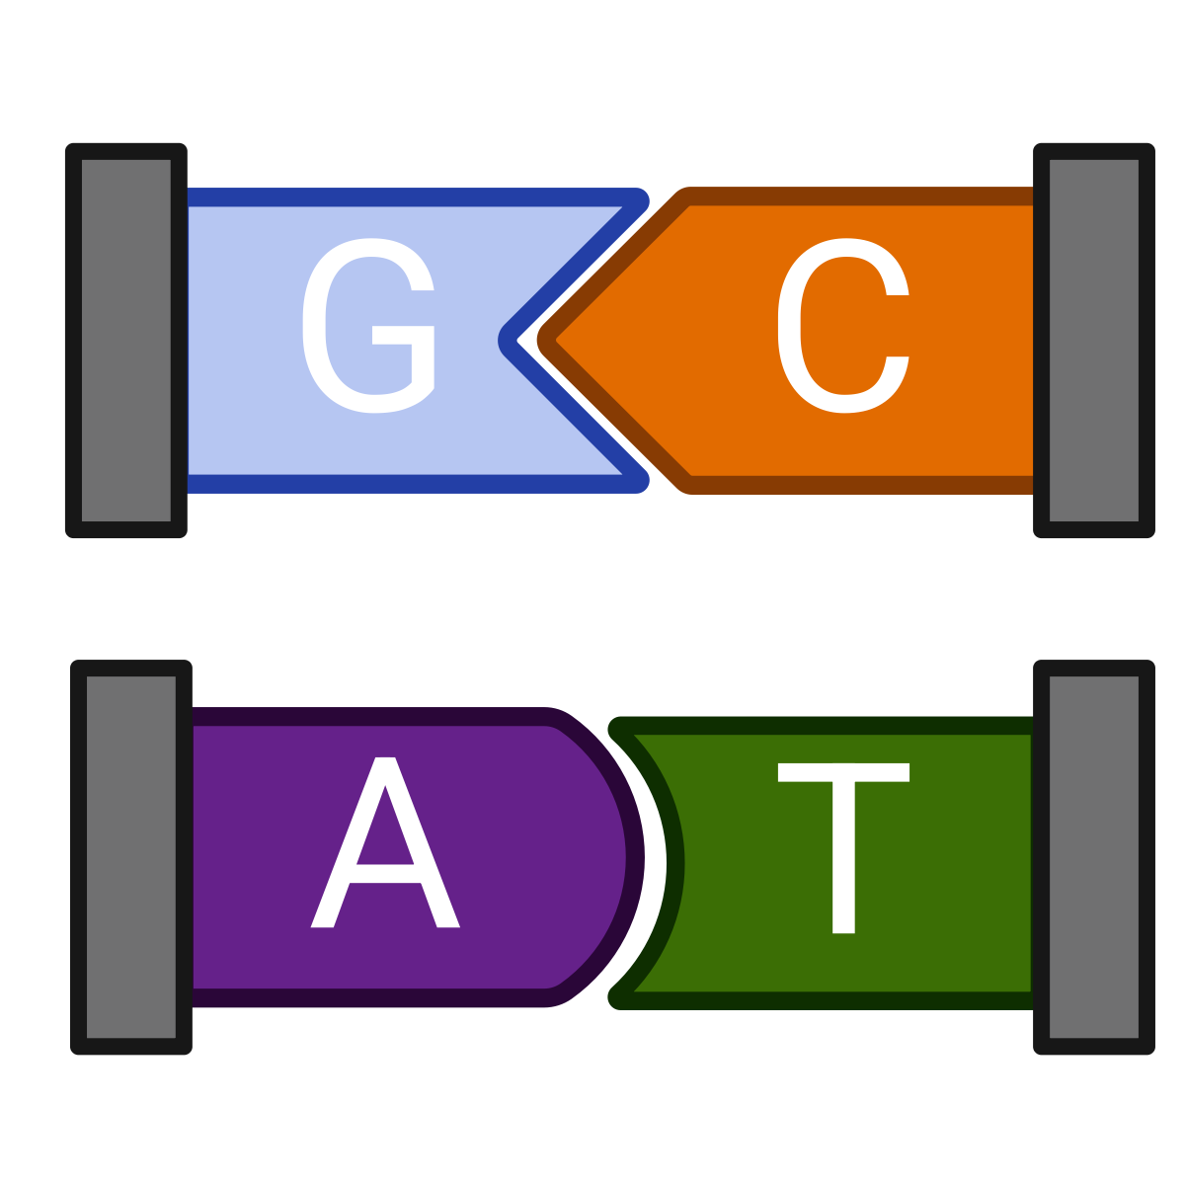
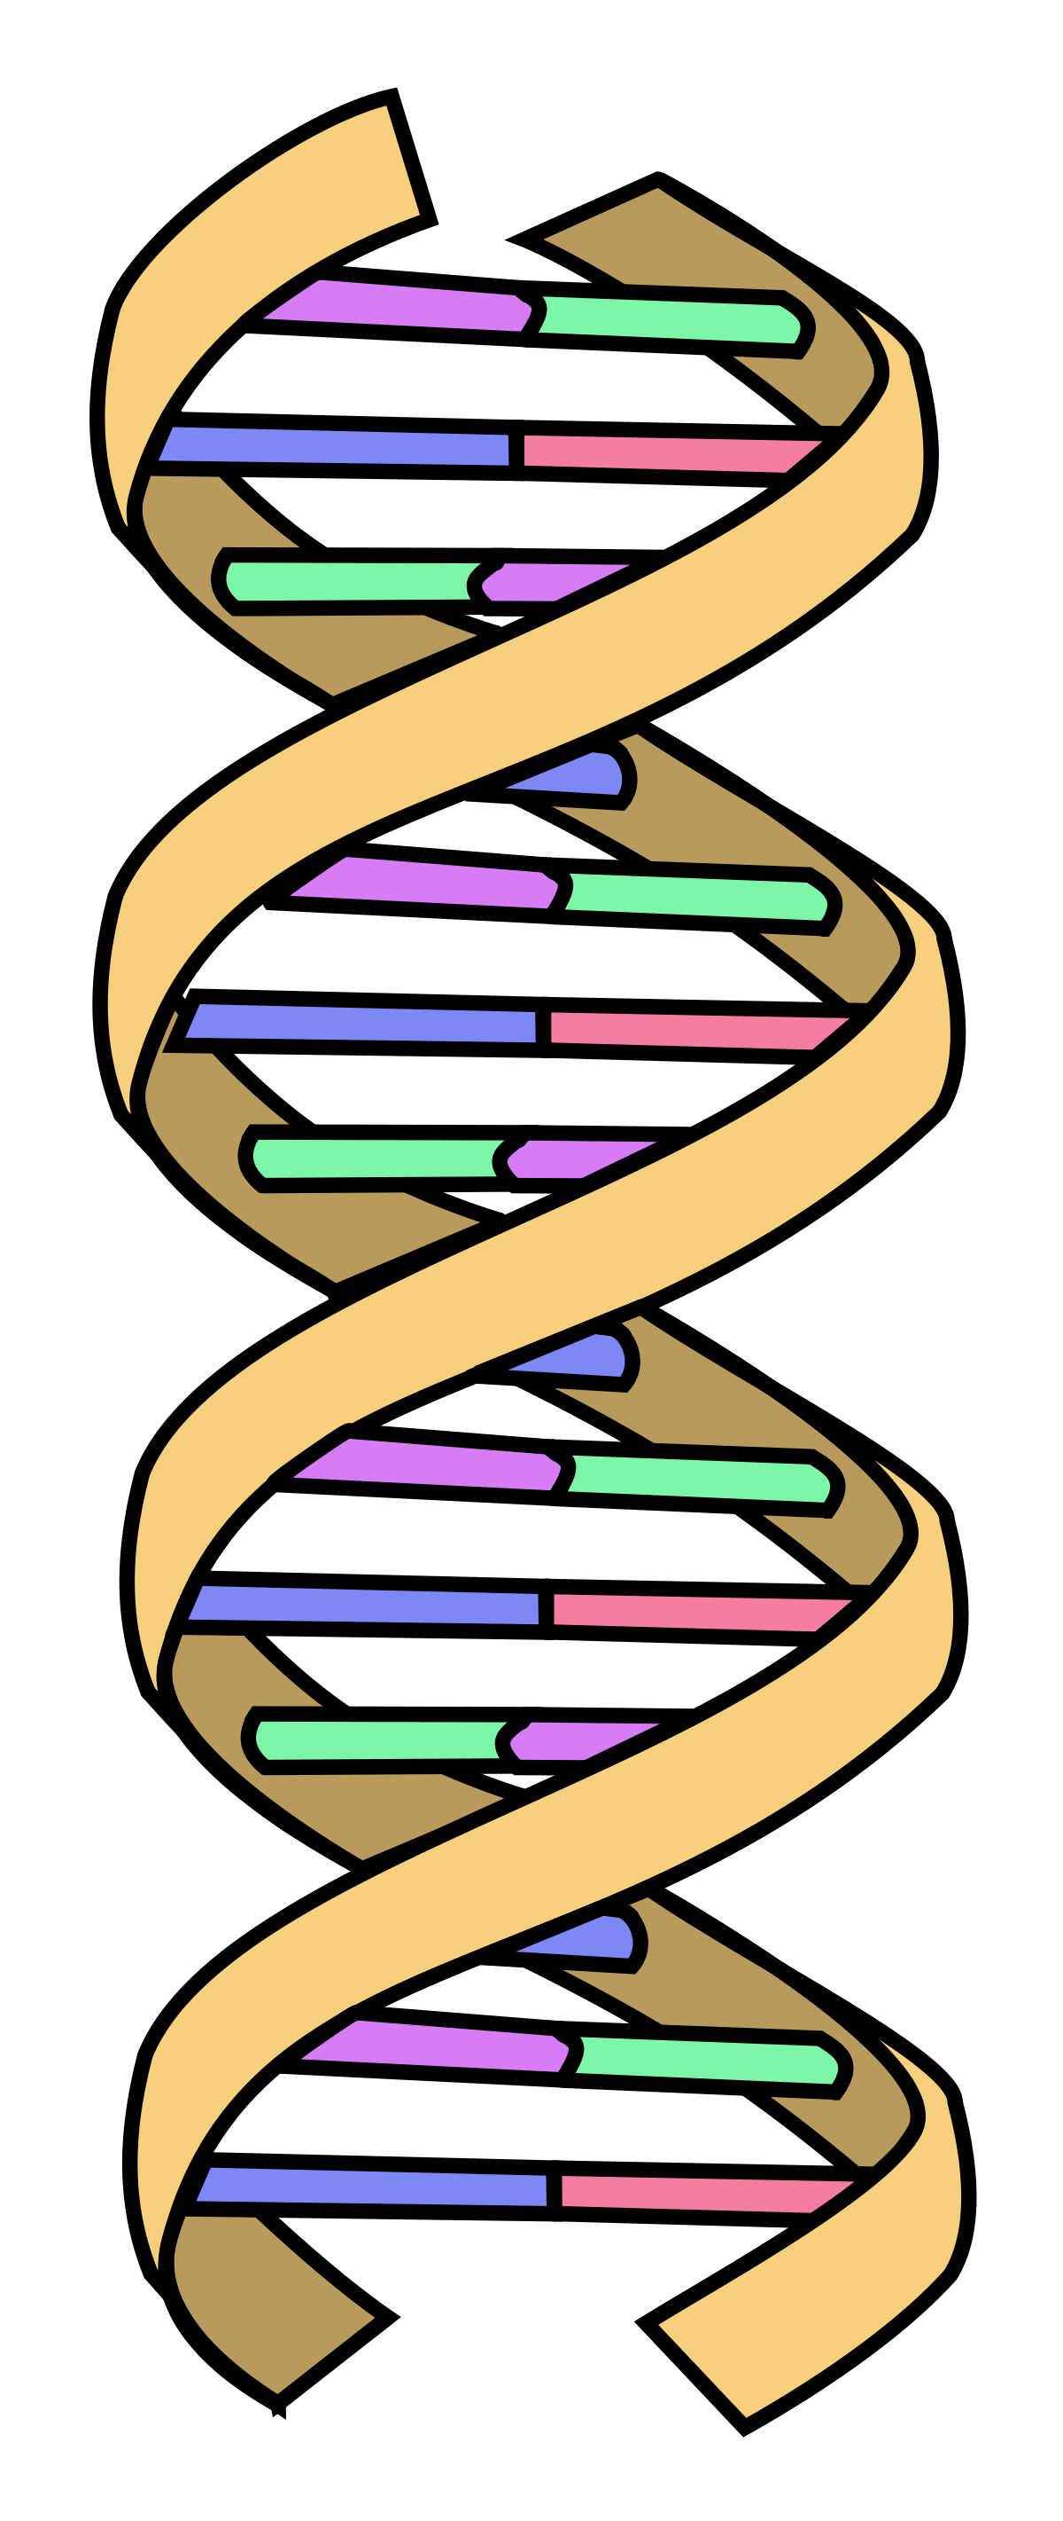

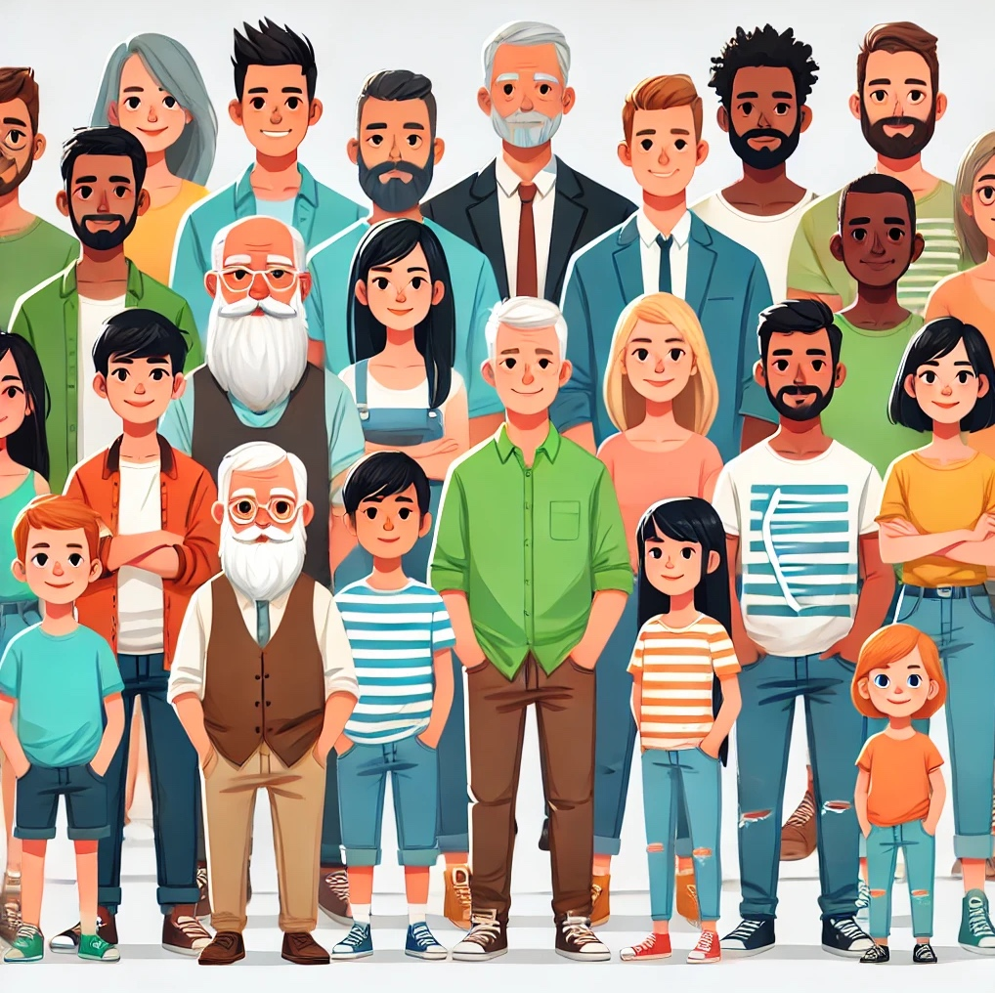
DNA – The Code of Life
Cell
(~6.4B bps)
Chromosome
(50M – 250M bps)
Basepair (bp)
DNA
Trillions of cells

Slide 6
Whole Genome Analysis is Critical
Even a single character can have
huge impact on health
Increased cancer risk
Sickle cell disease
Improving the quality of life?
Color blindness

Slide 7
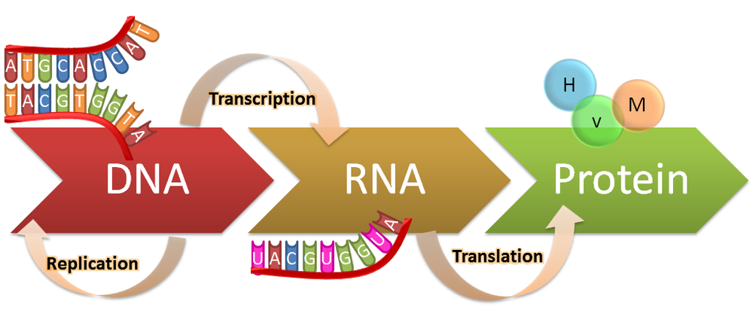

The Central Dogma of Molecular Biology
Genotypes
Phenotypes

Slide 8
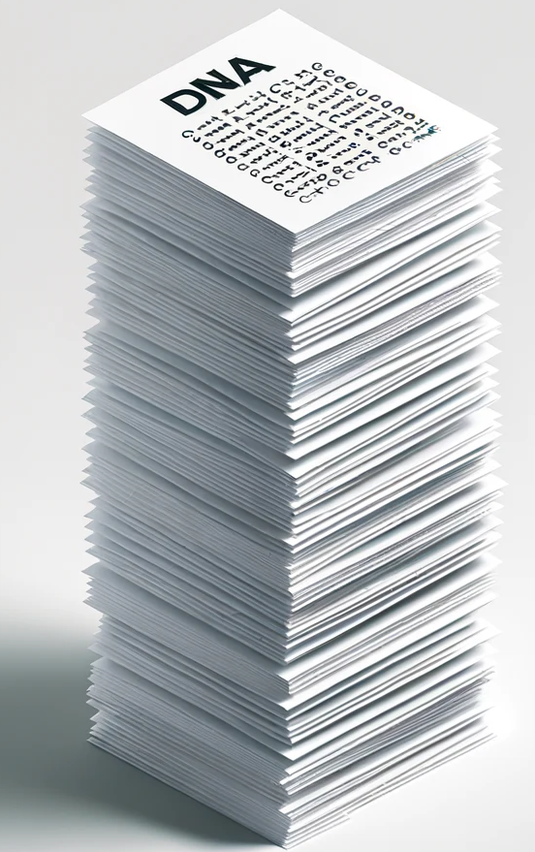
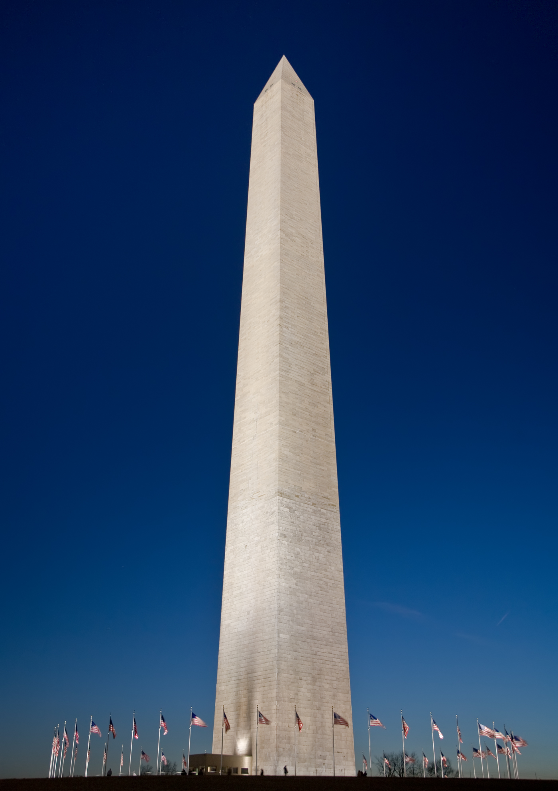
How Large Is a Human Genome?
~170 meters
~200 meters
Washington Monument, DC
~6.4 billion bases*
https://simple.wikipedia.org/wiki/Washington_Monument
*~200 meters = 80 characters per line, 40 lines per A4 page, each page is 0.1mm thick

Slide 9
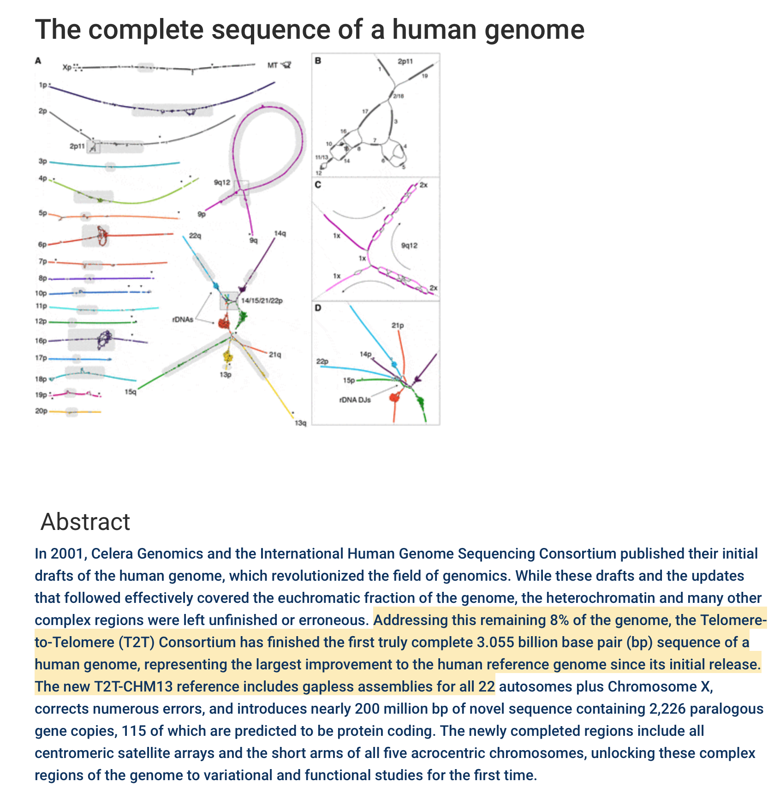
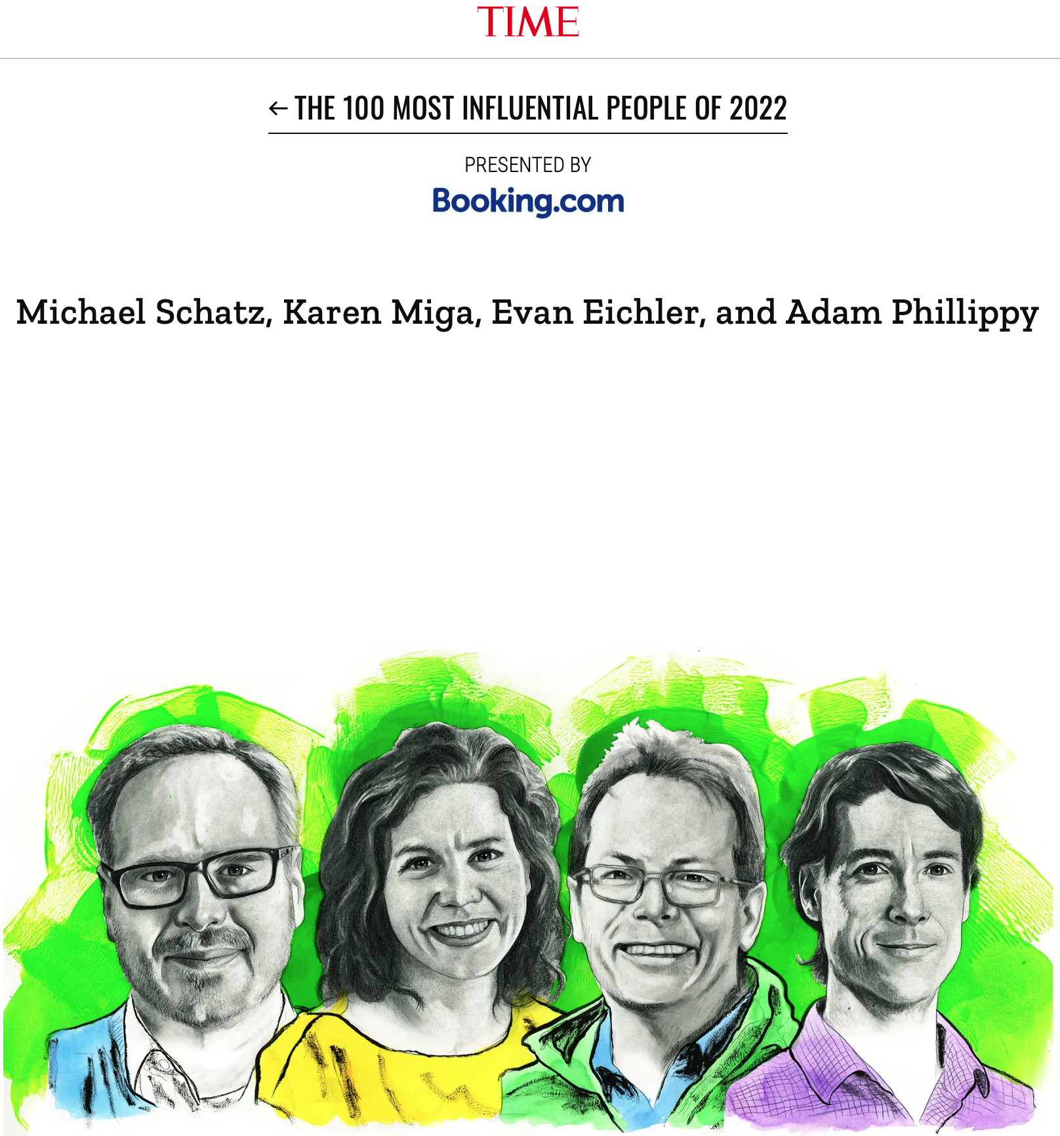
Constructing the Human Reference Genome
2022: A gapless human reference genome
https://genomics.ucsc.edu/2021/06/09/the-complete-sequence-of-a-human-genome/
https://time.com/collection/100-most-influential-people-2022/...

Slide 10
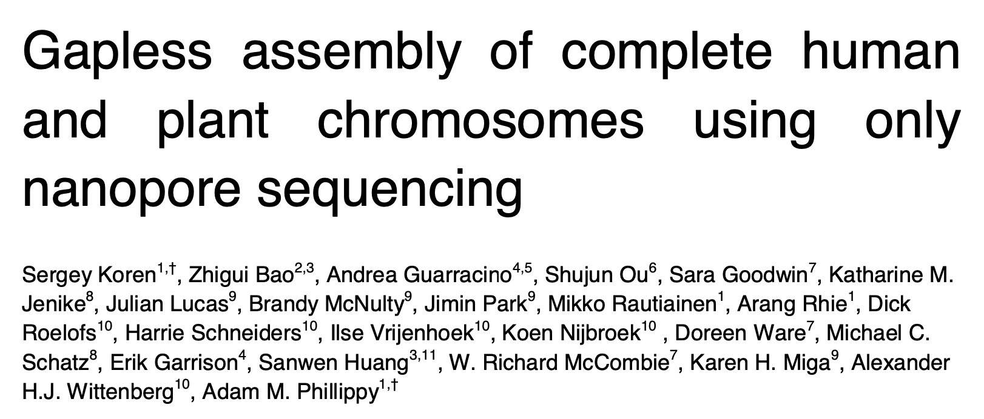
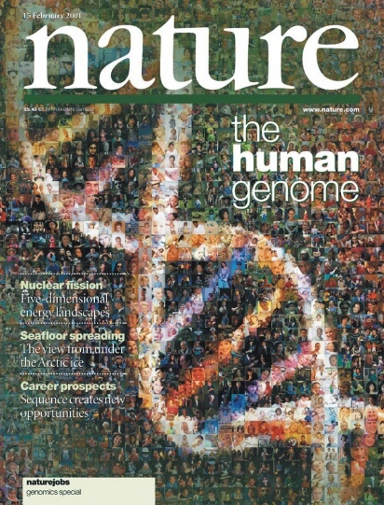

Humanity’s Longest Puzzle Solving Challenge
2003
2022
~1990
2018
Today
?
The Complete
Human Reference Genome
The Complete
Human Reference Genome (Really)
The Complete Human & Plant Chromosomes
A Complete
Human Genome
Significant resources, expertise, and time
(yet incomplete)
Significant resources
and expertise
Significant
expertise
No expertise,
Limited
resources, quick, and
accurate

Slide 11

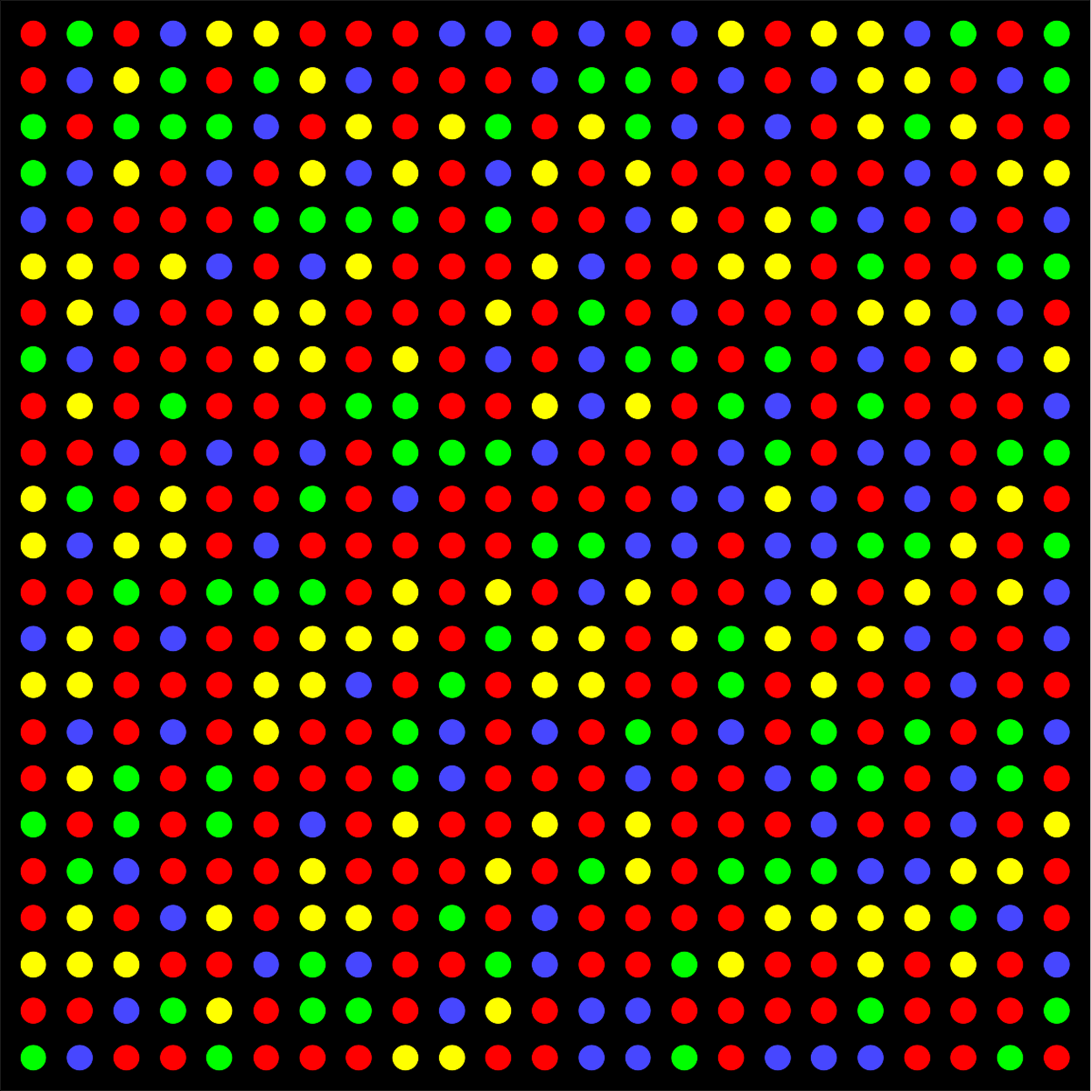

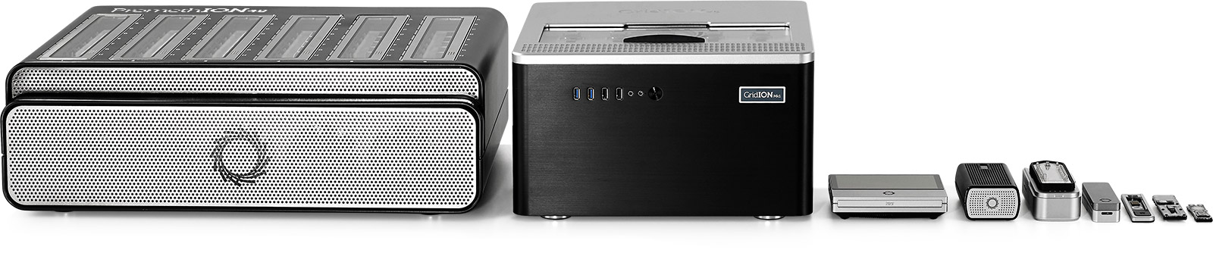


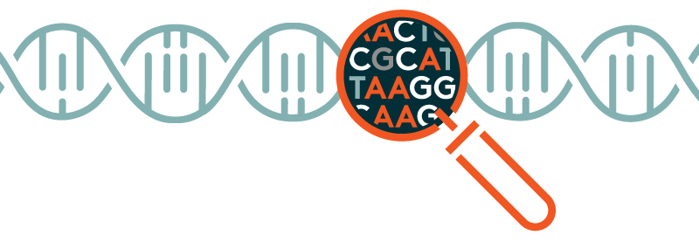
Genome Analysis in Real Life
Prepared DNA Fragments
Raw Sequencing Data
Sample Collection
Sequencing
Computational Steps
DNA
Molecule
Genomic Analyses
Library Preparation

Slide 12
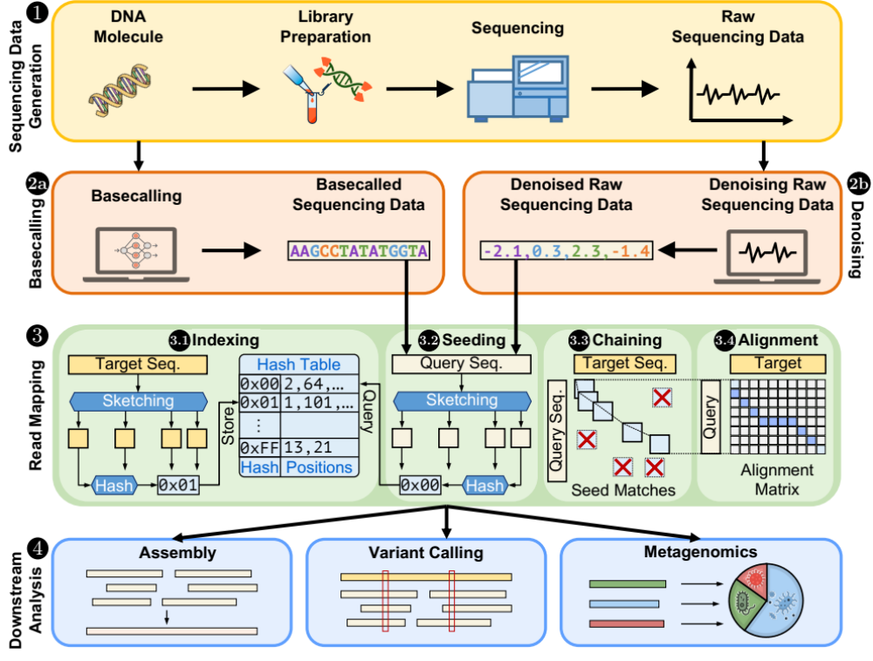
Genome Analysis Pipeline

Slide 13
Sequencing Data Generation

Slide 14
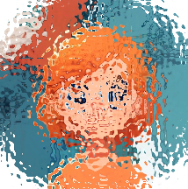
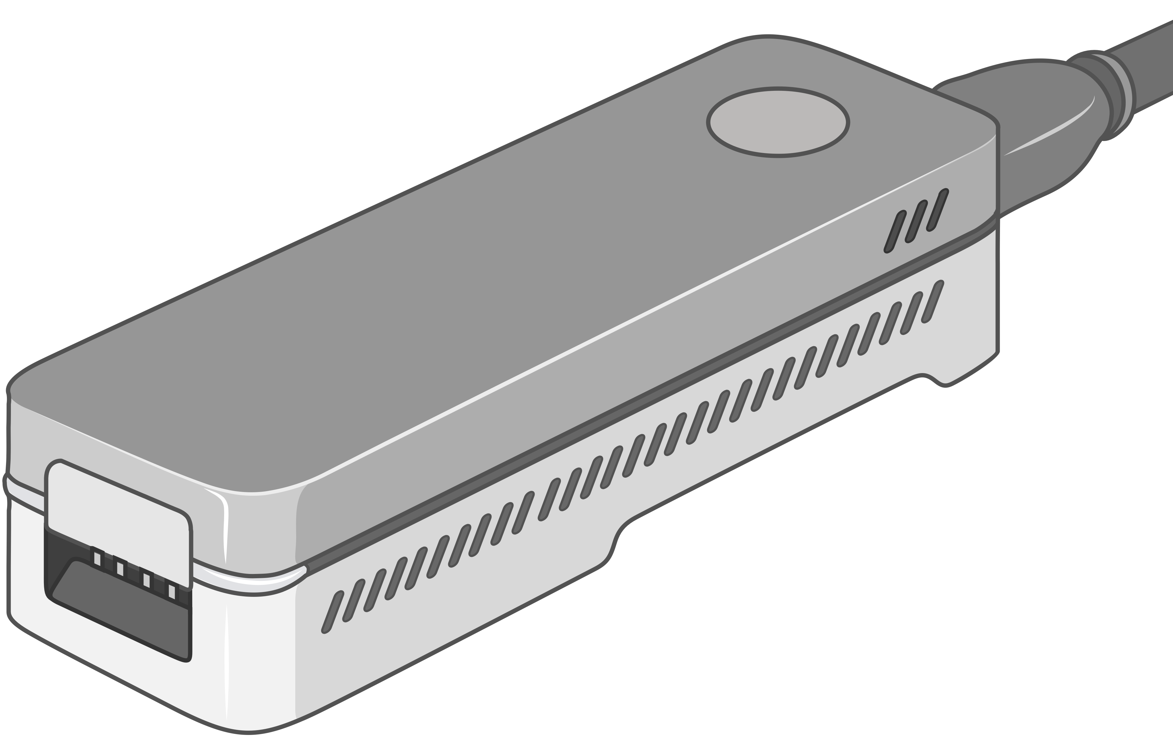
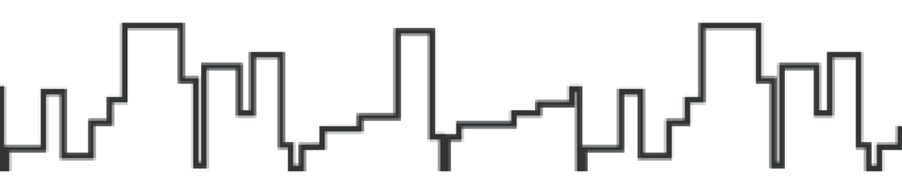

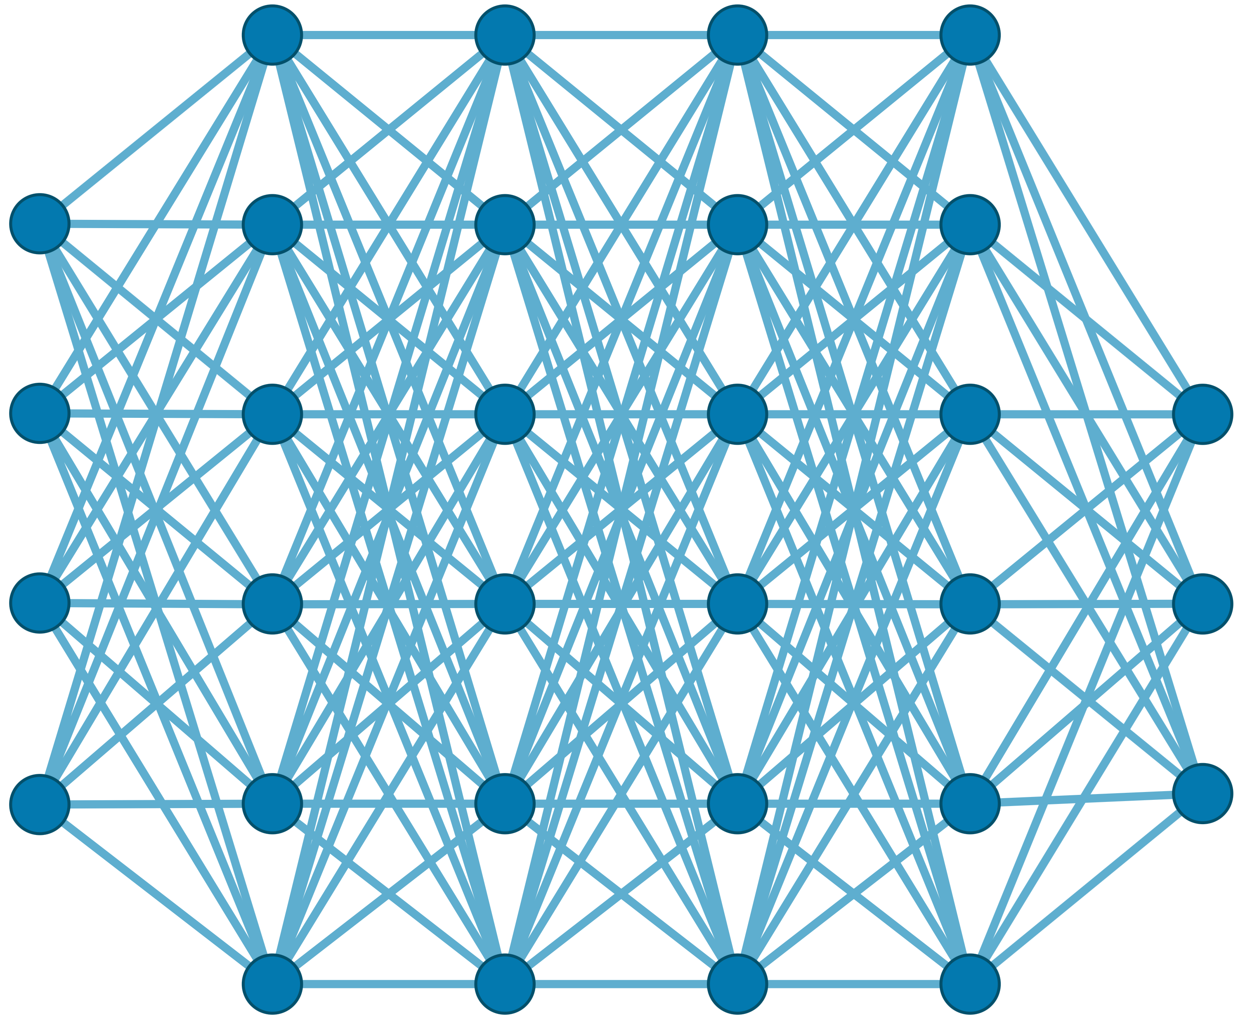

Recall: Generating the Entire Genomic Sequence
Whole Genome: 6.4B bps
(Non-human-readable)
Sequencing Device
Raw Genomic Data
(Human-readable?)
Translator (Basecalling)
AI
CGAAATGCC...AGATTAAACGCT...TGCCCTAA...GAATGGCGT
Whole Human Genome: 6.4B bps (Human-readable)

Slide 15





Genomic Data: Giant Jigsaw Puzzle to Solve
Human (Reference) Genome: 3.2 Billion bps (haploid)
CGAAATGCC...AGATTAAACGCT...TGCCCTAA...GAATGGCGT
?
Scale: ~$1/{10}^{8}$
AAATGG
CGAAATGCC...AGATTAAATGGT...TGCCCTAA...GAATGGCGT
Entire Genomic Sequence of an Organism
Read: ~100 – 100,000 bps
Small pieces (reads)
?
Unknown origins
Dealing with Massive and Noisy Datasets
(TBs to PBs)
Non-identical reference genome
Large volume of data to analyze

Slide 16
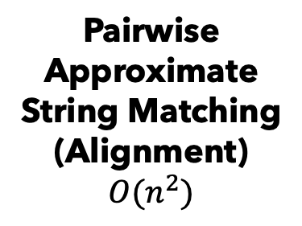

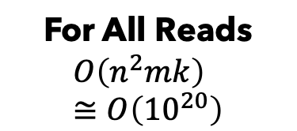
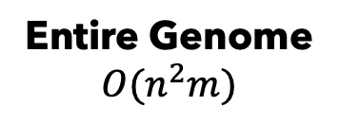
Solving the Puzzle: The Naïve Way
Human (Reference) Genome: 3.2 Billion bps (haploid)
CGAAATGCC...AGATTAAACGGGCTTTCT...TGCCCTAA...GAATGGCGT
AAATGG
Pairwise Approximate String Matching
(Alignment)
$$O(n^{2})$$
For All Reads
$$O\left(n^{2}mk\right) \\ ≅O\left({10}^{20}\right)$$
Entire Genome
$$O(n^{2}m)$$
$≅$Years
We will explain the practical solutions

Slide 17
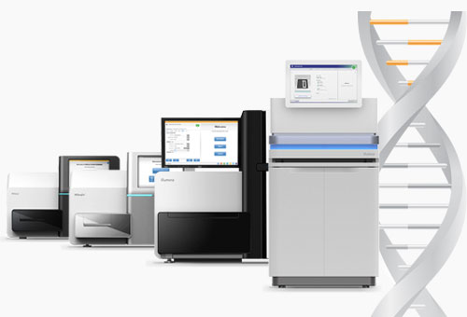
Sequencing Technologies
Oxford Nanopore Technologies (ONT)
PacBio (HiFi, CLR)
Illumina
… and more! All produce data with different properties.

Slide 18
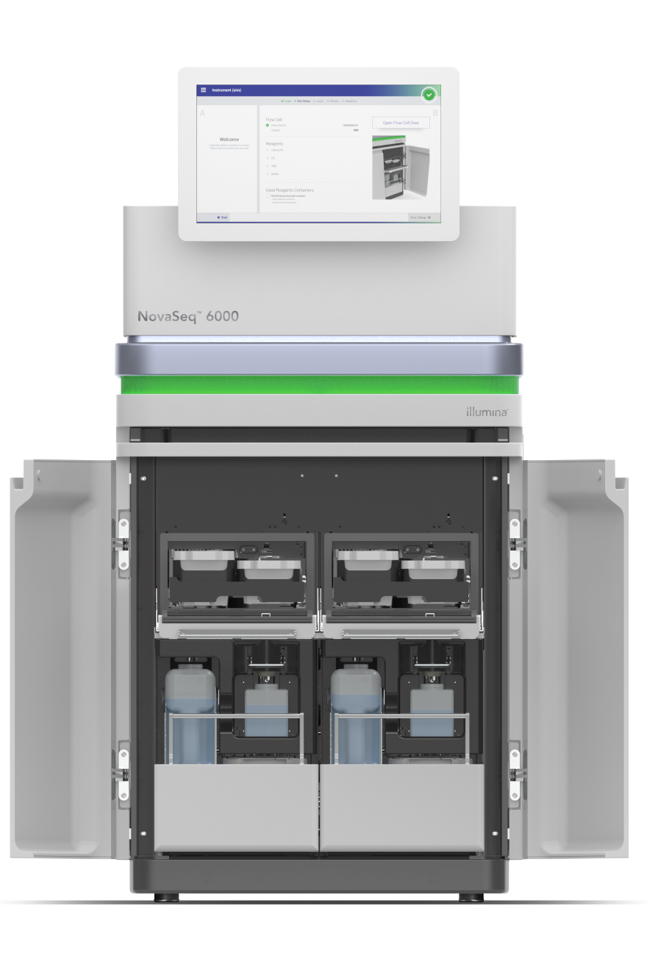
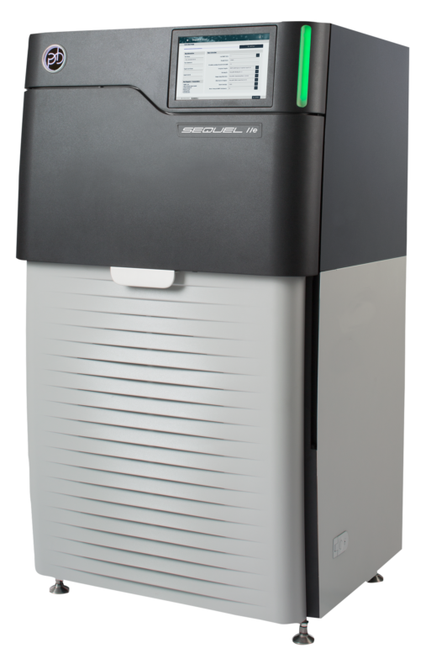
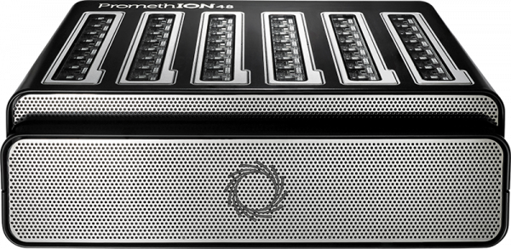


Different Raw Sequencing Data
Illumina (SBS)
PacBio (SMRT)
Nanopore
Multiple images
Fluorescence pulses
Electrical Signals
.BCL/.CBCL
.BAM
.POD5

Slide 19


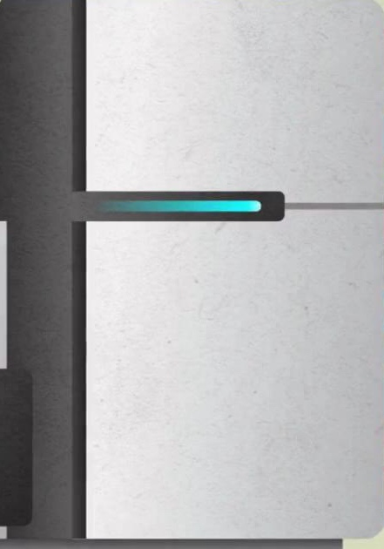


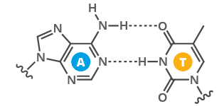
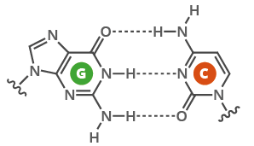
Sequencing using the Illumina Machines
T
Optical Sensor
C
A
G
T
A
C
Glass flow
cell surface
A
T
T
A

Slide 20
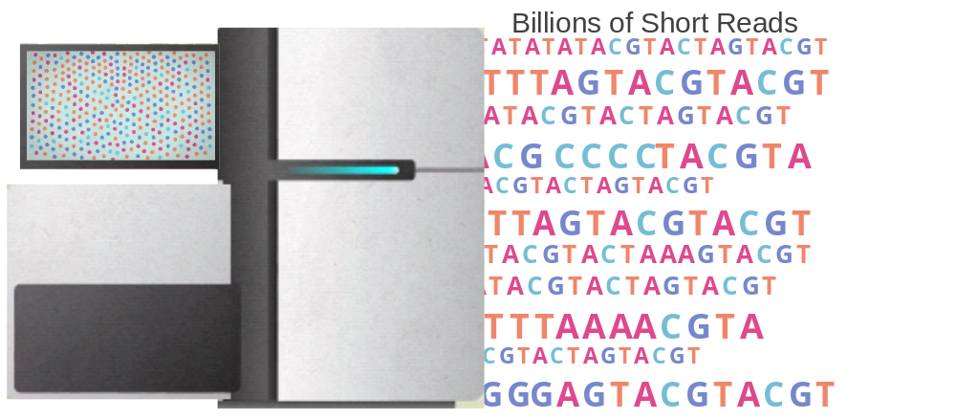
Sequencing using the Illumina Machines
The sequencer adds the molecule “T” to all bases near the flow cell surface and observes the chemical reaction via a CMOS sensor. If a reaction happens then the base is “A”
A
C
G
T
A
C
G
A
A
C
G
T
A
C
G
T
G
C
G
T
A
C
G
C
A
C
G
T
A
C
G
T
A
C
G
T
G
C
G
G
G
C
G
T
A
C
G
T
A
C
G
T
A
A
G
A
A
C
G
T
A
C
G
C
T
T
T
T
A
C
G
T
A
C
G
A
C
G
T
A
C
G
T
A
C
G
C
C
C
G
T
A
C
G
T
A
C
G
T
A
C
G
T
A
C
G
T
A
C
G G G C
G
C
T
Optical Sensor
C
A
G
T
A
C
Glass flow
cell surface
T
T
A
Sequenced bases form a read

Slide 21
Different Raw Sequencing Data
Illumina (SBS)
PacBio (SMRT)
Nanopore
Multiple images
Fluorescence pulses
Electrical Signals
.BCL/.CBCL
.BAM
.POD5

Slide 22
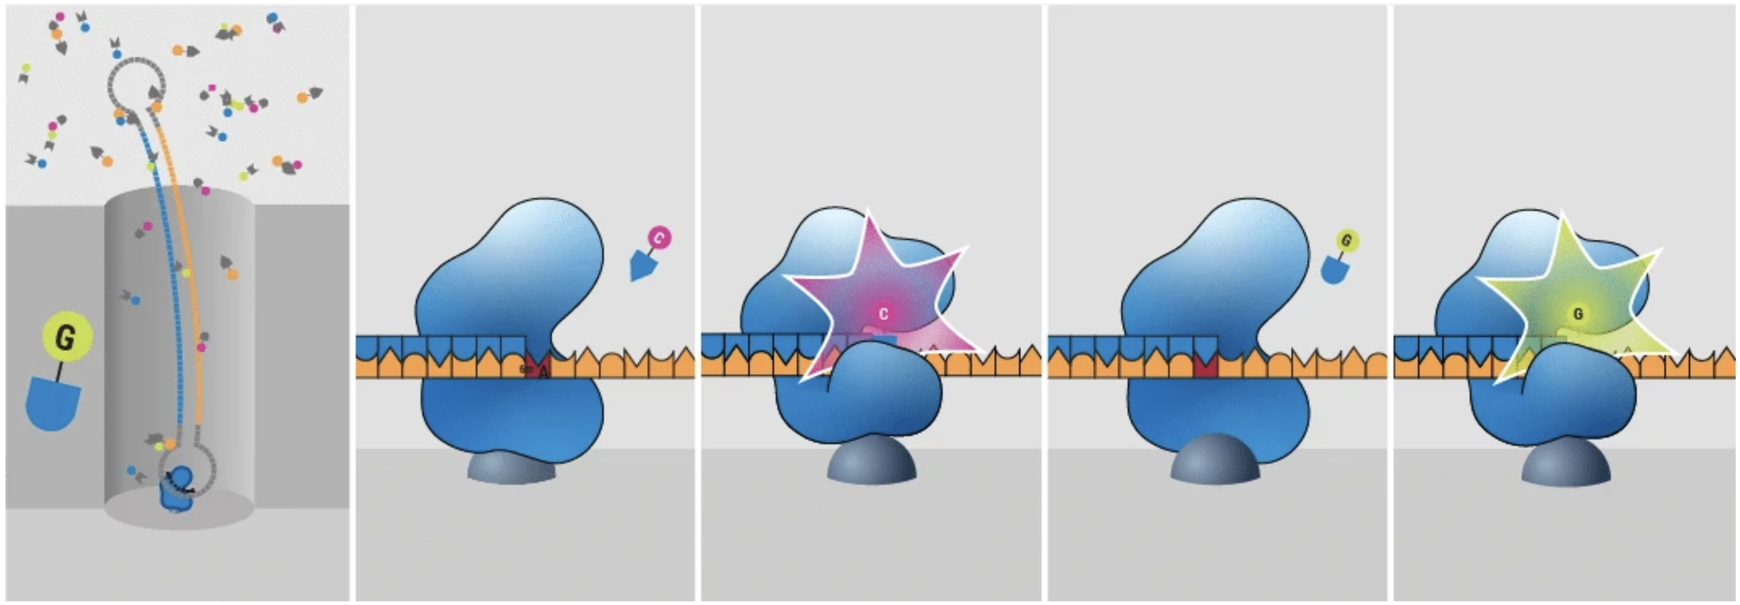
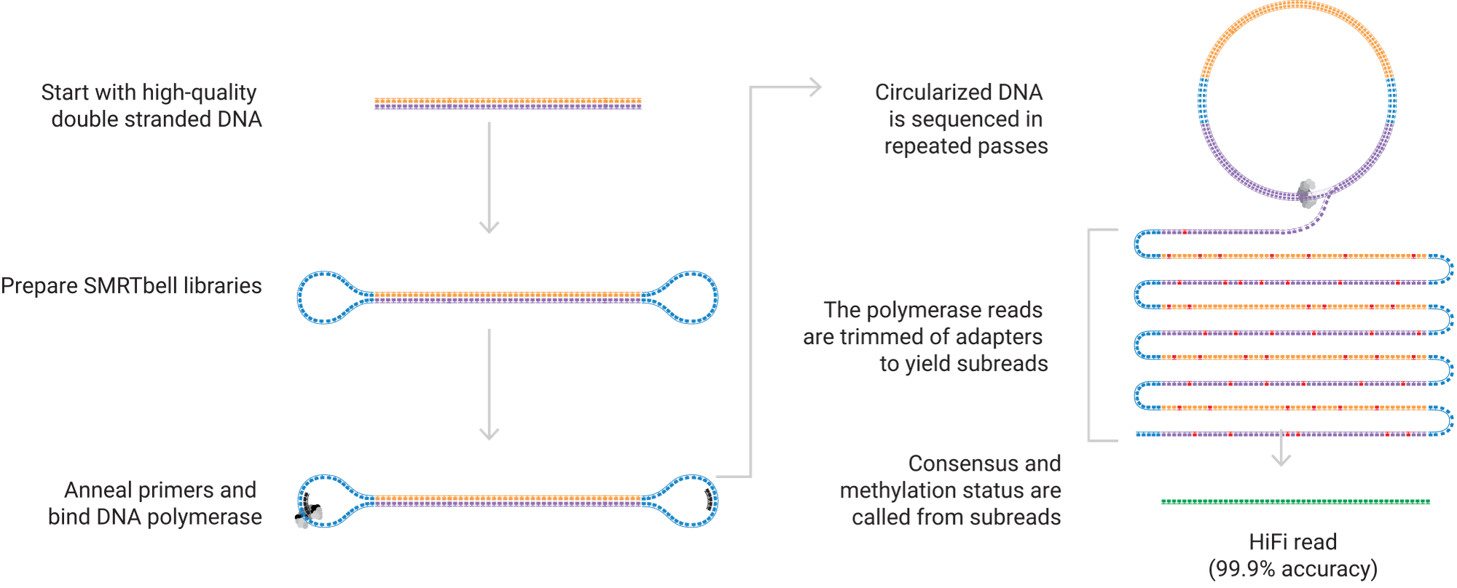
PacBio HiFi Sequencing
Repeated passes over the same DNA insert produce one HiFi read
Notes:
Follow the figure from the circular SMRTbell template to repeated passes and the final consensus. One polymerase produces fluorescence pulses during synthesis in a zero-mode waveguide. The multiple observations concern the same original DNA insert. They contribute to one consensus read, so the final read length reflects the insert length rather than the sum of all passes. Longer inserts and the number of passes involve a tradeoff. The manufacturer figure illustrates the HiFi mechanism; accuracy depends on the sample and processing. Figure and explanation: https://www.pacb.com/technology/hifi-sequencing/how-it-works/ ; original figure: https://www.pacb.com/wp-content/uploads/HiFi-reads-img.svg

Slide 23
Different Raw Sequencing Data
Illumina (SBS)
PacBio (SMRT)
Nanopore
Multiple images
Fluorescence pulses
Electrical Signals
.BCL/.CBCL
.BAM
.POD5

Slide 24
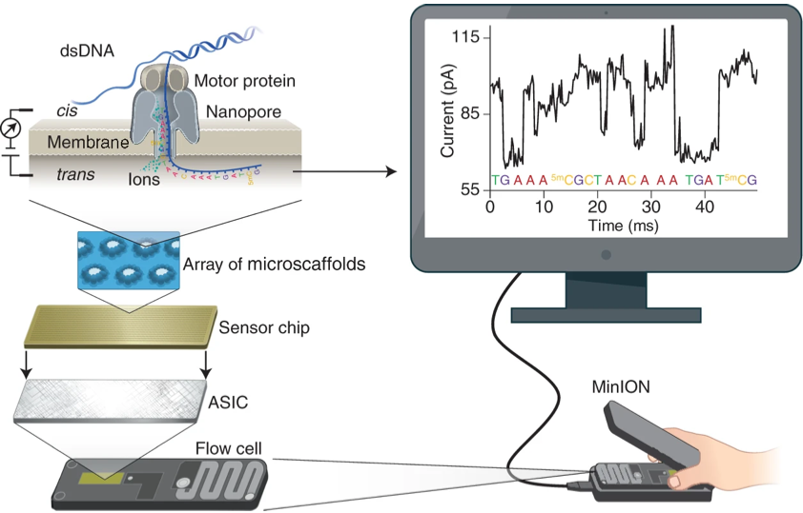
Nanopore Sequencing
Wang+, "Nanopore sequencing technology, bioinformatics and applications," Nature Biotechnology, 2021.

Slide 25
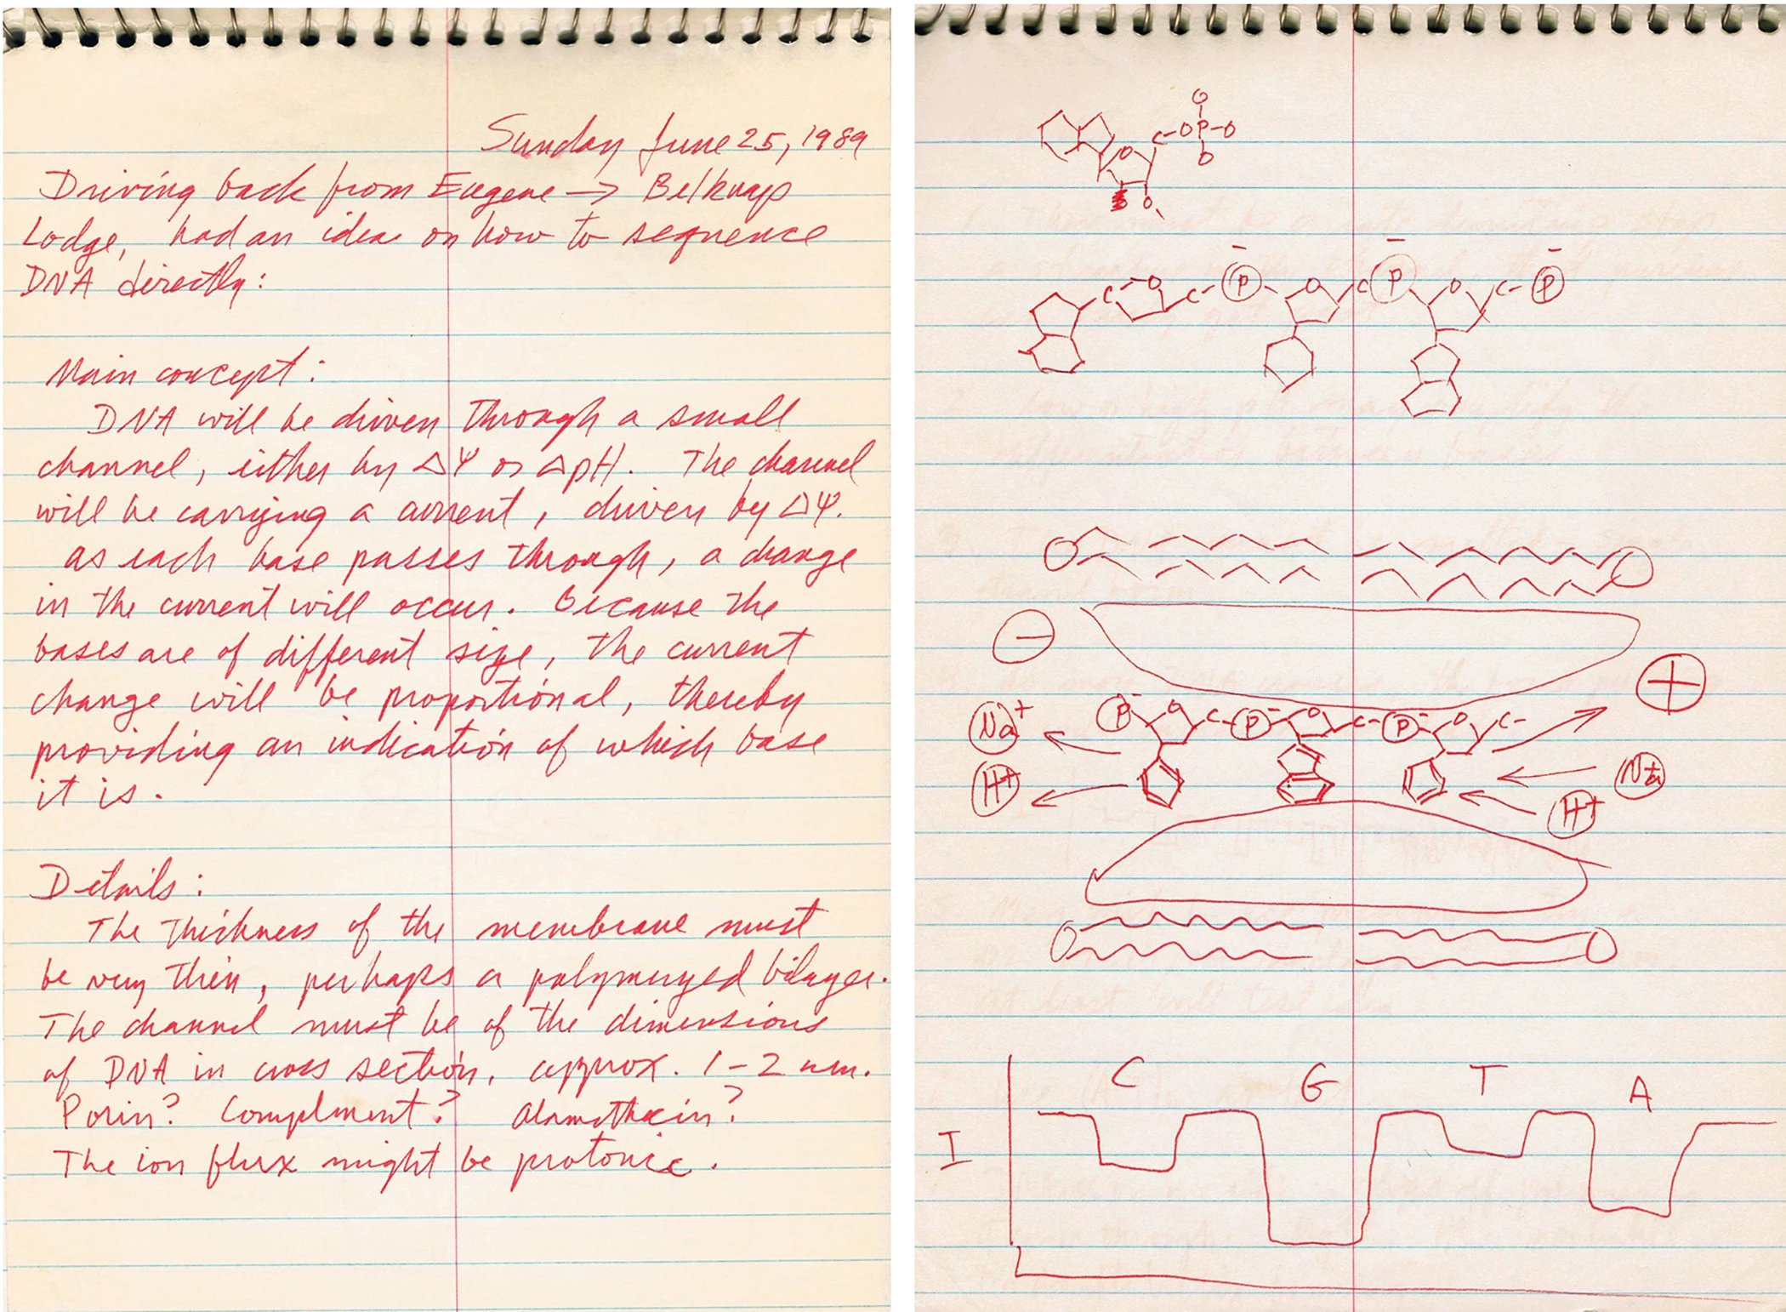
Nanopore Sequencing: The Original Idea
David Deamer’s handwriting on nanopore sequencing (June 25, 1989)
Deamer+, "Three decades of nanopore sequencing," Nature Biotechnology, 2016.

Slide 26
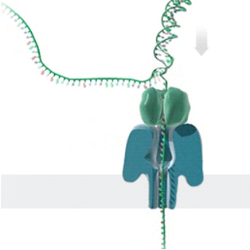
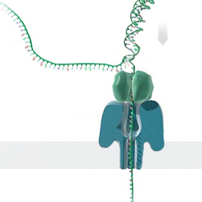

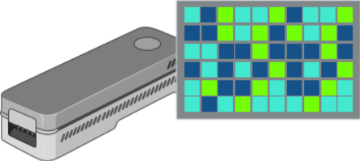


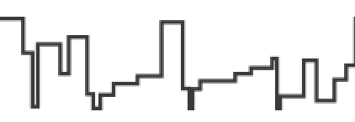
Recall: Generating Electrical Signals from DNA
Single Nanopore
Nanopore Sequencer
Raw Signals
(~5000 signals/sec)
Real-Time
Analysis
https://nanoporetech.com/platform/technology/basecalling
https://blogs.ed.ac.uk/institute-genetics-cancer/2020/04/08/nanopore-sequencing-controversial-world-records-and-whale-watching/

Slide 27
Recall: Benefits of Real-Time Analysis
✓
Reducing latency by overlapping analysis with sequencing
Time
Sequencing
Analysis
Reduced Latency
Sequencing & Real-Time Analysis
✓
Reducing sequencing time and cost by stopping sequencing early
Sequenced Bases
Completely Sequenced Read
Reduced Sequencing Time (and Cost)
Partially Sequenced Read
Sequencing is stopped early with a real-time decision

Slide 28
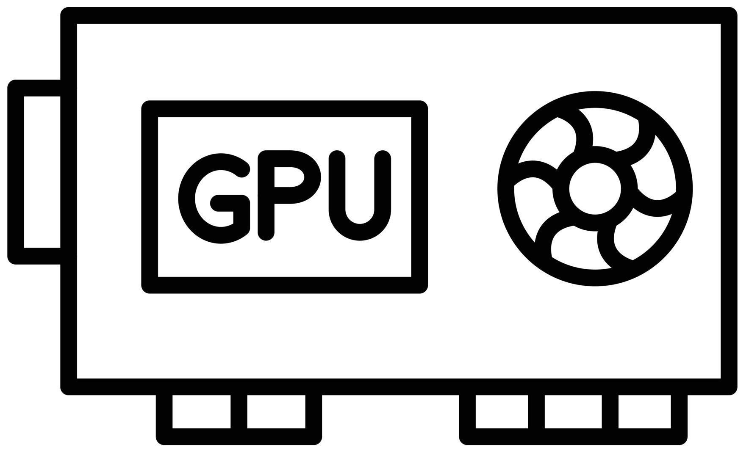
Recall: A Common Genome Analysis Pipeline
Raw
Signals
Basecalling (Translator)
Basecalled
(Translated)
Reads
Analysis
AAATGTGGTCCATTG
Noisy
Raw Signals
AI Models
Highly accurate reads

Slide 29
Can We Survive Without Translation?
Raw
Reads
Read
Mapping
Noisy
Raw Signals
Reference Genome
...
...
CTGCGTAGCAGCGTAATAG
How to communicate
without an accurate translator?

Slide 30
Reference-to-Signal Conversion
Goal: Convert the reference sequence into expected current levels.
K-mer model: A lookup table of expected signals for all k-mers.
Slide the k-mer window along the reference to synthesize a signal.
Reference Genome
Reference Signals
...
...
...
...
CTGCGTAGCAGCGTAATAG
-0.06,0.24,-0.74,
CTGCGT
K-mer model
K-mer model
-0.06
AAAAAA
-0.29
TGCGTA
K-mer model
0.24
…
…
GCGTAG
TTTTTT
0.04
K-mer model
-0.74
K-mer
Signal
Expected Signal

Slide 31
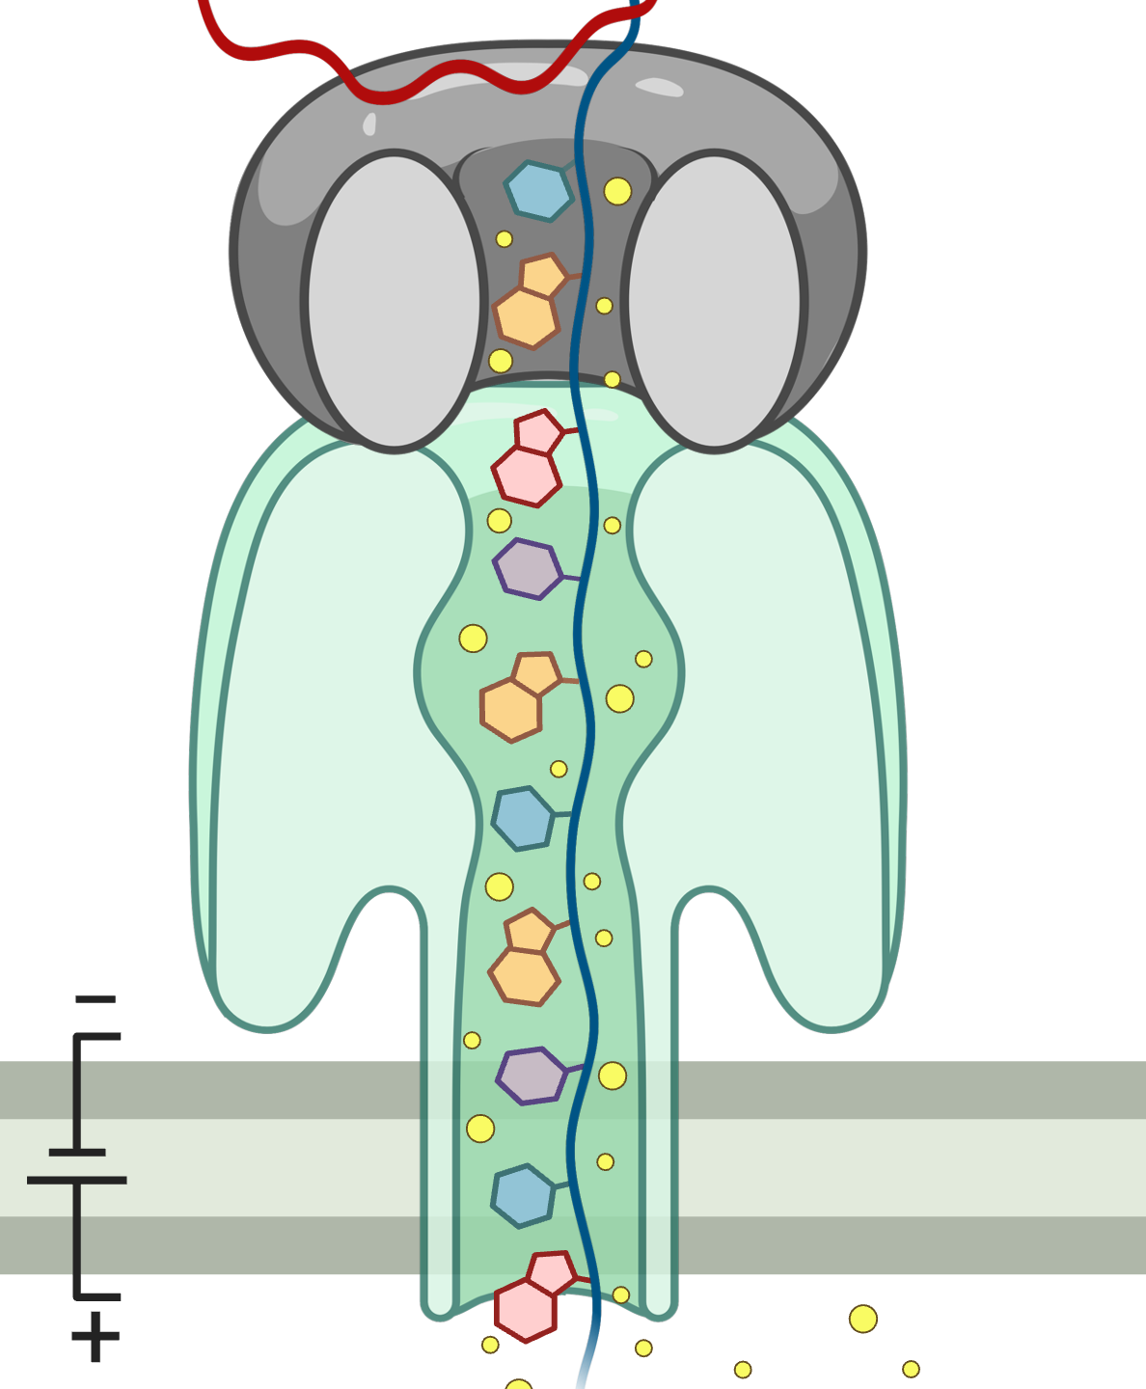
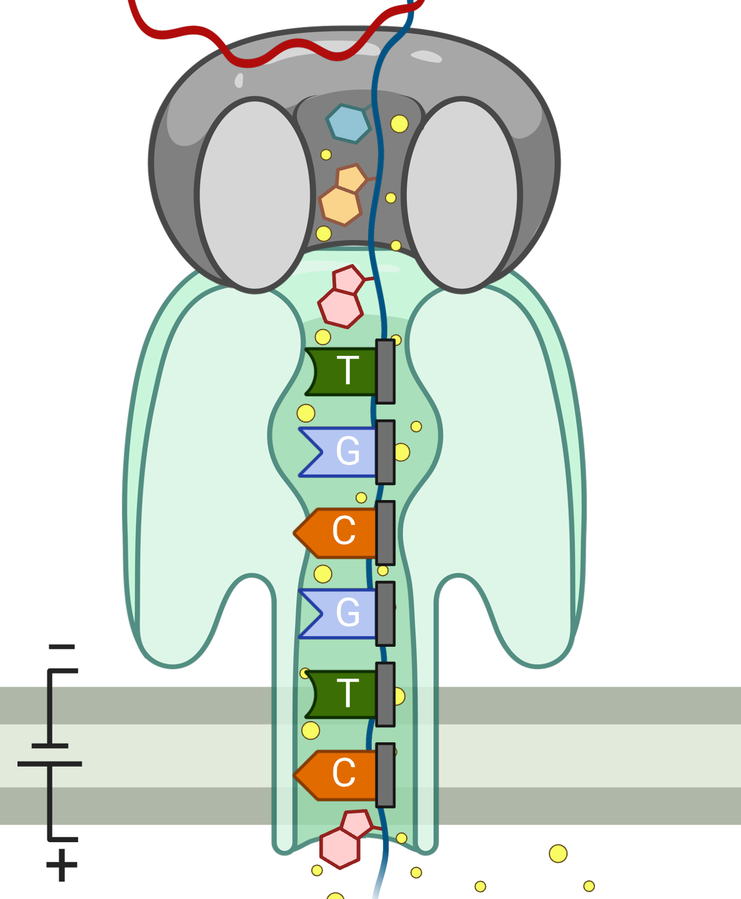
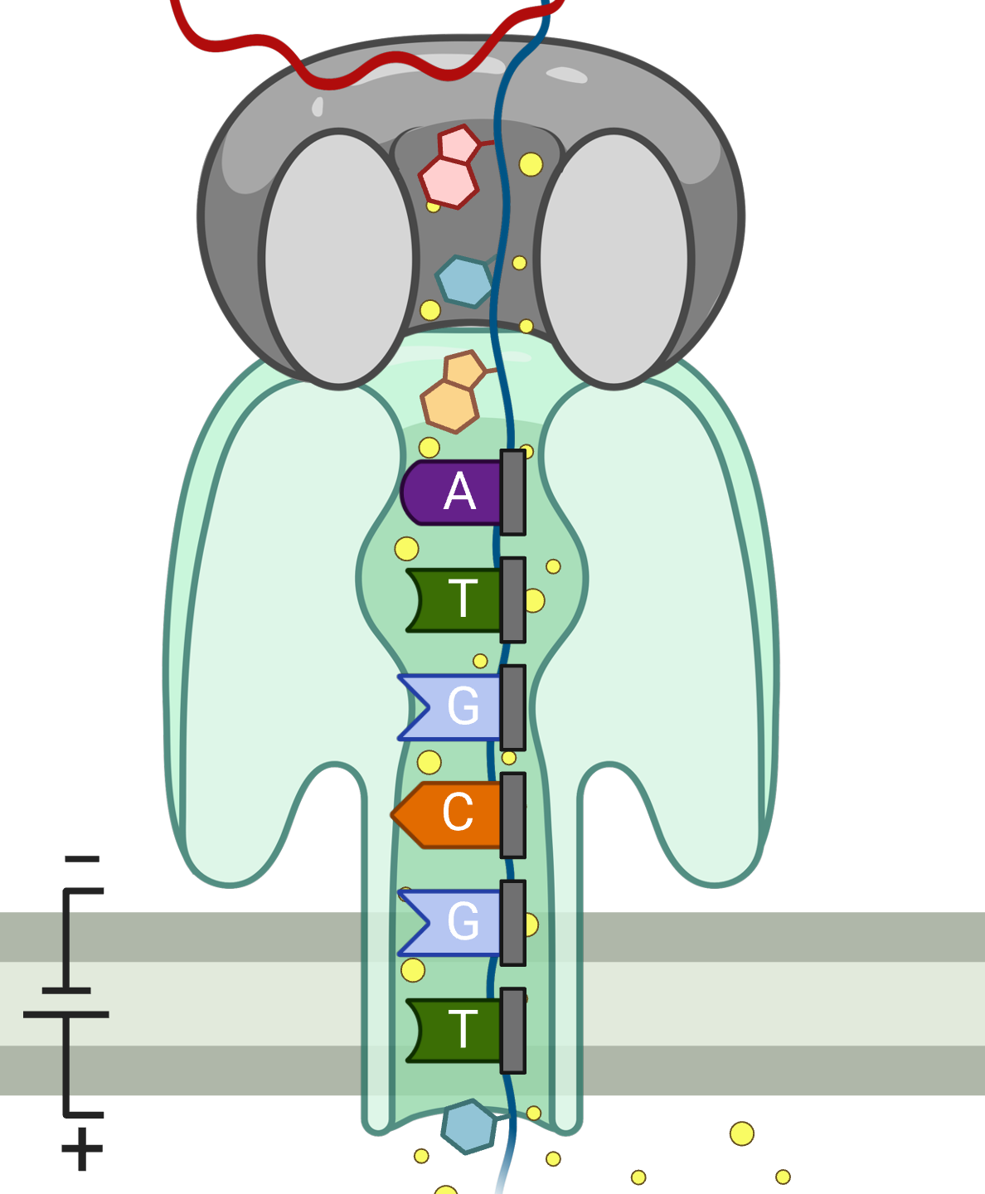


Processing Raw Nanopore Signals
K bases influence the signal at a time.
Observation: Signal levels change as DNA moves through the pore.
Goal: Segment the trace into events that reflect local sequence.
Event
…
…
pAmpere
Segment
…
…
Time
-0.06
-0.22
TGCGTC
ATGCGT
6-mer

Slide 32
Recall: Noise in Raw Electrical Signals
Single Nanopore
Nanopore
Sequencing Device
Observation: Identical molecules generate
similar raw signals
Sequencing CTGCGTAGCA
Raw
Signals:
[ , , , , ]
-0.06
-0.22
-0.75
0.96
-0.49
Similarity Search
Raw
Signals:
[ , , , , ]
-0.05
-0.21
-0.76
1.01
-0.51

Slide 33
Source of Noise in Nanopore Sequencing
Stochastic thermal fluctuations in the ionic current
  Random ionic movement due to inherent thermal energy (Brownian motion)
Variations in the translocation speed
  Mainly due to the motor protein
Environmental factors
  Temperature: Affecting enzymes including the motor protein
  pH levels: Affecting charge and the shape of molecules
Maybe: Aging & material-related noise between nanopores

Slide 34
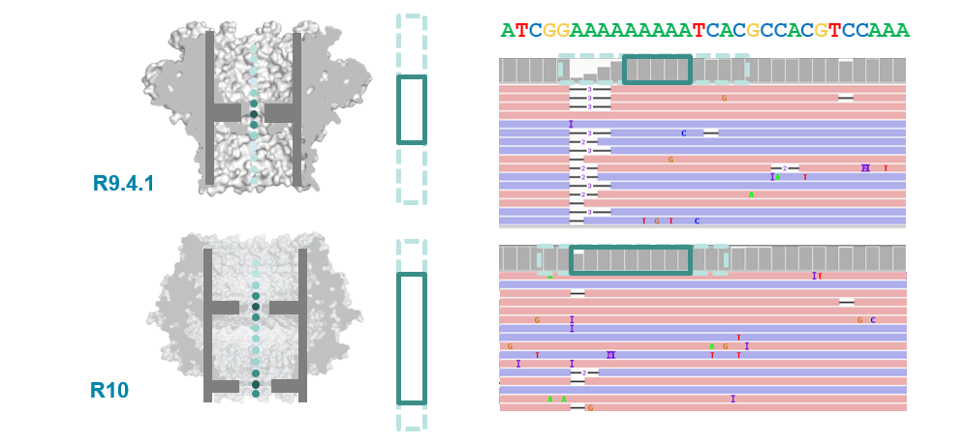
Various Nanopore Chemistries
Dual reader head in R10
Motor protein with more consistent translocation speed in R10

Slide 35
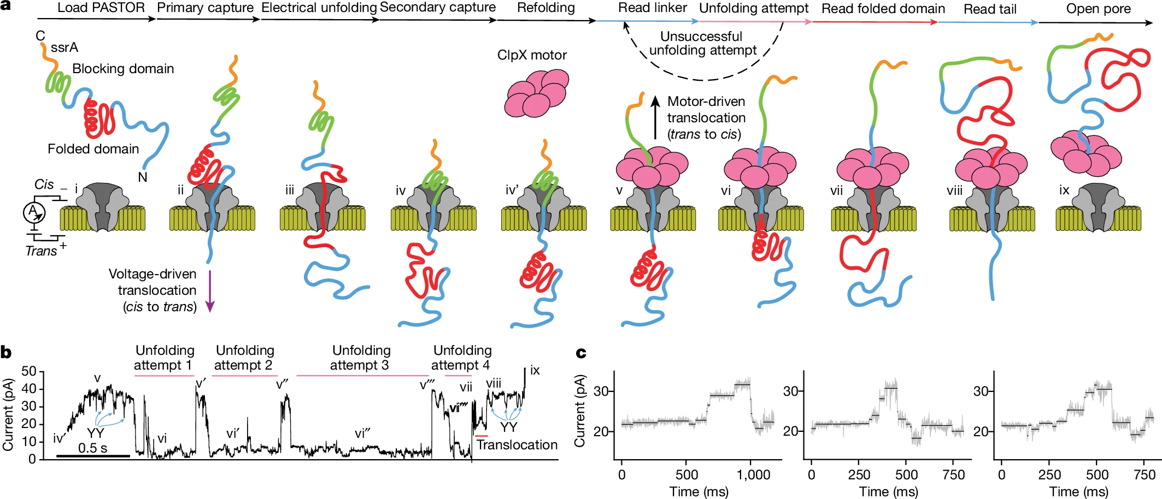
Proteomics with Nanopores
Motone+, “Multi-pass, single-molecule nanopore reading of long protein strands”, Nature 2024.

Slide 36
Recall: A Common Genome Analysis Pipeline
Raw
Signals
Basecalling (Translator)
Basecalled
(Translated)
Reads
Analysis
AAATGTGGTCCATTG
Noisy
Raw Signals
AI Models
Highly accurate reads

Slide 37
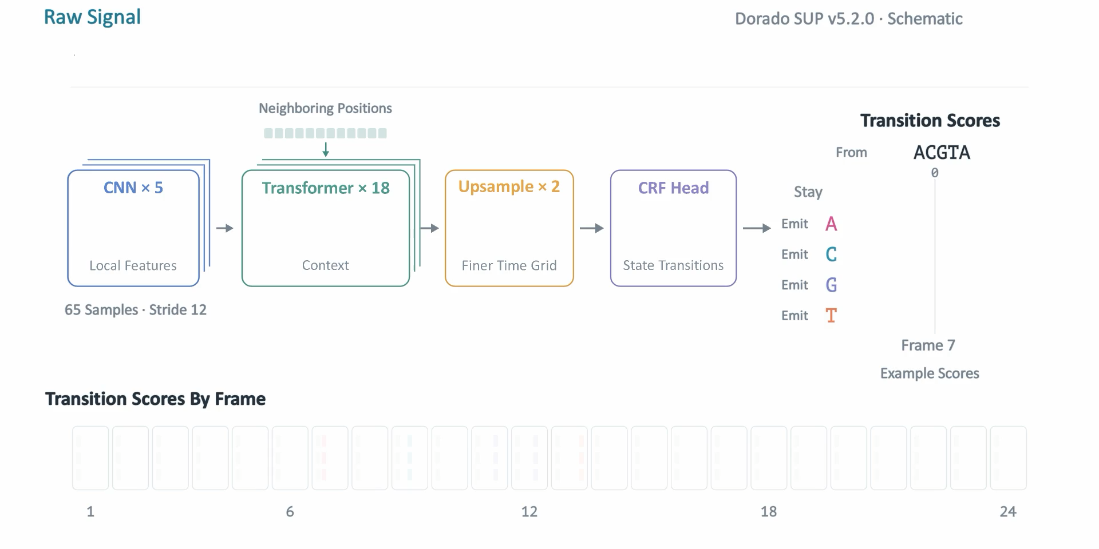
Basecalling Overview

Slide 38
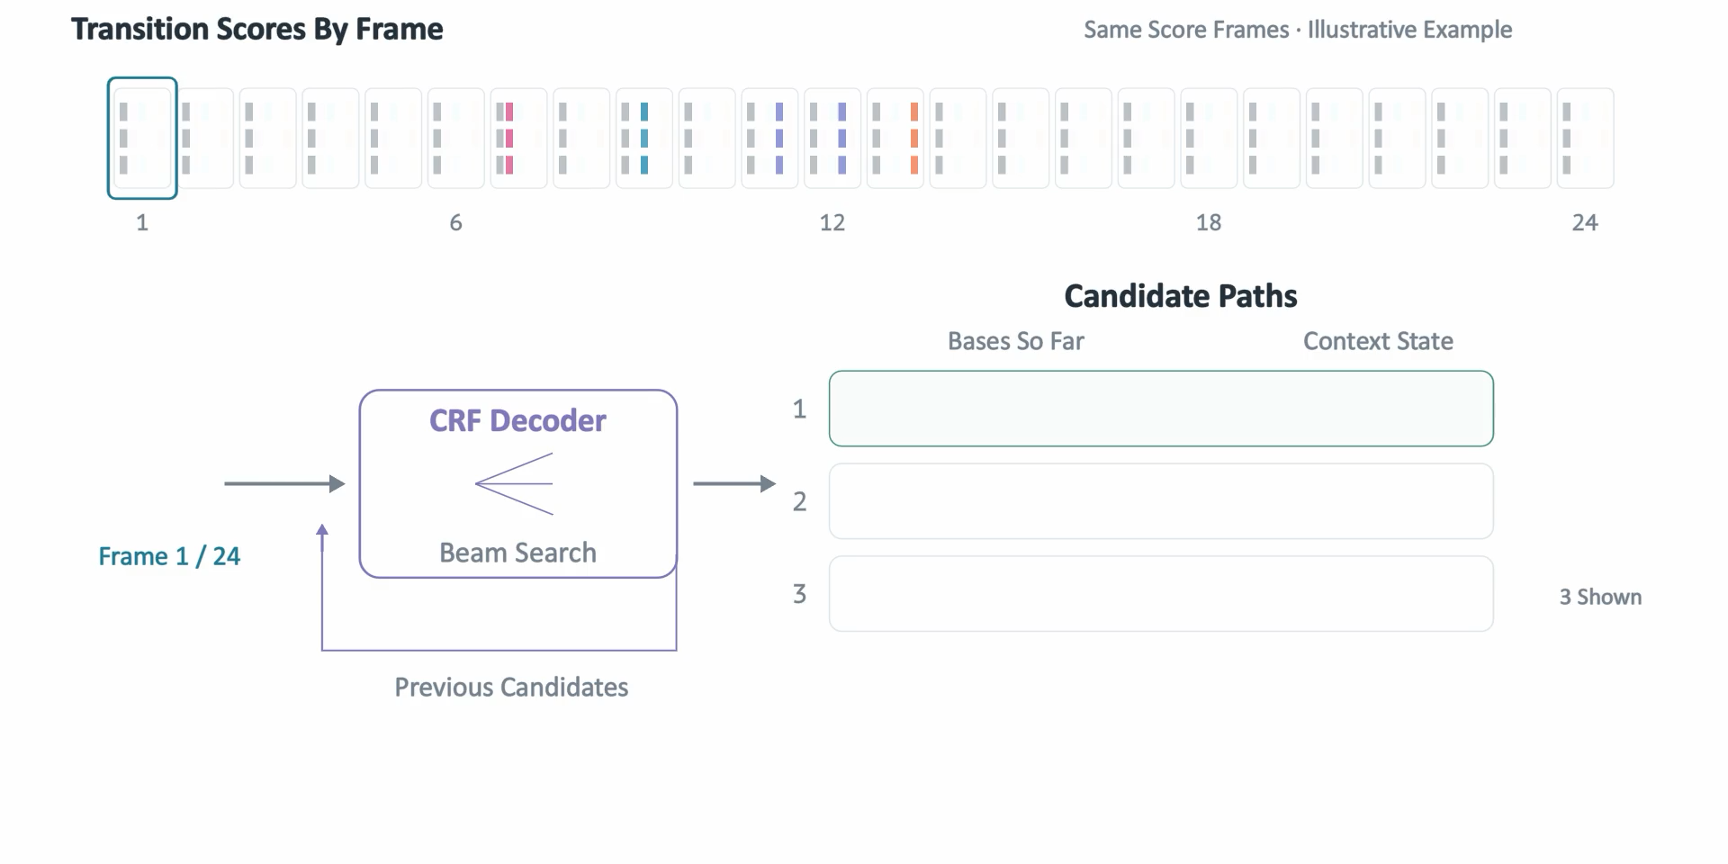
CTC-CRF Decoding

Slide 39
Questions?

Slide 40
Genome Analysis Pipeline

Slide 41
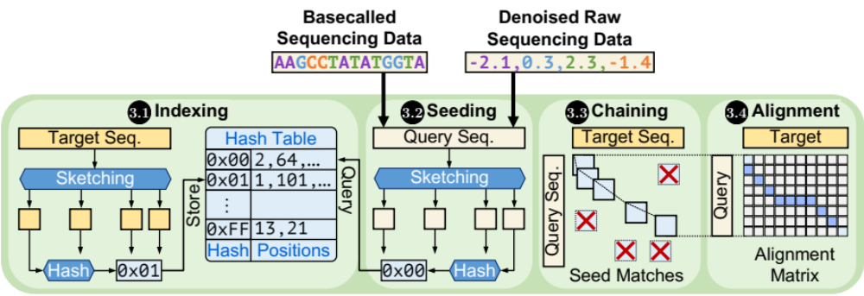
Next Lecture
Reminder: Finalize your paper selection by today 11:59pm!

Slide 42
CMSC 829C: Algorithms, AI, and Hardware
for Biological Data
Lecture 3: Introduction to Genomics and Sequencing
Fall 2026
September 8, 2026
Can Firtina | canfirtina@gmail.com | cs.umd.edu/~firtina
Assistant Professor of Computer Science at UMD

Slide 43
Solving the Puzzle: The Practical Way
Goal: Quickly and accurately reduce the search space
CGAAATGCC...AGATTAAATGGGCTTTCT...TGCCCTAA...GAATGGCGT
Costly alignment
is quickly avoided
in most regions
AAAT
AAAT
CTAA
AATG
AAATGG
AAATGG
Exact Match
AAAT
AAATGG
Read Mapping
Indexing
Seeding
Chaining
Alignment
Reference Genome
Hash Table
Read
0x00
2,64,…
Sketching
0x01
1,101,…
Query
Sketching
Store
…
0xFF
13,21
Hash
Positions
Hash
0x01
0x00
Hash
Hash Matches
DP Calculations
Notes:
There is a more practical way of solving this puzzle involving many heuristics
The goal of the practical approach is to ..

