Slide 1
CMSC 829C: Algorithms, AI, and Hardware
for Biological Data
Lecture 2: Moving the Needle - A Bioinformatics Perspective
Fall 2026
September 3, 2026
Can Firtina | canfirtina@gmail.com | cs.umd.edu/~firtina
Assistant Professor of Computer Science at UMD

Slide 2
Recall: Some More Materials to Internalize
Bill Dally,
"Moving the needle: Effective Computer Architecture Research
in Academe and Industry"
ISCA, 2010.
[Alternative Talk Video]
Michael Stonebraker,
"Make it Happen"
ACM Turing Award Lecture, 2014.
Martin A. Schwartz,
"The importance of stupidity in scientific research"
Journal of Cell Science, 2008.

Slide 3
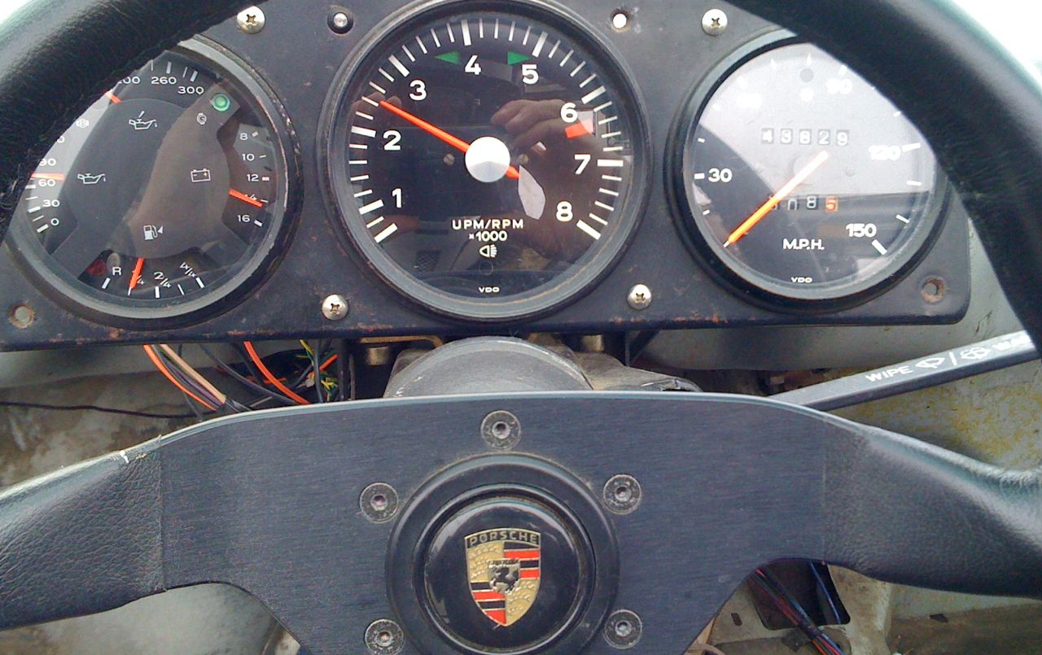
Some slides are adopted from Bill Dally’s original Moving the Needle talk at ISCA 2010: https://isca2010.inria.fr/media/slides/ISCA_Needle_A_0610.pptx
Moving the Needle
Computer Architecture Research
in Academe and Industry
Bill Dally
Chief Scientist & Sr. VP of Research, NVIDIA
Bell Professor of Engineering, Stanford University
3

Slide 4
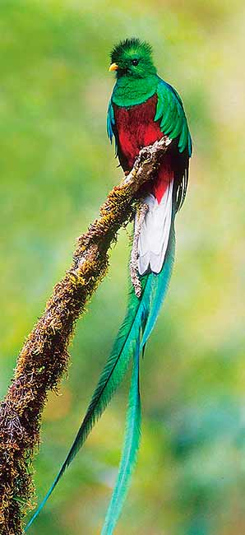
Research is a
hunt for insight
4

Slide 5
Recall: The Goal of Computing: Beyond Numbers
"The purpose of computing is insight, not numbers"
Richard Hamming
"Numerical Methods for Scientists and Engineers," Richard Hamming, 1962.

Slide 6
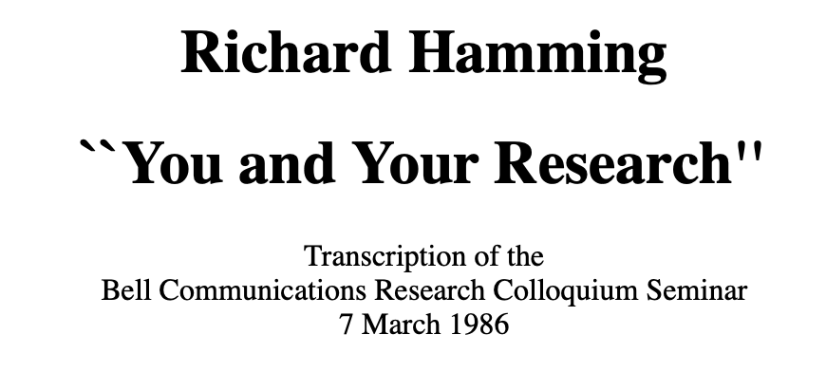
Recall: You and Your Research
Richard Hamming,
"You and Your Research"
Bell Communications Research Colloquium Seminar, 1986.
[Lecture Video] [Podcast]

Slide 7
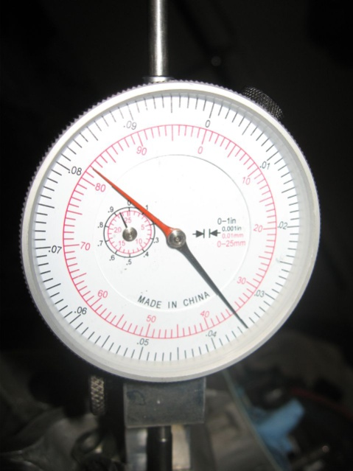
Goal – Positive Impact on a Product
7

Slide 8
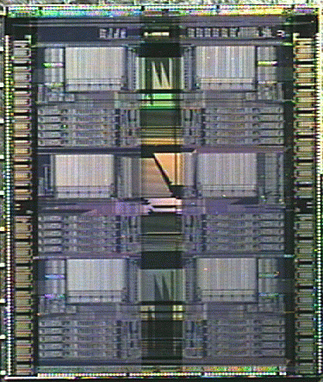






The Research Funnel
Technology
Insight
Concept
Dev
Model
Eval
Dev
Applications
Idea
8

Slide 9
Most ideas fail
So terminate the bad ones quickly
9

Slide 10

Most ideas fail
So terminate the bad ones quickly
Be a terminator, not an advocate
10

Slide 11
Heilmeier's Catechism
What are you trying to do? Articulate your objectives using absolutely no jargon.
How is it done today, and what are the limits of current practice?
What's new in your approach and why do you think it will be successful?
Who cares? If you're successful, what difference will it make?
What are the risks and the payoffs?
How much will it cost?
How long will it take?
What are the midterm and final "exams" to check for success?
https://techtransferfordefense.stanford.edu/creating-impactful-one-pagers-using-heilmeier-catechism

Slide 12
How to Present Papers/Ideas/Projects
Background
Problem
  What are the limitations of the state-of-the-art approach(es)
Goal
  Articulate what the paper is trying to achieve with absolutely no jargons
Key Idea/Mechanism
  What are the idea(s) and steps to achieve this goal
Key (Expected) Results
  What are the key observations?
  What insights do we generate from them?
Strengths and Weaknesses
Future Directions and Ideas

Slide 13
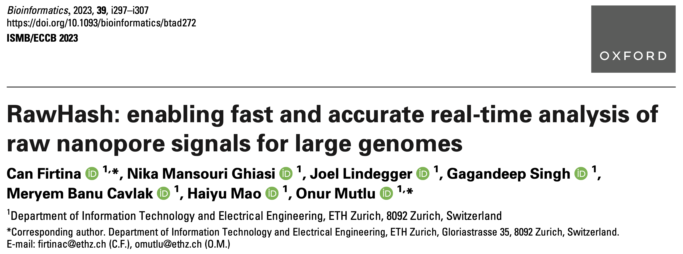
New Frontiers: Raw Signal Analysis [ISMB '23]
RawHash: enabling fast and accurate real-time analysis of raw nanopore signals
for large genomes
Can Firtina, Nika Mansouri Ghiasi, Joel Lindegger, Gagandeep Singh, Meryem Banu Cavlak, Haiyu Mao, Onur Mutlu
Proceedings of the 31st Annual Conference on Intelligent Systems for Molecular Biology and the 22nd European Conference on Computational Biology (ISMB/ECCB 2023), Lyon, France, July 2023.
[PDF] [Code] [DOI]
Conference talk [Video] [Slides (pptx)] [Slides (pdf)]
Preprint (bioRxiv) [Link] [PDF]
Social media thread [Twitter (X)]

Slide 14
How to Present Papers/Ideas/Projects
Background
Problem
  What are the limitations of the state-of-the-art approach(es)
Goal
  Articulate what the paper is trying to achieve with absolutely no jargons
Key Idea/Mechanism
  What are the idea(s) and steps to achieve this goal
Key (Expected) Results
  What are the key observations?
  What insights do we generate from them?
Strengths and Weaknesses
Future Directions and Ideas

Slide 15
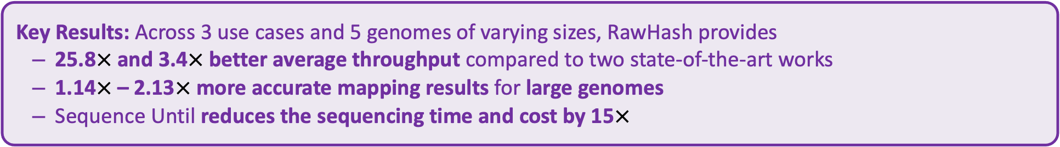
Executive Summary
Problem: Real-time analysis of nanopore raw signals is inaccurate and inefficient for large genomes
Goal: Enable fast and accurate real-time analysis of raw signals for large genomes
Key Contributions:
1) The first hash-based mechanism that can quickly and accurately analyze raw nanopore signals for large genomes
2) The novel Sequence Until technique can accurately and dynamically stop
the entire sequencing of all reads at once if further sequencing is not necessary
Key Results: Across 3 use cases and 5 genomes of varying sizes, RawHash provides
  25.8$×$ and 3.4$×$ better average throughput compared to two state-of-the-art works
  1.14$×$ – 2.13$×$ more accurate mapping results for large genomes
  Sequence Until reduces the sequencing time and cost by 15$×$

Slide 16
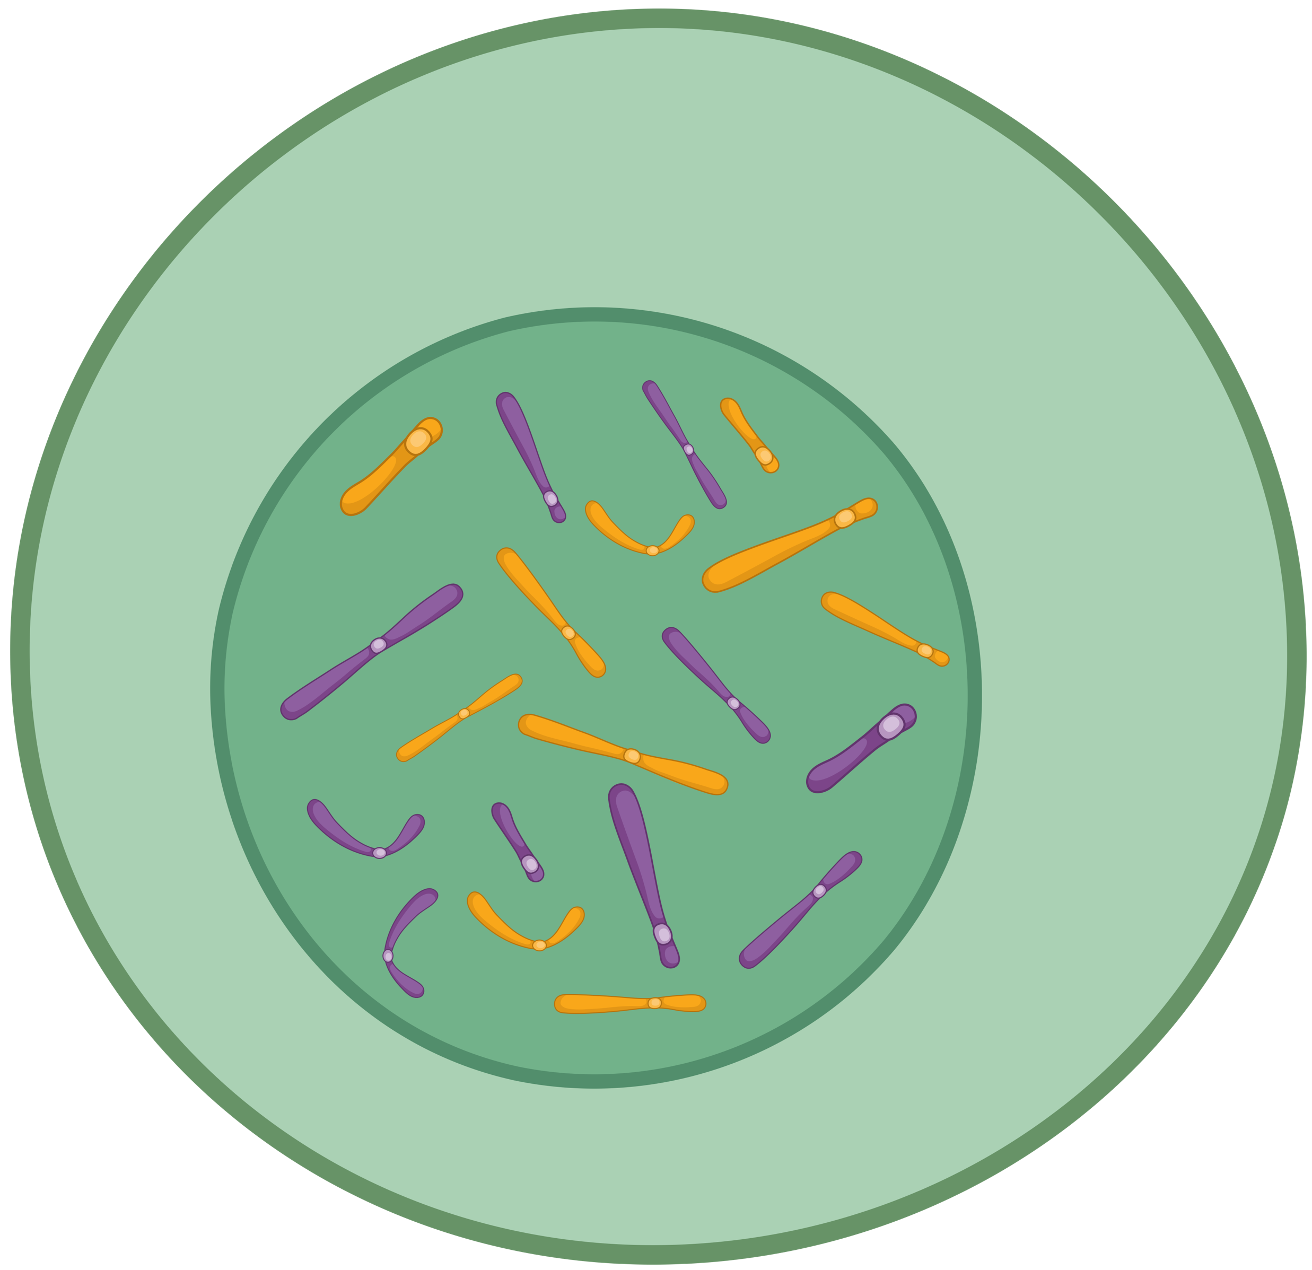
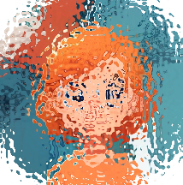
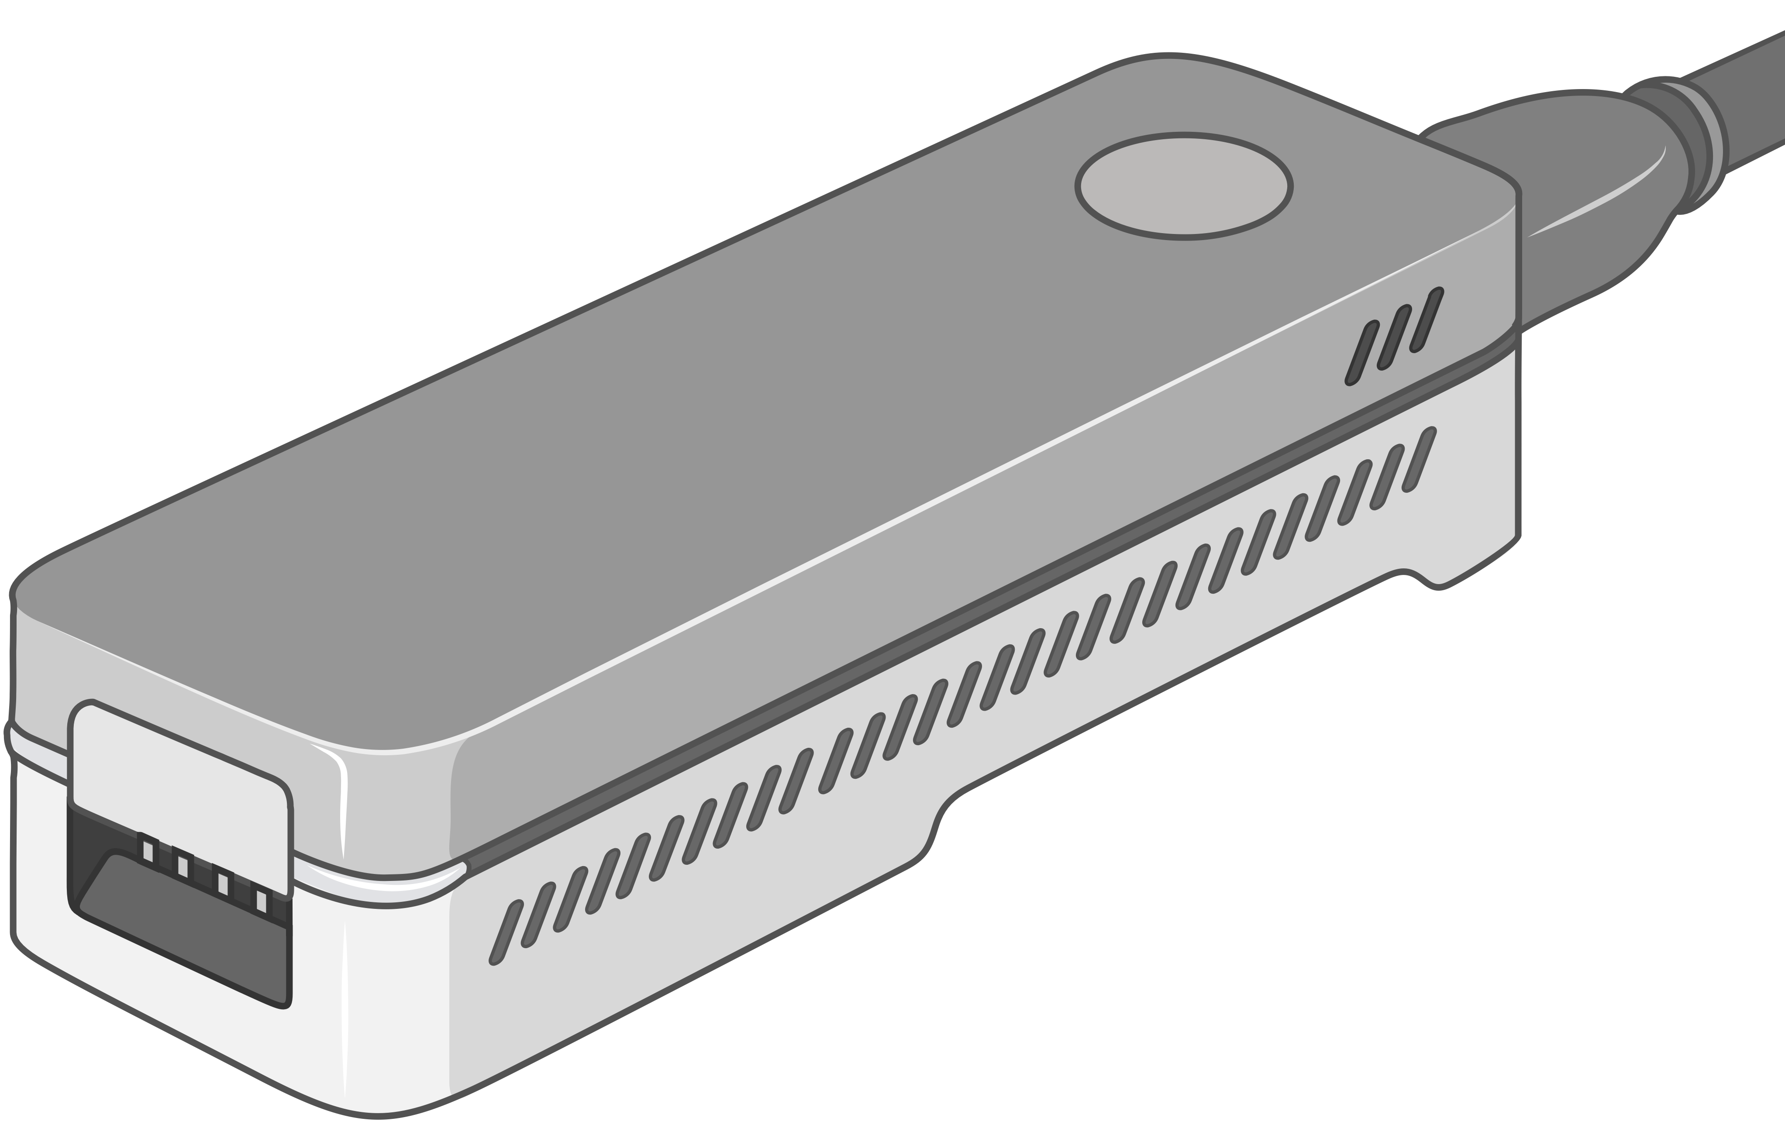
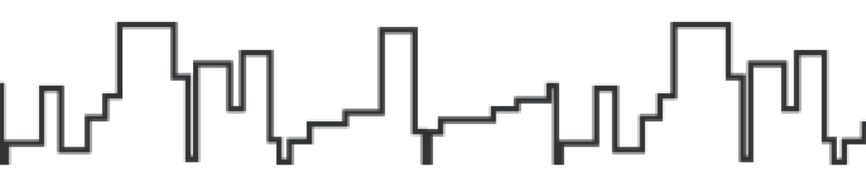
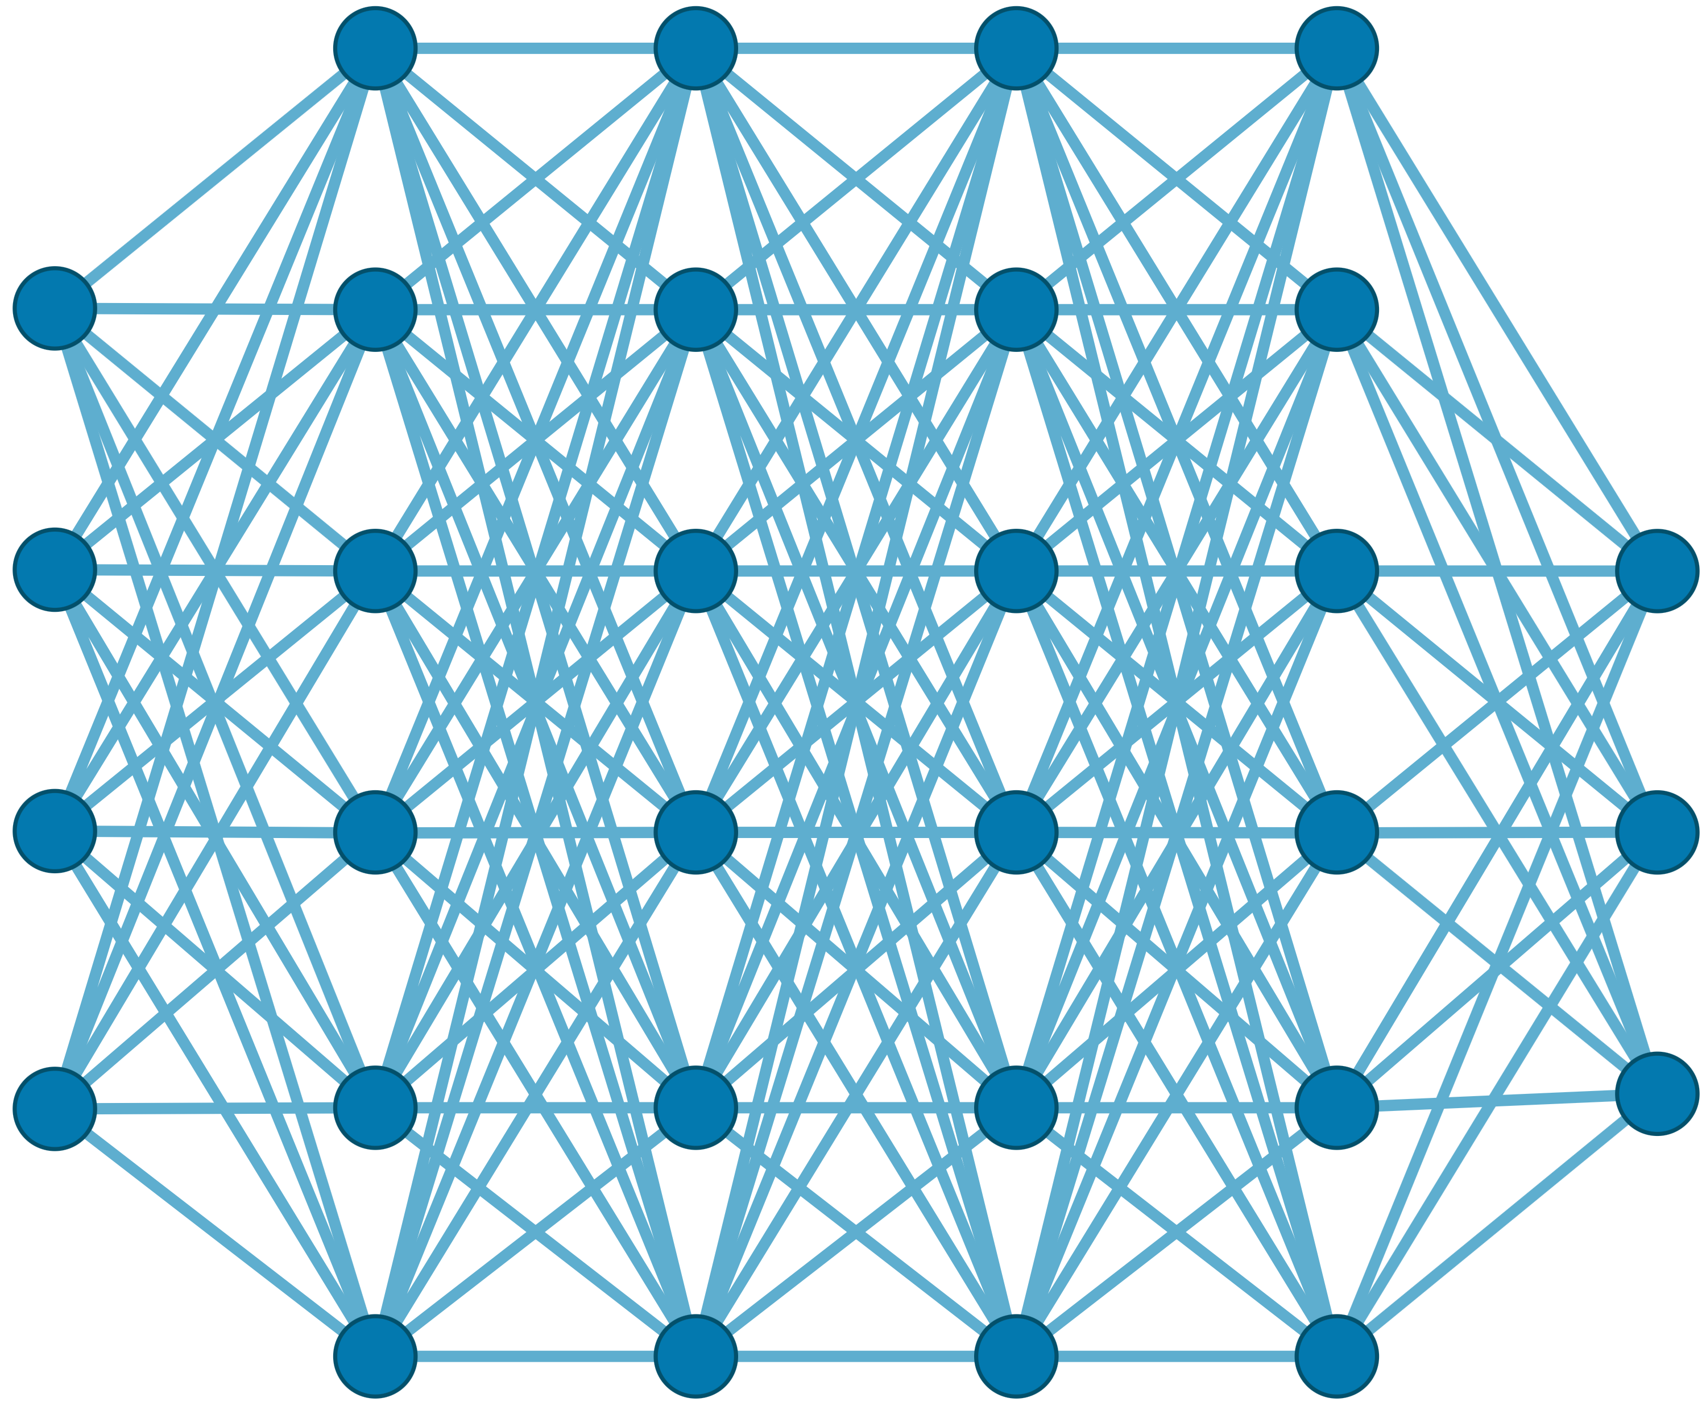

Recall: Generating the Entire Genomic Sequence
Whole Genome: 6.4B bps
(Non-human-readable)
Sequencing Device
Raw Genomic Data
(Human-readable?)
Translator (Basecalling)
AI
CGAAATGCC...AGATTAAACGCT...TGCCCTAA...GAATGGCGT
Whole Human Genome: 6.4B bps (Human-readable)

Slide 17
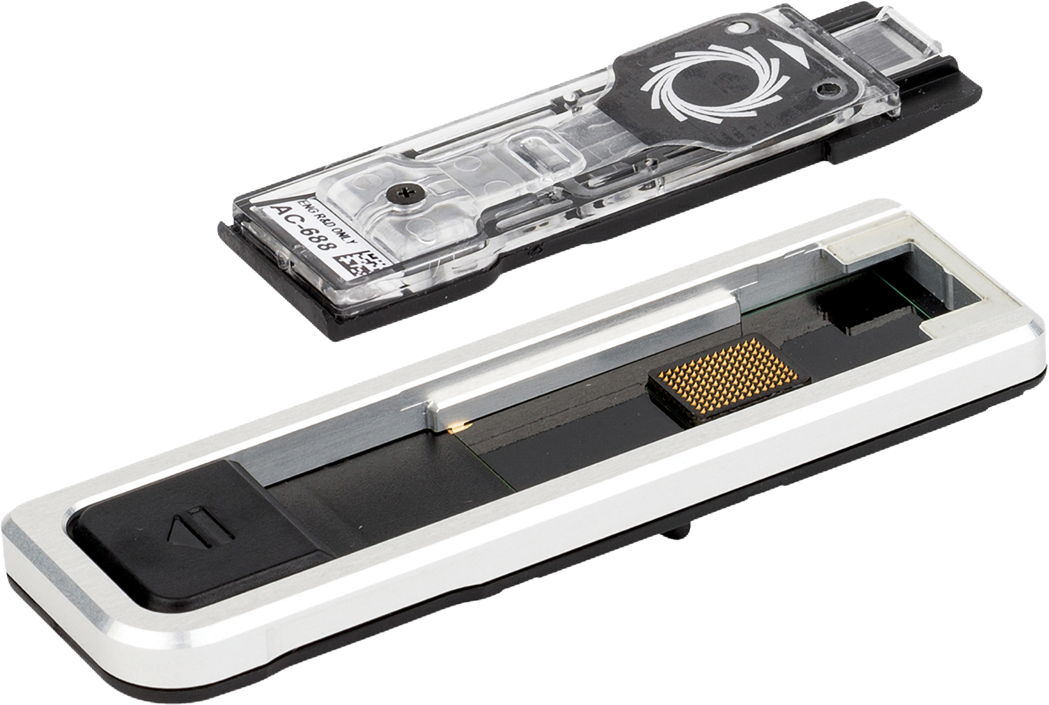
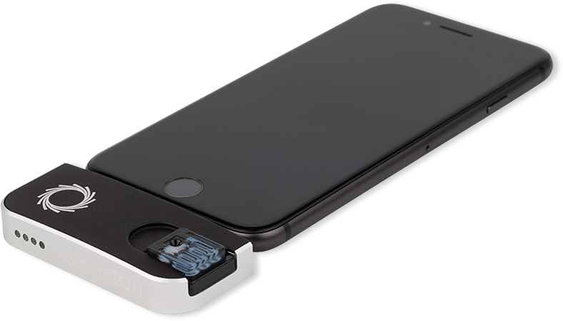
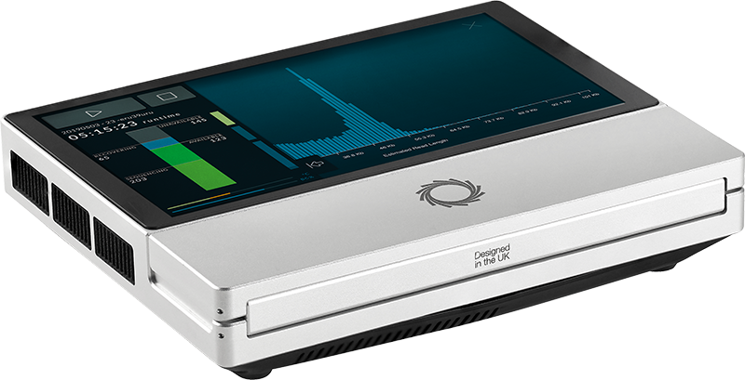
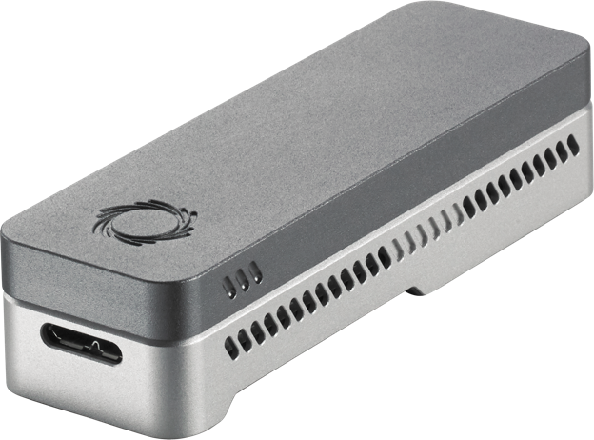
Nanopore Sequencing
Nanopore Sequencing: a widely used sequencing technology
  Can sequence large fragments of nucleic acid molecules (up to >2Mbp)
  Offers high throughput
  Cost-effective
  Enables real-time genome analysis

Slide 18
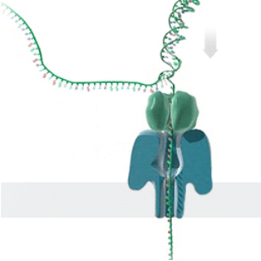
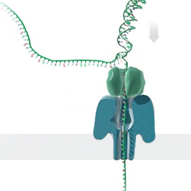

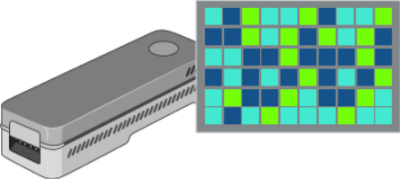


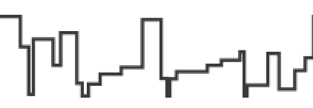
Generating Electrical Signals from DNA
Single Nanopore
Nanopore Sequencer
Raw Signals
(~5000 signals/sec)
Real-Time
Analysis
Raw Signals: Ionic current measurements generated at a certain throughput
Real-Time Analysis: Analyzing raw signals instantly as they are generated
Real-Time Decisions: Stopping sequencing early based on real-time analysis
https://nanoporetech.com/platform/technology/basecalling
https://blogs.ed.ac.uk/institute-genetics-cancer/2020/04/08/nanopore-sequencing-controversial-world-records-and-whale-watching/

Slide 19
Benefits of Real-Time Analysis
✓
Reducing latency by overlapping analysis with sequencing
Time
Sequencing
Analysis
Reduced Latency
Sequencing & Real-Time Analysis
✓
Reducing sequencing time and cost by stopping sequencing early
Sequenced Bases
Completely Sequenced Read
Reduced Sequencing Time (and Cost)
Partially Sequenced Read
Sequencing is stopped early with a real-time decision

Slide 20
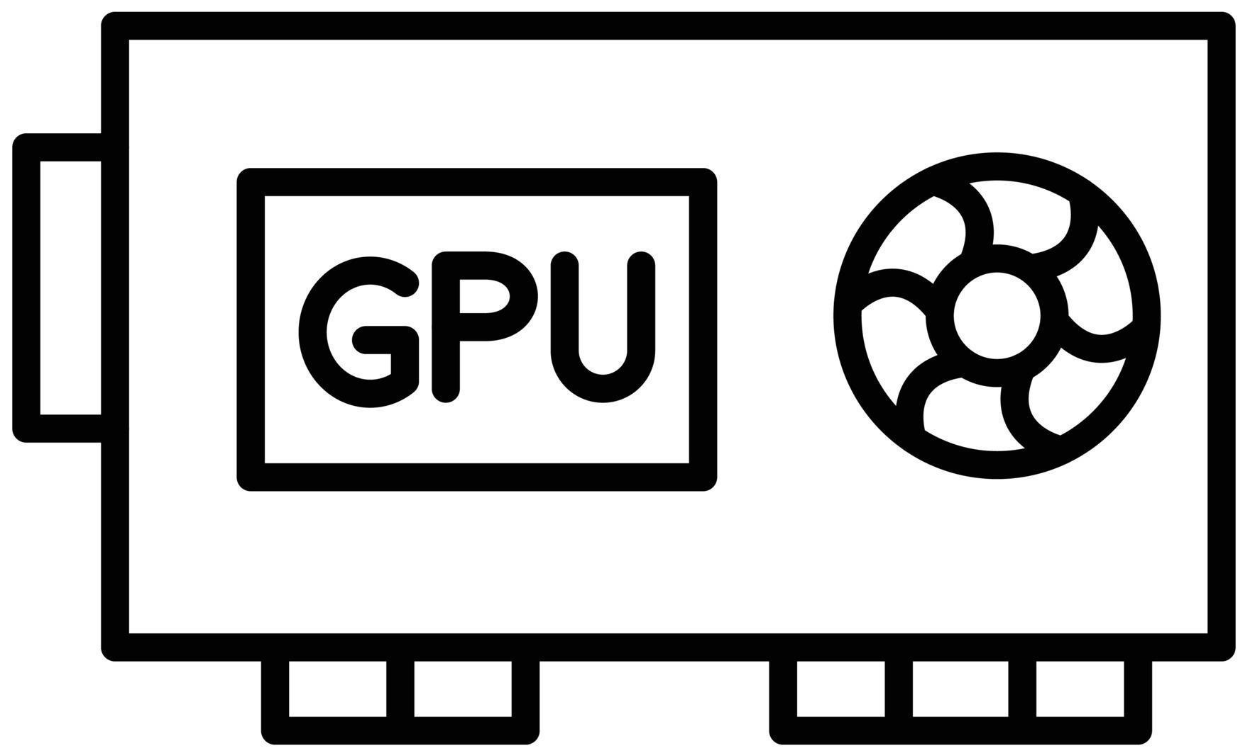
A Common Genome Analysis Pipeline
Raw
Signals
Basecalling (Translator)
Basecalled
(Translated)
Reads
Analysis
AAATGTGGTCCATTG
Noisy
Raw Signals
Costly
AI Models
Highly accurate reads

Slide 21
Alternative: Directly Analyze Raw Signals
Raw
Signals
Analysis
Noisy
Raw Signals
Faster and Scalable Analysis

Slide 22
Noise in Raw Electrical Signals
Observation: Identical molecules generate
similar raw signals
Sequencing CTGCGTAGCA
Raw
Signals:
[ , , , , ]
-0.06
-0.22
-0.75
0.96
-0.49
Prior Work: Perform vector similarity estimation
based on nearest neighbor search
Raw
Signals:
[ , , , , ]
-0.05
-0.21
-0.76
1.01
-0.51
Sequencing CTGCGTAGCA

Slide 23
How to Present Papers/Ideas/Projects
Background
Problem
  What are the limitations of the state-of-the-art approach(es)
Goal
  Articulate what the paper is trying to achieve with absolutely no jargons
Key Idea/Mechanism
  What are the idea(s) and steps to achieve this goal
Key (Expected) Results
  What are the key observations?
  What insights do we generate from them?
Strengths and Weaknesses
Future Directions and Ideas

Slide 24
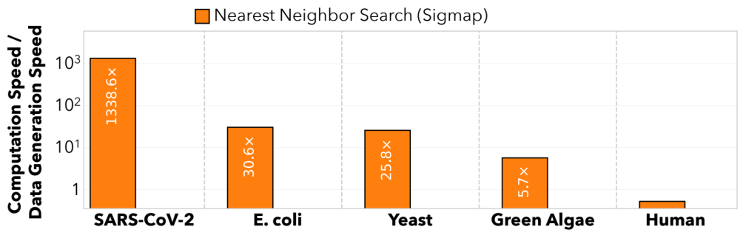




Scalability Issues Limit Real-Time Analysis
Genome Size Increase: 150$×$
2.4$×$
9.2$×$
28$×$
Problem: No Real-Time Analysis for Larger Genomes:
Searching mechanism does not scale well

Slide 25
How to Present Papers/Ideas/Projects
Background
Problem
  What are the limitations of the state-of-the-art approach(es)
Goal
  Articulate what the paper is trying to achieve with absolutely no jargons
Key Idea/Mechanism
  What are the idea(s) and steps to achieve this goal
Key (Expected) Results
  What are the key observations?
  What insights do we generate from them?
Strengths and Weaknesses
Future Directions and Ideas

Slide 26
RawHash’s Goal
Enable Fast, Accurate, and Scalable
Real-Time Analysis for Larger Genomes

Slide 27
How to Present Papers/Ideas/Projects
Background
Problem
  What are the limitations of the state-of-the-art approach(es)
Goal
  Articulate what the paper is trying to achieve with absolutely no jargons
Key Idea/Mechanism
  What are the idea(s) and steps to achieve this goal
Key (Expected) Results
  What are the key observations?
  What insights do we generate from them?
Strengths and Weaknesses
Future Directions and Ideas

Slide 28
A Key Idea
Key Idea: Perform similarity estimation with
signal processing techniques

Slide 29
Key Idea: Perform similarity estimation with classical signal processing techniques

Slide 30
RawHash’s Key Idea
Key Idea: Perform similarity estimation
based on quick exact matches
Raw Signals:
[ , , , , ]
-0.06
-0.22
-0.75
0.96
-0.49
Hash
0x77db
Fast Match
Hash
0x77db
Raw Signals:
[ , , , , ]
-0.05
-0.21
-0.76
1.01
-0.51
Challenge: How to generate the same hash value
for similar enough signals with various noise types?

Slide 31
RawHash Overview
Reference Genome (Converted to Signals)
Raw Signals
(~5000 signals/sec)
Reference Signals
Offline Indexing
Hash Table
(Index)
Quantize
Quantize
Store
Query
Hash
Hash
Real-Time Mapping
Yes: Analyze the next chunk
Matching Regions
Chaining & Mapping
Continue Mapping?
No: Stop
Sequencing

Slide 32
Step 1: Quantization
Reference Genome (Converted to Signals)
Raw Signals
(~5000 signals/sec)
Reference Signals
Quantize
Quantize

Slide 33
RawHash’s Key Idea – Quantization
CTGCGT
-0.05
-0.07
-0.06
-0.05
-0.06
Quantize
Quantize
Quantize
Quantize
Quantize
Bucket #
0
1
2
3
4
5
6
7
8
9
10
11
12
13
14
15
-3.00
Range of raw signals (normalized)
+3.00
✓
Enables matching raw signals by eliminating slight differences

Slide 34
How to Better Quantize Signals
Bucket #
0
1
2
3
4
5
6
7
8
9
10
11
12
13
14
15
-3.00
Range of raw signals (normalized)
+3.00
✕
Equal-width buckets leads to
unbalanced bucket loading
600
K-mer count
400
200
0
1
2
3
4
5
6
7
8
9
10
11
12
13
14
15
-3.00
+3.00
✕
Reduced uniqueness and poor resource utilization

Slide 35
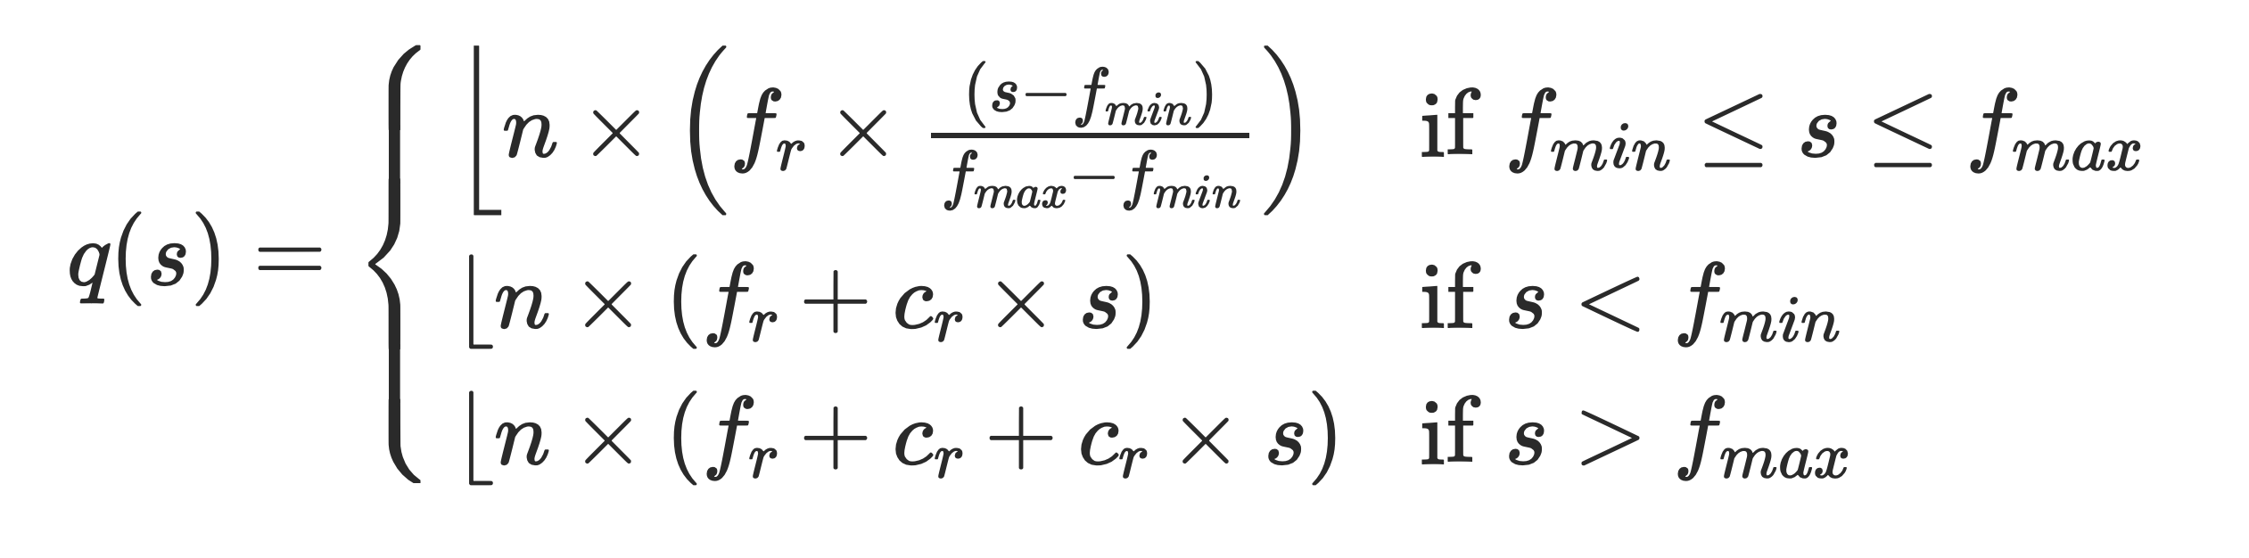
Adaptive Quantization
Key Idea: Quantizing raw signals with non-equal bucket widths
by leveraging raw signal distribution
Bucket #
0
1
2
3
4
5
6
7
8
9
10
11
12
13
14
15
-3.00
Range of raw signals (normalized)
+3.00
K-mer count
-3.00
3.00
✓
Better bucket utilization

Slide 36
Step 2: Hashing Quantized Signals
Reference Genome (Converted to Signals)
Raw Signals
(~5000 signals/sec)
Reference Signals
Quantize
Quantize
Hash
Hash

Slide 37
RawHash Key Idea – Hash-based Matching
Sequencing CTGCGTAGCA
[ , , , , ]
-0.06
-0.22
-0.75
0.96
-0.49
Quantize
Quantize
Quantize
Quantize
Quantize
Hash
0x77db
0b0111
0b0111
0b0110
0b1011
0b0110
Pack
0b01110111011010110110
Hash
0x77db
Fast and Accurate Match
Key Contribution: The first hash-based search
(and indexing) mechanism for raw signals

Slide 38
RawHash Overview
Reference Genome (Converted to Signals)
Raw Signals
(~5000 signals/sec)
Reference Signals
Offline Indexing
Hash Table
(Index)
Quantize
Quantize
Store
Query
Hash
Hash
Real-Time Mapping
Yes: Analyze the next chunk
Matching Regions
Chaining & Mapping
Continue Mapping?
No: Stop
Sequencing

Slide 39
How to Present Papers/Ideas/Projects
Background
Problem
  What are the limitations of the state-of-the-art approach(es)
Goal
  Articulate what the paper is trying to achieve with absolutely no jargons
Key Idea/Mechanism
  What are the idea(s) and steps to achieve this goal
Key (Expected) Results
  What are the key observations?
  What insights do we generate from them?
Strengths and Weaknesses
Future Directions and Ideas

Slide 40
Evaluation Methodology
Compared to Sigmap [Zhang+, ISMB/ECCB'21]
Evaluation metrics:
  Throughput (computation speed / data generation speed)
  Read mapping accuracy (F1)
    Ground truth: Basecalled read mapping
You can also mention: Datasets, simulators, baseline implementation, hardware and so on
  Evaluation methodology is where you describe the experimental setup used for generating the results you are about to show

Slide 41

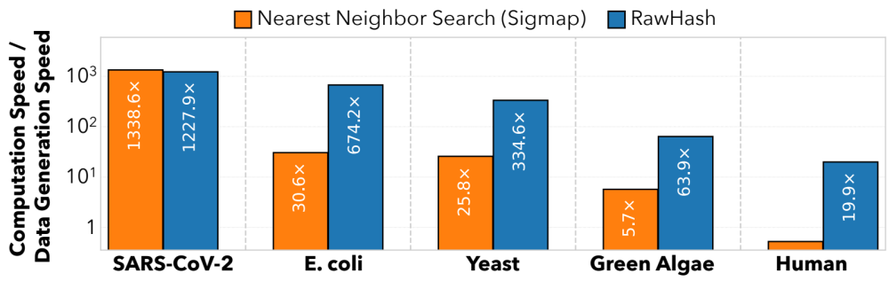
Real-Time Analysis Benefits from Fast Search
Genome Size Increase: 150$×$
2.4$×$
9.2$×$
28$×$
Real-time Analysis for Human Genomes:
Fast search instead of costly neighbor search

Slide 42
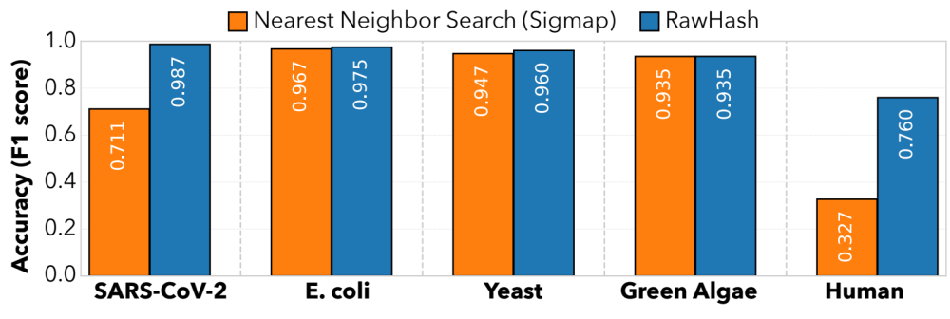
Fast Search Leads to Accurate Search
Best accuracy for all genomes:
Hash values span longer sequences than vectors ->
More unique and informative matches
(Almost) Identical accuracy to basecalled analysis:
Is the small difference because RawHash is even better?

Slide 43
How to Present Papers/Ideas/Projects
Background
Problem
  What are the limitations of the state-of-the-art approach(es)
Goal
  Articulate what the paper is trying to achieve with absolutely no jargons
Key Idea/Mechanism
  What are the idea(s) and steps to achieve this goal
Key (Expected) Results
  What are the key observations?
  What insights do we generate from them?
Strengths and Weaknesses
Future Directions and Ideas

Slide 44
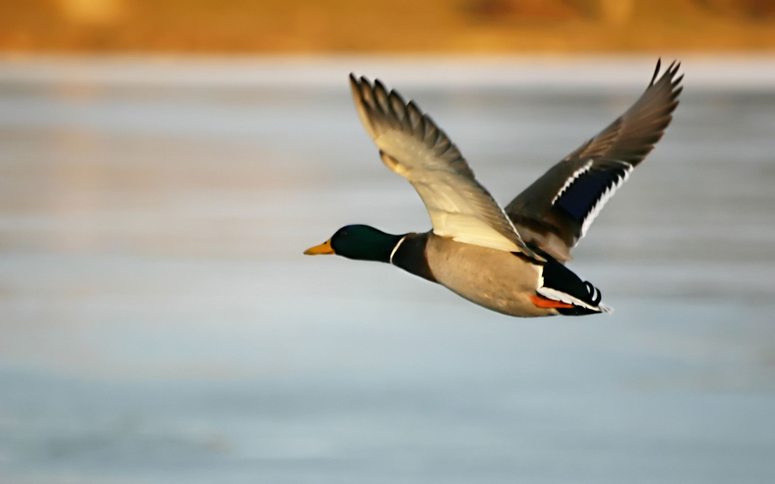
Aim Here
Current Practice
5-10 years

Slide 45
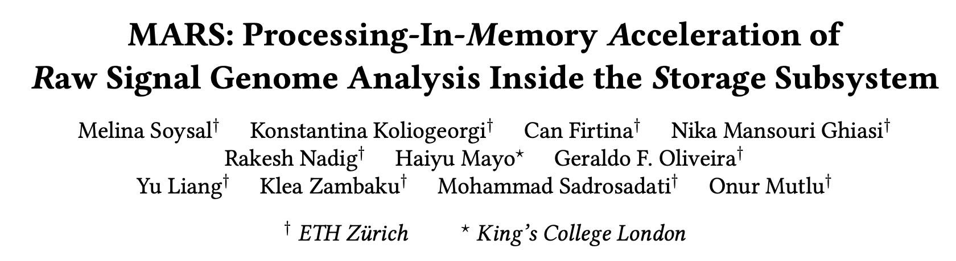
In-Storage Raw Signal Analysis [ICS '25]
MARS: Processing-In-Memory Acceleration of Raw Signal Genome Analysis
Inside the Storage Subsystem
Melina Soysal, Konstantina Koliogeorgi, Can Firtina, Nika Mansouri Ghiasi, Rakesh Nadig, Haiyu Mao, Geraldo Francisco Oliveira Junior, Yu Liang, Klea Zambaku, Mohammad Sadrosadati,
Onur Mutlu
Proceedings of the 39th International Conference on Supercomputing (ICS 2025), Salt Lake City, Utah, USA, June 2025.
[PDF] [DOI]
Conference talk [Video] [Slides (pptx)] [Slides (pdf)]

Slide 46
Motivation
Chaining & seeding consistently dominate runtime
Event detection & I/O overhead are non-negligible for some datasets

Slide 47
Impact of I/O data movement
We model I/O data movement overhead when accelerating commonly targeted steps in the pipeline: seeding and chaining
As compute latency is reduced, I/O becomes the dominant contributor to total execution time
I/O data movement from SSD becomes dominant overhead as compute steps are accelerated in RSGA

Slide 48
In-Storage Raw Signal Analysis [ICS '25]
MARS: Processing-In-Memory Acceleration of Raw Signal Genome Analysis
Inside the Storage Subsystem
Melina Soysal, Konstantina Koliogeorgi, Can Firtina, Nika Mansouri Ghiasi, Rakesh Nadig, Haiyu Mao, Geraldo Francisco Oliveira Junior, Yu Liang, Klea Zambaku, Mohammad Sadrosadati,
Onur Mutlu
Proceedings of the 39th International Conference on Supercomputing (ICS 2025), Salt Lake City, Utah, USA, June 2025.
[PDF] [DOI]
Conference talk [Video] [Slides (pptx)] [Slides (pdf)]

Slide 49
The contribution is insight
Not novelty
Not numbers
49

Slide 50
Research is a
hunt for insight
Need to get off the beaten path to find new insights
50

Slide 51

Lost keys here
Looking here for lost keys
51

Slide 52
Conclusion
Research is a multi-step process (art + science)
  Focus on important problems
  Figure out a way to test your ideas quickly
  Build resilience
As researchers, we seek insight to solve important problems
Communicate the insights you generate extremely clearly
  Otherwise, those insights will need to be rediscovered
Keep your mind open

Slide 53
Questions?

Slide 54
Next Lecture
Lecture 3: Introduction to Genomics and Sequencing
  How sequencing technologies work and initial steps of its analysis
Before next class
  Finalize your paper selection (due Sep 8, 11:59pm)

Slide 55
CMSC 829C: Algorithms, AI, and Hardware
for Biological Data
Lecture 2: Moving the Needle - A Bioinformatics Perspective
Fall 2026
September 3, 2026
Can Firtina | canfirtina@gmail.com | cs.umd.edu/~firtina
Assistant Professor of Computer Science at UMD

