Slide 1
CMSC 829C: Algorithms, AI, and Hardware
for Biological Data
Lecture 1: Introduction and Course Logistics
Fall 2026
September 1, 2026
Can Firtina | canfirtina@gmail.com | cs.umd.edu/~firtina
Assistant Professor of Computer Science at UMD

Slide 2
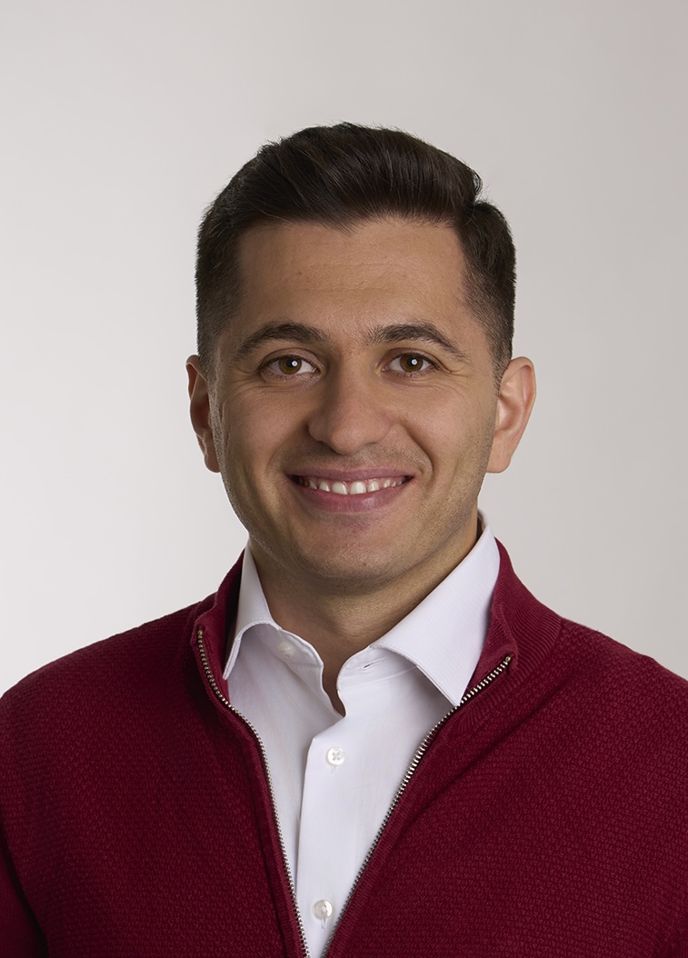
Brief Self Introduction
Can Firtina
  Assistant Professor of Computer Science at UMD since Sept 2025
  STORM Group at UMD: storm.cs.umd.edu
  Personal website: cfirtina.com | Contact: canfirtina@gmail.com
  PhD in CS from ETH Zurich in 2025
  MSc and BSc in Computer Engineering from Bilkent University
Research Interests: Bioinformatics & Computer Architecture
  Designing algorithmic, machine learning, and hardware solutions for genomics
  Real-time, portable, energy-efficient genome analysis

Slide 3











STORM Research Group
Research Directions
Real-Time and Portable Genomic Signal Analysis
Goal
Enable fundamentally better integration of biological data analysis in our everyday lives
Data-centric and
AI-Driven Solutions to Analyze Genomic Data
Accurate and Fast
Algorithms Scalable to
Large Volumes of Genomic Data

Slide 4
Agenda
The need to co-design algorithms, ML and hardware
Course information and logistics

Slide 5
Agenda
The need to co-design algorithms, ML and hardware
Course information and logistics

Slide 6
The Goal of Computing: Beyond Numbers
"The purpose of computing is insight, not numbers"
Richard Hamming
"Numerical Methods for Scientists and Engineers," Richard Hamming, 1962.

Slide 7
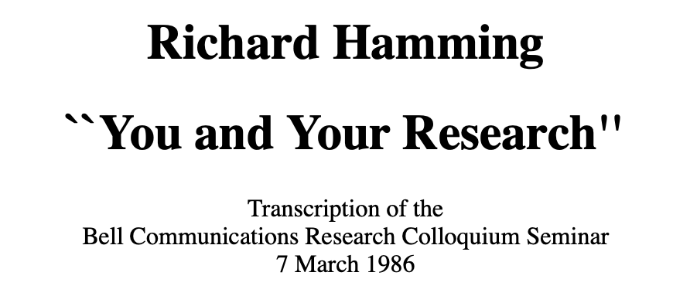
Recommended: You and Your Research
Richard Hamming,
"You and Your Research"
Bell Communications Research Colloquium Seminar, 1986.
[Lecture Video] [Podcast]

Slide 8
Some More Materials to Internalize
Bill Dally,
"Moving the needle: Effective Computer Architecture Research
in Academe and Industry"
ISCA, 2010.
[Alternative Talk Video]
Michael Stonebraker,
"Make it Happen"
ACM Turing Award Lecture, 2014.
Martin A. Schwartz,
"The importance of stupidity in scientific research"
Journal of Cell Science, 2008.

Slide 9
The Goal of Computing: Beyond Numbers
"The purpose of computing is insight, not numbers"
Richard Hamming
"Numerical Methods for Scientists and Engineers," Richard Hamming, 1962.

Slide 10
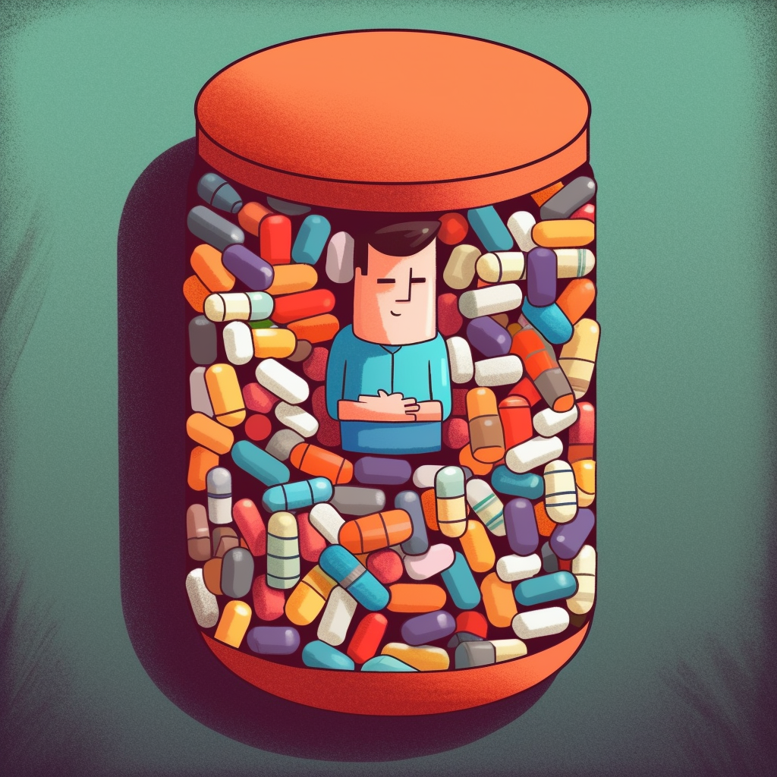
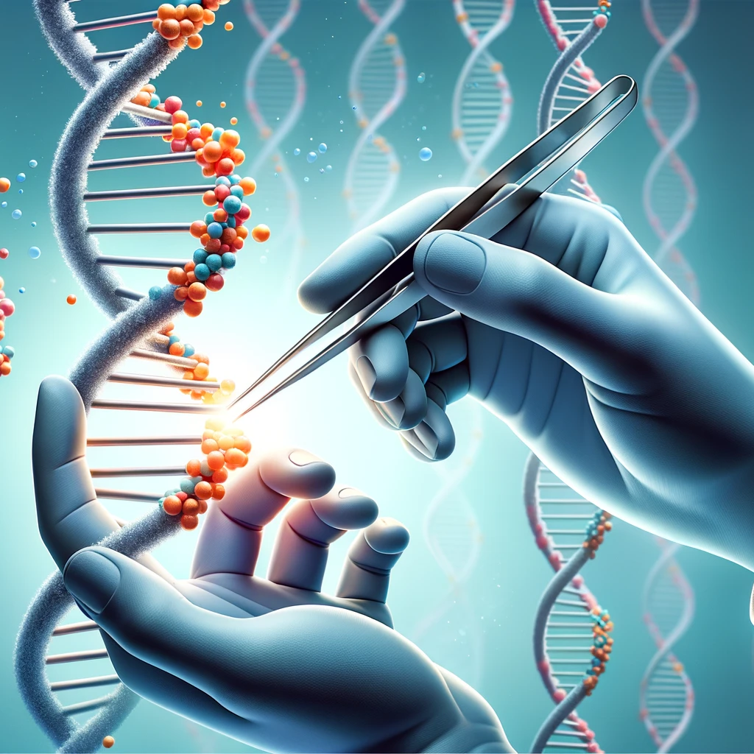


Analyzing Genomes Reveals Key Insights
Personalized Medicine
Genome Editing
Detecting pathogens
in the environment
Rapid surveillance of
disease outbreaks

Slide 11
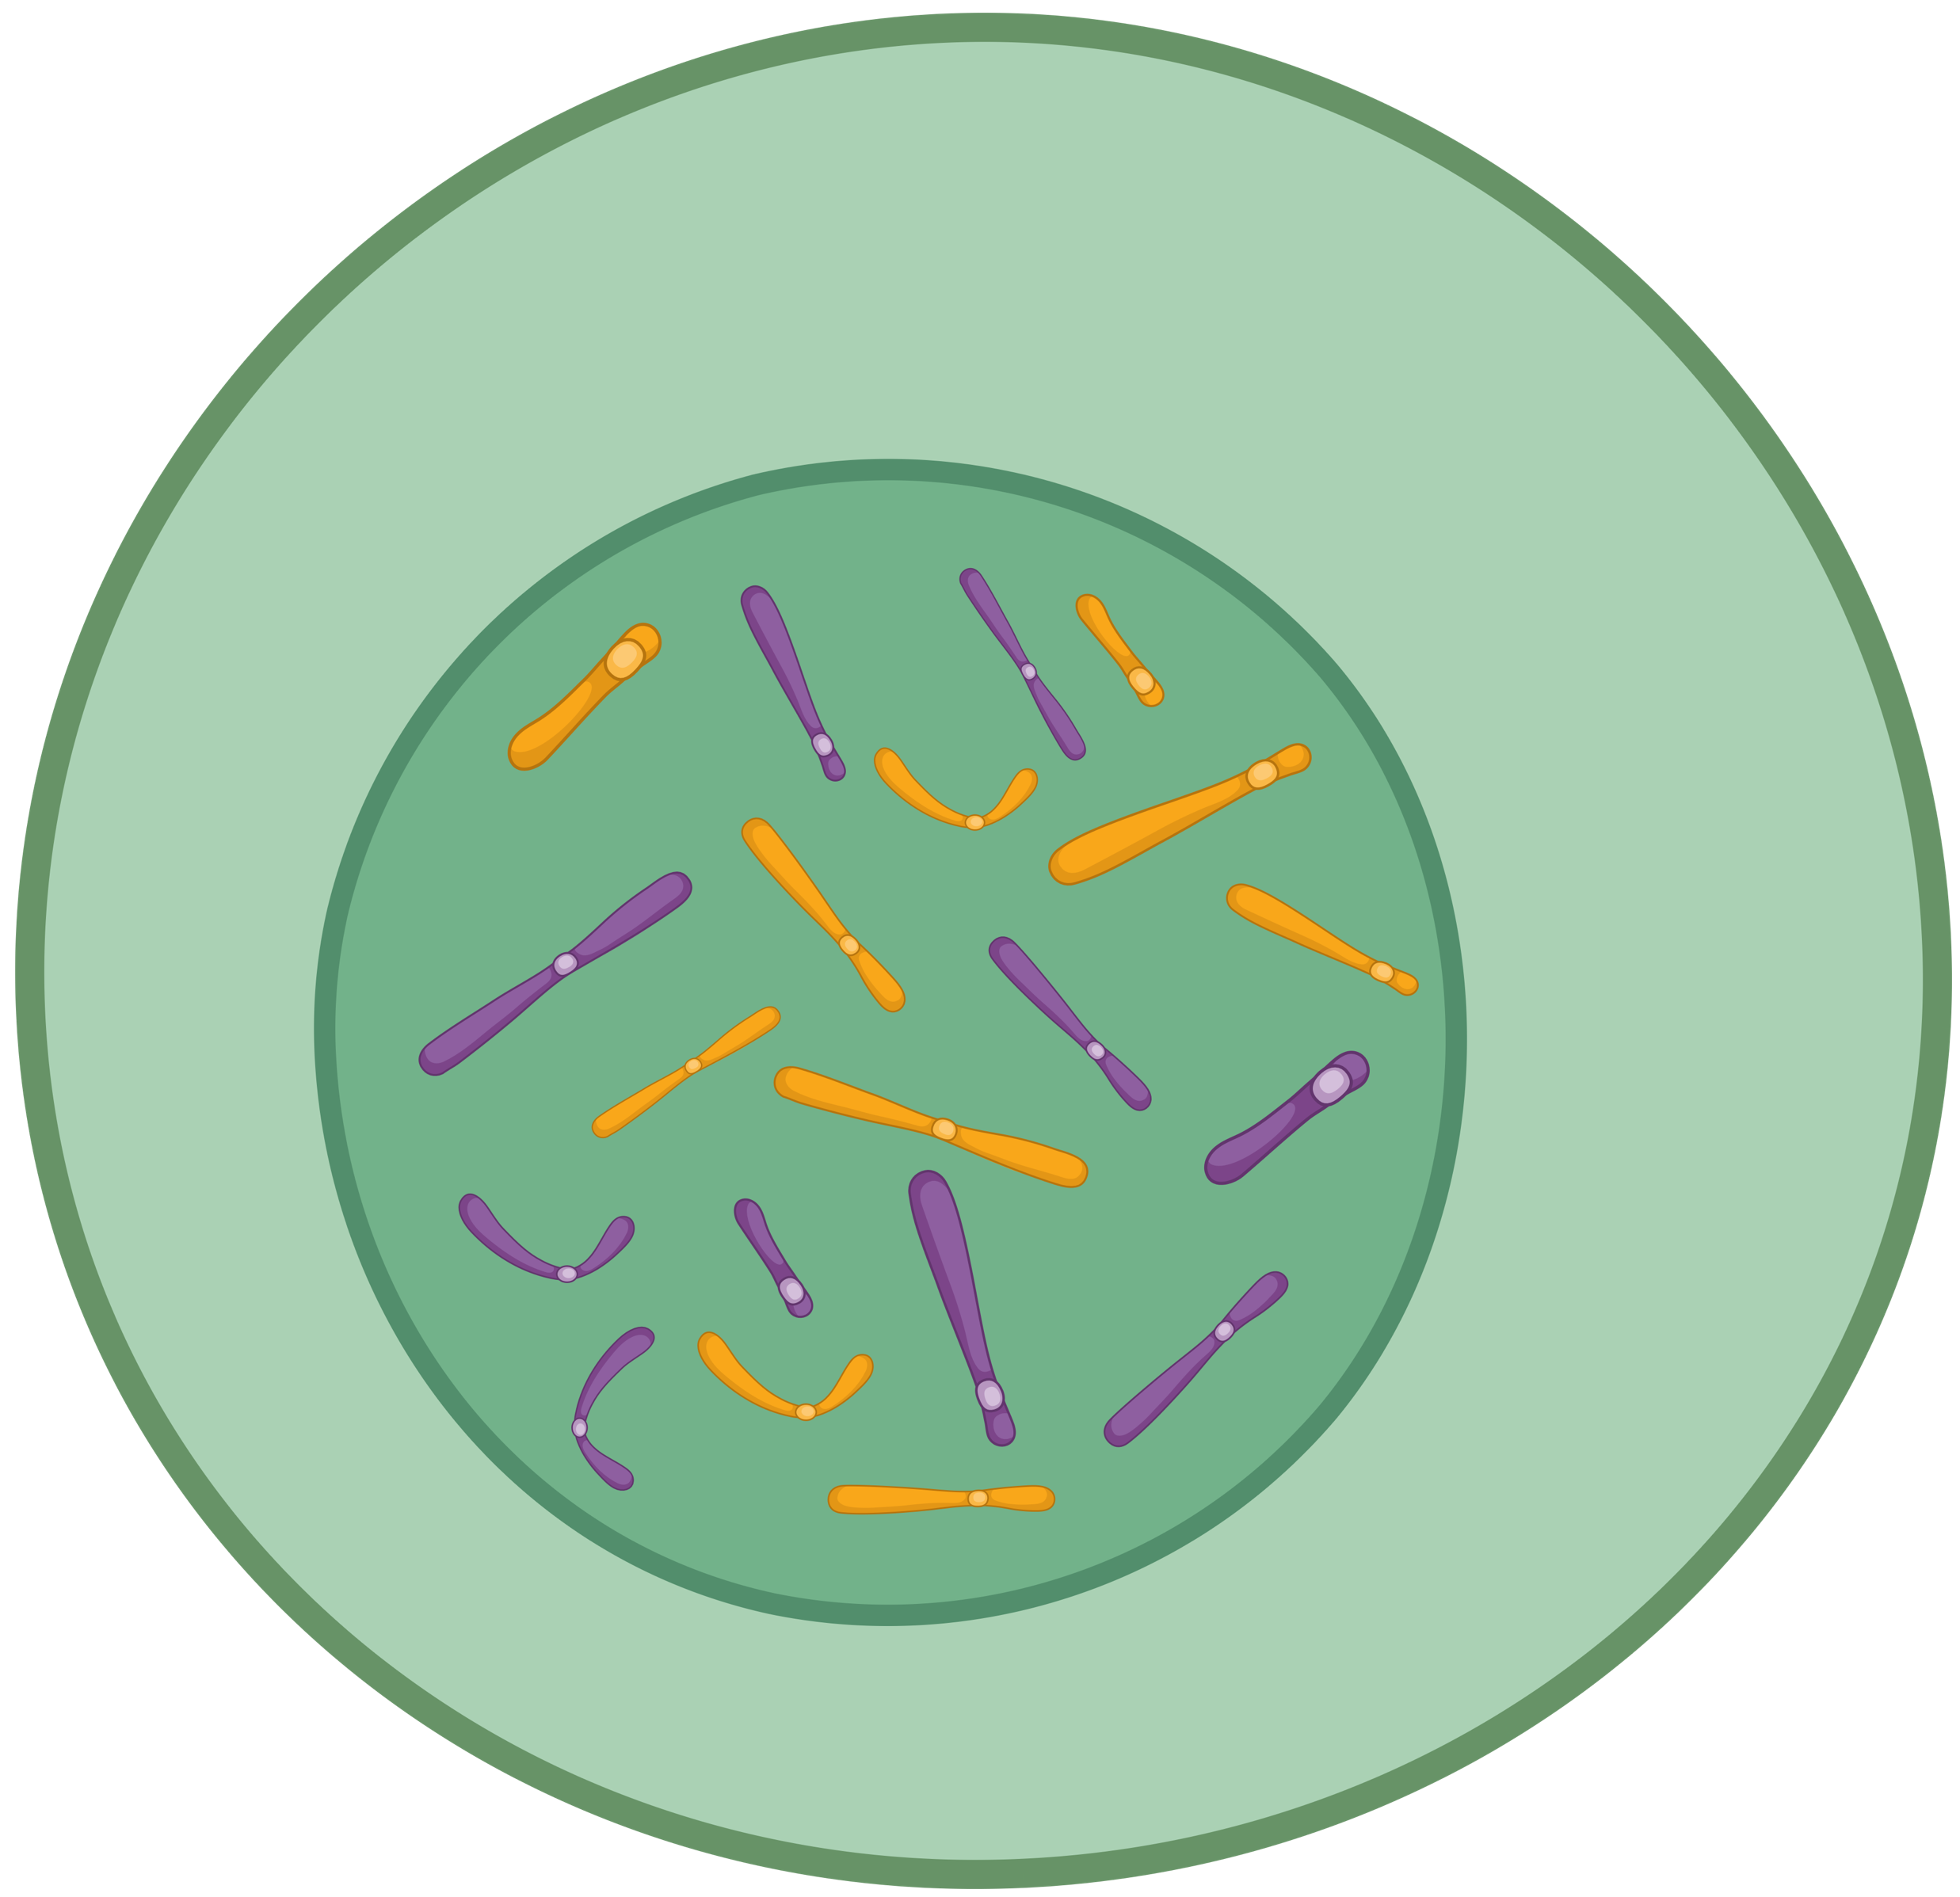
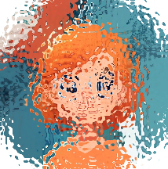
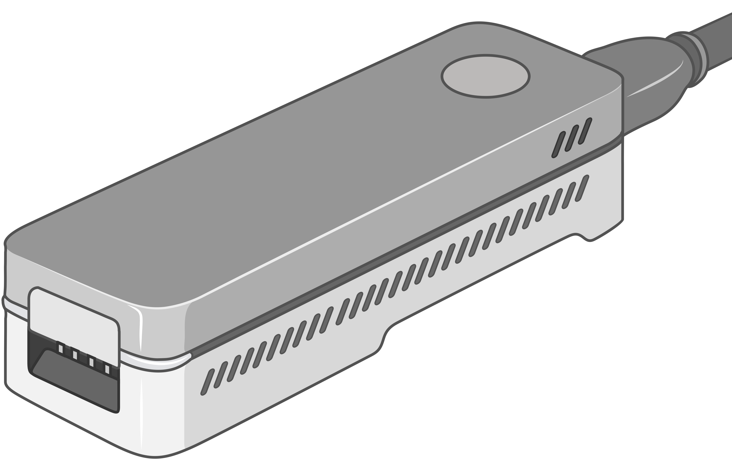
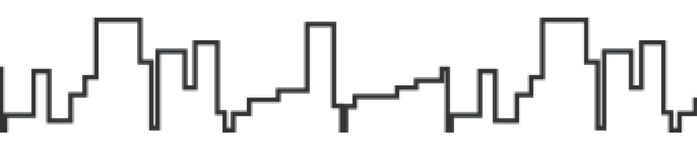
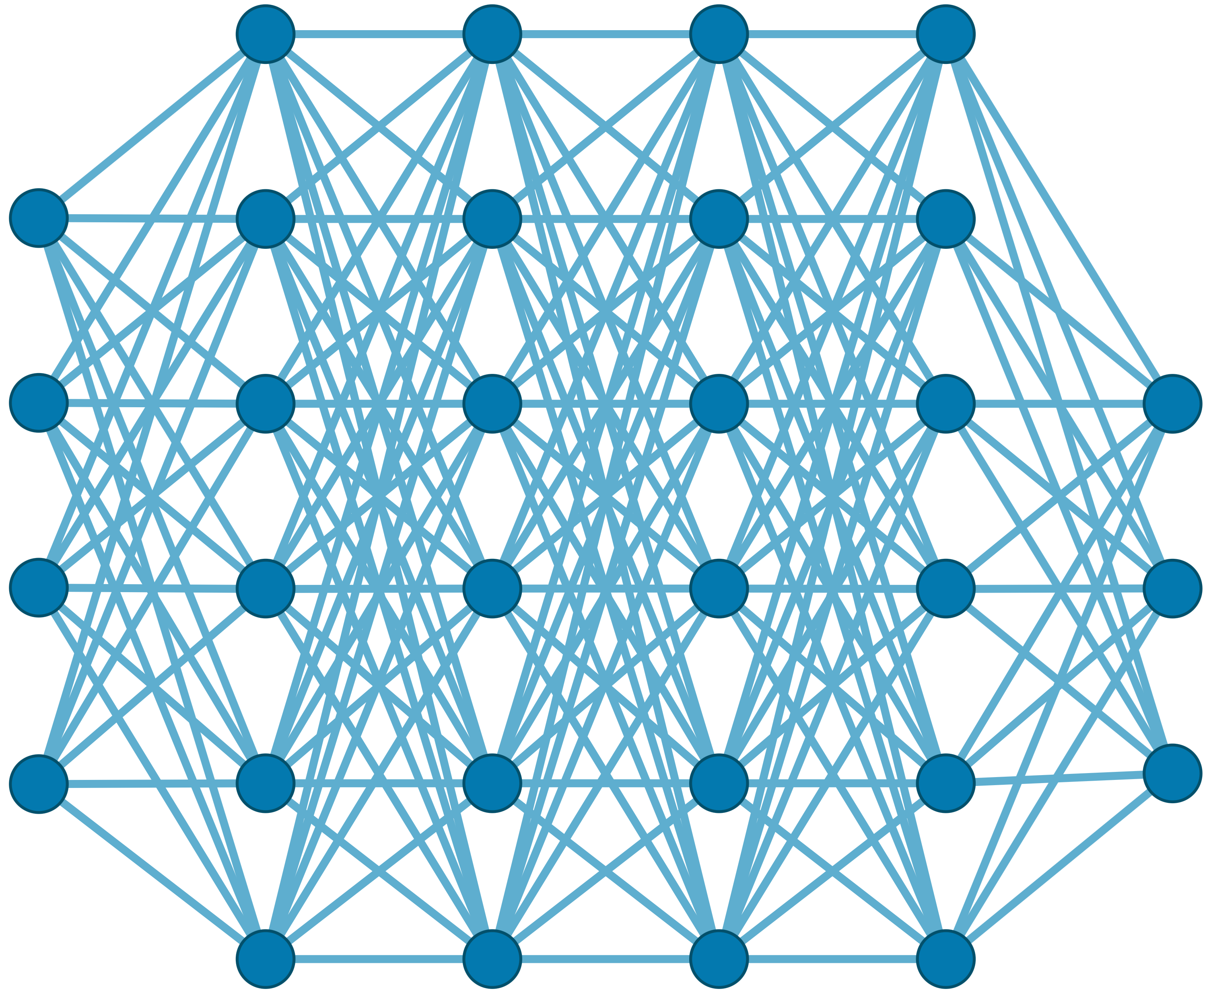

Generating the Entire Genomic Sequence
Whole Genome: 6.4B bps
(Non-human-readable)
Sequencing Device
Raw Genomic Data
(Human-readable?)
Translator (Basecalling)
AI
CGAAATGCC...AGATTAAACGCT...TGCCCTAA...GAATGGCGT
Whole Human Genome: 6.4B bps (Human-readable)

Slide 12
A Common Genome Analysis Pipeline
Raw
Reads
Basecalling (Translator)
Basecalled
(Translated)
Reads
Read
Mapping
AAATGTGGTCCATTG
Assembly
Variant Calling
Metagenomics
Downstream Analysis

Slide 13
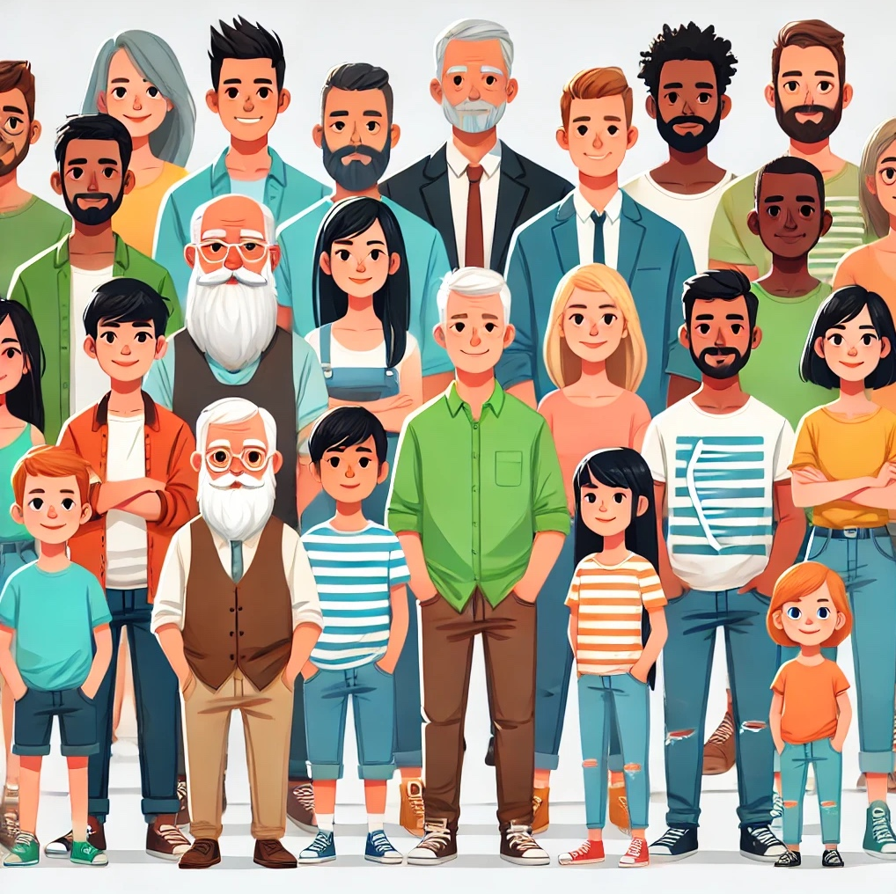
A Pipeline That is Computationally Costly
Significant computational overhead

Slide 14
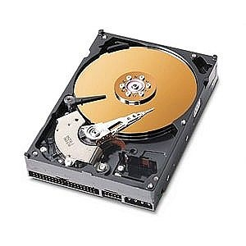
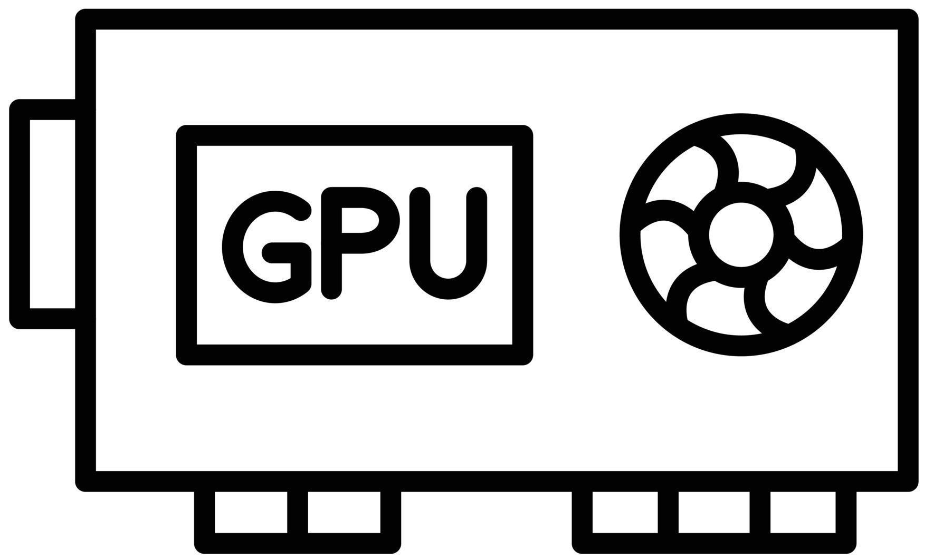
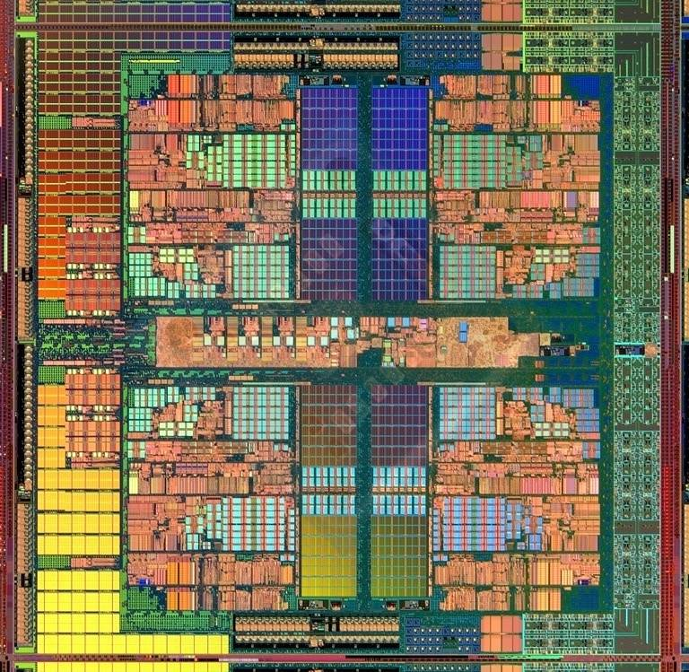
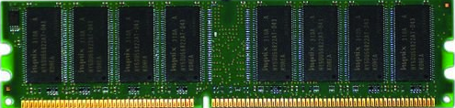
A Pipeline That Wastes Resources
Useless
Useless
Useless
Whole Dataset (~TBs)
Useful
Useful
Useful
Costly and large volumes of data movement
Wasted money, time, energy

Slide 15

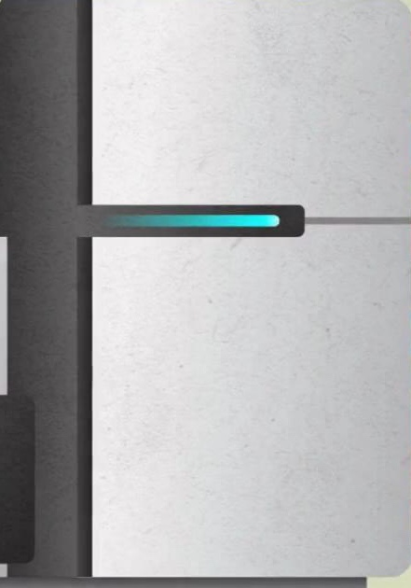


Data Movement Dominates Performance
Data movement dominates performance and is a major system
energy bottleneck (accounting for 40% - 62%)
Data Movement
Sequencing
Machine
Storage (SSD/HDD)
Main Memory
Microprocessor
Single memory request consumes >160$×$ - 800$×$ more energy compared to performing an addition operation
⁻ Boroumand et al., “Google Workloads for Consumer Devices: Mitigating Data Movement Bottlenecks,” ASPLOS 2018
⁻ Kestor et al., “Quantifying the Energy Cost of Data Movement in Scientific Applications,” IISWC 2013
⁻ Pandiyan and Wu, “Quantifying the energy cost of data movement for emerging smart phone workloads on mobile platforms,” IISWC 2014

Slide 16
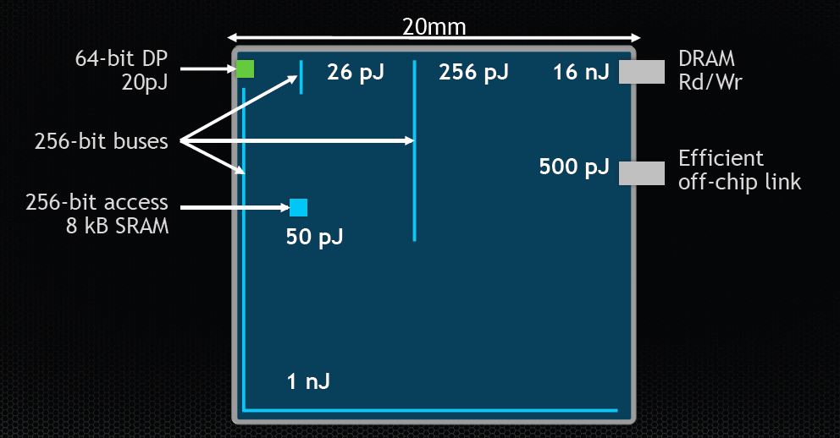
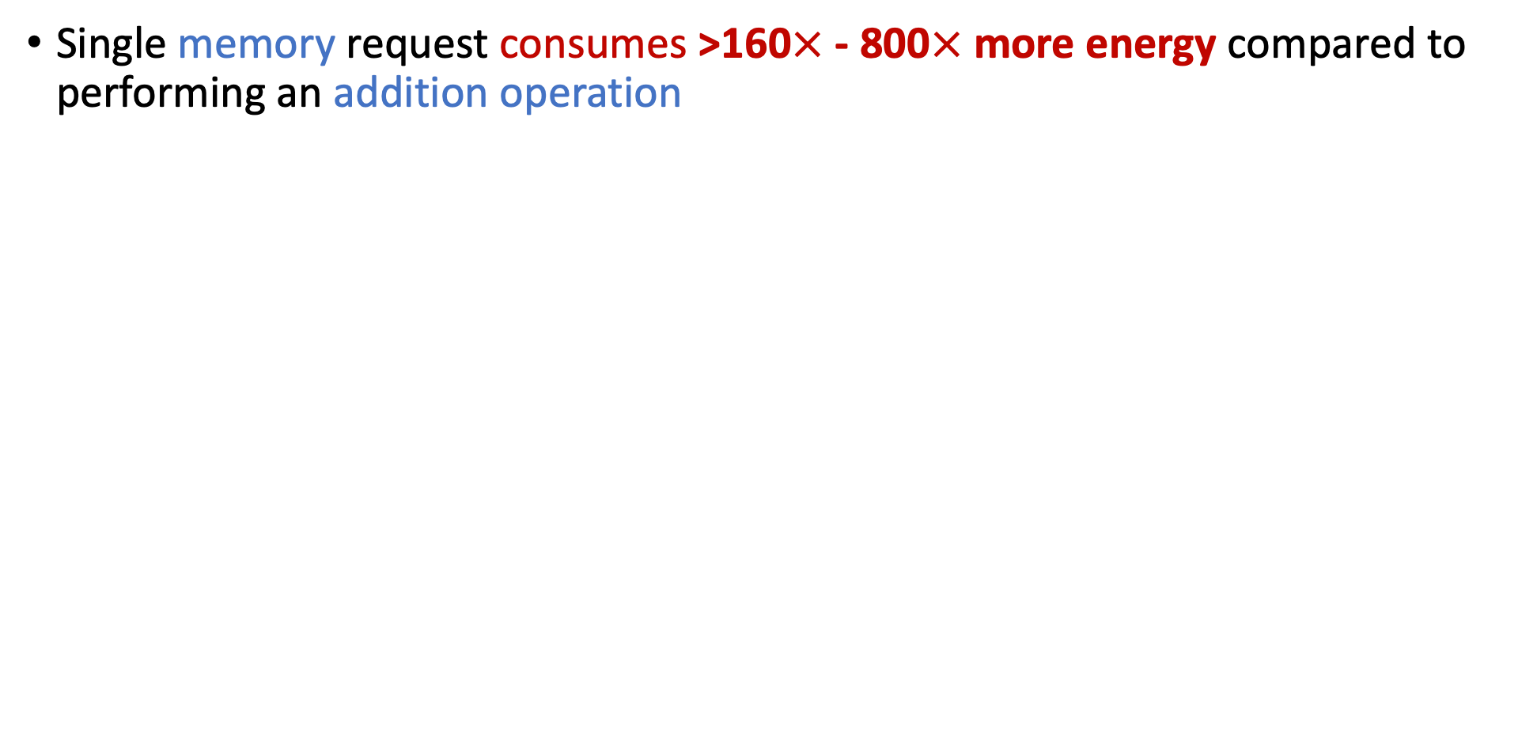
Communication Dominates Arithmetic
Single memory request consumes >160$×$ - 800$×$ more energy compared to performing an addition operation
William Dally, HiPEAC 2015

Slide 17
Problems with Data Analysis Today
Special-Purpose Machine
for Data Generation
General-Purpose Machine
for Data Analysis
FAST
SLOW
Processing capabilities oblivious to data analysis requirements
Large amounts of data movement

Slide 18
We need to co-design algorithms and architecture to handle data well

Slide 19
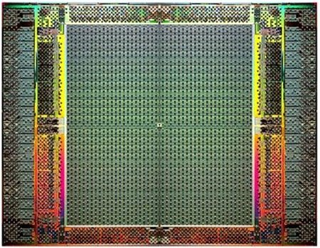
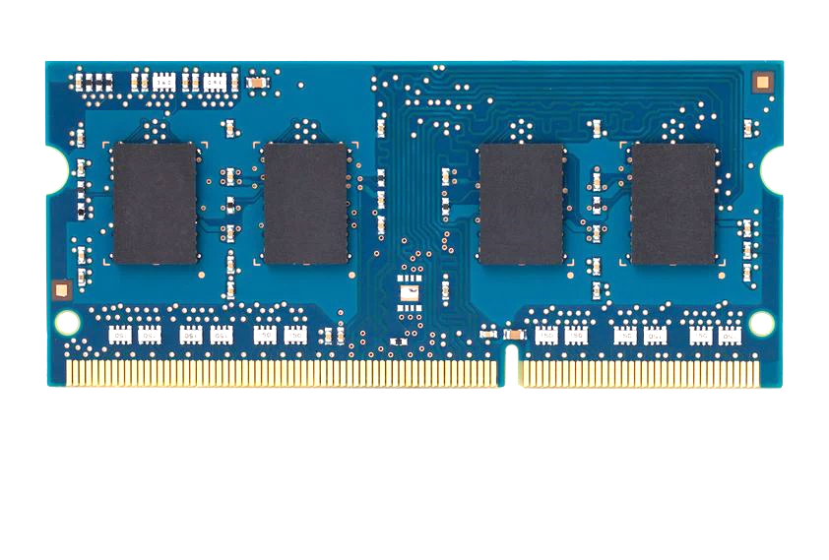
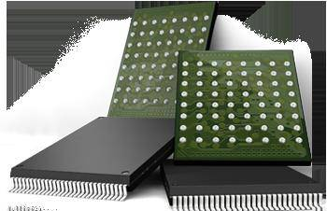
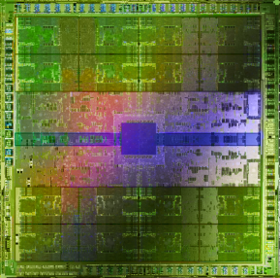
Pushing Towards New Architectures
Modern systems
?
FPGAs
Sequencing Machine
Hybrid Main Memory
Heterogeneous
Processors &
Accelerators
Persistent Memory/Storage
GPUs

Slide 20
Algorithm-Architecture Co-design is Critical
Problem
Algorithm
Program/Language
System Software
Computer Architecture (expanded view)
SW/HW Interface
Micro-architecture
Logic
Devices
Electrons

Slide 21
Why Do We Need This Course?
To give you the perspective:
Learn how to critically analyze and present research papers
To inform you on computational challenges and solutions in bioinformatics
We need to co-design
algorithms and architecture
to handle data well

Slide 22
Applications are
Limitless (Almost)

Slide 23
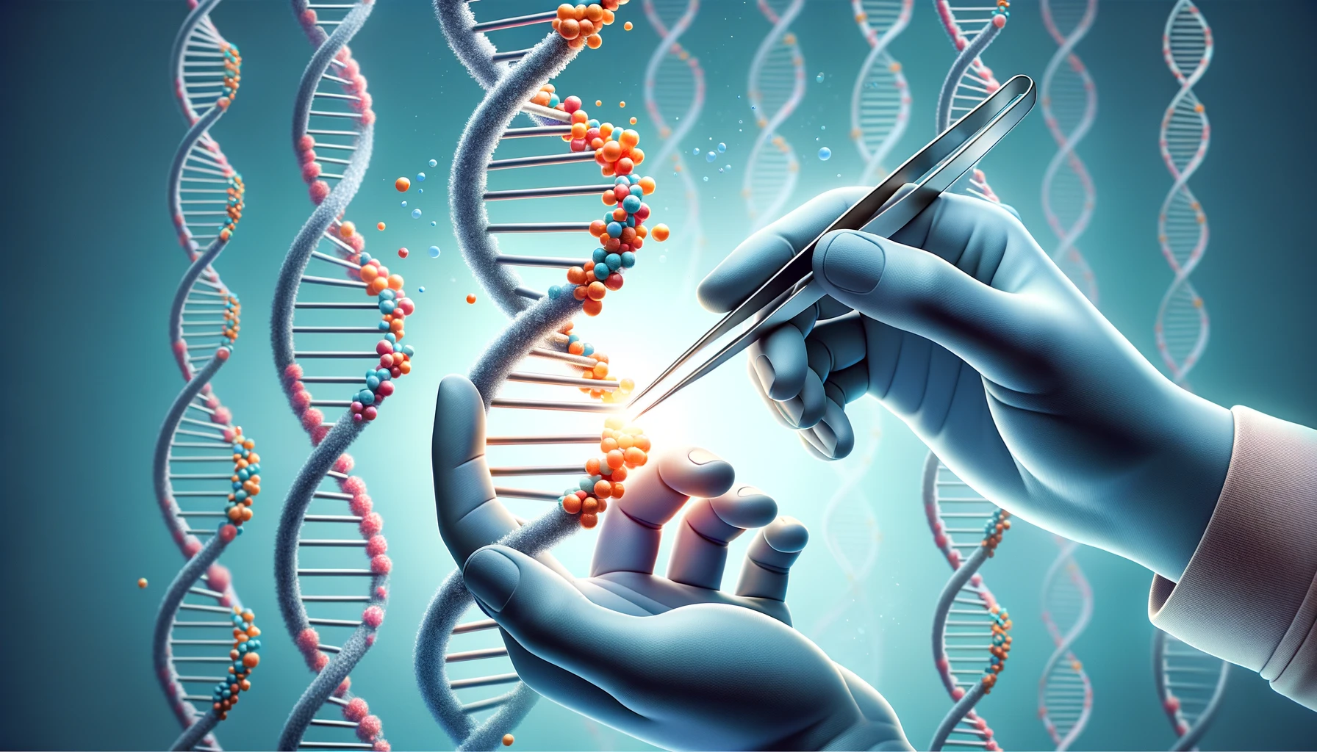
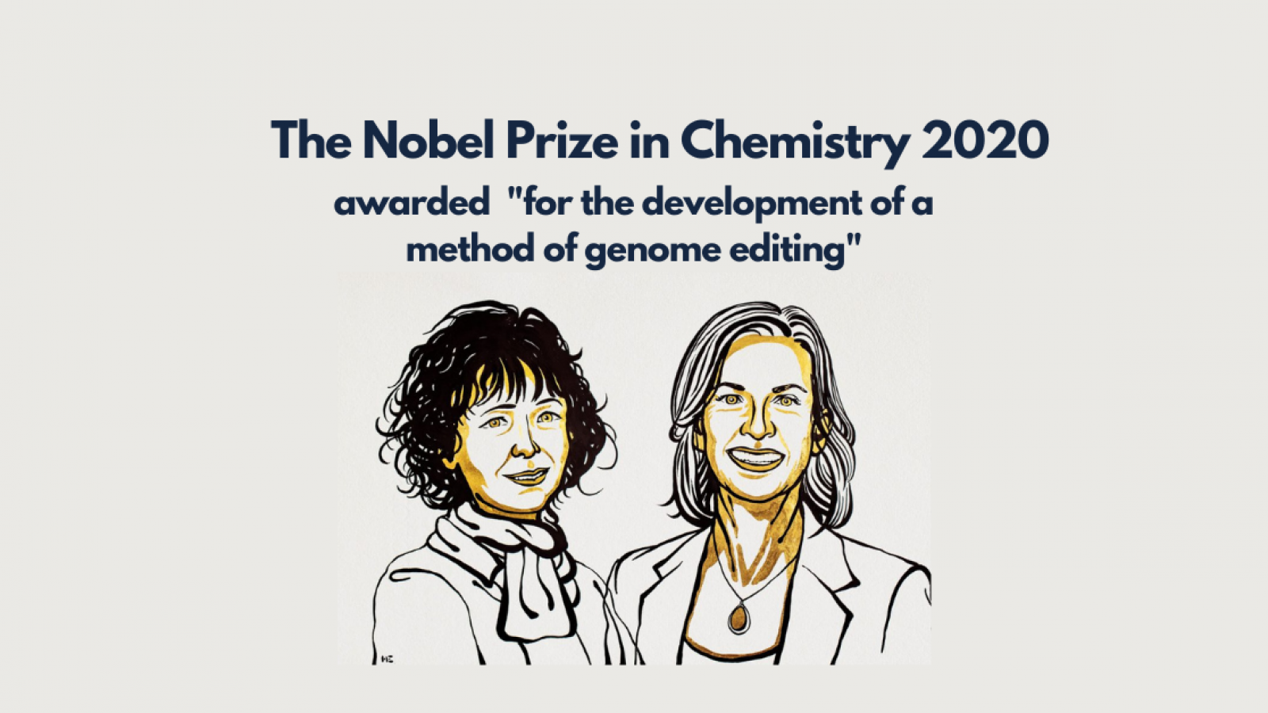
Genome Editing
https://www.nobelprize.org/prizes/chemistry/2020/press-release/

Slide 24
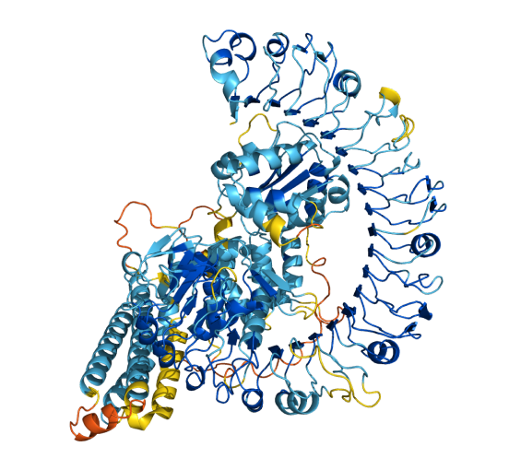
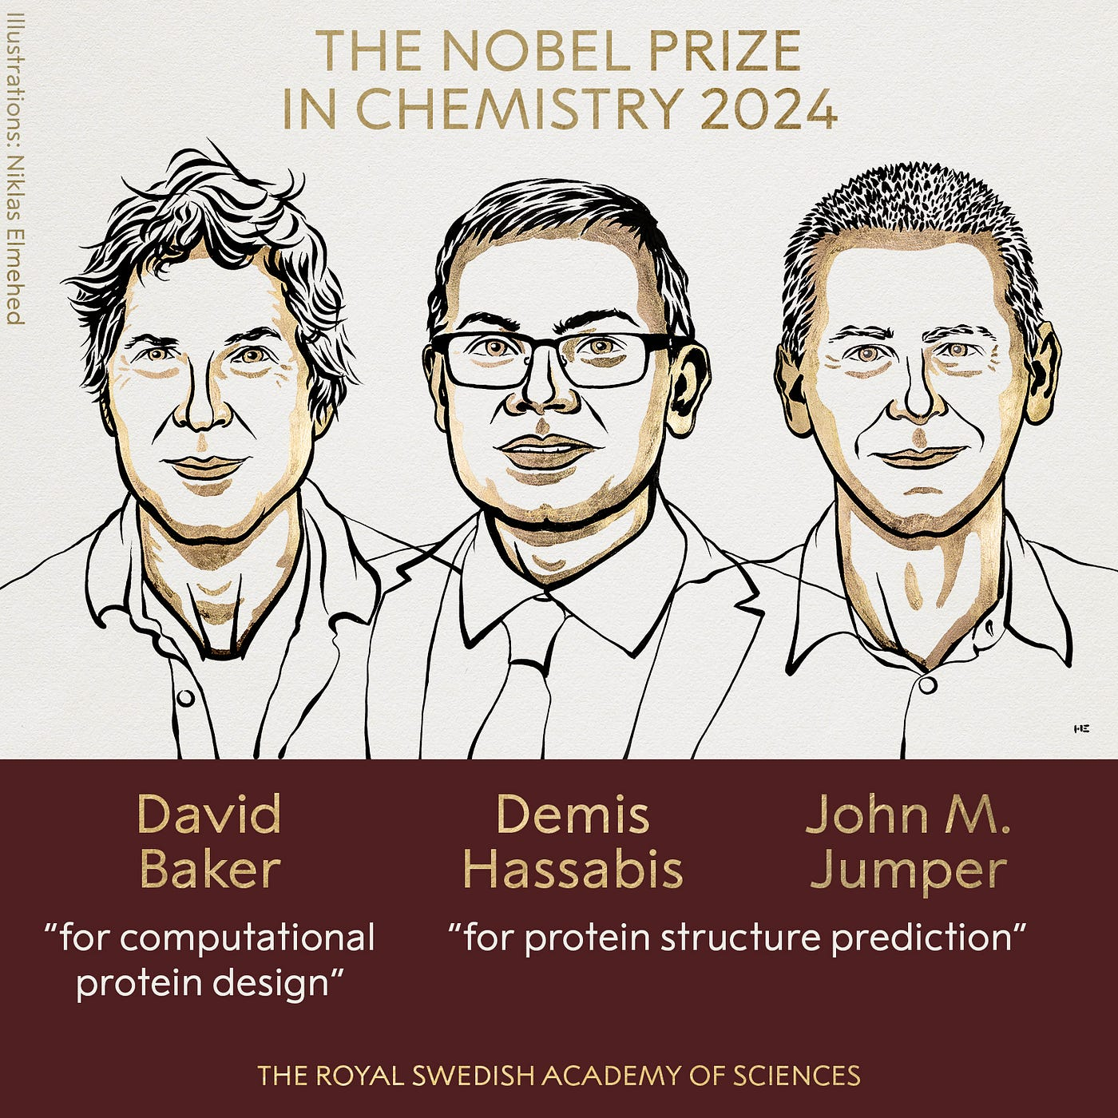
Protein Structure Prediction
https://www.nobelprize.org/prizes/chemistry/2024/press-release/

Slide 25
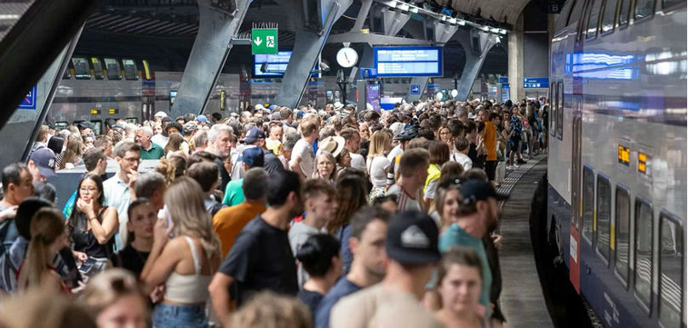
Large Scale Analysis

Slide 26
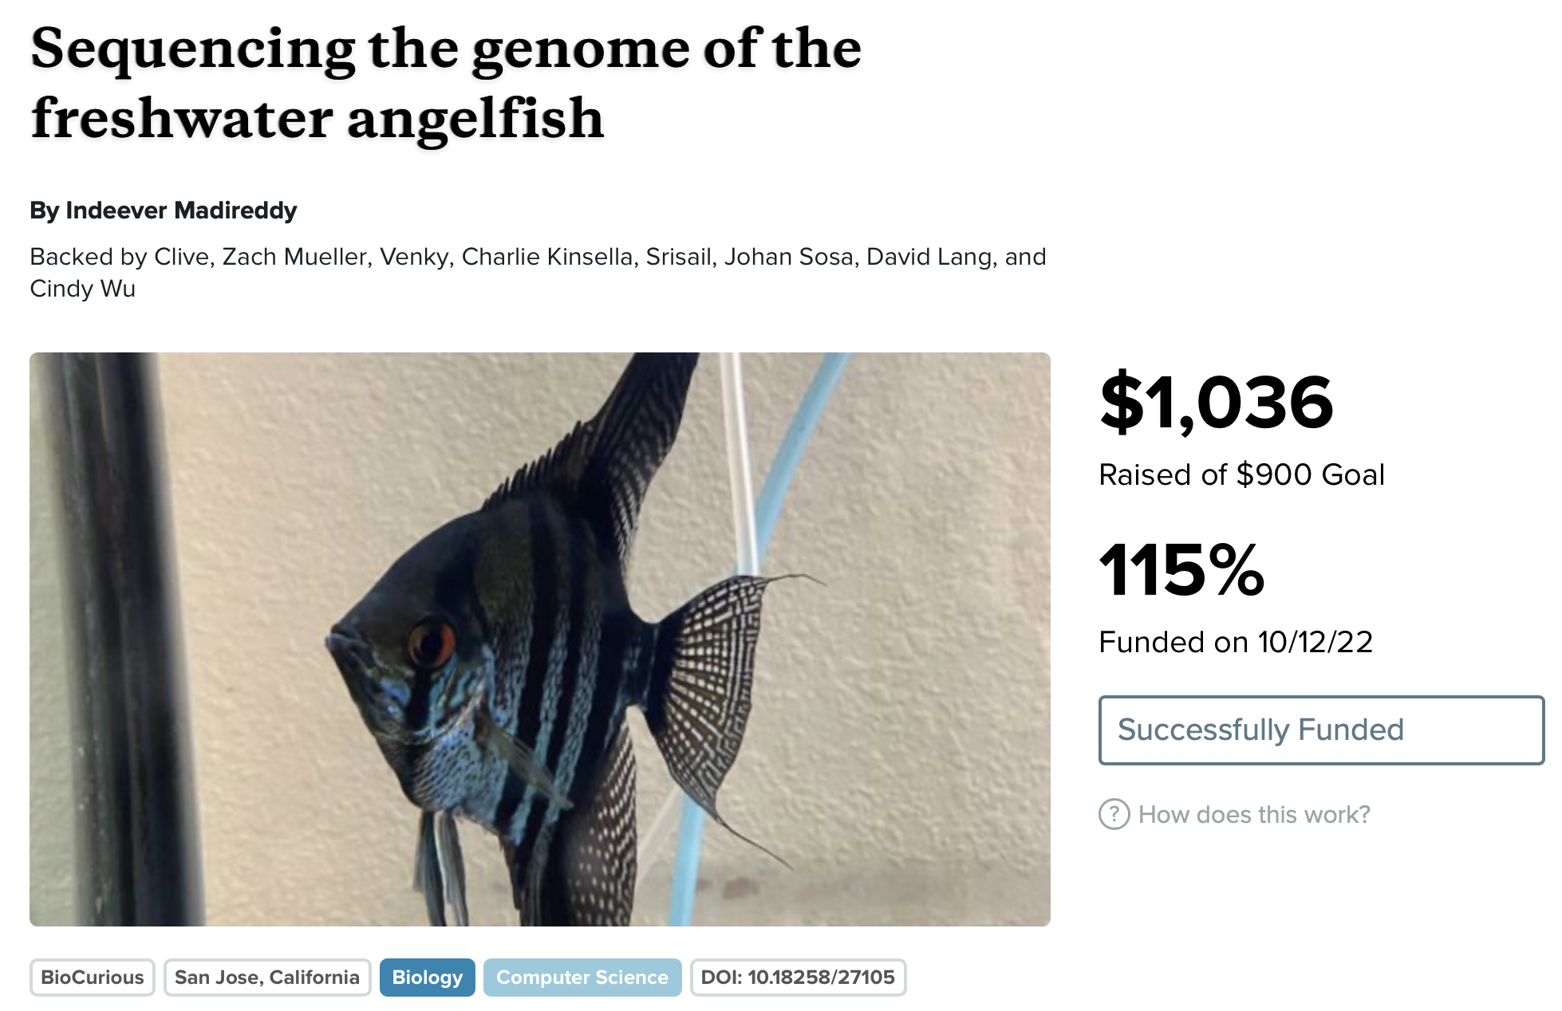
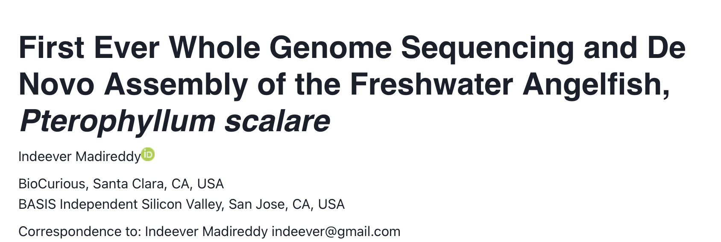
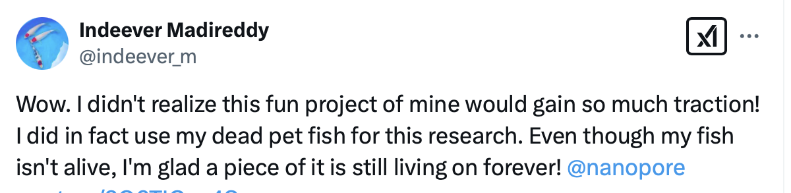
Democratizing Genome Analysis
https://experiment.com/projects/sequencing-the-genome-of-the-freshwater-angelfish

Slide 27
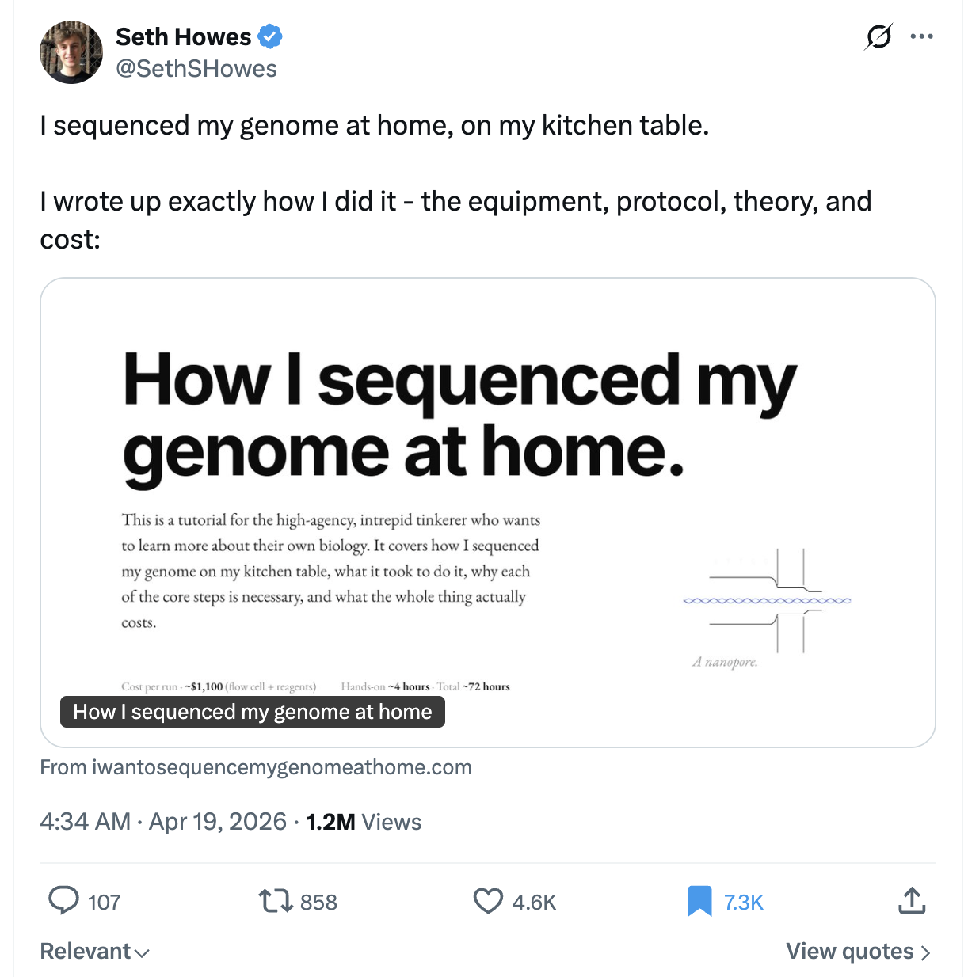
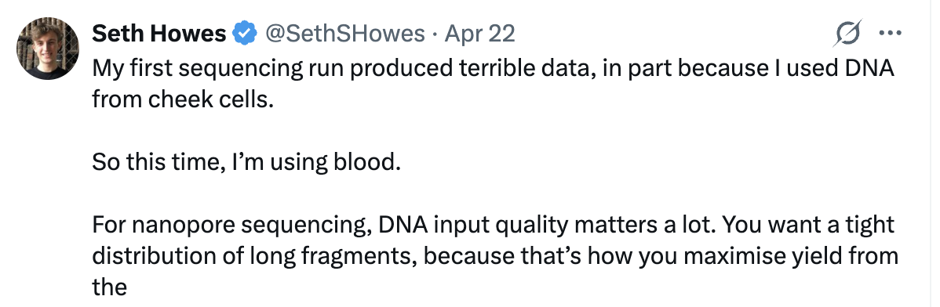
Democratizing Genome Analysis
https://x.com/SethSHowes/status/2045782975380406623

Slide 28
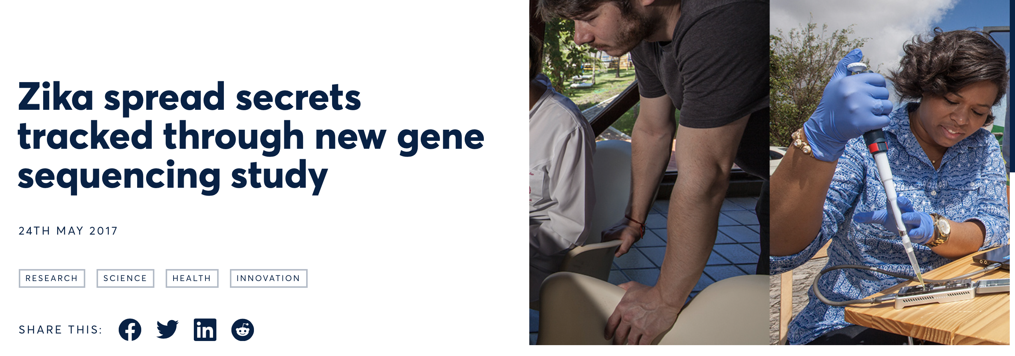
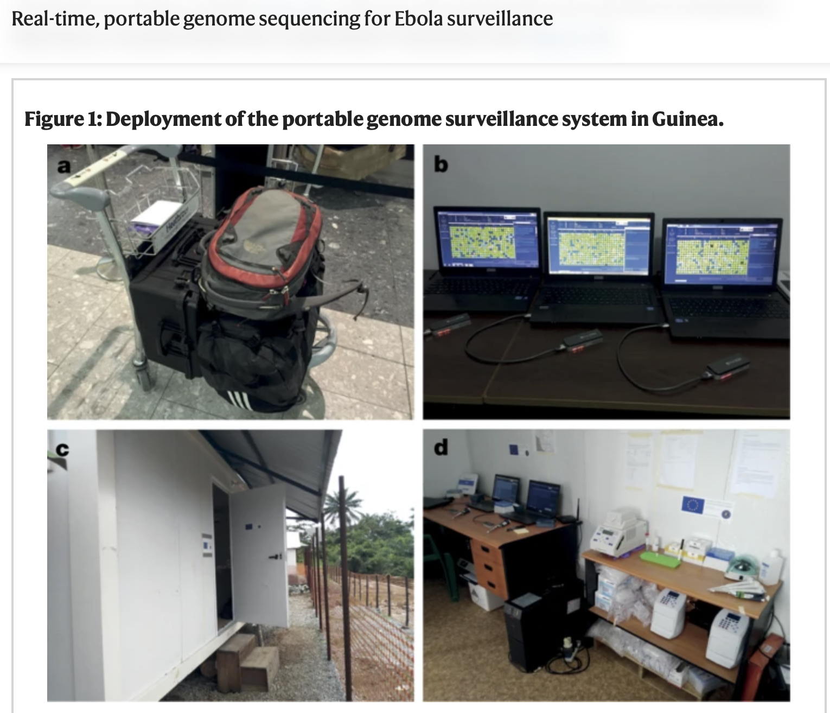

Rapid Surveillance of Disease Outbreaks
Quick+, “Real-time, portable genome sequencing for Ebola surveillance”, Nature, 2016

Slide 29
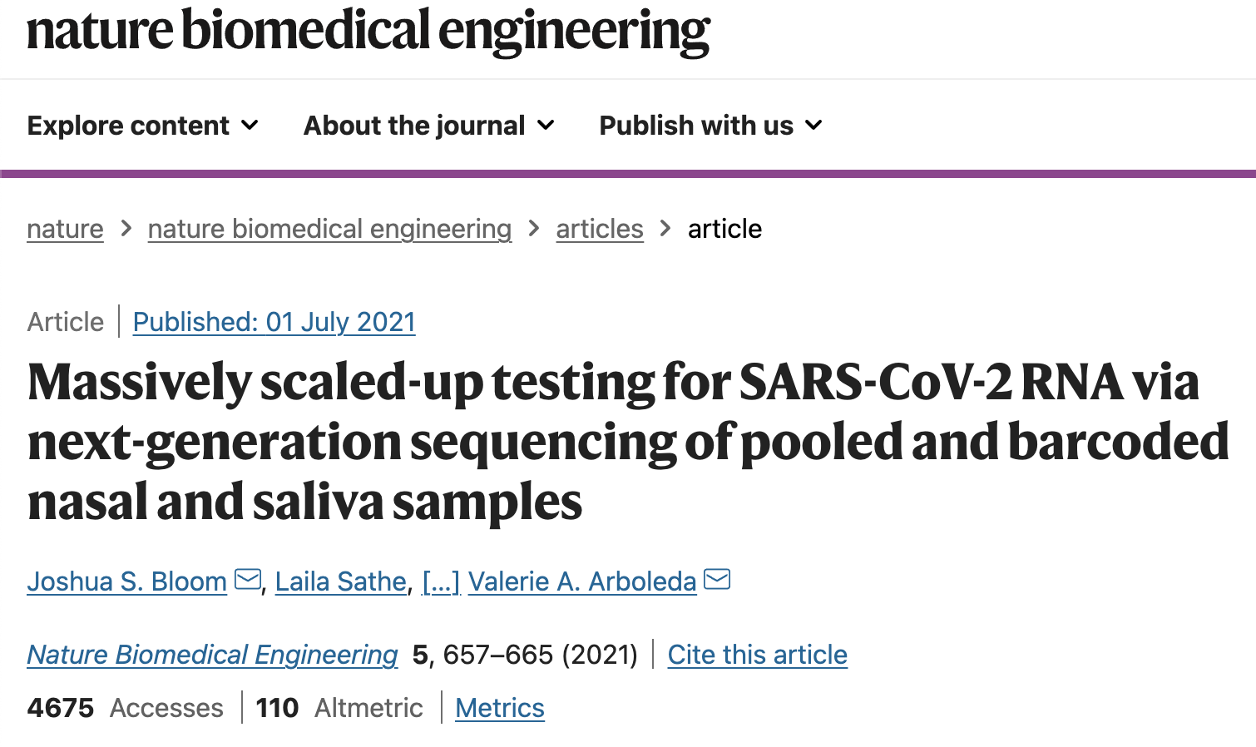
Cheap & Fast SARS-CoV-2 Testing
Bloom+, "Swab-Seq: A high-throughput platform for massively scaled up SARS-CoV-2 testing", Nature Biomedical Engineering, 2021

Slide 30
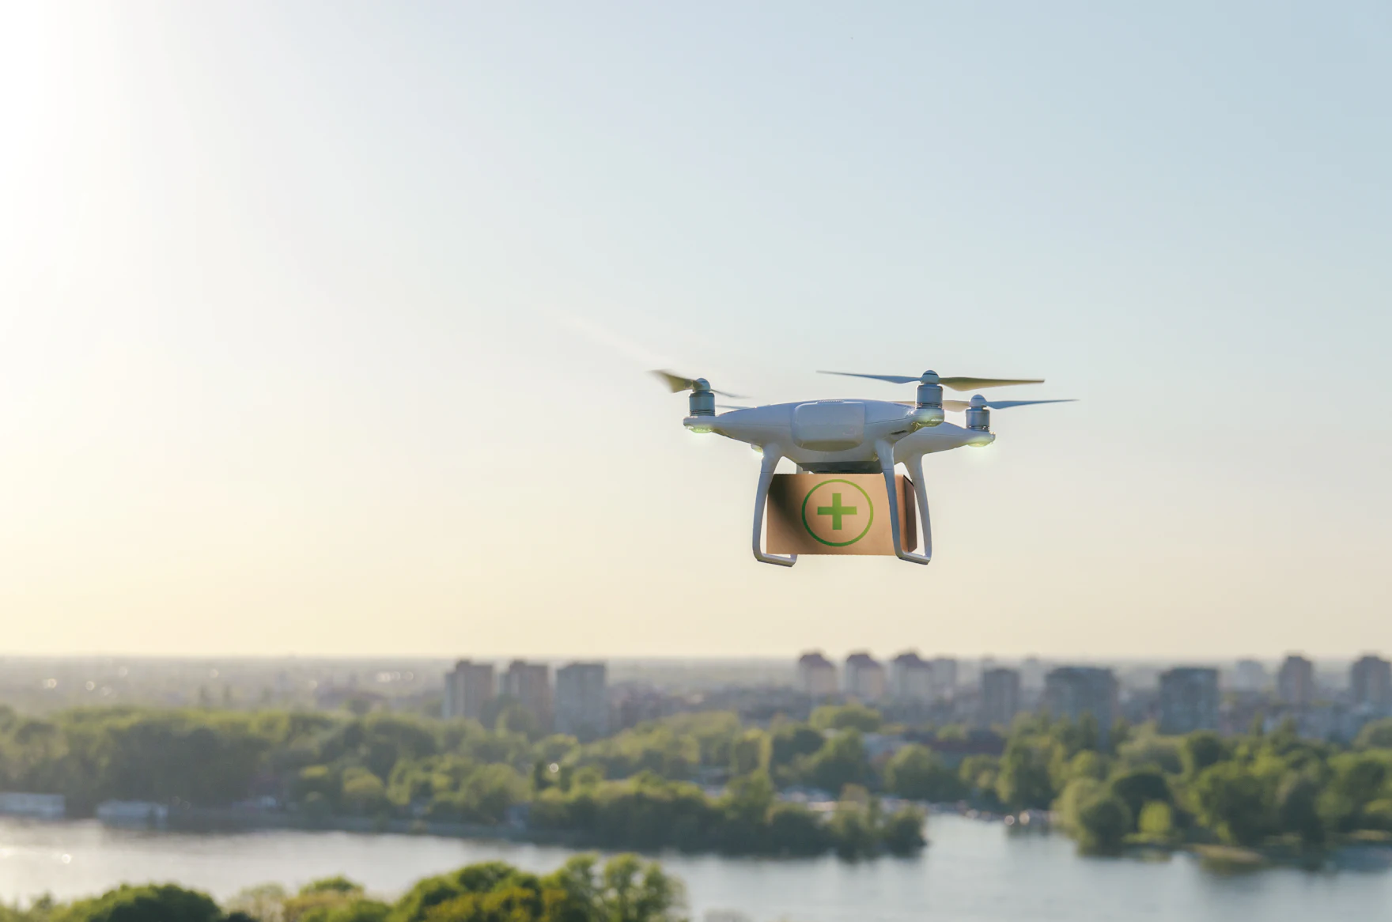
In-Field Portable Analysis
https://www.acs.org/pressroom/presspacs/2024/september/who-lives-in-the-treetops-dna-collecting-drone-provides-insights.html

Slide 31
Challenging Environment in Outer Space

Slide 32
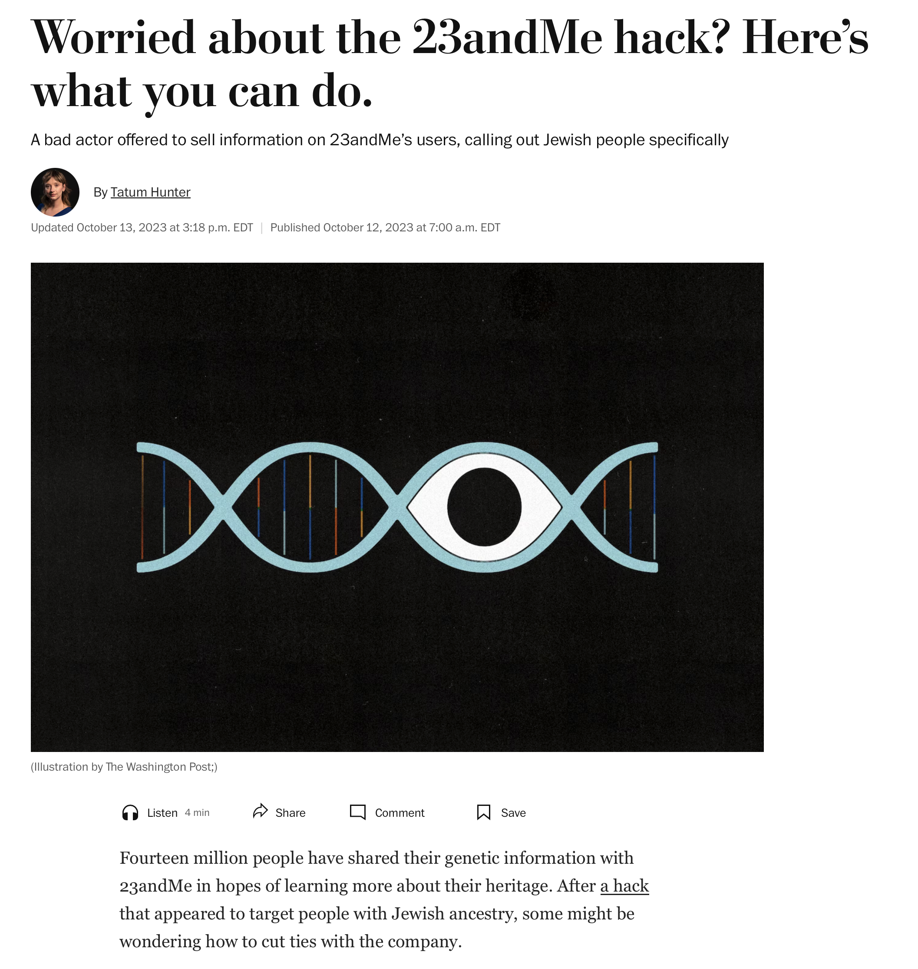
DNA is a Valuable Asset to Protect
https://www.washingtonpost.com/technology/2023/10/12/23andme-hack-data-breach/

Slide 33
New Personalized Shopping Paradigm
https://www.insightsip.com/news/what-s-new/600-dnanudge-shopping-with-your-dna

Slide 34
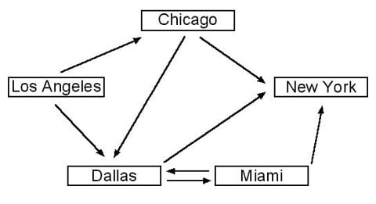
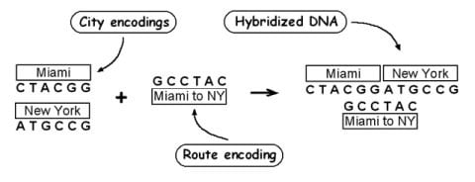
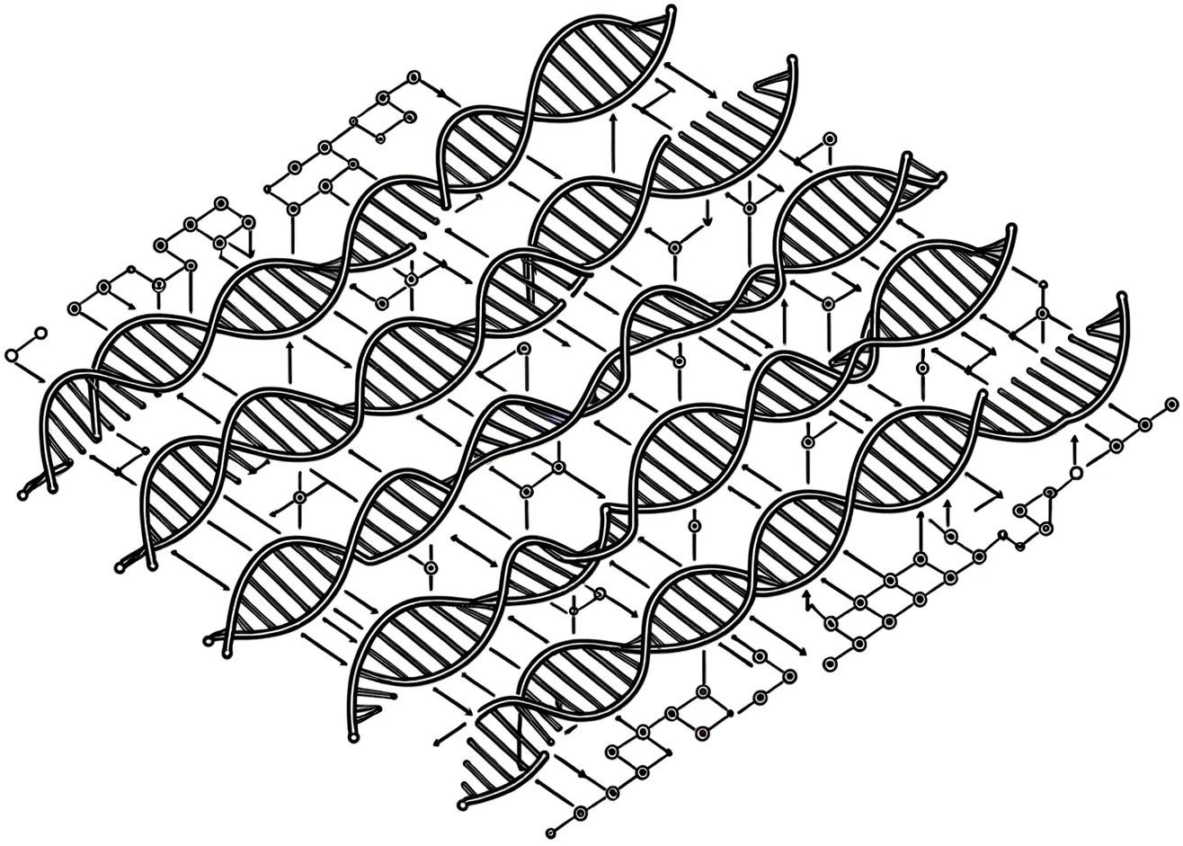
DNA Computing
Massive parallelism to solve
(hard) problems!

Slide 35
Things are Happening in Industry

Slide 36
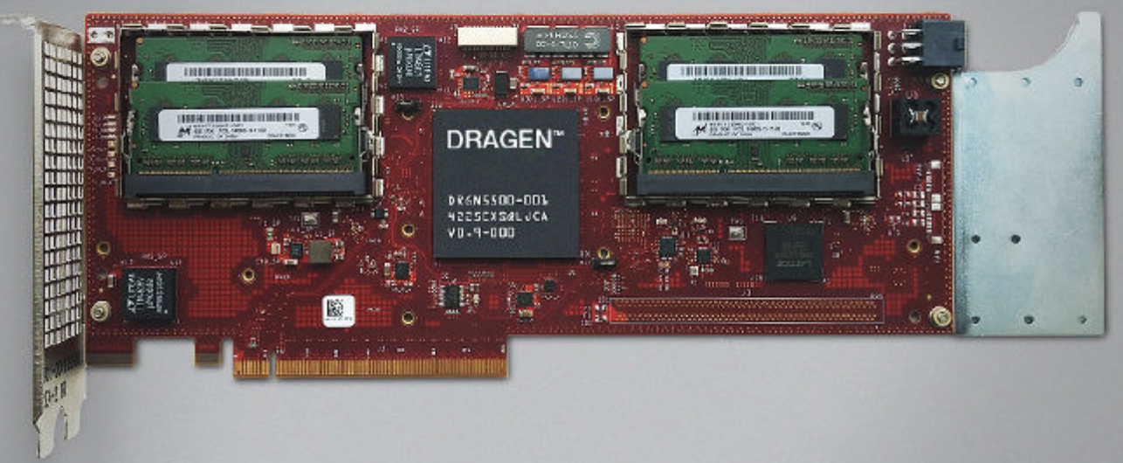
Illumina DRAGEN Platform
Processes whole genome at 40x coverage in ~30 minutes with hardware support for data compression
FPGA Board integrated within Illumina sequencers
https://www.illumina.com/products/by-type/informatics-products/dragen-secondary-analysis.html

Slide 37
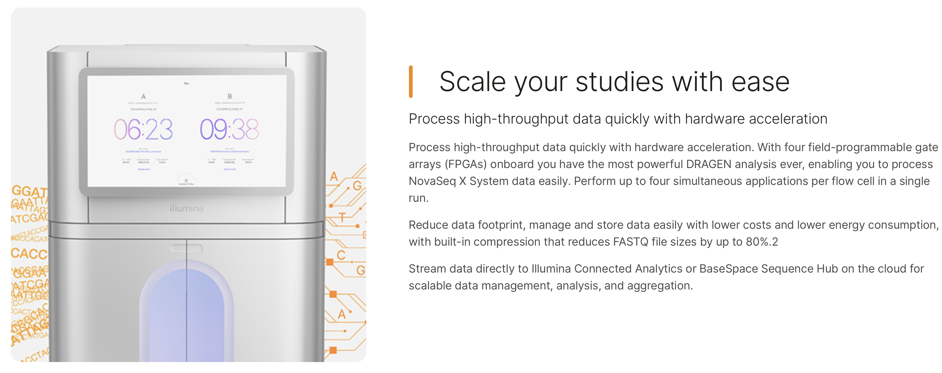
Nova/NextSeq with Analysis Capability
https://www.illumina.com/content/dam/illumina/gcs/assembled-assets/marketing-literature/dragen-bio-it-data-sheet-m-gl-00680/dragen-bio-it-data-sheet-m-gl-00680.pdf
https://emea.illumina.com/systems/sequencing-platforms/novaseq-x-plus/products-services/software.html

Slide 38
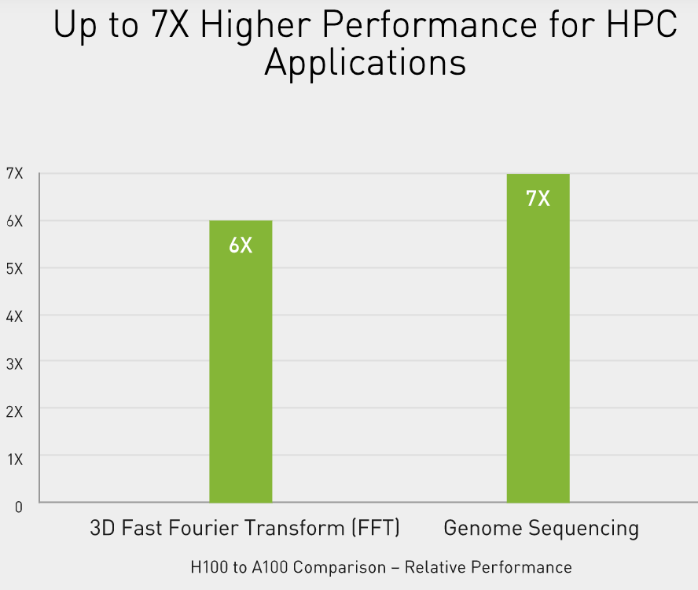
NVIDIA H100 (2022)
NVIDIA is claiming a 7x improvement in dynamic programming algorithm (DPX instructions) performance on a single H100 versus naïve execution on an A100.
https://www.nvidia.com/en-us/data-center/h100/

Slide 39
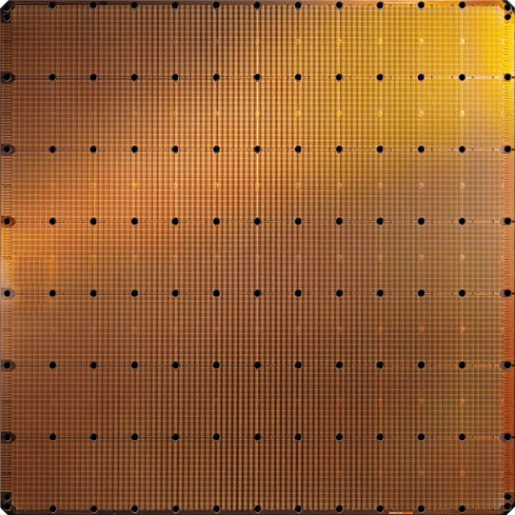
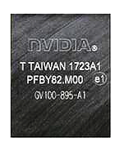
Cerebras’s Wafer Scale Engine (2024)
The largest ML accelerator chip (2024)
900,000 cores
Cerebras WSE-3
~4 Trillion transistors
46,225 mm²
NVIDIA H100 GPU
80 Billion transistors
814 mm²
https://cerebras.ai/blog/cerebras-cs3

Slide 40
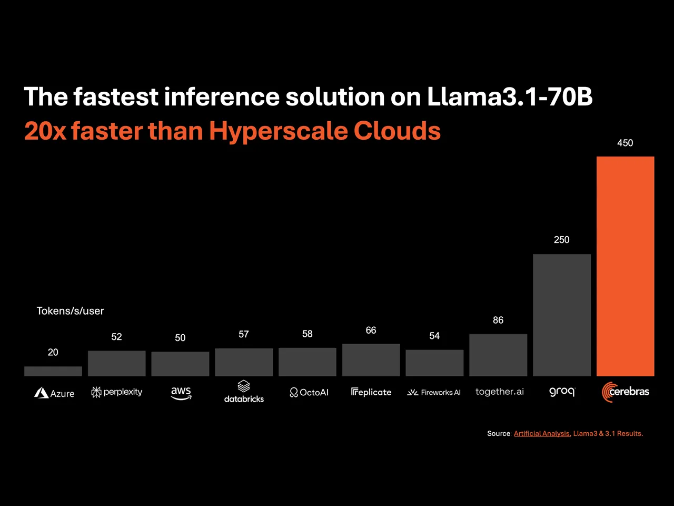
Cerebras’s Wafer Scale Engine (2024)
https://cerebras.ai/blog/cerebras-cs3
https://cerebras.ai/press-release/cerebras-launches-the-worlds-fastest-ai-inference

Slide 41
UPMEM Processing-in-DRAM Engine (2019)
Processing in DRAM Engine
Includes standard DIMM modules, with a large number of DPU processors combined with DRAM chips.
Replaces standard DIMMs
  DDR4 R-DIMM modules
    8GB+128 DPUs (16 PIM chips)
    Standard 2x-nm DRAM process
  Large amounts of compute & memory bandwidth

Slide 42
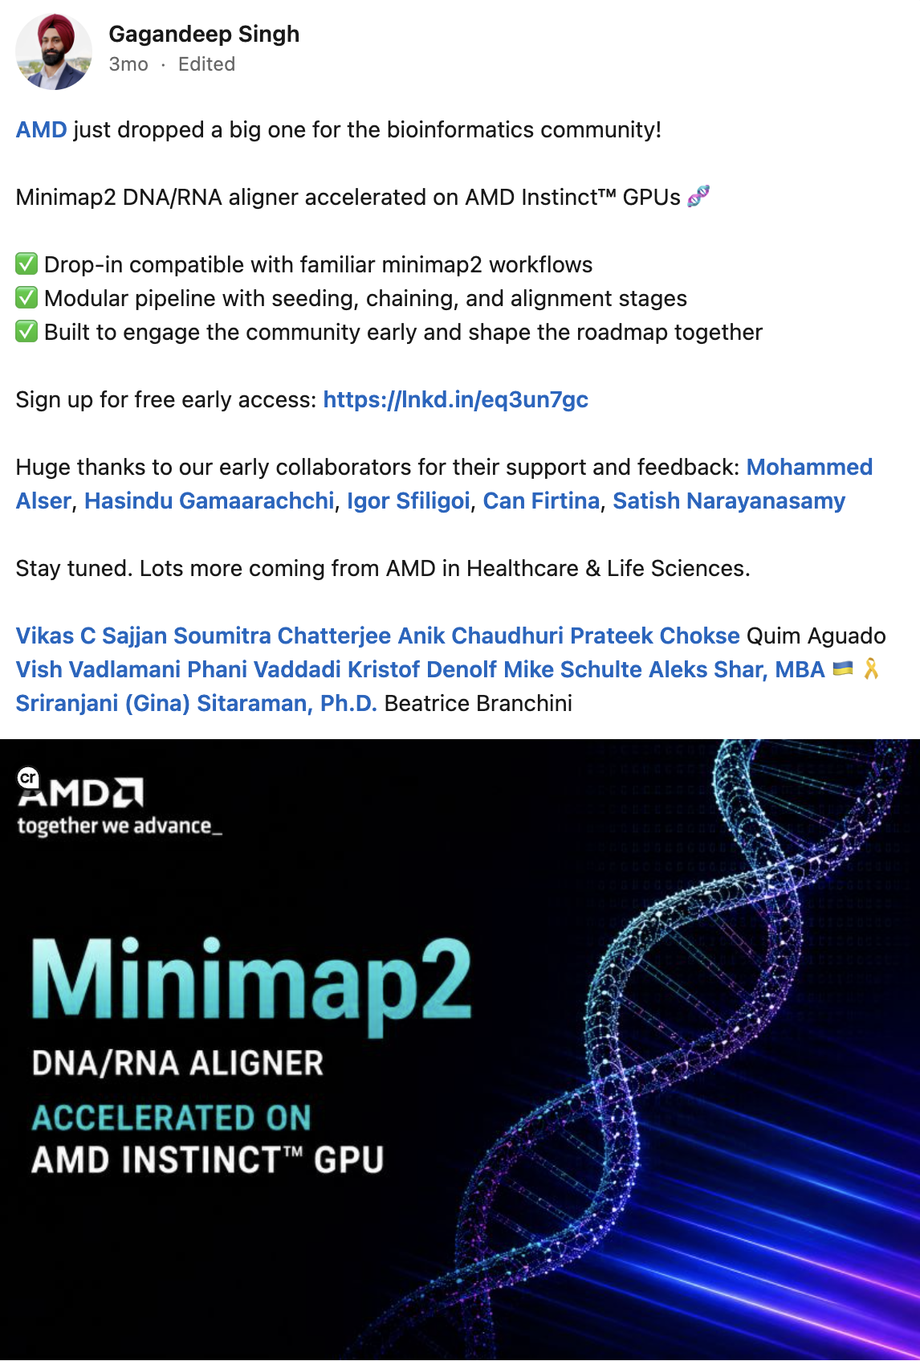
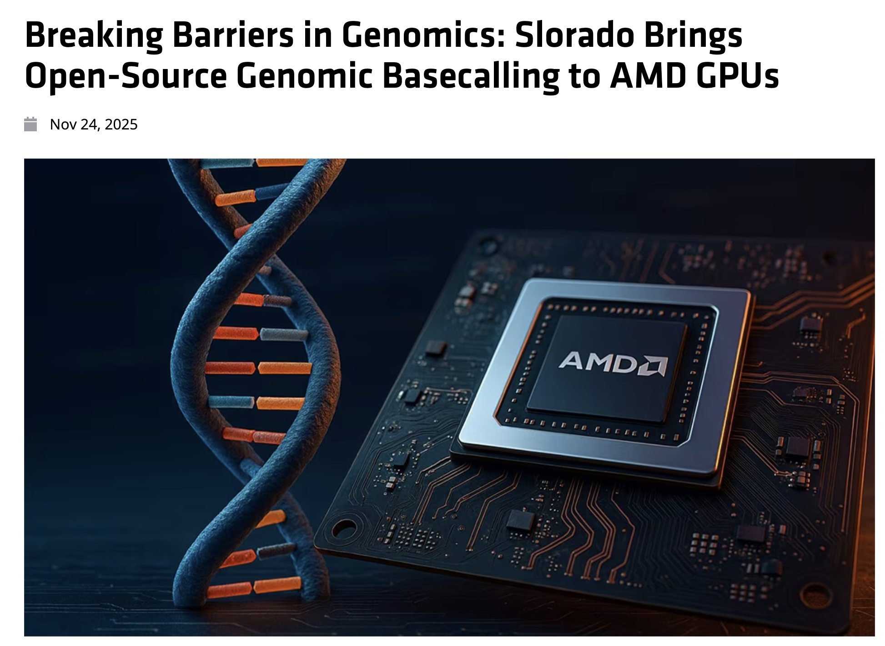
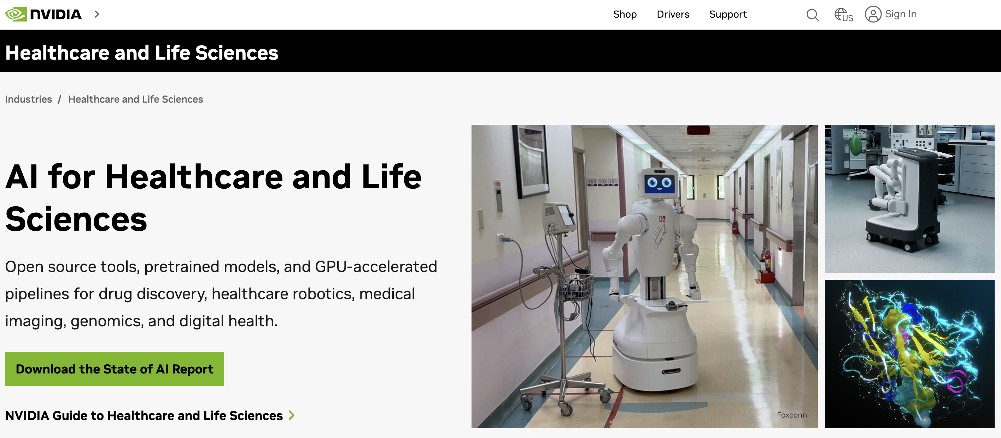
GPU Acceleration of Bioinformatics Workloads

Slide 43
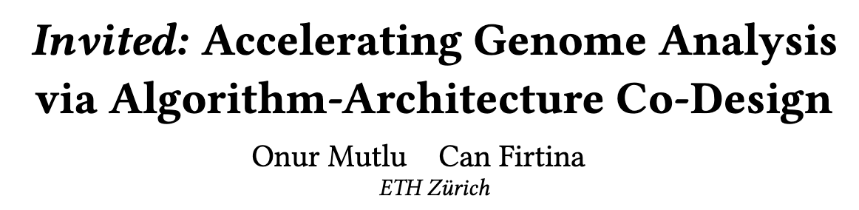
Recommended: Accelerating Genome Analysis [DAC '23]
Invited: Accelerating Genome Analysis via Algorithm-Architecture Co-Design
Onur Mutlu, Can Firtina
Proceedings of the 60th Design Automation Conference (DAC 2023), San Francisco, CA, USA, July 2023.
[PDF] [Link]

Slide 44
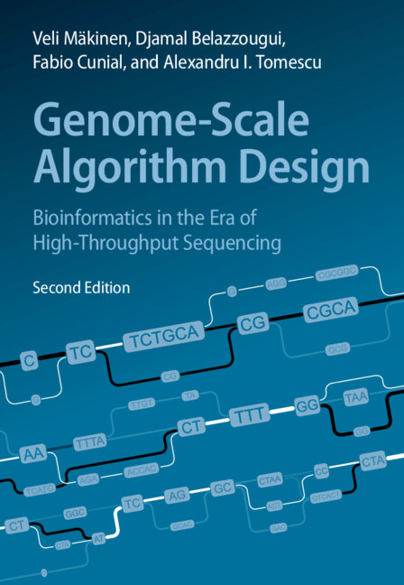
Recommended Textbook for Algorithm Design
Veli Mäkinen, Djamal Belazzougui, Fabio Cunial, and Alexandru I. Tomescu. "Genome-Scale Algorithm Design: Bioinformatics in the Era of High-Throughput Sequencing," Cambridge University Press, 2023.

Slide 45
Enabling New Directions in
Genome Analysis via New Algorithms

Slide 46

New Frontiers: Raw Signal Analysis [ISMB '23]
RawHash: enabling fast and accurate real-time analysis of raw nanopore signals
for large genomes
Can Firtina, Nika Mansouri Ghiasi, Joel Lindegger, Gagandeep Singh, Meryem Banu Cavlak, Haiyu Mao, Onur Mutlu
Proceedings of the 31st Annual Conference on Intelligent Systems for Molecular Biology and the 22nd European Conference on Computational Biology (ISMB/ECCB 2023), Lyon, France, July 2023.
[PDF] [Code] [DOI]
Conference talk [Video] [Slides (pptx)] [Slides (pdf)]
Preprint (bioRxiv) [Link] [PDF]
Social media thread [Twitter (X)]

Slide 47

Real-Time Raw Signal Analysis [Bioinformatics '24]
RawHash2: Mapping Raw Nanopore Signals Using Hash-Based Seeding
and Adaptive Quantization
Can Firtina, Melina Soysal, Joël Lindegger, Onur Mutlu
Bioinformatics, July 2024.
[PDF] [Code] [DOI]

Slide 48

New Directions: Assembling Raw Signals
Rawsamble: Overlapping Raw Nanopore Signals using a Hash-based Seeding Mechanism
Can Firtina, Maximilian Mordig, Harun Mustafa, Sayan Goswami, Nika Mansouri Ghiasi, Stefano Mercogliano, Furkan Eris, Joel Lindegger, Andre Kahles, Onur Mutlu
Bioinformatics, February 2026.
[PDF] [Code] [DOI]
ISMB 2024 Talk [Video] [Slides (pptx)] [Slides (pdf)]
CSHL 2024 (Biological Data Science) Talk [Video] [Slides (pptx)] [Slides (pdf)]
Social media thread [Twitter (X)] [LinkedIn]

Slide 49

Quickly Aligning Raw Signals [IEEE Access '24]
RawAlign: Accurate, Fast, and Scalable Raw Nanopore Signal Mapping
via Combining Seeding and Alignment
Joël Lindegger, Can Firtina, Nika Mansouri Ghiasi, Mohammad Sadrosadati, Mohammed Alser, Onur Mutlu
IEEE Access, December 2024.
[PDF] [Code] [DOI]

Slide 50

In-Storage Raw Signal Analysis [ICS '25]
MARS: Processing-In-Memory Acceleration of Raw Signal Genome Analysis
Inside the Storage Subsystem
Melina Soysal, Konstantina Koliogeorgi, Can Firtina, Nika Mansouri Ghiasi, Rakesh Nadig, Haiyu Mao, Geraldo Francisco Oliveira Junior, Yu Liang, Klea Zambaku, Mohammad Sadrosadati,
Onur Mutlu
Proceedings of the 39th International Conference on Supercomputing (ICS 2025), Salt Lake City, Utah, USA, June 2025.
[PDF] [DOI]
Conference talk [Video] [Slides (pptx)] [Slides (pdf)]

Slide 51

Correcting Raw Signals [arXiv '26 & ISMB'26]
CRANE: Correcting Errors in Raw Nanopore Signals Using Hidden Markov Models
Simon Ambrozak, Ulysse McConnell, Bhargav Srinivasan, Burak Ozkan, Ernest Zhang, Can Firtina
arXiv, March 2026.
[PDF] [Code] [Link]
ISMB 2026 (HiTSeq) Talk [Slides (pptx)] [Slides (pdf)]

Slide 52

Benchmarking Raw Signal Analysis [ACM-BCB '25]
RawBench: A Comprehensive Benchmarking Framework for
Raw Nanopore Signal Analysis Techniques
Furkan Eris, Ulysse McConnell, Can Firtina, Onur Mutlu
Proceedings of the 16th ACM Conference on Bioinformatics, Computational Biology, and Health Informatics (ACM-BCB 2025), Philadelphia, PA, USA, October 2025.
[PDF] [DOI]
Conference talk [Slides (pptx)] [Slides (pdf)]

Slide 53

Tolerating Noise in String Matching [NARGAB '23]
BLEND: a fast, memory-efficient and accurate mechanism to find fuzzy seed matches
in genome analysis
Can Firtina, Jisung Park, Mohammed Alser, Jeremie S. Kim, Damla Senol Cali, Taha Shahroodi, Nika Mansouri Ghiasi, Gagandeep Singh, Konstantinos Kanellopoulos, Can Alkan, Onur Mutlu
NAR Genomics and Bioinformatics (NARGAB), March 2023.
[PDF] [Code] [DOI]
Preprint (bioRxiv) [Link] [PDF]
RECOMB 2023 Talk [Video] [Slides (pptx)] [Slides (pdf)]
Social media thread [Twitter (X), publication] [Twitter (X), preprint]

Slide 54

Mitigating Useless Computations [IEEE/ACM TCBB '24]
AirLift: A Fast and Comprehensive Technique for Remapping Alignments between Reference Genomes
Jeremie S. Kim, Can Firtina, Meryem Banu Cavlak, Damla Senol Cali, Nastaran Hajinazar, Mohammed Alser, Can Alkan, Onur Mutlu
IEEE/ACM Transactions on Computational Biology and Bioinformatics (TCBB), August 2024.
[PDF] [Code] [DOI]
APBC 2023 Talk [Video] [Slides (pptx)] [Slides (pdf)]

Slide 55

Mitigating Useless Computations [Bioinformatics '22]
FastRemap: a tool for quickly remapping reads between genome assemblies
Jeremie S. Kim, Can Firtina, Meryem Banu Cavlak, Damla Senol Cali, Can Alkan, Onur Mutlu
Bioinformatics, September 2022.
[PDF] [Code] [DOI]

Slide 56
Utilizing AI/ML in
Genome Analysis via New Algorithms and
Architectures

Slide 57

Error Correction using ML [Bioinformatics '20]
Apollo: a sequencing-technology-independent, scalable and accurate
assembly polishing algorithm
Can Firtina, Jeremie S. Kim, Mohammed Alser, Damla Senol Cali, A Ercument Cicek, Can Alkan, Onur Mutlu
Bioinformatics, June 2020.
[PDF] [Code] [Link]

Slide 58

Accelerating ML & Genome Graphs [ACM TACO '24]
ApHMM: Accelerating Profile Hidden Markov Models for Fast and Energy-efficient
Genome Analysis
Can Firtina, Kamlesh Pillai, Gurpreet S. Kalsi, Bharathwaj Suresh, Damla Senol Cali, Jeremie S. Kim, Taha Shahroodi, Meryem Banu Cavlak, Joël Lindegger, Mohammed Alser, Juan Gómez Luna, Sreenivas Subramoney, Onur Mutlu
ACM Transactions on Architecture and Code Optimization (TACO), February 2024.
[PDF] [Code] [DOI]
HiPEAC 2024 Talk [Video] [Slides (pptx)] [Slides (pdf)]

Slide 59

Translating Raw Signals using ML [Genome Biology '24]
RUBICON: a framework for designing efficient deep learning-based genomic basecallers
Gagandeep Singh, Mohammed Alser, Kristof Denolf, Can Firtina, Alireza Khodamoradi, Meryem Banu Cavlak, Henk Corporaal, Onur Mutlu
Genome Biology, February 2024.
[PDF] [Code] [DOI]

Slide 60

Eliminating Useless Basecalling [Frontiers In Genetics '24]
TargetCall: Eliminating the Wasted Computation in Basecalling via Pre-Basecalling Filtering
Meryem Banu Cavlak, Gagandeep Singh, Mohammed Alser, Can Firtina, Joel Lindegger, Mohammad Sadrosadati, Nika Mansouri Ghiasi, Can Alkan, Onur Mutlu
Frontiers in Genetics, September 2024.
[PDF] [Code] [DOI]

Slide 61

Basecalling using PIM [MICRO '23]
Swordfish: A Framework for Evaluating Deep Neural Network-Based Basecalling
Using Computation-In-Memory with Non-Ideal Memristors
Taha Shahroodi, Gagandeep Singh, Mahdi Zahedi, Haiyu Mao, Joel Lindegger, Can Firtina, Stephan Wong, Onur Mutlu, Said Hamdioui
Proceedings of the 56th International Symposium on Microarchitecture (MICRO 2023), Toronto, ON, Canada, November 2023.
[PDF] [DOI]
Conference talk [Slides (pptx)] [Slides (pdf)]

Slide 62
DNN Hardware Acceleration
DNN execution is dominated by:
Vector-Matrix Multiplication (VMM)
Data movement between memory and accelerator
(e.g., GPU or TPU)
Memristor-based PIM for DNN Acceleration
Memristor-based crossbars support VMM
Processing in Memory (PIM) minimizes data movement
  [Ankit+, ASPLOS 2019], [Chi+, ISCA 2016], [Lou+, PACT2020], [Shafiee+, ISCA 2016]

Slide 63








VMM in Memristor-based Crossbars
Digital to Analog Converters
Analog to Digital Converters

Slide 64
Non-idealities in Memristor-based Crossbars
Variation in
Synaptic Conductance
Non-ideal DAC
Digital to Analog Converters
Wire Resistance
Analog to Digital Converters
Non-ideal ADC
Subpar utilization of trained models due to non-idealities

Slide 65

Accuracy: All Non-idealities without Mitigation
D1
Baseline
D2
Baseline
Accuracy (%)
Non-idealities
Combined non-idealities leads to significant accuracy loss (>18%)

Slide 66

Accuracy: Enhancement Techniques on All Non-idealities
D1
Baseline
D3
Baseline
Accuracy (%)
Enhancement Technique
Accuracy loss drops to 6% from 18% after handling all non-idealities

Slide 67

ML-based Genome Analysis via PIM [MICRO '22]
GenPIP: In-Memory Acceleration of Genome Analysis via Tight Integration of
Basecalling and Read Mapping
Haiyu Mao, Mohammed Alser, Mohammad Sadrosadati, Can Firtina, Akanksha Baranwal, Damla Senol Cali, Aditya Manglik, Nour Almadhoun Alserr, Onur Mutlu
Proceedings of the 55th International Symposium on Microarchitecture (MICRO 2022), Chicago, IL, USA, October 2022.
[PDF] [Link]
Conference talk [Slides (pptx)] [Slides (pdf)]

Slide 68
Problem 1: Large Data Movement
Raw Signals
Basecalling
Reads
Read quality
control
High-quality
reads
Read
mapping
Mapped
reads
3913 GB
546 GB
437 GB
382 GB
Large data movement between genome analysis steps
Bowden+ “Sequencing of human genomes with nanopore technology,” Nature Communications, 2019.

Slide 69
Problem 2: Wasted Computation
100%
79.5%
69.5%
Raw Signals
Basecalling
Reads
Read quality
control
High-quality
reads
Read
mapping
Mapped
reads
Low-quality
reads
Unmapped
reads
20.5%
10%
A considerable amount of computation on useless data due to
Low-quality reads
Unmapped reads

Slide 70
Goal and Opportunities
Goal: Efficiently accelerate the entire genome analysis pipeline while minimizing data movement and useless computation
We perform a study to quantify potential performance benefits
NVM-based PIM accelerators for separate basecalling and read mapping
No Data Movement
between the accelerators of analysis steps
no data movement
and
no useless reads
(ideal case)

Slide 71
GenPIP Overview
Raw signals from the sequencing machine
GenPIP
In-memory
Read Mapping
[PARC, ASPDAC’20]
+ Our design
In-memory
Basecaller
[Helix, PACT’20]
Signal
chunk
eDRAM
Basecalled
chunk
Chunk
Average Calculator
Read Mapping Controller
Base quality score
Chunk quality score
Quality score
PIM-CQS
PIM chunk quality score calculation
ER
Controller
Chunk mapping score
Read mapping result
To storage
Basecalling Module
ER
GenPIP Controller
ER
Read Mapping Module

Slide 72
Fast, Accurate, and Efficient
Genome Analysis
via Algorithm-Architecture
Co-design

Slide 73

Accelerating String Matching [MICRO '20]
GenASM: A High-Performance, Low-Power Approximate String Matching Acceleration Framework for Genome Sequence Analysis
Damla Senol Cali, Gurpreet S. Kalsi, Zülal Bingöl, Can Firtina, Lavanya Subramanian, Jeremie S. Kim, Rachata Ausavarungnirun, Mohammed Alser, Juan Gómez-Luna, Amirali Boroumand, Anant Norion, Allison Scibisz, Sreenivas Subramoney, Can Alkan, Saugata Ghose, Onur Mutlu
Proceedings of the 53rd International Symposium on Microarchitecture (MICRO 2020), Virtual, October 2020.
[PDF] [Code] [Link]
Conference talk [Video] [Slides (pptx)] [Slides (pdf)]

Slide 74

Accelerating Genome Graphs [ISCA '22]
SeGraM: A Universal Hardware Accelerator for Genomic Sequence-to-Graph and
Sequence-to-Sequence Mapping
Damla Senol Cali, Konstantinos Kanellopoulos, Joël Lindegger, Zülal Bingöl, Gurpreet S. Kalsi, Ziyi Zuo, Can Firtina, Meryem Banu Cavlak, Jeremie Kim, Nika Mansouri Ghiasi, Gagandeep Singh, Juan Gómez-Luna, Nour Almadhoun Alserr, Mohammed Alser, Sreenivas Subramoney, Can Alkan, Saugata Ghose, Onur Mutlu
Proceedings of the 49th Annual International Symposium on Computer Architecture (ISCA 2022), New York City, NY, USA, June 2022.
[PDF] [Code] [DOI]
Conference talk [Video] [Slides (pptx)] [Slides (pdf)]

Slide 75

In-Storage Filtering for Genomics [ASPLOS '22]
GenStore: A High-Performance in-Storage Processing System
for Genome Sequence Analysis
Nika Mansouri Ghiasi, Jisung Park, Harun Mustafa, Jeremie Kim, Ataberk Olgun, Arvid Gollwitzer, Damla Senol Cali, Can Firtina, Haiyu Mao, Nour Almadhoun Alserr, Rachata Ausavarungnirun, Nandita Vijaykumar, Mohammed Alser, Onur Mutlu
Proceedings of the 27th International Conference on Architectural Support for Programming Languages and Operating Systems (ASPLOS 2022), Lausanne, Switzerland, February 2022.
[PDF] [Code] [DOI]
Conference talk [Video] [Slides (pptx)] [Slides (pdf)]

Slide 76

In-Storage Decompression for Genomics [HPCA '26]
SAGe: A Lightweight Algorithm-Architecture Co-Design for Mitigating the Data Preparation Bottleneck in Large-Scale Genome Sequence Analysis
Nika Mansouri Ghiasi, Talu Güloglu, Harun Mustafa, Can Firtina, Konstantina Koliogeorgi, Konstantinos Kanellopoulos, Haiyu Mao, Rakesh Nadig, Mohammad Sadrosadati, Jisung Park, Onur Mutlu
Proceedings of the 32nd International Symposium on High-Performance Computer Architecture (HPCA 2026), Sydney, Australia, January 2026.
[PDF] [Link]

Slide 77

In-Storage Metagenomics [ISCA '24]
MegIS: High-Performance, Energy-Efficient, and Low-Cost Metagenomic Analysis with
In-Storage Processing
Nika Mansouri Ghiasi, Mohammad Sadrosadati, Harun Mustafa, Arvid Gollwitzer, Can Firtina, Julien Eudine, Haiyu Mao, Joël Lindegger, Meryem Banu Cavlak, Mohammed Alser, Jisung Park, Onur Mutlu
Proceedings of the 51st Annual International Symposium on Computer Architecture (ISCA 2024), Buenos Aires, Argentina, July 2024.
[PDF] [Code] [DOI]
Conference talk [Slides (pptx)] [Slides (pdf)]

Slide 78
Recommended: Accelerating Genome Analysis [DAC '23]
Invited: Accelerating Genome Analysis via Algorithm-Architecture Co-Design
Onur Mutlu, Can Firtina
Proceedings of the 60th Design Automation Conference (DAC 2023), San Francisco, CA, USA, July 2023.
[PDF] [Link]

Slide 79

Recommended: Genome Analysis Steps [CSBJ '22]
From molecules to genomic variations: Accelerating genome analysis via
intelligent algorithms and architectures
Mohammed Alser, Joel Lindegger, Can Firtina, Nour Almadhoun, Haiyu Mao, Gagandeep Singh, Juan Gomez-Luna, Onur Mutlu
Computational and Structural Biotechnology Journal (CSBJ), August 2022.
[PDF] [Code] [DOI]

Slide 80
Agenda
The need to co-design algorithms, ML and hardware
Course information and logistics

Slide 81
Agenda
The need to co-design algorithms, ML and hardware
Course information and logistics

Slide 82

Sanity Check
Make sure you are here for
CMSC 829C: Algorithms, AI, and Hardware for Biological Data

Slide 83

Course Website
Slides, syllabus, other required materials will be publicly released at
  https://storm.cs.umd.edu/teaching/cmsc829c/fall2026/
Canvas for discussion and assignments at
  https://umd.instructure.com/courses/1408667

Slide 84
Course Structure
2 x 75-minute lectures or paper presentation sessions per week
  TuTh 3:30pm – 4:45pm in IRB 2107
  Office Hours: TuTh 4:45pm - 5:30pm (after class)
  My office: IRB 3236
Lectures (first few weeks): To provide the necessary background
  How to review, analyze, and present research papers
  Fundamentals of bioinformatics
  Algorithmic, machine learning, and hardware solutions
Paper presentation sessions

Slide 85
Who Is This Course For?
No prior background in biology is required
  The first few weeks cover the fundamentals you need
Intended primarily for graduate students
  Interested in algorithms, machine learning, hardware, or bioinformatics
Advanced undergraduates with a strong research interest are welcome
  Follow the university's guidelines for undergraduates taking graduate courses
  Send me an email with your CV if you would like to enroll

Slide 86
Paper Presentation Sessions
You will choose the papers you want to present
  Paper list will be released soon
  Typically 1 or 2 papers per student
Presenter's role (lead)
  Meet with your mentor (me) at least 1 week before your session
  Read the paper and bring a draft of your slides to get feedback
  Submit your final slides at least 24 hours before class
  In-class: present, analyze, lead the discussion (~40 + ~30 min)
Participants' role
  Read the paper before each class and submit your questions
  Engage in discussions

Slide 87
Assignments
Submitting your questions before each presentation session
  Due 11:59 PM the day before each presentation session
  Questions should enable a nice discussion in class
  Try to avoid obvious questions (e.g., "what if we try dataset X?")
  We will ask some (or all) of these questions to the presenter
Paper review towards the end of the semester
  Use your analysis and review skills to write a structured review, the way real conference and journal reviews are written
  You will review the same assigned paper (will be announced later)
  Due Thursday, December 10 – we discuss the reviews together in the last class

Slide 88
Grading
Please make sure you are here to learn and get a new perspective
Leading paper presentations: 35%
  Before-class preparedness: 10%
  Paper presentation without the analysis part: 15%
  Analysis and discussion leadership: 10%
Participation: 20%
  Engaging with questions asked by other students
  Helping to drive the discussions related to the questions you submitted
Submitting questions: 25%
  Your 5 lowest scores are dropped (busy weeks, absences)
Writing a paper review: 20%

Slide 89
Key Dates to Remember
Every presentation session (when you are not presenting)
  Discussion questions due 11:59 PM the day before
Your presentation session
  Mentor meeting with draft slides: at least 1 week before your session
  Final slides: at least 24 hours before class
End of the term
  Paper review due Thursday, December 10 (we discuss reviews in the last class)
Check the course website and ELMS-Canvas regularly – turn on notifications!

Slide 90
Questions?

Slide 91
Next Lecture
Lecture 2: Moving the Needle – A Bioinformatics Perspective
  Thursday, September 3, 3:30pm – 4:45pm, IRB 2107
  Key aspects in research and how to present with these aspects in mind
Before next class
  Read the syllabus on the course website
  Log in to ELMS-Canvas and turn on notifications
  Email me if you have questions about enrollment or the course

Slide 92
CMSC 829C: Algorithms, AI, and Hardware
for Biological Data
Lecture 1: Introduction and Course Logistics
Fall 2026
September 1, 2026
Can Firtina | canfirtina@gmail.com | cs.umd.edu/~firtina
Assistant Professor of Computer Science at UMD

