Slide 1






AirLift
A Fast and Comprehensive Technique for Remapping Alignments between Reference Genomes
Jeremie S. Kim*, Can Firtina*, Meryem Banu Cavlak, Damla Senol Cali,
Nastaran Hajinazar, Mohammed Alser, Can Alkan, and Onur Mutlu
arXiv Preprint
Source Code

Slide 2

Genome Analysis
Genome analysis is critical for many applications
  Personalized medicine
  Outbreak tracing
  Evolutionary studies
Genome sequencing machines extract smaller fragments of the original DNA sequence, known as reads
AAGCTTCCATGG
AAATGGGCTTTC
Reads
GCTTCCAGAATG
GCCCAAATGGTT

Slide 3
Reference Genomes
Reference genomes play a crucial role in genome analysis for
  Accurately mapping reads to potential matching locations in the genome
  Identifying genomic differences in an individual’s genome
Reference Genome
…GCCCATATGGTTAAGCTTCCATGGAAATGGGCTTTCGCTTCCACAATG…
Differences
Differences
GCTTCCAGAATG
AAGCTTCCATGG
Reference genomes should provide an accurate and complete representation of a species to enable accurate analysis in the later steps of genome analysis:
  Variant calling
  Gene annotation and enrichment
AAATGGGCTTTC
GCCCAAATGGTT

Slide 4
Updating the Reference Genomes
Reference genomes are updated regularly to
  Correct the errors in the older versions
  Fill in the missing genomic sequences
Unmapped Reads
AAATGGGCTTTC
AAGCTTCCATGG
Old Reference Genome
…GCCCATATCCAAAAGCTTC
??????
AATGGGCTTAACCTTCCACAATG…
GCCCAAATGGTT
GCTTCCAGAATG
New (updated) Reference Genome
…GCCCATATGGTTAAGCTTCCATGGAAATGGGCTTTCGCTTCCACAATG…
Remapping the reads to the updated reference genome can generate novel information due to
  More accurately identified genomic differences
  New reads mapped to updated or completed regions

Slide 5
Changes between Reference Genomes
Retired Regions
  Removed from the new reference genome
New Regions
  Added to the new reference genome
Constant Regions
  Exactly the same sequences
  Positions may change
Updated Regions
  Mostly the same sequences with small changes

Slide 6
Existing Solutions for Remapping Reads
1
Map all the reads from scratch
2
Move the mapping locations

Slide 7
Existing Solutions for Remapping Reads
1
Map all the reads from scratch
2
Move the mapping locations

Slide 8


Mapping Reads from Scratch
Mapped Reads
Unmapped Reads
Read Mapping
✓
Accurate mapping
Significant computation overhead

Slide 9
Mapping Reads from Scratch
A large portion of the reference genome remains unchanged (constant regions)
Entire Reference Genome
12%
Changed Content
Identifying the differences for reads in the constant regions is redundant

Slide 10
Existing Solutions for Remapping Reads
1
Map all the reads from scratch
2
Move the mapping locations

Slide 11
Existing Solutions for Remapping Reads
1
Map all the reads from scratch
2
Move the mapping locations

Slide 12
Moving the Mapping Locations
Mapped Reads
Move Locations
✓
Minimal computation overhead
Inaccurate Mapping

Slide 13
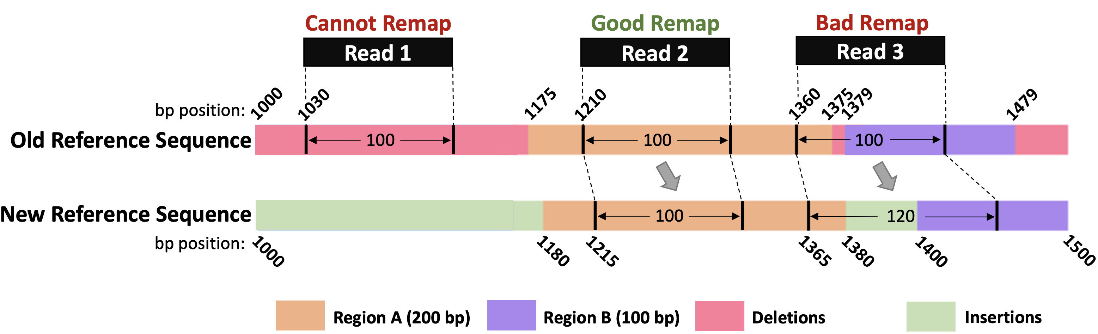
Moving the Mapping Locations
Cannot Remap: Reads in the deleted regions are not remapped
Bad Remap: Reads in the updated regions may map other regions better
A large portion of the mapping information is lost or inaccurate

Slide 14
Outline
Background
Motivation and Goal
Experimental Methodology
Temperature Analysis
Aggressor Row Active Time Analysis
Spatial Variation Analysis
Implications on Attacks and Defenses
Conclusions
Goal and Key Idea
AirLift
Evaluation
Conclusions

Slide 15
Our Goal
Accurately and quickly remap all reads
by either mapping or moving them
from the old reference genome
to the new reference genome

Slide 16



Avoids redundant read mapping
for the constant regions
Quickly identifies and maps the reads
that cannot be accurately moved

Slide 17
Outline
Background
Motivation and Goal
Experimental Methodology
Temperature Analysis
Aggressor Row Active Time Analysis
Spatial Variation Analysis
Implications on Attacks and Defenses
Conclusions
Goal and Key Idea
AirLift
Evaluation
Conclusions

Slide 18
AirLift Overview
Mapped Reads
Unmapped Reads
AirLift
✓
Low computation overhead
✓
Accurate Mapping

Slide 19
AirLift
AirLift Indexing (Offline)
AirLift Mapping

Slide 20
AirLift
AirLift Indexing (Offline)
AirLift Mapping

Slide 21
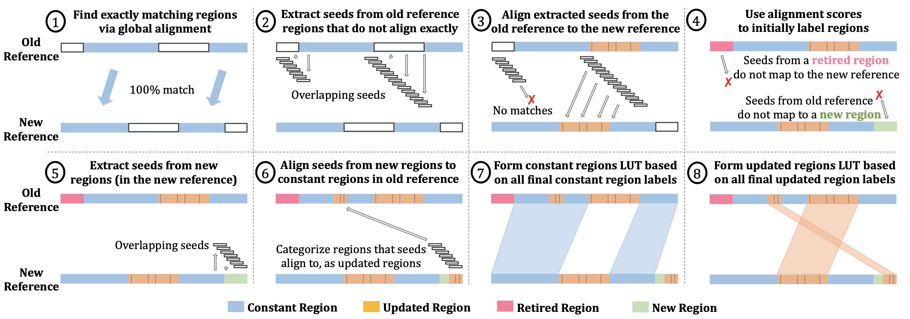
AirLift Indexing (Offline)

Slide 22
AirLift Indexing (Offline)

Slide 23
AirLift
AirLift Indexing (Offline)
AirLift Remapping

Slide 24
AirLift Remapping
Mapped Reads
Unmapped Reads
AirLift
Quickly move reads in the constant regions
Remap reads in the updated regions
Remap retired and unmapped reads

Slide 25
AirLift Remapping
AirLift fully utilizes all reads
by either moving or remapping them
✓
AirLift generates an accurate
alignment file (BAM) that can easily be used
in downstream analysis
✓

Slide 26
Outline
Background
Motivation and Goal
Experimental Methodology
Temperature Analysis
Aggressor Row Active Time Analysis
Spatial Variation Analysis
Implications on Attacks and Defenses
Conclusions
Goal and Key Idea
AirLift
Evaluation
Conclusions

Slide 27
Evaluation Methodology
Remapping
Baseline: Fully mapping all reads
  CrossMap remapper that can generate alignment files (BAM)
  LiftOver remapper that generates only the updated positions
Accuracy: Variant calling using AirLift and full mapping
Datasets
Human (hg): Oldest: HG16 Newest: HG38 (5 versions)
Worm (ce): Oldest: ce2 Newest: ce11 (5 versions)
Yeast (sacCer): Oldest: sacCer1 Newest: sacCer3 (3 versions)

Slide 28
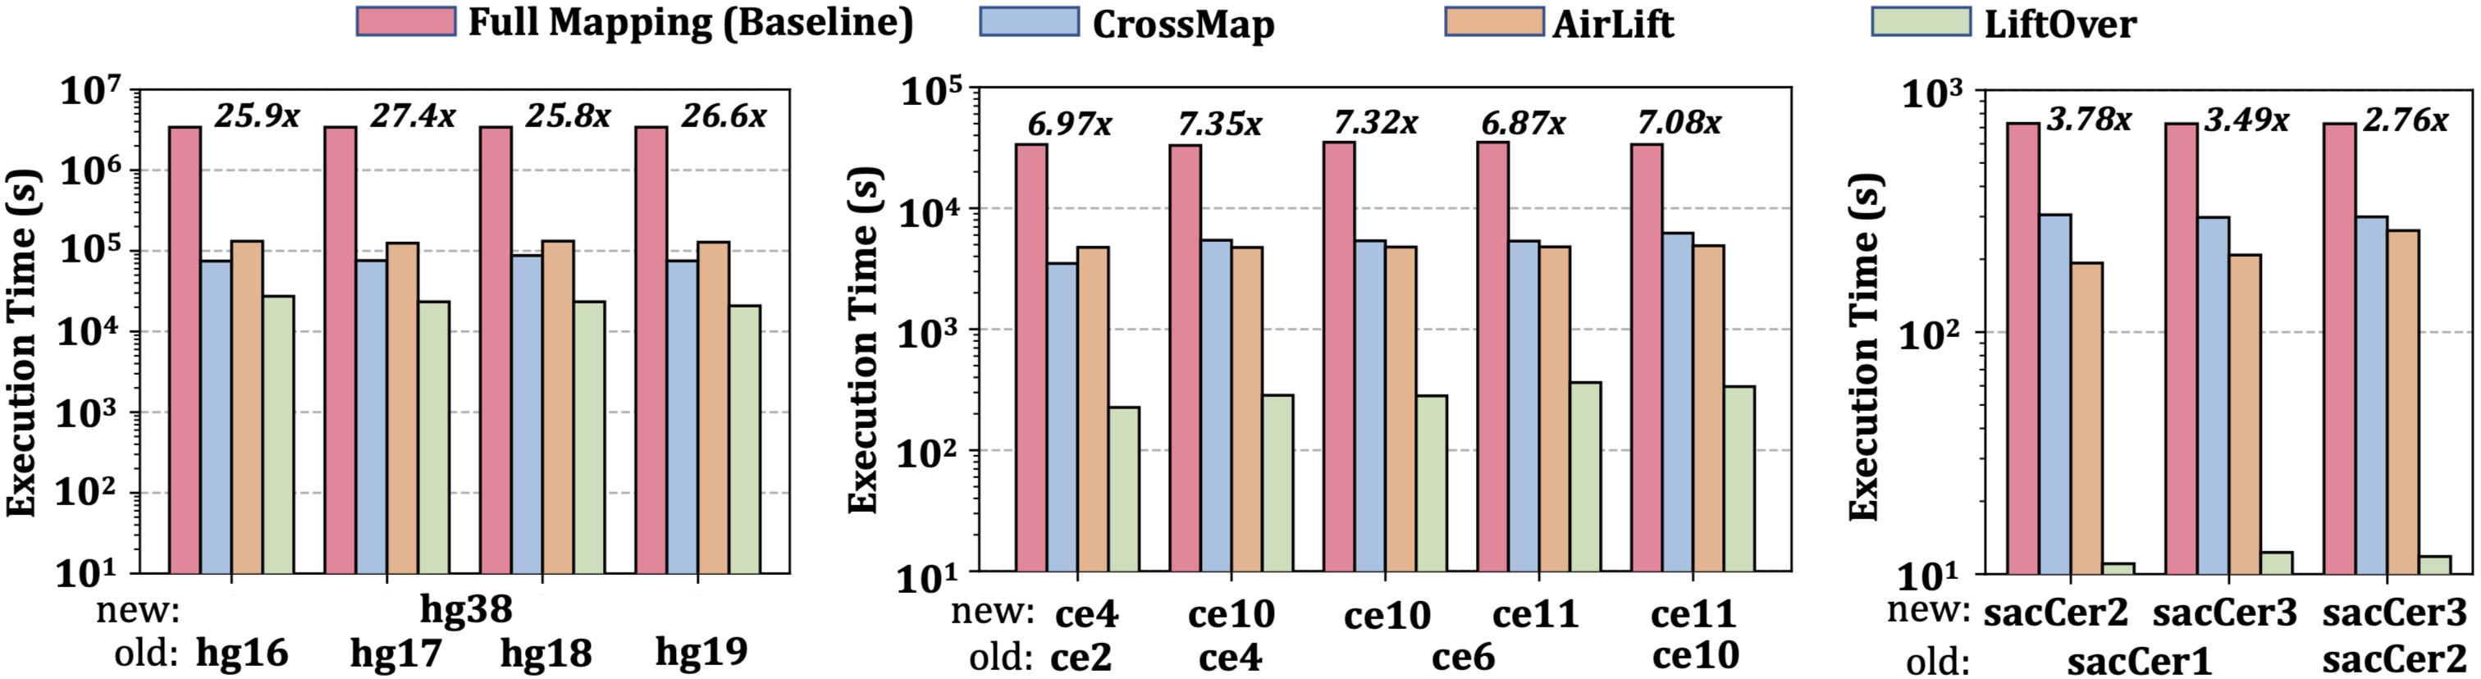
Performance
2.8× – 27.4× speedup compared to the full mapping
More comprehensive mapping:
Longer execution times than CrossMap and LiftOver

Slide 29
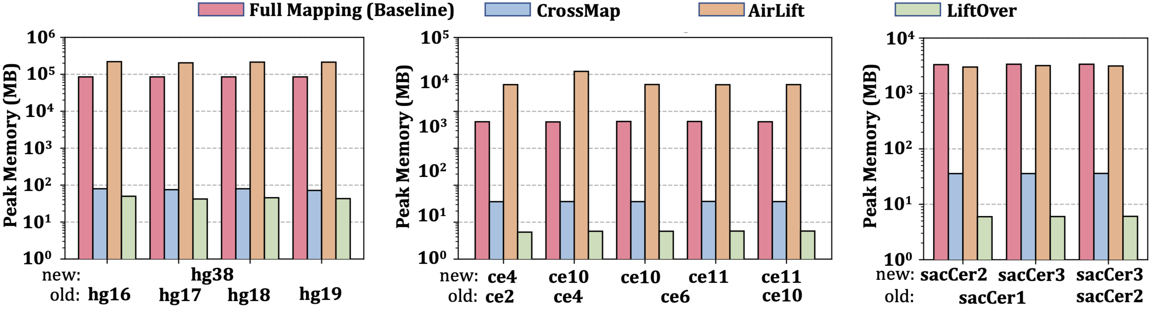
Peak Memory Usage
Peak memory usage similar to full mapping

Slide 30
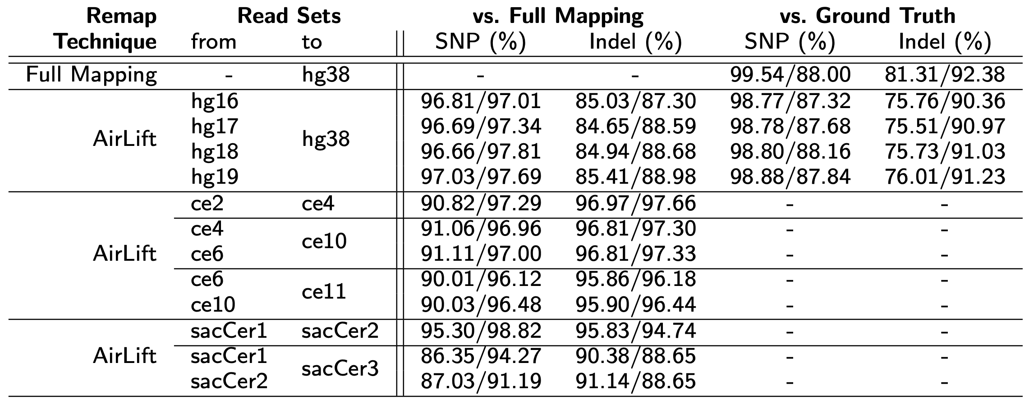
Accuracy – Variant Calling
Precision/Recall values compard to
Ground truth
Full mapping
Baseline:
Comparable accuracy to full mapping without the significant performance cost

Slide 31
Outline
Background
Motivation and Goal
Experimental Methodology
Temperature Analysis
Aggressor Row Active Time Analysis
Spatial Variation Analysis
Implications on Attacks and Defenses
Conclusions
Goal and Key Idea
AirLift
Evaluation
Conclusions

Slide 32
AirLift Summary
Problem | Remapping to a new reference genome is either costly (full mapping) or inaccurate (moving mapping positions)
Goal | Accurately and quickly remap all reads by either mapping or moving them from the old reference genome to the new reference genome
AirLift | AirLift Indexing: Accurately categorize and label each region in the old reference genome compared to the new reference genome AirLift Remapping: Remap a read to a new reference genome or Quickly move its position based on AirLift index
Key Results | AirLift consistently outperforms full mapping 2.8x – 27.4x speedup over full mapping AirLift identifies SNPs and INDELs with precision and recall similar to full mapping

Slide 33
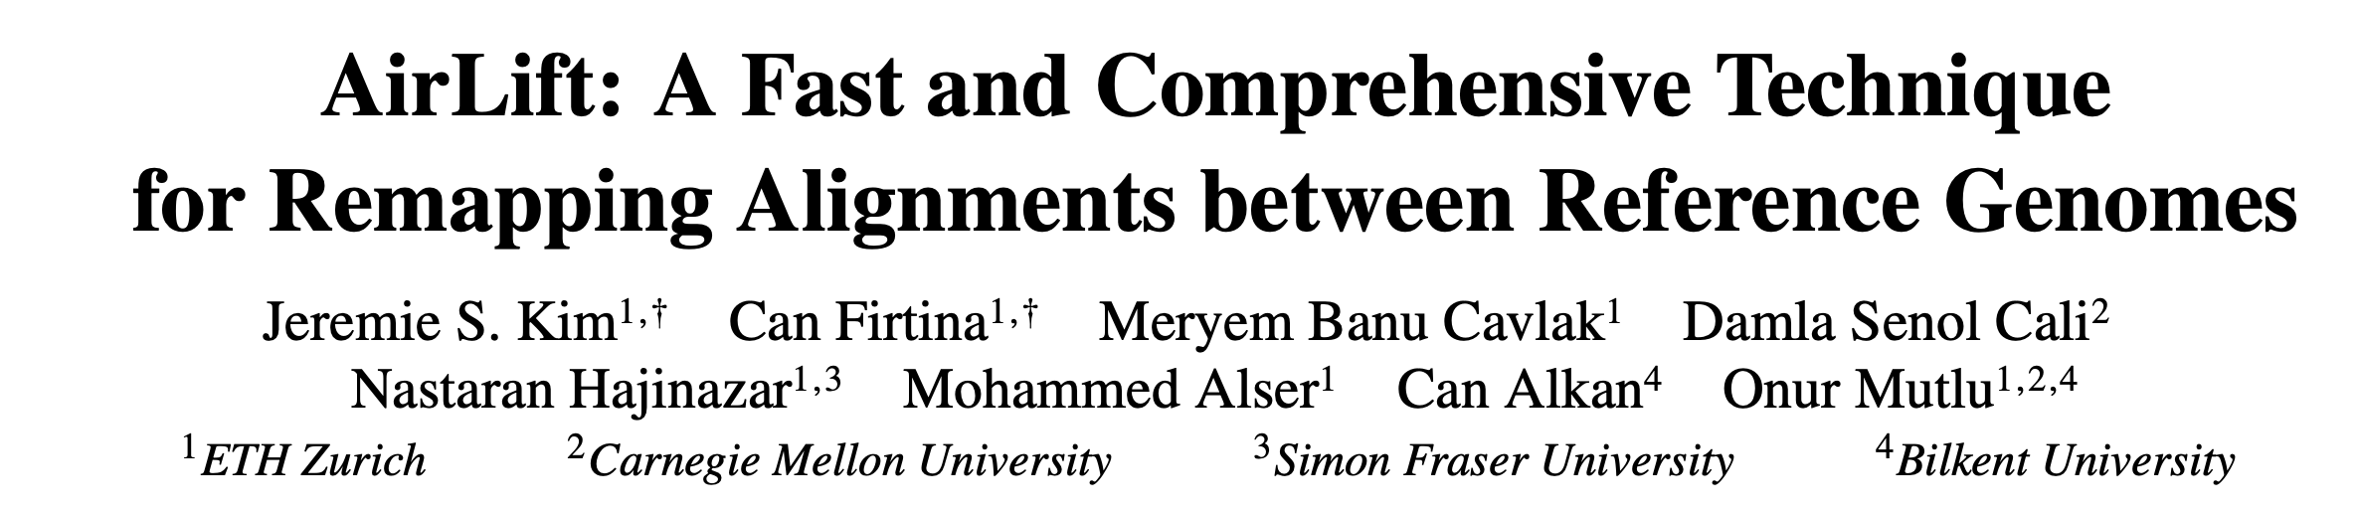
AirLift
Jeremie S. Kim, Can Firtina, Meryem Banu Cavlak, Damla Senol Cali, Nastaran Hajinazar, Mohammed Alser, Can Alkan, and Onur Mutlu,
"AirLift: A Fast and Comprehensive Technique for Remapping Alignments between Reference Genomes"
IEEE/ACM TCBB, August 2024.
[arXiv preprint]
[bioRxiv preprint]
[IEEE version]
Presented at the 21st APBC, Changsha, China, April 2023.
[Slides (pptx) (pdf)]
[Talk Video at BIO-Arch 2023 Workshop]
[BIO-Arch 2023 Workshop Slides (pptx) (pdf)]
[AirLift Source Code and Data]
arXiv Preprint

Slide 34
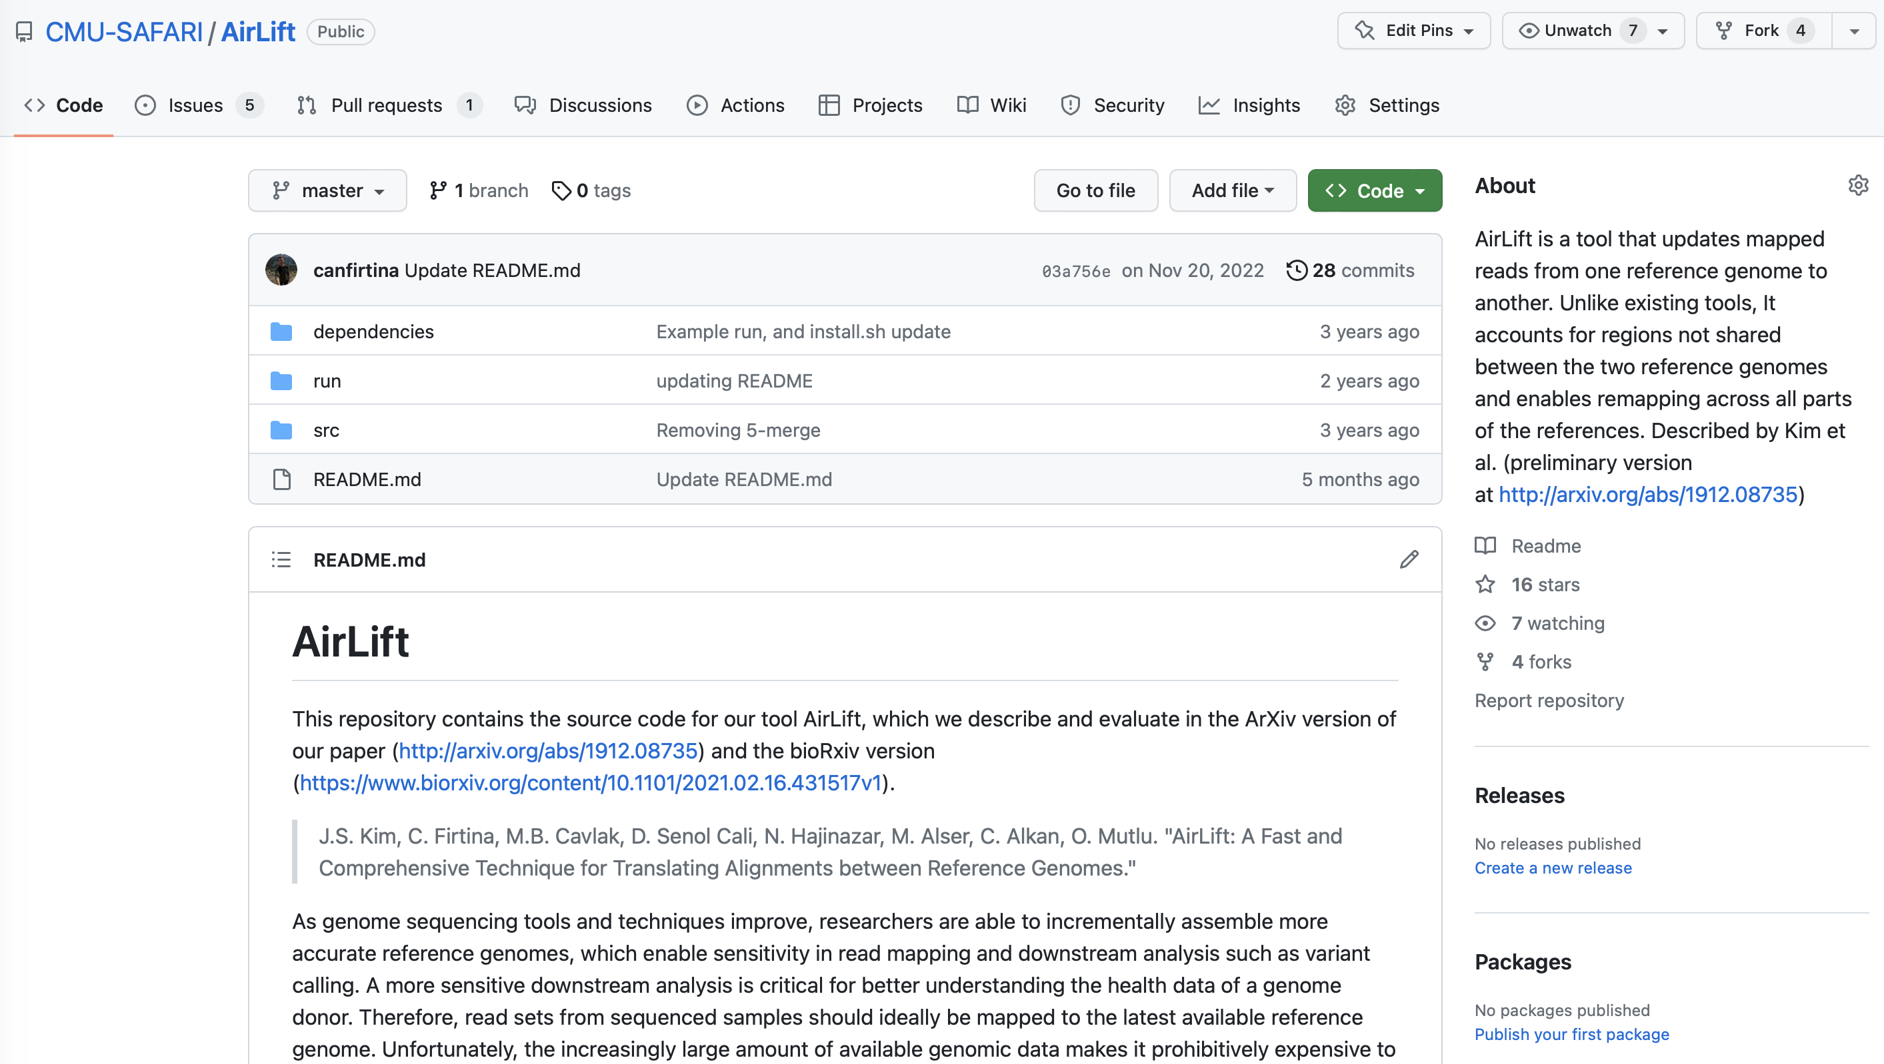
AirLift Source Code
Source Code
https://github.com/CMU-SAFARI/AirLift

Slide 35
AirLift
A Fast and Comprehensive Technique for Remapping Alignments between Reference Genomes
Jeremie S. Kim*, Can Firtina*, Meryem Banu Cavlak, Damla Senol Cali,
Nastaran Hajinazar, Mohammed Alser, Can Alkan, and Onur Mutlu
arXiv Preprint
Source Code

Slide 36
Motivation and Goal
Experimental Methodology
Temperature Analysis
Aggressor Row Active Time Analysis
Spatial Variation Analysis
Implications on Attacks and Defenses
Conclusions
Backup Slides

Slide 37
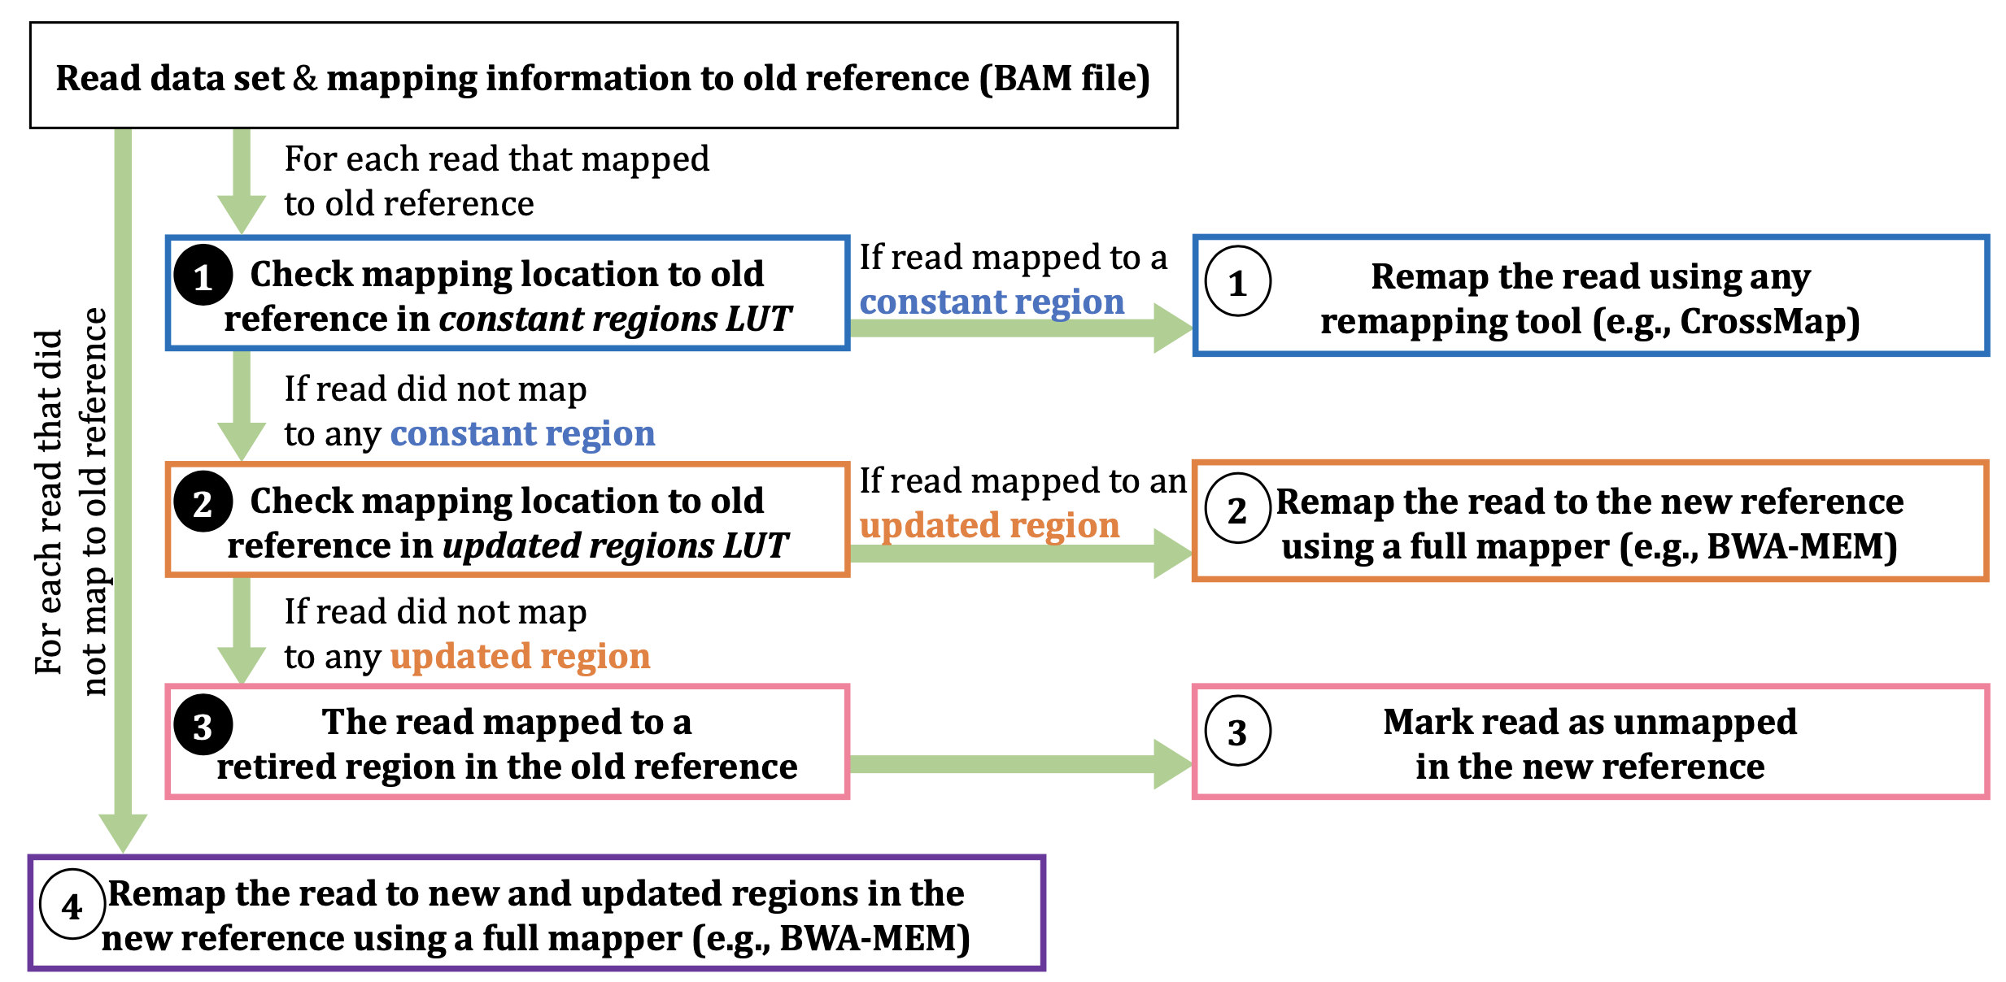
AirLift Remapping

